Slide 1
Book1
File created on: 2/4/2020 6:00:55 PM

Slide 2
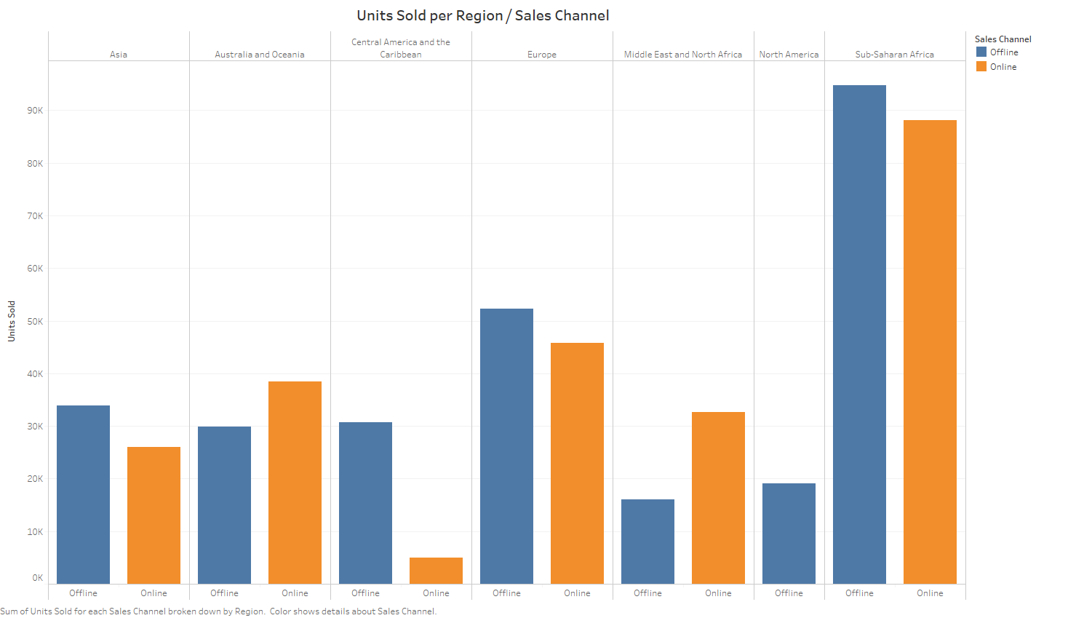

Slide 3
