Slide 1
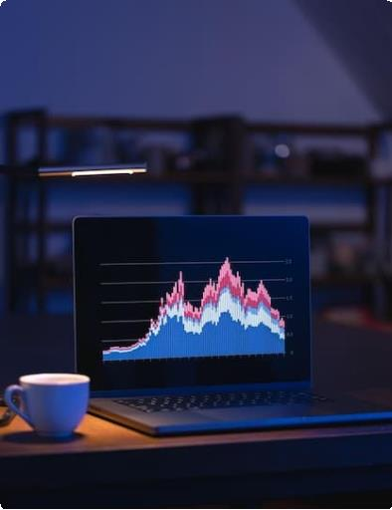
Created by using DrLambda
Nvidia stock
analysis

