Slide 1
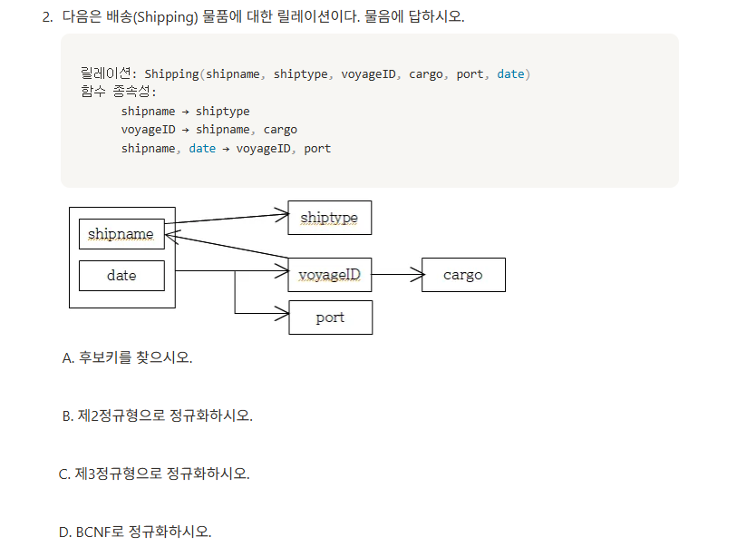
후보키
1: SHIPNAME-> SHIPTYPE
2 VOYAGEID-> SHIPNAME, CARGO
3SHIPNAME, DATE->VOYAGEID, PORT
제2 정규형
1: SHIP(SHIPNAME PK, SHIPTYPE)
2: VOYAGE(VOYAGEID PK, SHIPNAME FK, CARGO)
3: SCHEDULE(SHIPNAME PK, DATA PK, VOYAGE FK, PORT)
제3 정규형
1:SHIP(SHIPNAME, SHIPTYPE)
2:VOYAGE(VOYAGEID, SHIPNAME, CARGO)
3:VOYAGEPORT(VOYAGEID PK, DATE PK, PORT)
BCNF정규화
Ship(shipname pk, shiptype)
Voyage(voyageid pk, shipname 라, cargo)
Voyageport(voyageid pk, date pk, port)

Slide 2
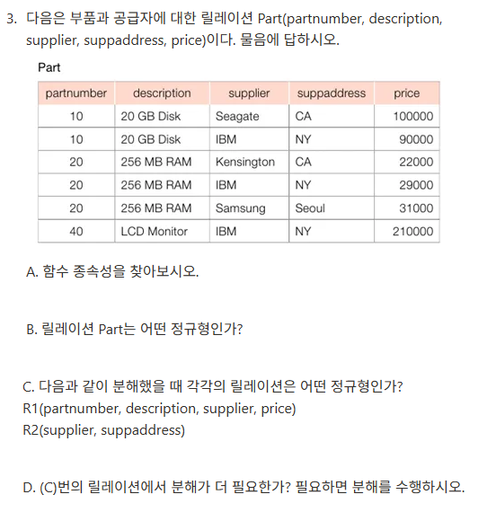
함수 종속성
Partnumber->description
Supplier-> suppaddress
Partnumber, supplier->price
정규형
1정규형
릴레이션 정규형
R1= 1nf
R2= bcnf
릴레이션 분해
Partnumber pk, description
Partnumber pk, supplier pk, price

