Slide 1
AI-POWERED CODE ANALYSIS
AI-Powered
Code Reviewer &
Quality Assistant
A Smart System for Automated Code
Quality, Documentation & Validation
Presented by: Rohan CR
Streamlit
Groq API
Radon
Plotly
Pytest

Slide 2
OVERVIEW
Project Overview
🎯
⚠
💡
Project Goal
Problem Addressed
Proposed Solution
To develop an AI-powered tool that automates code reviews, enhances code quality, and improves maintainability across Python projects.
Manual code reviews are time-consuming, subjective, and require experienced reviewers to catch every issue consistently.
An AI assistant that automatically analyses Python code, detects issues, enforces PEP 257 standards, and generates documentation.
01
02
03

Slide 3
PROBLEM
Problem Definition
No Visibility
No Auto-Fix
No quick way to see which functions lack documentation across a project.
Fixing missing docstrings by hand for every function is time-consuming.
1
3
2
4
Manual Checking
Complexity Blind
PEP 257 compliance checks done manually are tedious and inconsistent.
No built-in tool measures cyclomatic complexity or flags hotspots.

Slide 4
ARCHITECTURE
Implemented Modules
core/parser
core/validator
🔍
✅
AST scanner — extracts function metadata, complexity score and MI score
PEP 257 checker — validates D100–D400 rules on every function and class
core/docstring_engine
core/reporter
✍
📋
Generates Google/NumPy/ReST templates; Groq LLM smart docstring generation
Builds ProjectCoverage reports and exports per-file stats to JSON
core/review_engine
main_app.py
🤖
🖥
AI code reviewer — sends source to Groq LLM and logs structured results
Streamlit dashboard — 5 views: Home, Dashboard, Metrics, Coverage, Validation

Slide 5
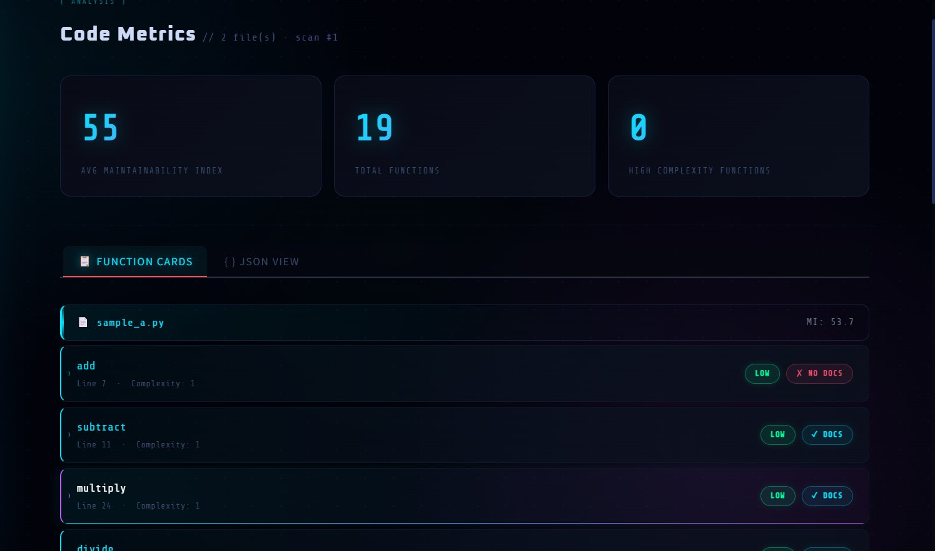
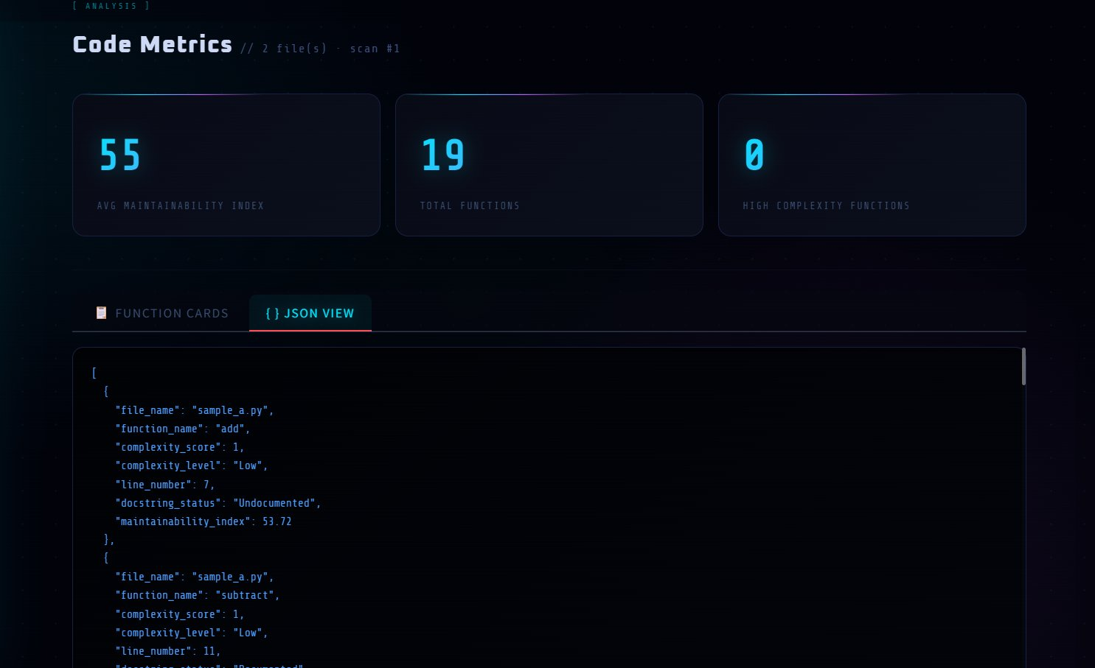
MILESTONE 1
Milestone — 1
Code Complexity · Maintainability Index · Function Cards · JSON Export
3 metric cards — Avg MI Score, Total Functions, High Complexity Functions shown at a glance
📊
Function Cards display every function with Low/Medium/High complexity badge and Docs status per file
🃏
JSON View exports the full structured analysis — file, function, complexity, MI score, docstring status
📋

Slide 6
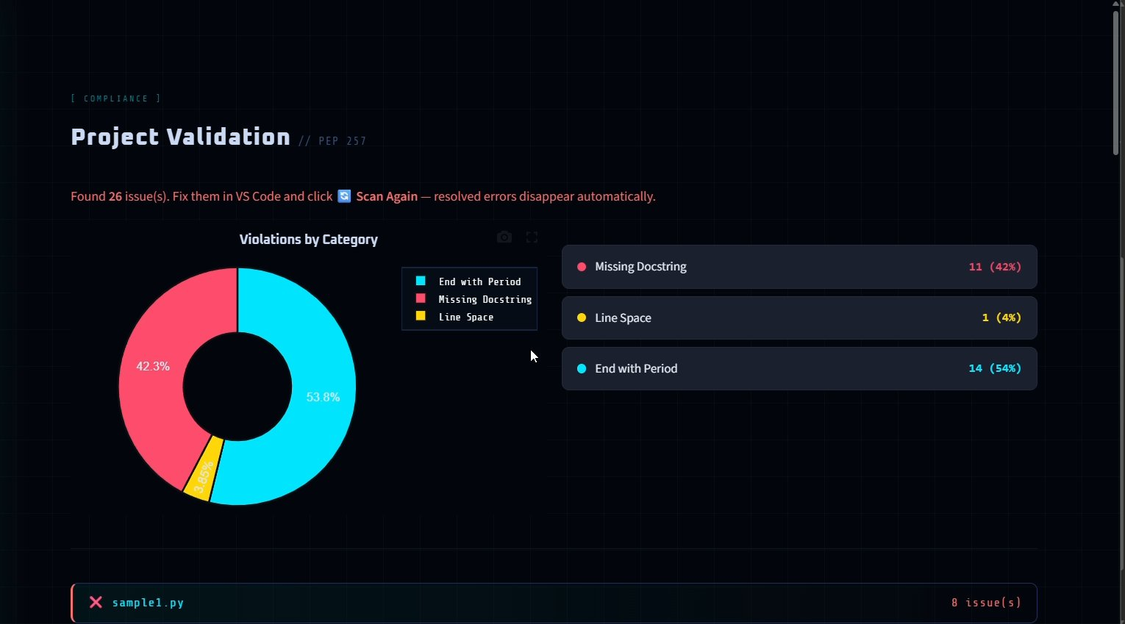
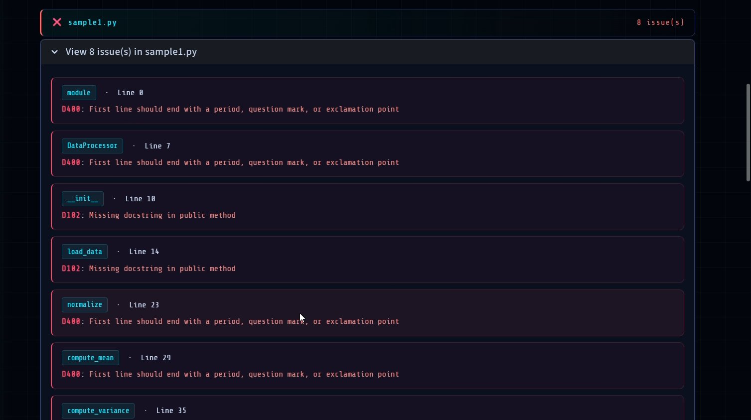
MILESTONE 2
Milestone — 2
PEP 257 Compliance · Pie Chart Breakdown · Per-File Issue Details
Pie chart shows violation breakdown — Missing Docstring 42% · End with Period 54% · Line Space 4%
🥧
Each file expands to show every violation with PEP code (D102, D400) and exact line number
📄
Click Fix Errors for Groq AI to auto-repair all violations at once across the entire project
🔧

Slide 7
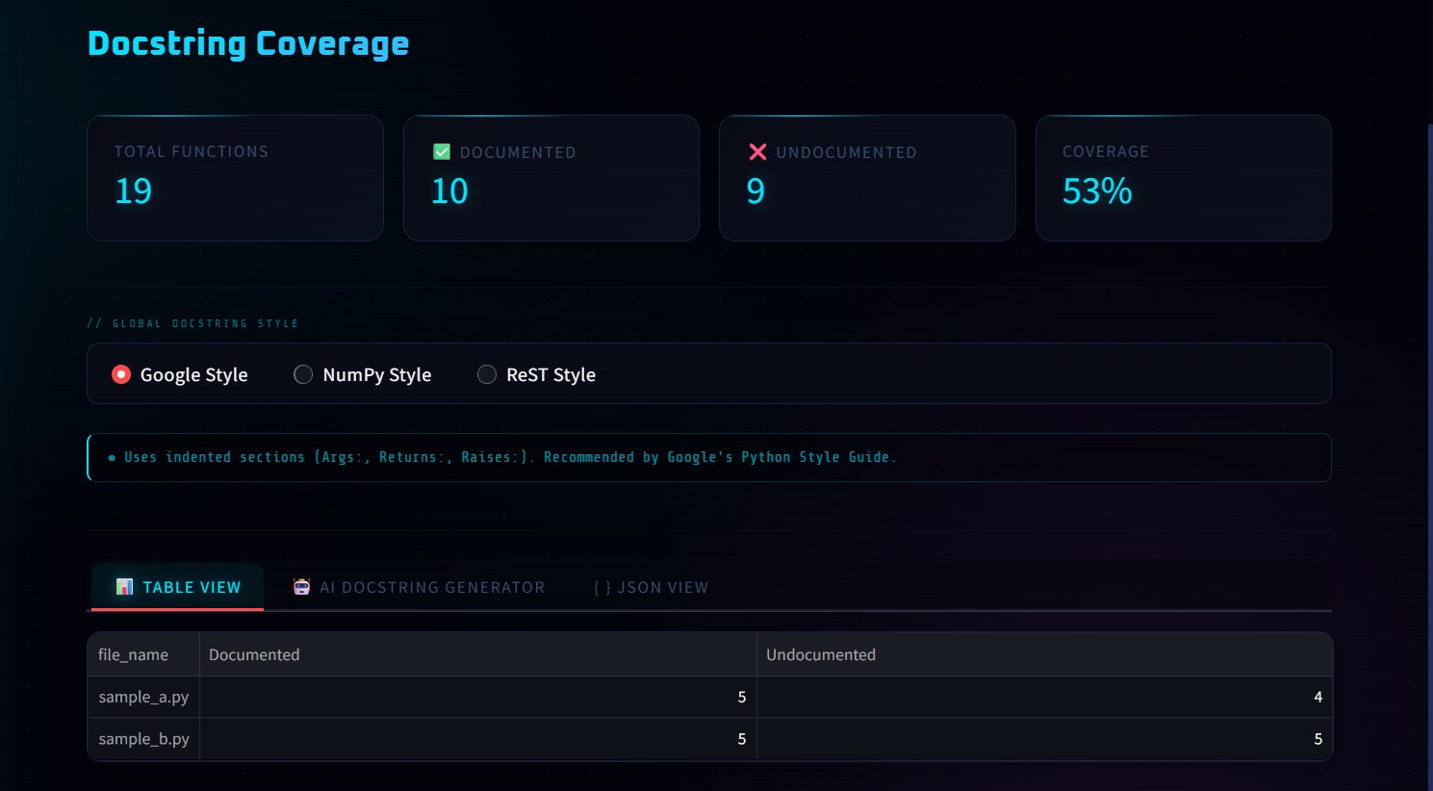
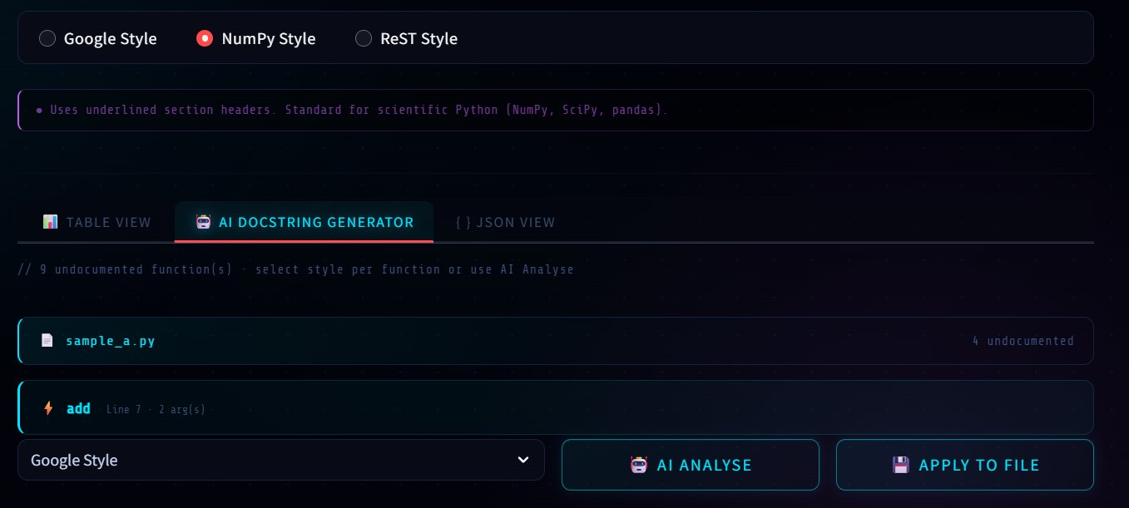
MILESTONE 3
Milestone — 3
Coverage Stats · Style Selector · AI Analyse · Apply to File
Coverage stats — Total Functions, Documented, Undocumented, coverage % with per-file table view
📈
Select Google, NumPy or ReST style globally or per function — description updates instantly below
✍
AI Analyse: Groq LLM reads the function body and generates a smart docstring. Apply to File writes it directly
🤖

Slide 8
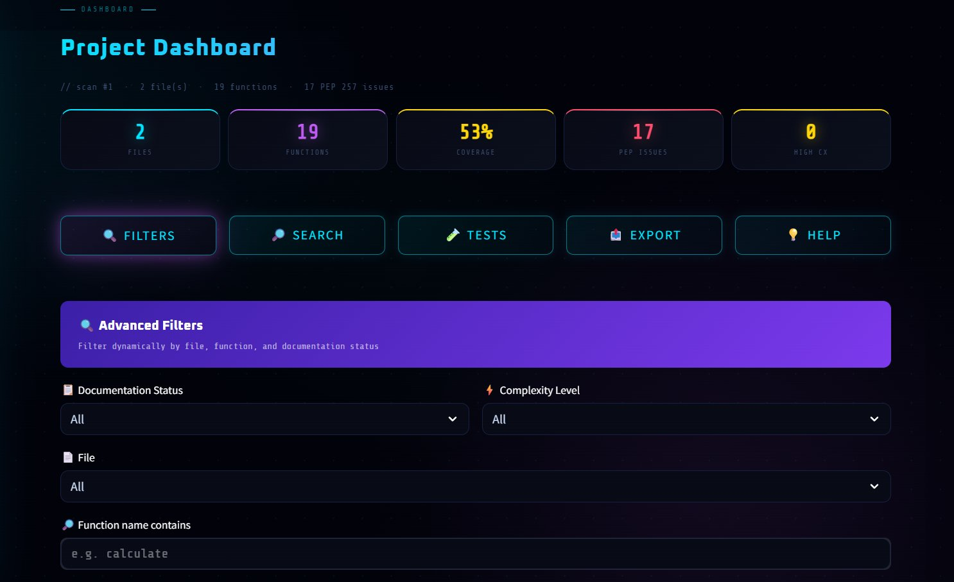
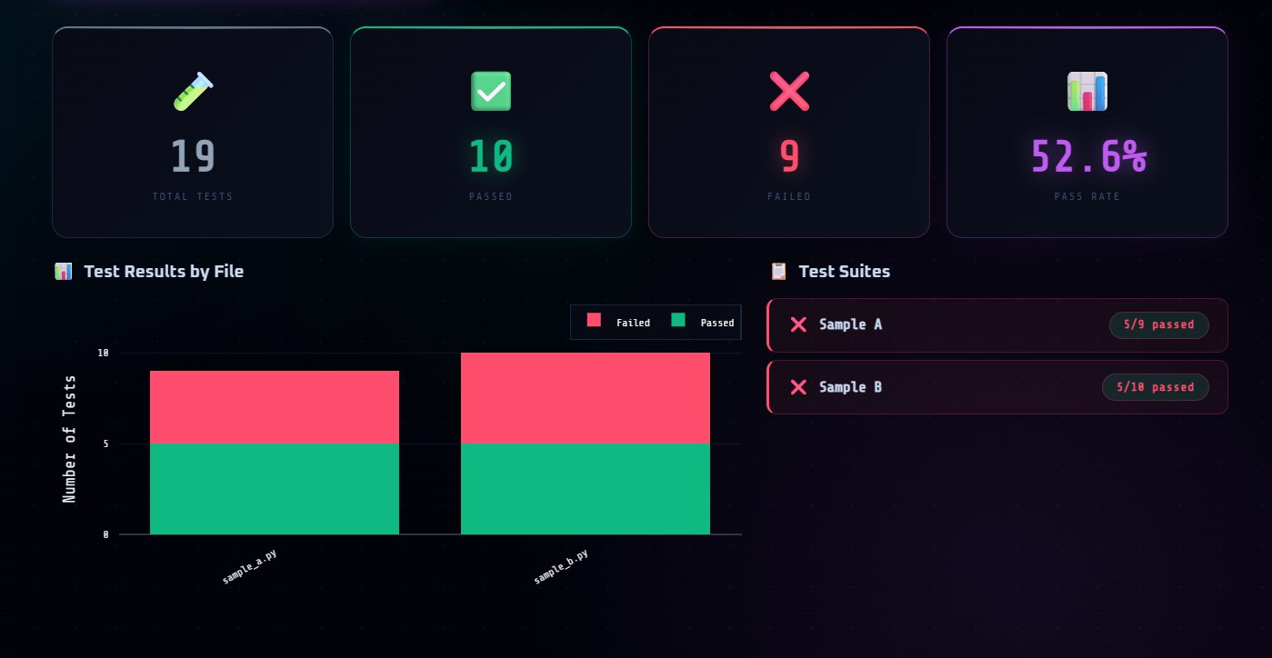
MILESTONE 4
Milestone — 4
Mini Stats · Filters · Search · Tests · Export · Help
Mini stat row — Files, Functions, Coverage %, PEP Issues, High CX. 5 tool buttons for all features
📊
Advanced Filters — filter by Documentation Status, Complexity Level, File name and Function name
🔍
Tests panel: Total 19, Passed 10, Failed 9, Pass Rate 52.6% with stacked bar chart and Test Suites
🧪

Slide 9
OBJECTIVES
Project Objectives
Automated Analysis
AI-Assisted Generation
Coverage Reports
Parse Python source code to identify potential quality issues automatically.
Generate docstrings using Groq AI to improve code understanding.
Provide detailed coverage reports for documentation quality tracking.
1
3
5
2
4
Docstring Identification
Standard Validation
Identify missing or incomplete docstrings to ensure comprehensive documentation.
Validate documentation against PEP 257 styles to maintain consistency.

Slide 10
SUMMARY
Project Summary — What We Built
M1
M2
M3
M4
Metrics View
Validation & AI Fix
Docstring Generator
Interactive Dashboard
AST-based complexity scoring
Radon Maintainability Index
Function cards with badges
JSON + CSV export
PEP 257 D100–D400 checker
Per-file & bulk AI Fix
Groq LLM auto-repair
Diff view + apply to disk
Google / NumPy / ReST styles
Per-function style selector
AI Analyse from function body
One-click apply to file
5-tool navigation bar
Test suite 4 stat cards
Stacked bar chart by file
Mini stat row + test suites
Result — A fully working AI-powered code quality dashboard. Scan any Python project, fix issues with one click, track coverage over time.

Slide 11
Thank You
AI Code Reviewer · AI-Powered Python Code Analysis
Presented by: Rohan CR
Built with Streamlit · Groq API · Radon · Plotly · Pytest

