Slide 1

Jira Automation Using Python Delete Jira Issue In Bulk From Rest Api Using Python Tutorial :12

Slide 2
Delete Jira issue in bulk
https://developer.atlassian.com/cloud/jira/platform/rest/v3/api-group-issues/#api-rest-api-3-issue-issueidorkey-delete

Slide 3
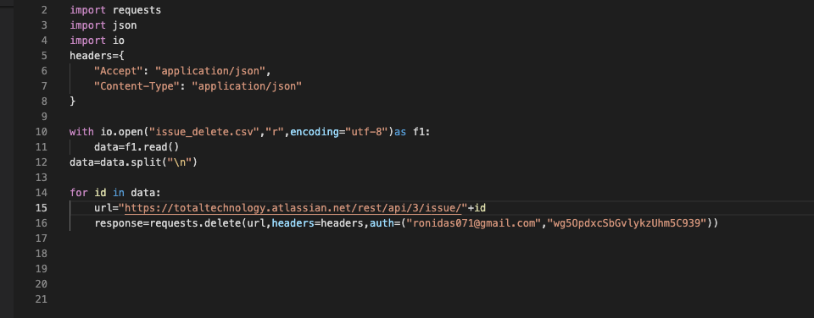
Delete Jira issue in bulk

