Slide 1

Jira Automation Using Python Create Jira Issue In Bulk From Rest Api Using Python Tutorial :11

Slide 2
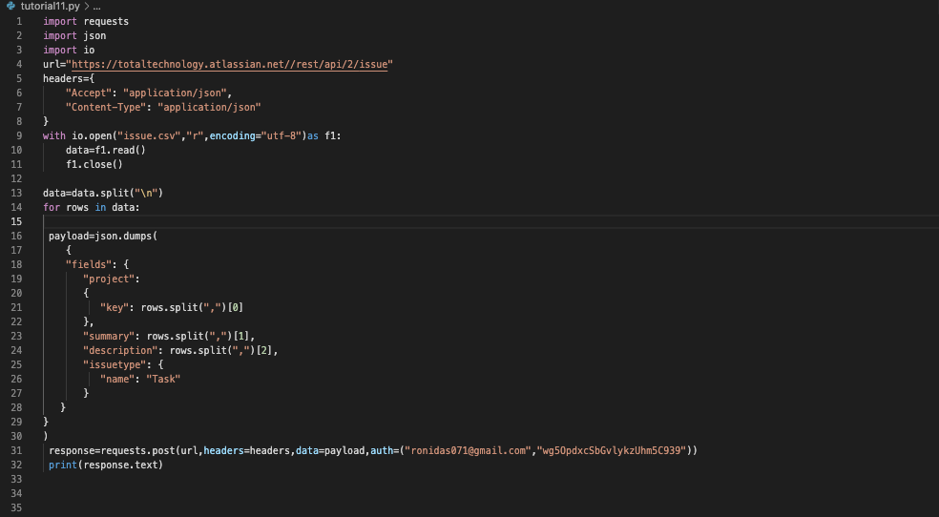
Create Jira issue in bulk

