Slide 1

Jira Automation Using Python How To Change Jira Issue Status From Rest Api Using Python Tutorial :15

Slide 2
Delete Jira issue in bulk
https://community.atlassian.com/t5/Jira-questions/JIRA-How-to-change-issue-status-via-rest/qaq-p/528133

Slide 3
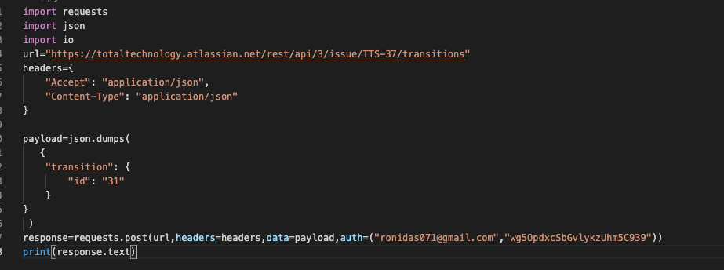
How to change jira issue status

