Slide 1

Jira Automation Using Python Assign Jira Issue To Multiple Users From Rest Api Using Python Tutorial :14

Slide 2
Delete Jira issue in bulk
https://developer.atlassian.com/cloud/jira/platform/rest/v3/api-group-issues/#api-rest-api-3-issue-issueidorkey-assignee-put

Slide 3
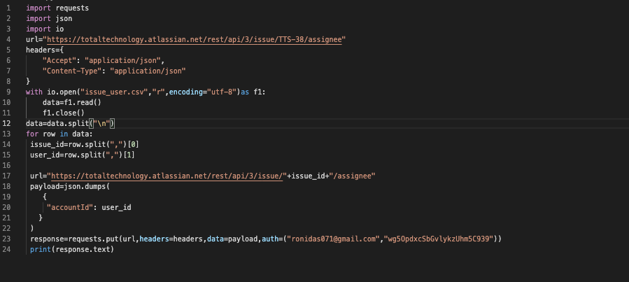
Assign Jira issue To Multiple Users

