Slide 1
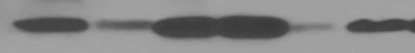

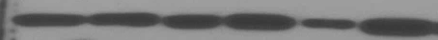
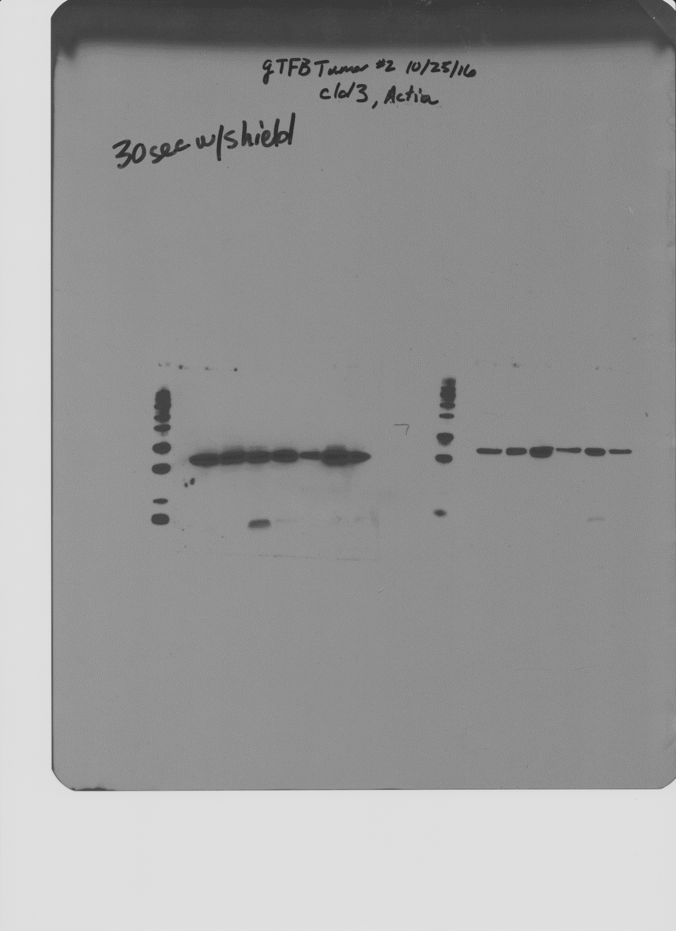



Supplementary Figure 1
B.
Sample | Tissue/ Tumor Histology
1008 | Normal Fallopian Tube
952 | Normal Fallopian Tube
958 | Normal Fallopian Tube
968 | Normal Fallopian Tube
1003 | High Grade Serous Ovarian Cancer
923 | High Grade Serous Ovarian Cancer
956 | High Grade Serous Ovarian Cancer
952 | High Grade Serous Ovarian Cancer
966 | High Grade Serous Ovarian Cancer
945 | High Grade Serous Ovarian Cancer
905 | High Grade Serous Ovarian Cancer
930 | High Grade Serous Ovarian Cancer
995 | High Grade Serous Ovarian Cancer
909 | High Grade Serous Ovarian Cancer
999 | Borderline Tumor
950 | High Grade Malignant Müllerian Mixed Tumor
122 | Borderline Tumor
993 | Grade 2 Mucinous Ovarian Cancer
953 | Low Grade Serous Ovarian Cancer
943 | Borderline Tumor
991 | High Grade Malignant Müllerian Mixed Tumor
826 | Borderline Tumor
A.
905
923
930
945
950
953
966
982
991
993
995
Claudin-4
GAPDH
943
122
952
1003
968
966
826
958
1008
999
909
Claudin-4
GAPDH

