Slide 1
Information Retrieval
Di Zhang
Jinxuan Qu
Chao Huang

Slide 2
General
Purpose
Implement a Hadoop based IR system
Data Description
Dataset contains 802431 files
The Reuter news from 1996.8.20 to 1997.8.29
the data format: xml (easy to parse through Java)

Slide 3





Techniques

Slide 4

Search

Slide 5
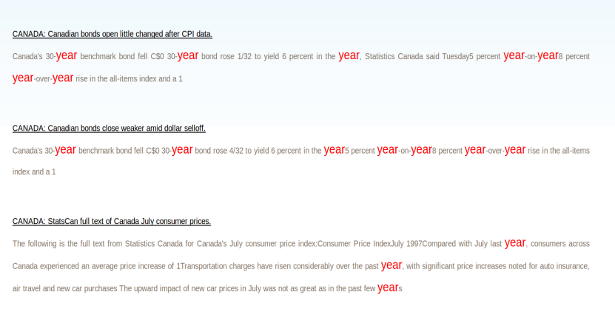
Search

Slide 6
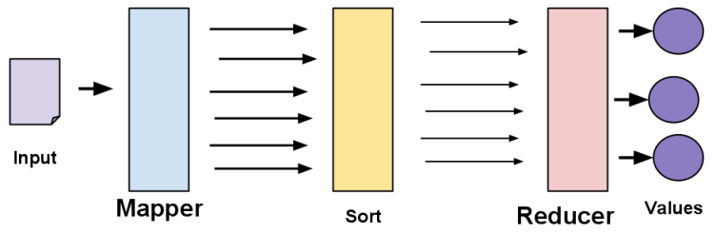
Basic Framework
Is Splitable ?
Zip File (java zip class)
Key, Value
Basic Hash Partition
Can we do it more efficiently?

Slide 7

What is a good search engine?

Slide 8
Three factors
Speed of response
Size of the index
Relevance of results

Slide 9
Speed Result
Speed of Search for “year” (s/average)
 | Boolean | TFIDF | BM2.5
chaoh | 122(Palmetto) | 78(Palmetto) | 12 (local)
jinxuanq | 85(Palmetto) | 112(Palmetto) | 12 (local)
dizhang | 65(Palmetto) | 95(Palmetto) | 12 (local)

Slide 10
Speed factors
Speed
Size
Relevance
Different data structure
No combiner & hash table
Make a heap for each node

Slide 11
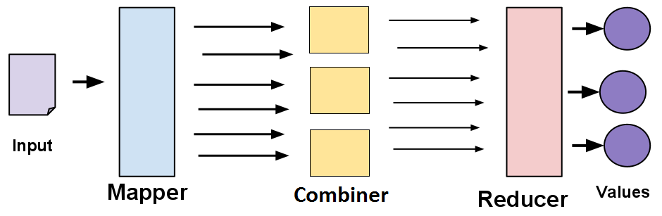
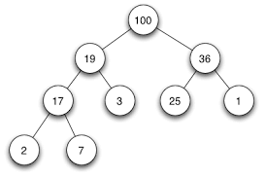
Add Combiner
Add a combiner in each node

Slide 12
Different Structure
Speed
Size
Relevance
Different data structure
Make a heap for each node
Make a new customized class
Problems:
“word-doc” will be used as the key in mapper
In the reducer, we have to split this key
Lots of construction methods will be called

Slide 13
Customize Class
How to make it as a Key
Item
Item. Word
Item. Title
Item. Position
Word
Title
Position

Slide 14
Search Cache
Speed
Size
Relevance
Search Cache (Ajax)
Different search strategy
1. search all first
2. step by step

Slide 15
Search All First
1. First time search cost longer time
Hadoop Running:
Get the index for local
Local java search
Local java search
Local java search

Slide 16

Search Cache
Only search for the first page
Do the search in the backend while reading
Hadoop Running:
Search for top ten
Do next step search

Slide 17
Size of the Index
Speed of response
Size of the index
Relevance of results

Slide 18
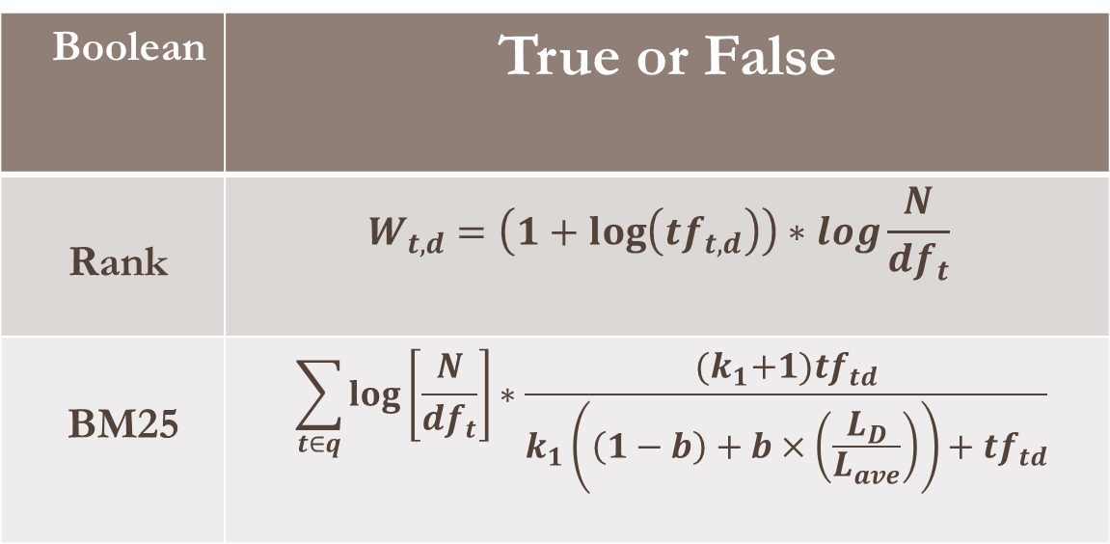
Three Index Systems
Word doc1,doc2
Doc1: Count – Doc2:Count
Boolean | True or False
Rank | $$W_{t,d}=\left(1+\log\left(tf_{t,d}\right)\right)∗log\frac{N}{df_{t}}$$
BM25 | $$\sum_{t∈q}{\log\left[\frac{N}{df_{t}}\right]∗\frac{{(k}_{1}+1)tf_{td}}{k_{1}\left(\left(1−b\right)+b×\left(\frac{L_{D}}{L_{ave}}\right)\right)+tf_{td}}}$$
doc1@len:count

Slide 19
How to Save Memory

Slide 20
Previous Problem
Speed
Size
Relevance
Single index search
Problem:
Calculate the length of docs
Word: Doc1(len1):Count1---Doc2(length2):Count2
Hash Table(Docs, Docs_Length)

Slide 21
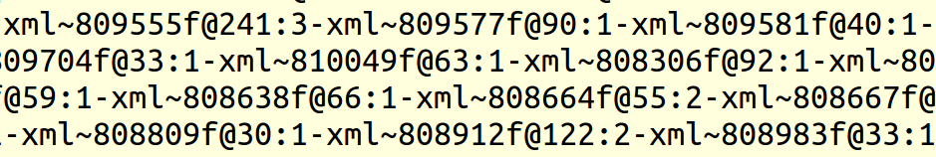
Normal TFIDF Index
Use big hash to get this figure
Pros:
Speed, use one index will increase the speed of search
Cons:
Big hash table will be used
Not easy to update the index

Slide 22
Single Index
Speed
Size
Relevance
Previous: Single index search
Problem:
Calculate the length of docs
Hash table will cost too much space
Inconvenient to update Index

Slide 23

Chain Map & Data Driven
Thread Map I:
Search tf-idf Index
Reduce:
Search
the result
Make a small hash table for ‘necessary’ docs
Data driven
Thread Map II:
Get the length of per doc from page info index
Basic Parameters

Slide 24
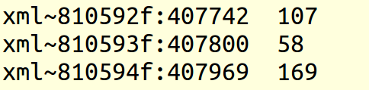
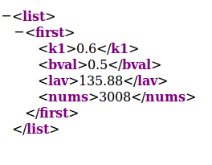
Update Index
Update index:
including insert or delete file
Xml~newdoc:2
Xml~newdoc:408079 100
Lav = (lav*nums+new)/(nums+1)
Nums ++

Slide 25
Size of Index
Speed
Size
Relevance
Index result (GB)
 | Boolean | TFIDF | BM2.5
chaoh | 0.56 | 1.5 | 0.995+0.016
jinxuanq | 0.77 | 1.9 | 0.995+0.016
dizhang | 0.85 | 2.3 | 0.995+0.016

Slide 26
Three factors
Speed of response
Size of the index
Relevance of results

Slide 27
Result Measure
Precision
Recall

Slide 28
How to Improve Relevance

Slide 29
Relevance Improvement
Speed
Size
Relevance
Dynamic abstract
User Habit

Slide 30
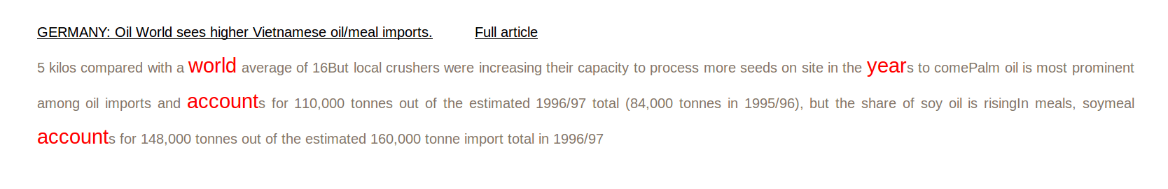
Dynamic abstract
snippets
Static summary
Dynamic summary
positional factor
content factor

Slide 31
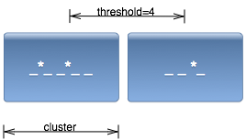

Dynamic Summaries
Cluster:
sentences include search words
Reference: Mining the Social Web: Analyzing Data from Facebook,
Twitter, LinkedIn, and Other Social Media Sites. 8th chapter.

Slide 32
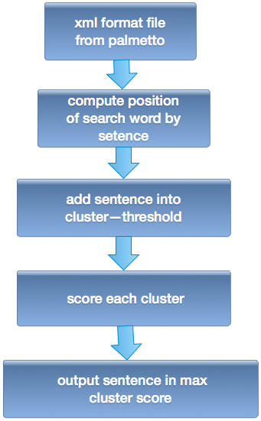
Processing

Slide 33
Much Better ?

Slide 34
User Habit
What a XML file include?
Title
Headline
Dateline
Text
Metadata

Slide 35
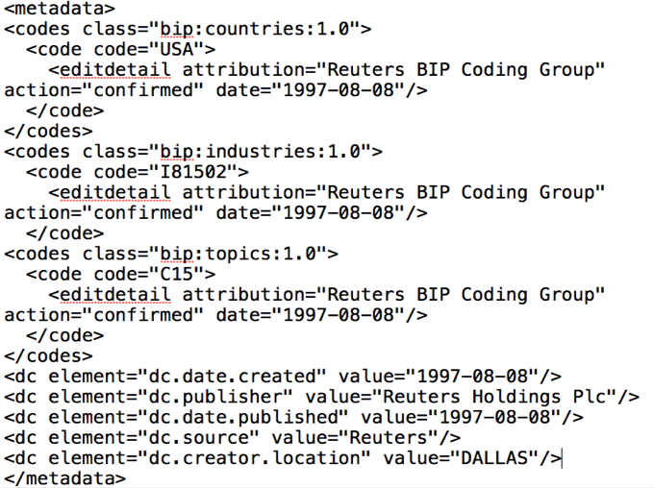
Something may be ignored

Slide 36
Create a Region Index
Result
Tf-Idf
Index
Habit
Index
Page Info
Index

Slide 37
Result Measure
Relevance of Result for “year”
 | Previous | After
“year” | 20% | 100%

Slide 38
Demo

Slide 39
Q & A

