Slide 1

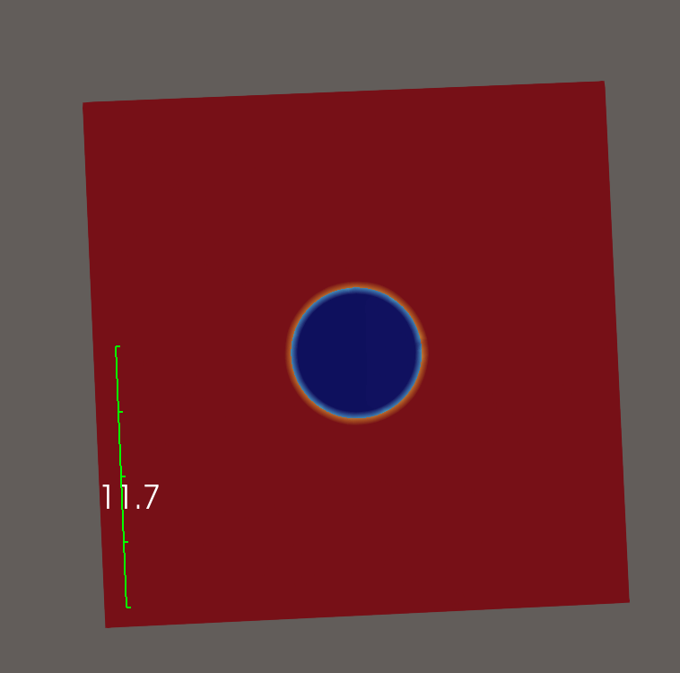
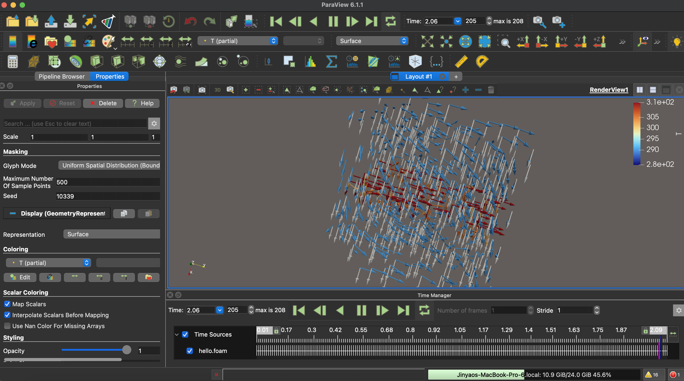
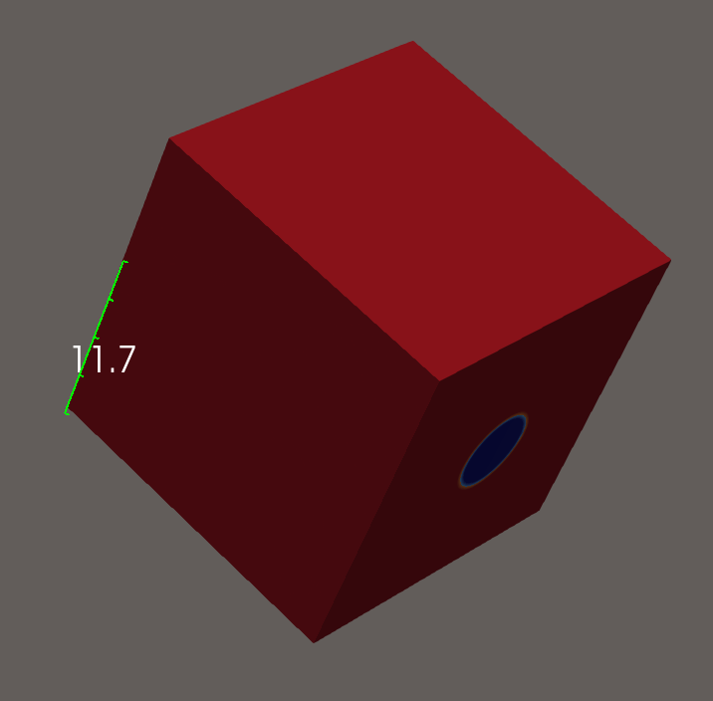
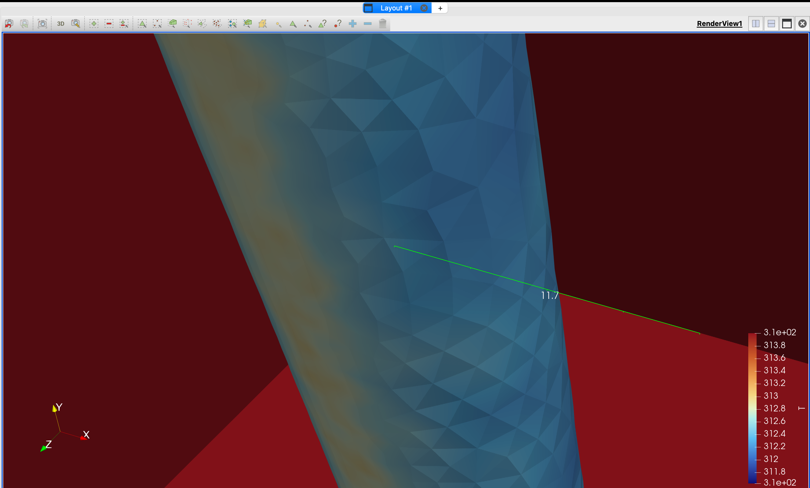
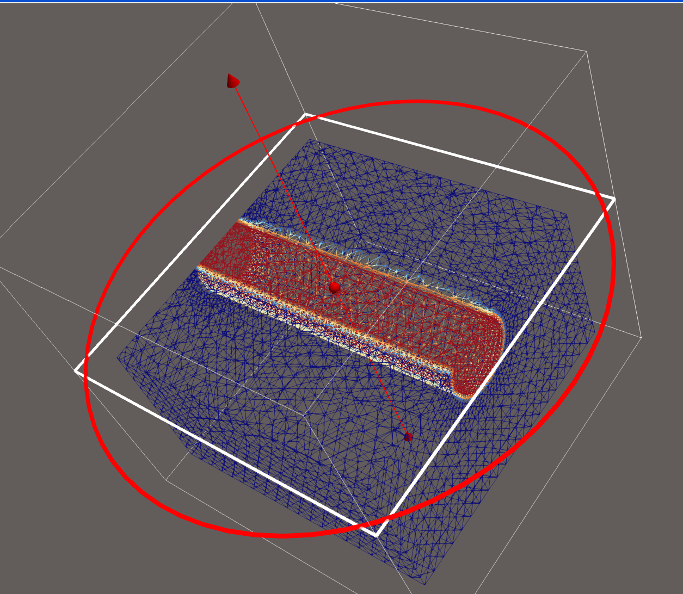
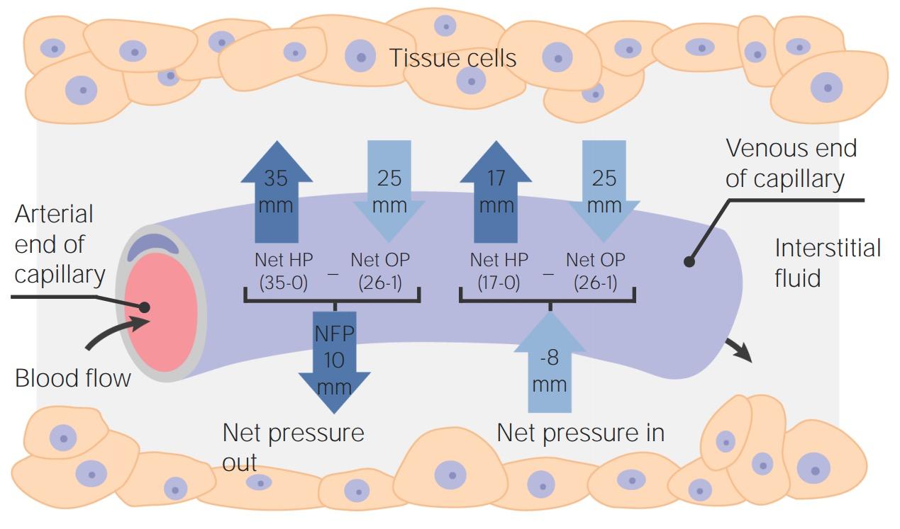

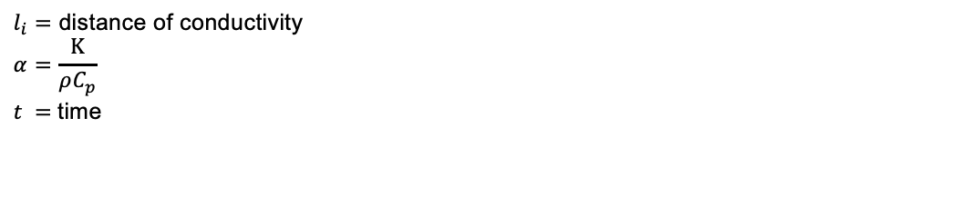
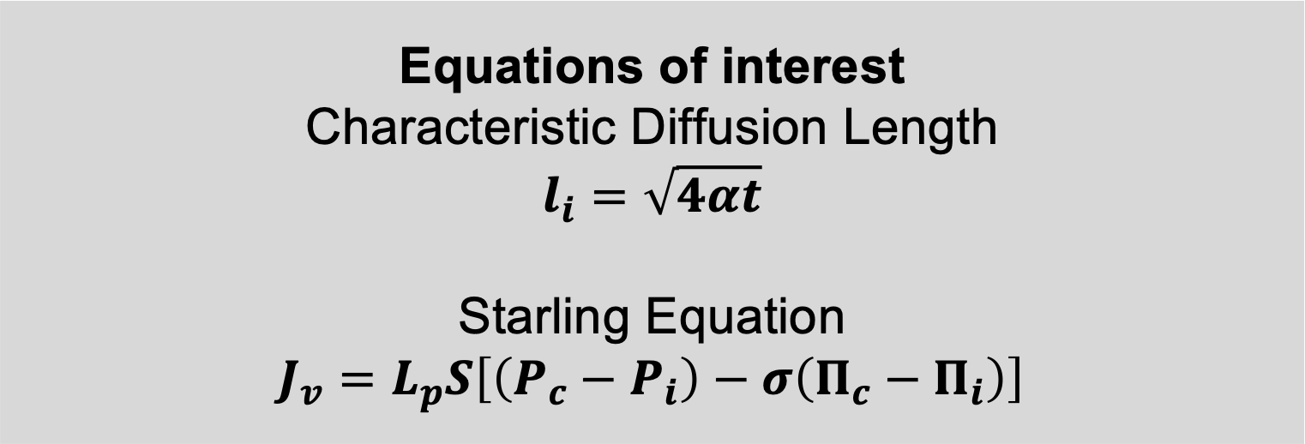
Carney Center For Brain Science
SREIP for VLANS
Rush: A 3d Computational Fluid Model of Neuro-Vascular Coupling as a mechanism for Heat Management and Biochemical Computing
Jinyao Z. DeSandies, Christopher I. Moore
Funding provided by National Institute of Neurological Disorders and Stroke for Carney Summer Scholars Program
Introduction
Using opensource 3D meshing software SALOME and Computational Fluid Dynamics Simulation Software OpenFOAM, a 3D model of the brain simulating temperature and fluid transfers of a neural-capillary system was created. With further work, the Rush model could recreate the exact mechanism of these systems computationally.
Equations of interest
Characteristic Diffusion Length
$$l_{i}=\sqrt{4αt}$$
Starling Equation
$$J_{v}=L_{p}S\left[\left(P_{c}−P_{i}\right)−σ\left(Π_{c}−Π_{i}\right)\right]$$
Temperature Change
Axons near vasculature should either benefit from being inhibited, or fire more commonly than other neurons.
This wraparound effect was found in 2-Photon Imaging demonstrating action potentials coupled with neural signals.
The characteristic diffusion length formula calculations yield that conduction should travel 10 cm over 20 seconds, which in a micron-level system should mean full mixing
Liquid Convection
Because of temperature differences between the hotter outer shell and cooler inside pipe, the fluid being cools by the pipe rapidly exits downward as they increase in density due to less movement.
A potential mechanism for rapid, controllable fluid transfer in Brain. Chemicals within the system can flow in ways to mix into new signaling chemicals
Ca and K can be transmitted across systems, as so neurons could fire together without wiring together
\
The Starling Equation can be qualified as a tight race between the hydrostatic and oncotic pressure. Combined with the fluid dynamics driven by temperature, neural systems can be be designed to exchange neurotransmitters without wired connections
Pc − Pi = hydrostatic pressure gradient
Πc − Πi = oncotic pressure gradient
LpS = capillary filtration coefficient
σ = reflection (protein permeability) coefficient
$l_{i}=$ distance of conductivity
$$α=\frac{Κ}{ρC_{p}}$$
$t =$time
Special Thanks to Spike Lab, Dept. Neuroscience, Pomona College, Claremont CA

Slide 2
Carney Center For Brain Science
SREIP for VLANS
Rush: A 3d Computational Fluid Model of Neuro-Vascular Coupling as a mechanism for Heat Management and Biochemical Computing
Jinyao Z. DeSandies, Christopher I. Moore
Funding provided by National Institute of Neurological Disorders and Stroke for Carney Summer Scholars Program
Introduction
Using opensource 3D meshing software SALOME and Computational Fluid Dynamics Simulation Software OpenFOAM, a 3D model of the brain simulating temperature and fluid transfers of a neural-capillary system was created. With further work, the Rush model could recreate the exact mechanism of these systems computationally.
Equations of interest
Characteristic Diffusion Length
$$l_{i}=\sqrt{4αt}$$
Starling Equation
$$J_{v}=L_{p}S\left[\left(P_{c}−P_{i}\right)−σ\left(Π_{c}−Π_{i}\right)\right]$$
Temperature Change
Axons near vasculature should either benefit from being inhibited, or fire more commonly than other neurons.
This wraparound effect was found in 2-Photon Imaging demonstrating action potentials coupled with neural signals.
The characteristic diffusion length formula calculations yield that conduction should travel 10 cm over 20 seconds, which in a micron-level system should mean full mixing
Liquid Convection
Because of temperature differences between the hotter outer shell and cooler inside pipe, the fluid being cools by the pipe rapidly exits downward as they increase in density due to less movement.
A potential mechanism for rapid, controllable fluid transfer in Brain. Chemicals within the system can flow in ways to mix into new signaling chemicals
Ca and K can be transmitted across systems, as so neurons could fire together without wiring together
\
The Starling Equation can be qualified as a tight race between the hydrostatic and oncotic pressure. Combined with the fluid dynamics driven by temperature, neural systems can be be designed to exchange neurotransmitters without wired connections
Pc − Pi = hydrostatic pressure gradient
Πc − Πi = oncotic pressure gradient
LpS = capillary filtration coefficient
σ = reflection (protein permeability) coefficient
$l_{i}=$ distance of conductivity
$$α=\frac{Κ}{ρC_{p}}$$
$t =$time
Special Thanks to Spike Lab, Dept. Neuroscience, Pomona College, Claremont CA

Slide 3
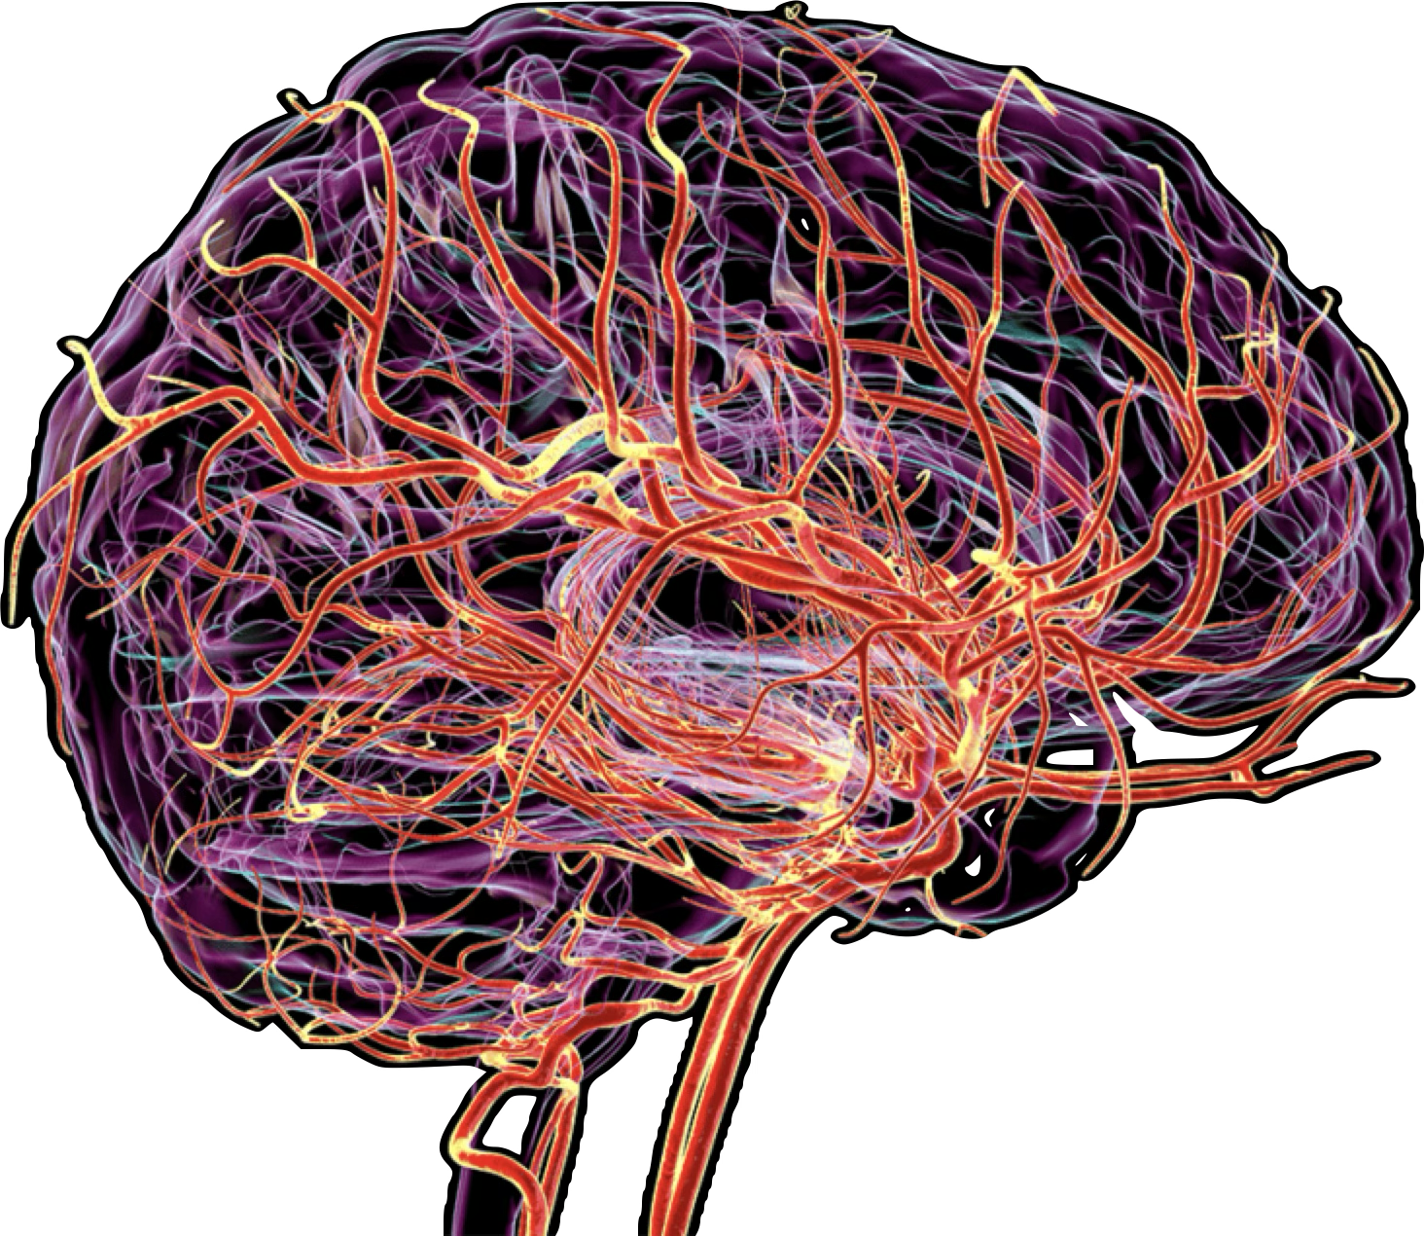
Carney Center For Brain Science
SREIP for VLANS
Introduction
Jinyao Z. DeSandies, Christopher I. Moore
Funding provided by National Institute of Neurological Disorders and Stroke for Carney Summer Scholars Program
Relationship between the neural and vascular system
conventional hypotheses focus on metabolic delivery;
The vascular system’s design is optimized for many other functions (Wilson and Matschinsky 2020).
Selective brain cooling, Information processing, and Chemical computing (Moore and Cao 2008)(Chakravarthy et al. 2026).
Opensource 3D meshing software SALOME and Computational Fluid Dynamics Simulation Software OpenFOAM,
A 3D model of the brain simulating temperature and fluid transfers of a neural-capillary system was created.
Verifies the other hypotheses and, with further work, could recreate the exact mechanism of these systems computationally.
Special Thanks to Spike Lab, Dept. Neuroscience, Pomona College, Claremont CA

Slide 4
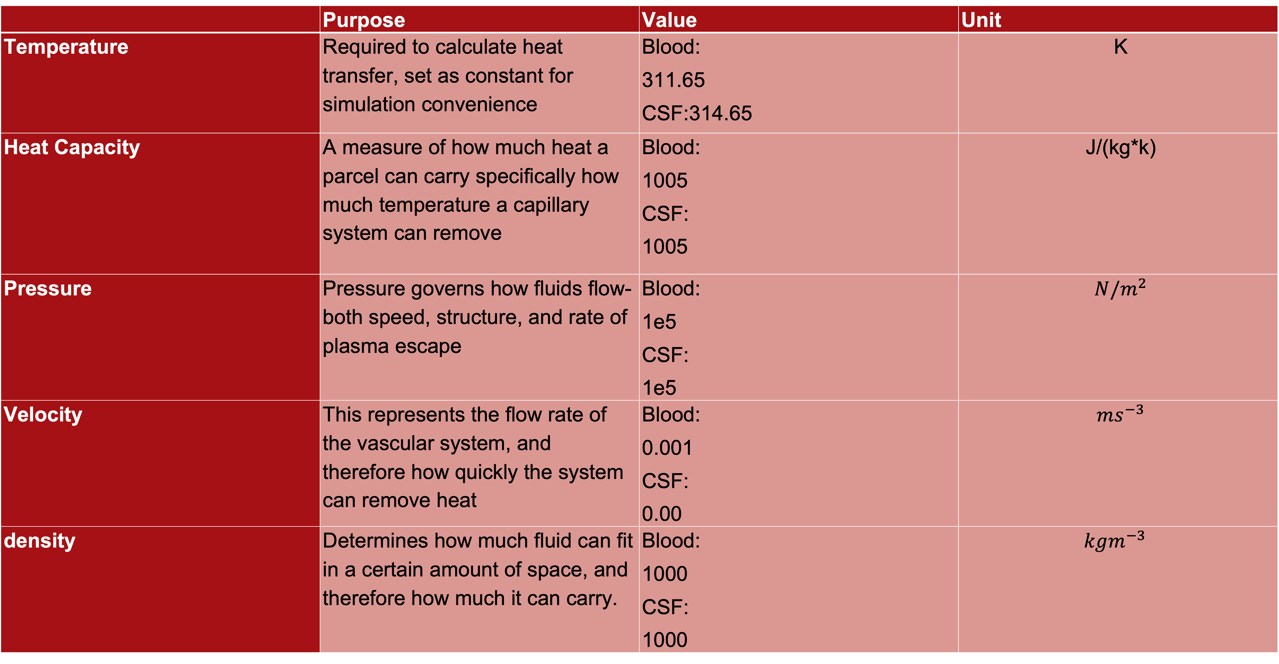
Carney Center For Brain Science
SREIP for VLANS
Model Parameters
Jinyao Z. DeSandies, Christopher I. Moore
Funding provided by National Institute of Neurological Disorders and Stroke for Carney Summer Scholars Program
 | Purpose | Value | Unit
Temperature | Required to calculate heat transfer, set as constant for simulation convenience | Blood: 311.65 CSF:314.65 | K
Heat Capacity | A measure of how much heat a parcel can carry specifically how much temperature a capillary system can remove | Blood: 1005 CSF: 1005 | J/(kg*k)
Pressure | Pressure governs how fluids flow- both speed, structure, and rate of plasma escape | Blood: 1e5 CSF: 1e5 | $N/m^{2}$
Velocity | This represents the flow rate of the vascular system, and therefore how quickly the system can remove heat | Blood: 0.001 CSF: 0.00 | $ms^{−3}$
density | Determines how much fluid can fit in a certain amount of space, and therefore how much it can carry. | Blood: 1000 CSF: 1000 | $$kgm^{−3}$$
Special Thanks to Spike Lab, Dept. Neuroscience, Pomona College, Claremont CA

Slide 5
Carney Center For Brain Science
SREIP for VLANS
Liquid Convection
Jinyao Z. DeSandies, Christopher I. Moore
Funding provided by National Institute of Neurological Disorders and Stroke for Carney Summer Scholars Program
temperature differences between the hotter outer shell and cooler inside cappilary, the CSF and ECF being cools rapidly exits downward a higher level of efficiency in temperature diffusion.
more advantageous for vessels to be placed above neurons if its purpose is to regulate temperature, or below neurons if the purpose is metabolic and oxygen delivery.
chemicals within the system can flow in ways to mix into new signaling chemicals or deliver Ca and K to allow neurons to excite or inhibit other neurons that are not wired directly.
Dynamic Simulation made
Special Thanks to Spike Lab, Dept. Neuroscience, Pomona College, Claremont CA

Slide 6
Carney Center For Brain Science
SREIP for VLANS
Temperature Change
Jinyao Z. DeSandies, Christopher I. Moore
Funding provided by National Institute of Neurological Disorders and Stroke for Carney Summer Scholars Program
unable to demonstrate temperature change as a similarly dynamic component .
Clear effect shown in which neurons near the vessel would necessarily be cooler than neurons far away, which is intuitive.
Axons near vasculature should either benefit from being inhibited, or fire more commonly than other neurons.
This wraparound effect was indeed found in 2-Photon Imaging demonstrating action potentials coupled with neural signals.
Pc − Pi = hydrostatic pressure gradient
Πc − Πi = oncotic pressure gradient
LpS = capillary filtration coefficient
σ = reflection (protein permeability) coefficient
Special Thanks to Spike Lab, Dept. Neuroscience, Pomona College, Claremont CA

Slide 7
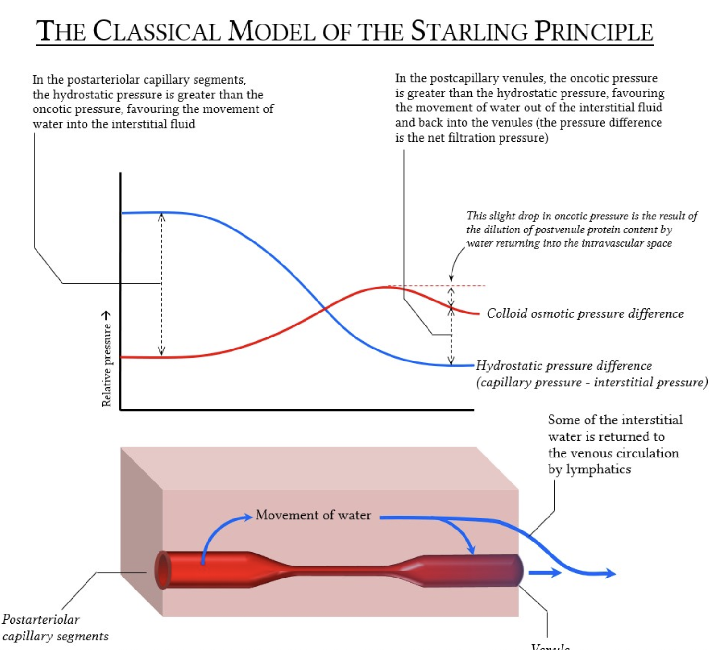
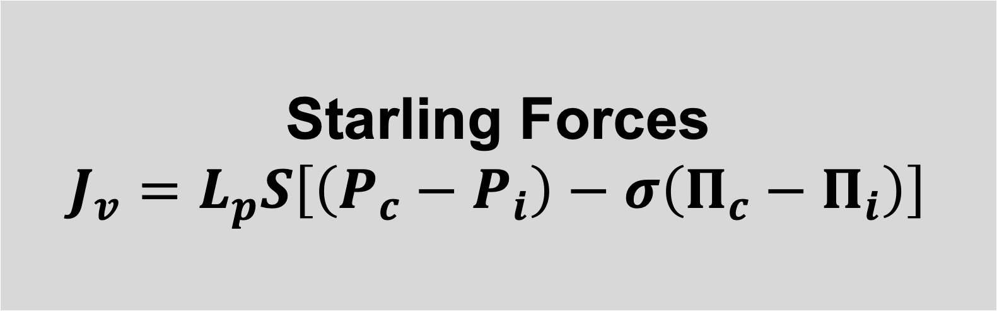
Carney Center For Brain Science
SREIP for VLANS
Rush: A 3d Computational Fluid Model of Neuro-Vascular Coupling as a mechanism for Heat Management and Biochemical Computing
Jinyao Z. DeSandies, Christopher I. Moore
Funding provided by National Institute of Neurological Disorders and Stroke for Carney Summer Scholars Program
Starling forces reveal another feature of the capillary system that is worth future exploration with the 3D model.
Imagine a tight race between the hydrostatic and oncotic pressure:
Hydrostatic pressure is pressure pushing against the wall of capillaries,
Oncotic pressure is pressure pulling in towards the capillary.
In the artery end, the hydrostatic pressure is higher (35mmhg), and we would see a permeation of the Blood Brain Barrier as plasma and other particles leaking into the Extracellular zone.
Over the span of the blood cycle hydrostatic pressure decreases to below oncotic pressure (25 mmhg), and vessels near the veins begin to absorb chemicals (and their signals) before potentially delivering them to the heart.
2 different types of pores – one for smaller microparticles and one for macroparticles
Oncotic pressure is driven by osmosis because of negatively charged particles in albumin on one side that pulls water containing sodium because it is too big to leave vessel wall
2 types of pores in capillaries: (4 nm) per unit area for water and small hydrophilic molecules; and a few large pores (10 to 20 nm) for macromolecules
Starling Forces
$$J_{v}=L_{p}S\left[\left(P_{c}−P_{i}\right)−σ\left(Π_{c}−Π_{i}\right)\right]$$
Pc − Pi = hydrostatic pressure gradient
Πc − Πi = oncotic pressure gradient
LpS = capillary filtration coefficient
σ = reflection (protein permeability) coefficient
Special Thanks to Spike Lab, Dept. Neuroscience, Pomona College, Claremont CA

