Slide 1
Geometry Calibration--PET
Jin, Yifei
04/22/2020

Slide 2
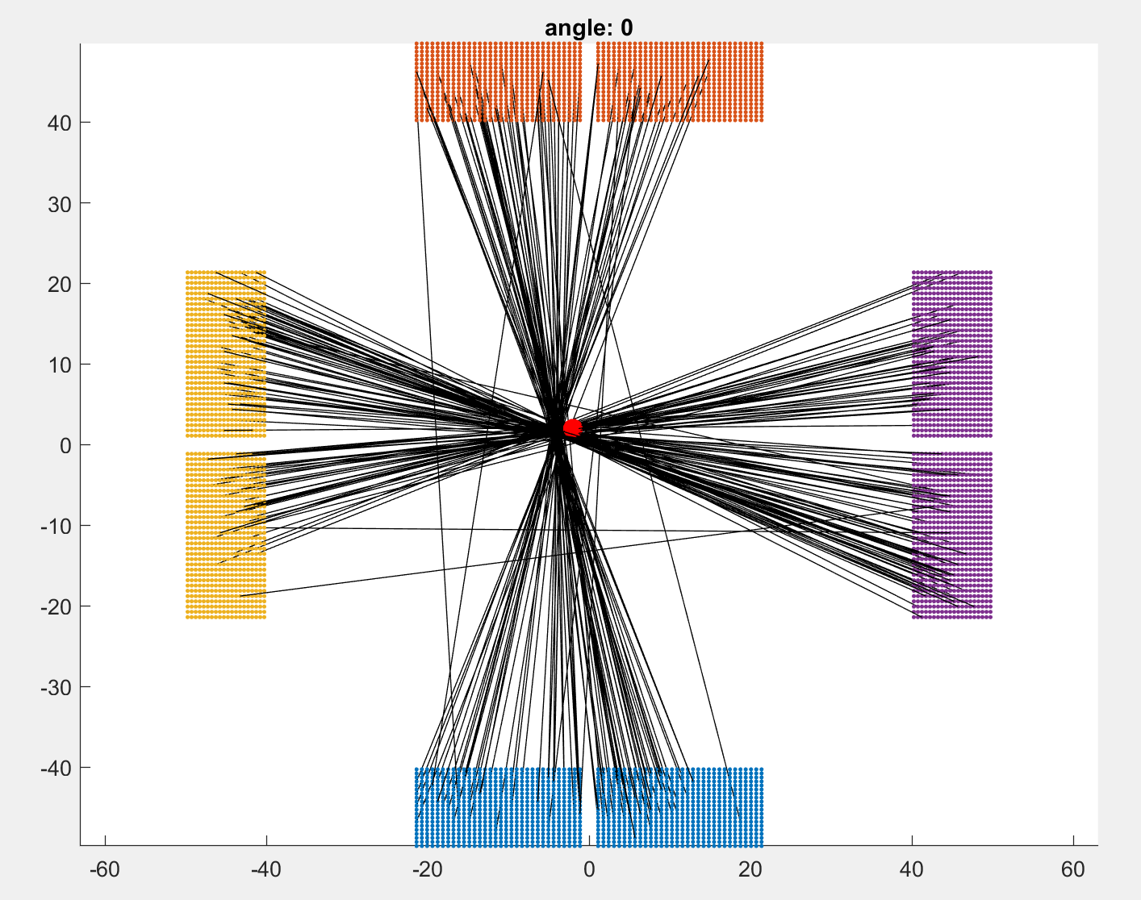
Initial guess

Slide 3
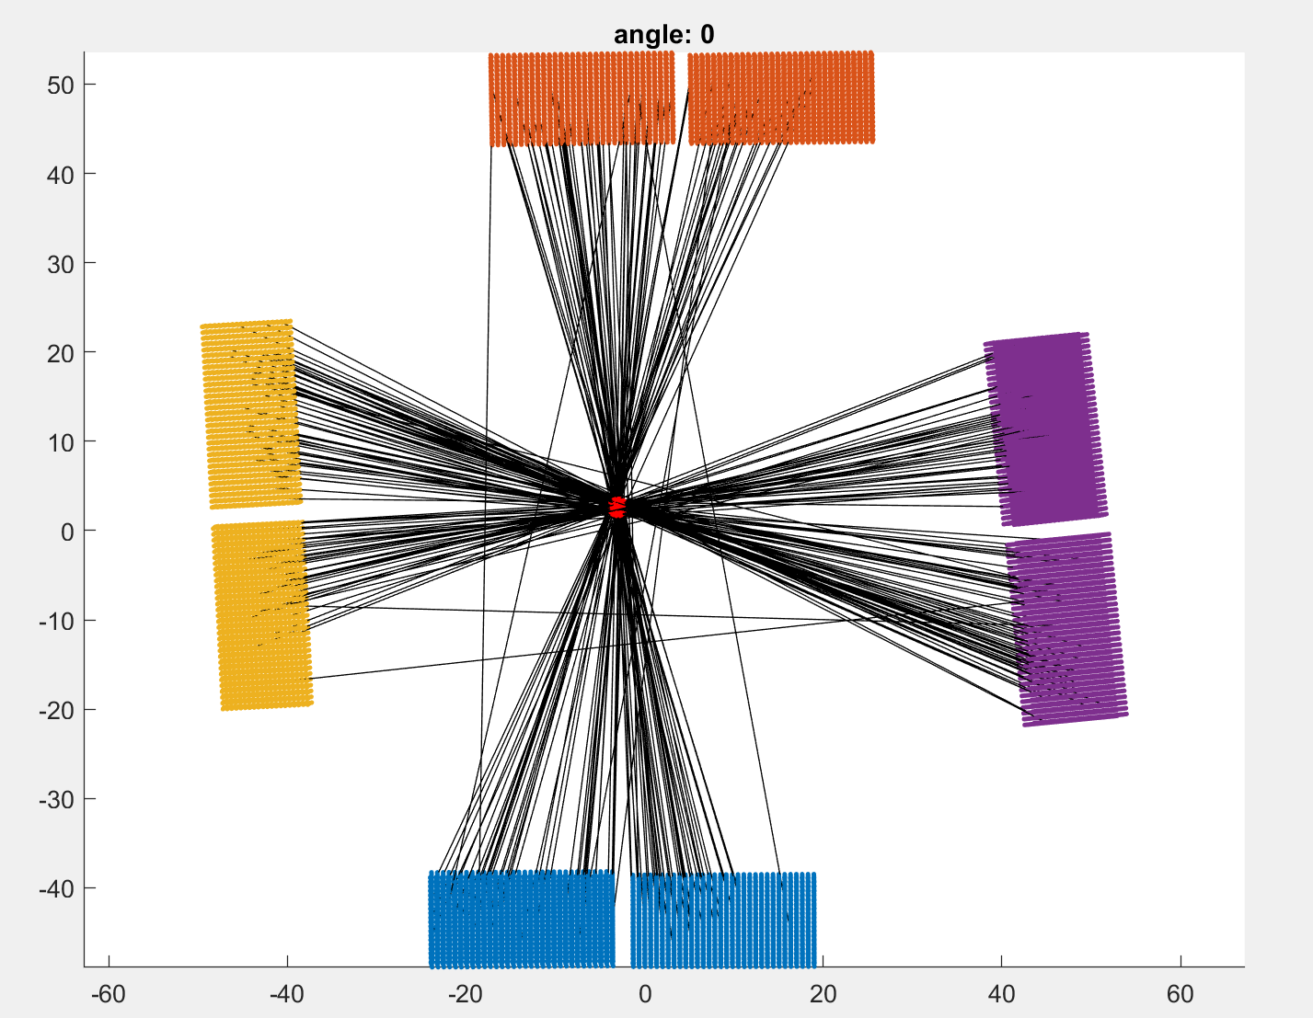
1st iteration

Slide 4
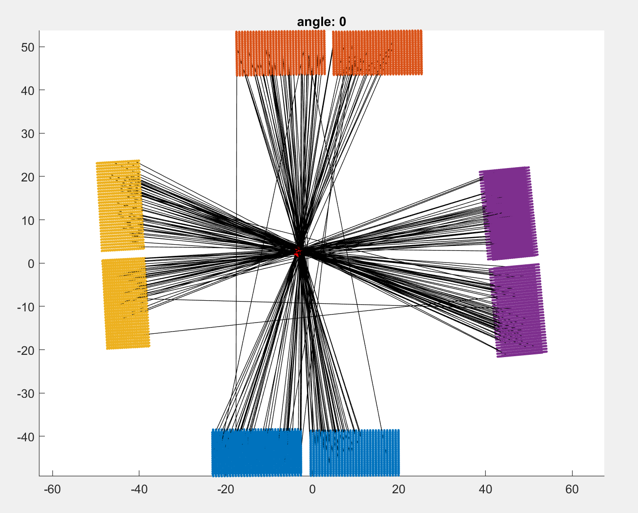
2nd iteration

Slide 5

3rd iteration

Slide 6

4th iteration

Slide 7

5th iteration

