Slide 1


Depth-First Search
A
B
D
E
C
1

Slide 2






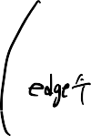
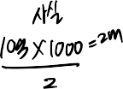








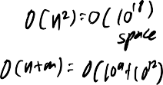
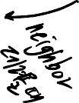











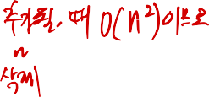


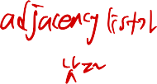

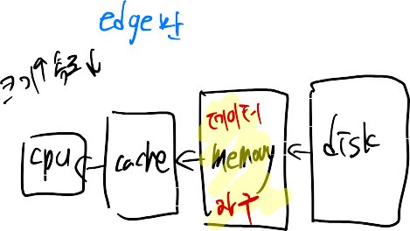




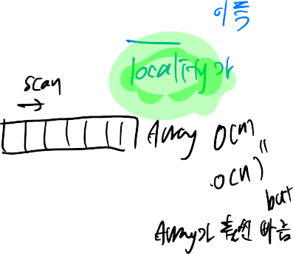


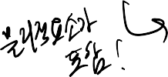

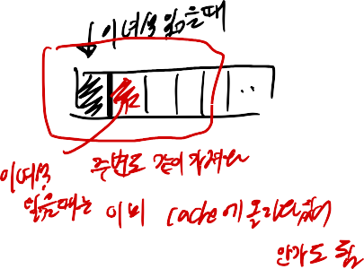
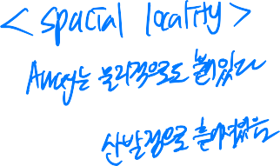
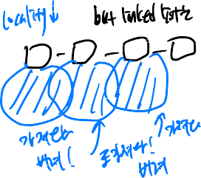


Slide 3







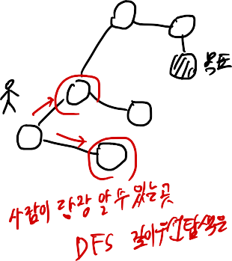


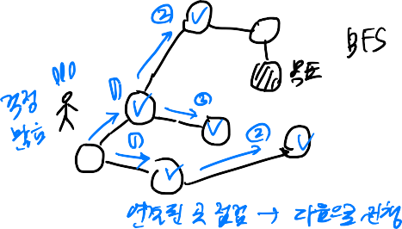



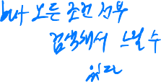
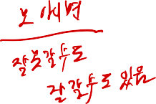









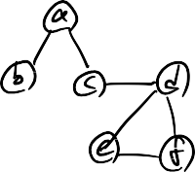


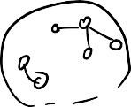













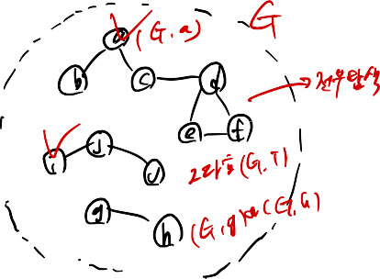






Slide 4








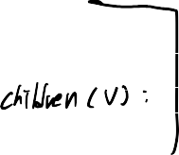

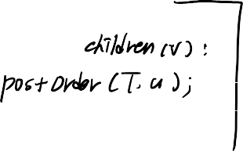




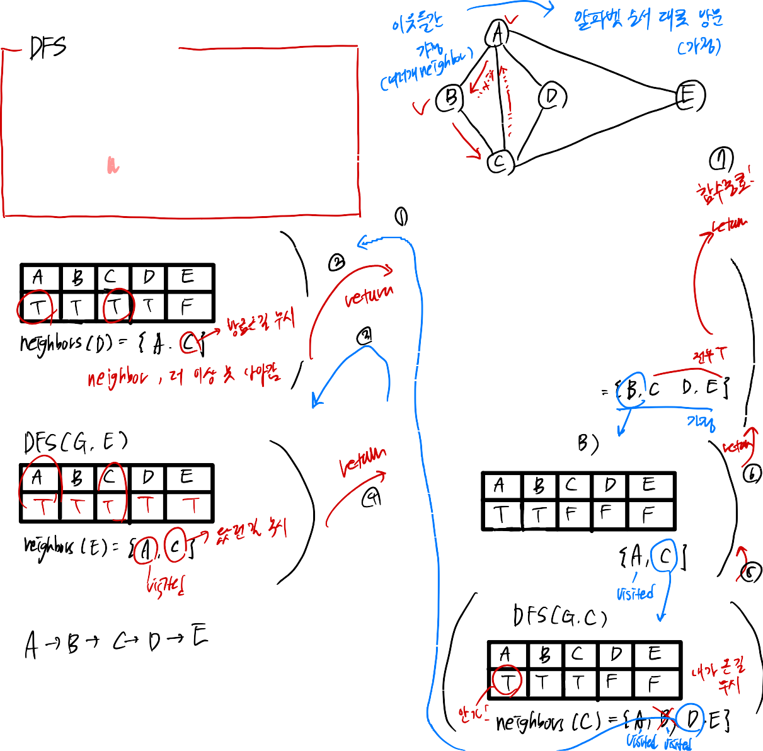





















Slide 5

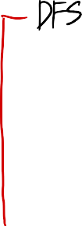


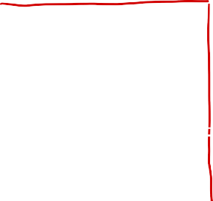












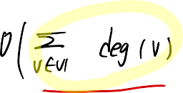







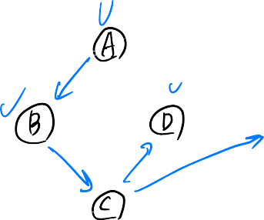




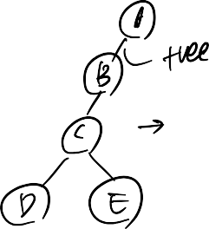



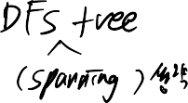
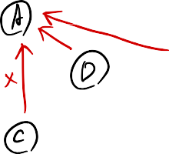

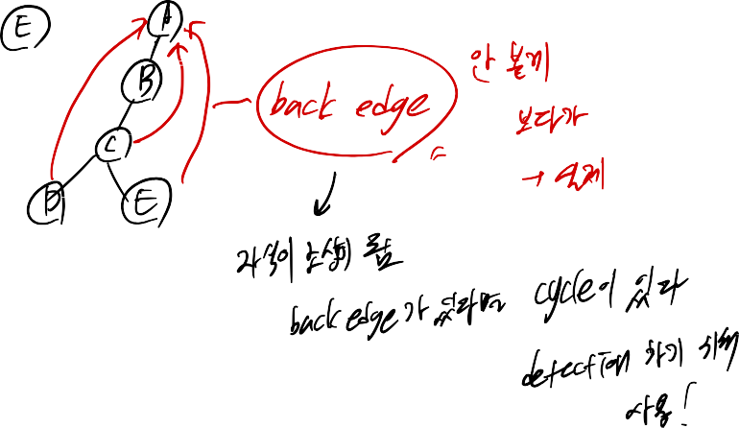





Slide 6




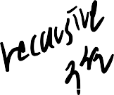
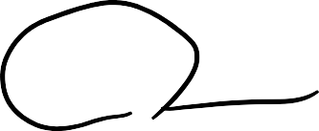
Maze Solving
The DFS algorithm is similar to a classic strategy for exploring a maze
We mark each intersection, corner and dead end (vertex) visited
We mark each corridor (edge) traversed
We keep track of the path back to the entrance (start vertex) by means of a rope (recursion stack)

Slide 7
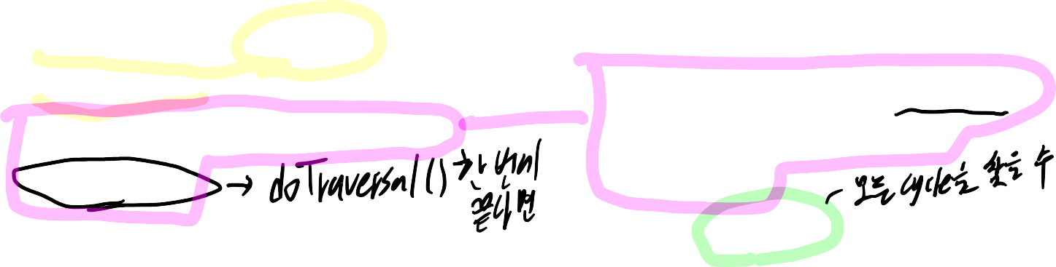
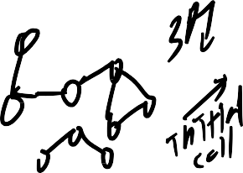

Depth-First Search
Depth-first search (DFS) is a general technique for traversing a graph
A DFS traversal of a graph G
Visits all the vertices and edges of G
Determines whether G is connected
Computes the connected
components of G
Computes a spanning forest of G
DFS on a graph with n vertices and m edges takes O(n + m) time
DFS can be further extended to solve other graph problems
Find and report a path between two given vertices
Find a cycle in the graph
Depth-first search is to graphs what Euler tour is to binary trees

Slide 8




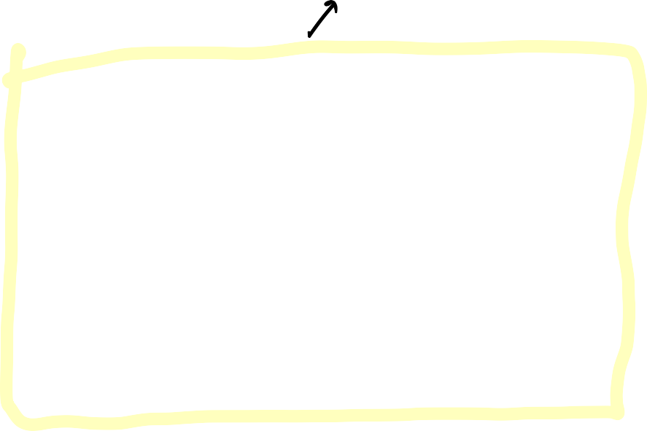


DFS Algorithm
The algorithm uses a mechanism for setting and getting “labels” of vertices and edges
Algorithm DFS_Traverse(G)
Input graph G = (V, E)
for all u ∈ V
mark u as UNVISITED
for all v ∈ V
if v is marked as UNVISITED DFS(G, v)
Algorithm DFS(G, v)
Input graph G =(V, E) and a start vertex
v ∈ V
mark v as VISITED
for all w ∈ {neighbors of v}
if w is marked as UNVISITED DFS(G, w)

Slide 9
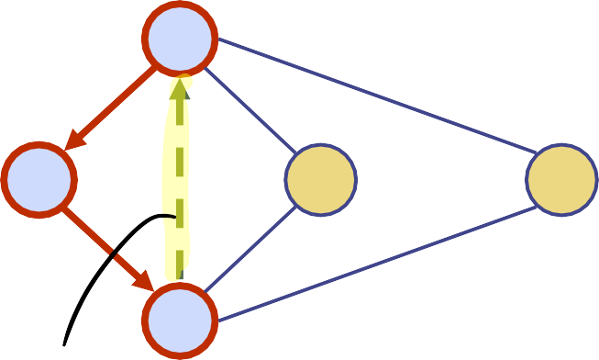

Example
A A
unvisited vertex
A
visited vertex unvisited edge discovery edge back edge
B
D
E
C
A
A
B
D
E
B
D
E
C
C

Slide 10
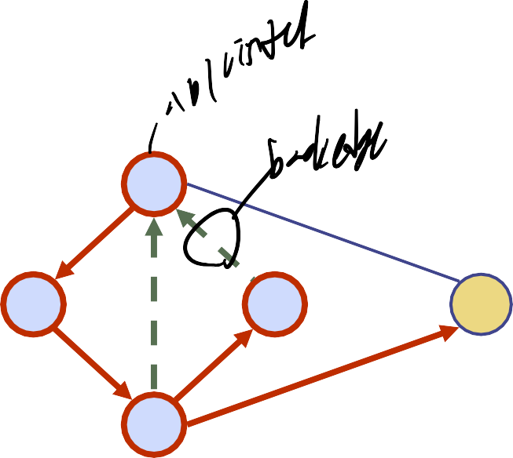
Example (cont.)
A
A
B
D
E
B
D
E
C
C
A
A
B
D
E
B
D
E
C
C

Slide 11
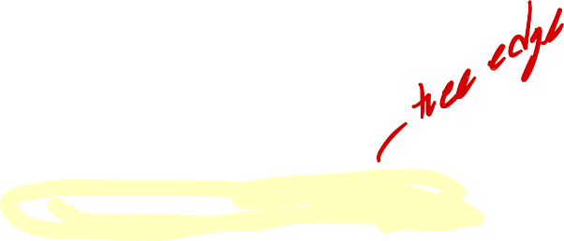

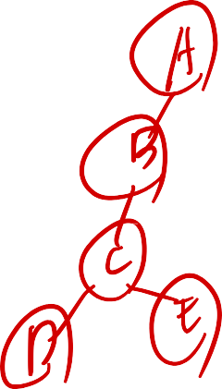

Properties of DFS
Property 1
DFS(G, v) visits all the vertices and edges in the connected component of v
A
Property 2
The discovery edges labeled by DFS(G, v) form a spanning tree of the connected component of v
B
D
E
C

Slide 12
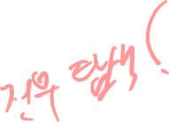

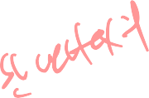
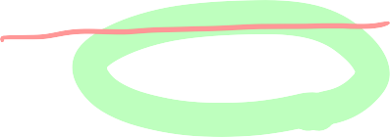










Analysis of DFS
Setting/getting a vertex/edge label takes O(1) time
Each vertex is labeled twice
once as UNVISITED
once as VISITED
Each edge is labeled twice
once as UNEXPLORED
once as DISCOVERY or BACK
Method incidentEdges is called once for each vertex
DFS runs in O(n + m) time provided the graph is
represented by the adjacency list structure
Recall that Σ_{v} deg(v) = 2m

Slide 13







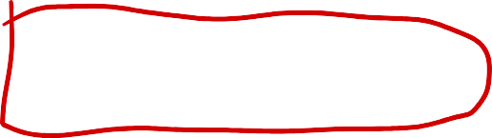
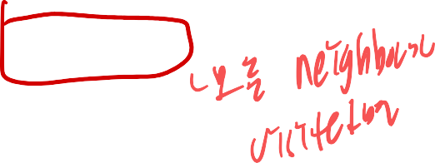


Path Finding
We can specialize the DFS algorithm to find a path between two given vertices u and z using the template method pattern
We call DFS(G, u) with u
as the start vertex
We use a stack S to keep track of the path between the start vertex and the current vertex
As soon as destination vertex z is encountered, we return the path a s the contents of the stack
Algorithm pathDFS(G, v, z)
Input graph G =(V, E) and a start vertex
v ∈ V
S.push(v)
mark v as VISITED
if v = z
return S.elements()
for all w ∈ {neighbors of v}
if w is marked as UNVISITED
pathDFS(G, w, z)
S.pop(v)

Slide 14

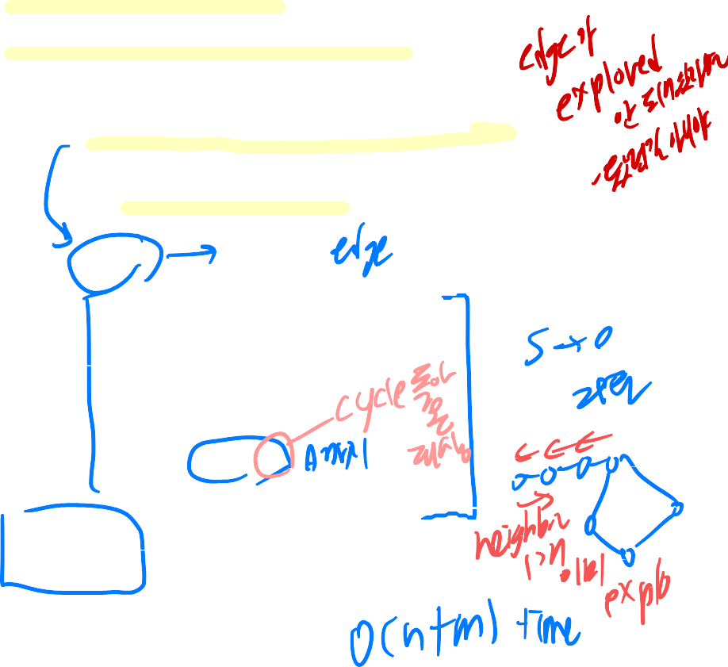



Cycle Finding
Algorithm cycleDFS(G, v) S.push(v)
mark v as VISITED
for all w ∈ {neighbors of v}
if (w, v) is UNEXPLORED
if w is marked as UNVISITED mark (w, v) as EXPLORED cycleDFS(G, w)
else
T ← new empty stack
repeat
o ← S.pop()
T.push(o)
until o = w
return T.elements()
S.pop(v)
We can specialize the DFS algorithm to find a simple cycle
We use a stack S to keep track of the path between the start vertex and the current vertex
As soon as a back edge (v, w) is encountered, we return the cycle as the portion of the stack from the top to vertex w

