Slide 1
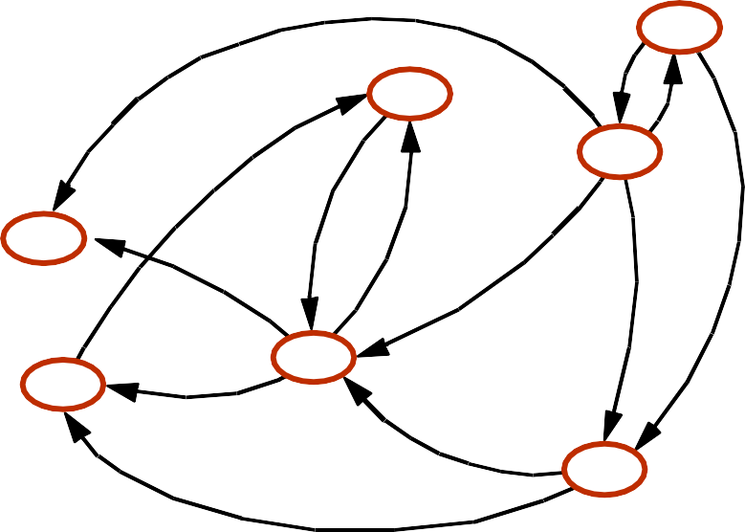
Directed Graphs
BOS
ORD
JFK
SFO
LAX
DFW
MIA
1

Slide 2
















Directed Graphs
BOS
ORD
JFK
SFO
LAX
DFW
MIA
1

Slide 3
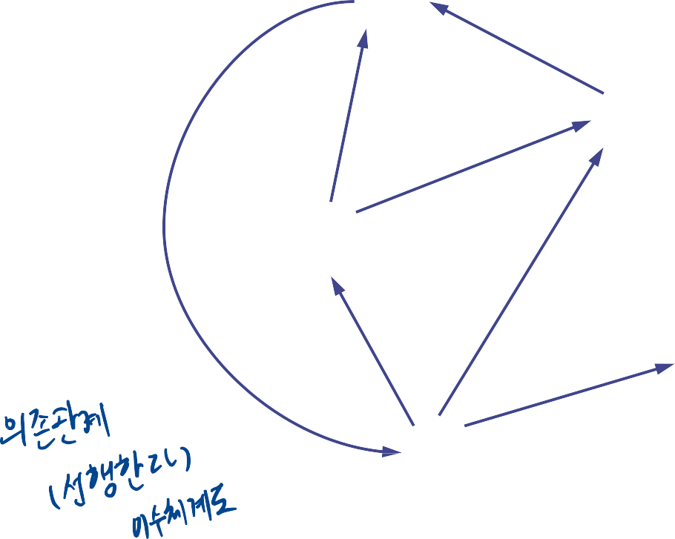

Digraphs
A digraph is a graph whose edges are all directed
Short for “directed graph”
D
E
Applications
one-way streets
flights
task scheduling
B
C
A

Slide 4


Digraph Properties
D
E
B
A graph G=(V,E) such that
Each edge goes in one direction:
C
A
Edge (a,b) goes from a to b, but not b to a
If G is simple, m < n⋅(n − 1)
If we keep in-edges and out-edges in separate adjacency lists, we can perform listing of incoming edges and outgoing edges in time proportional to their size

Slide 5
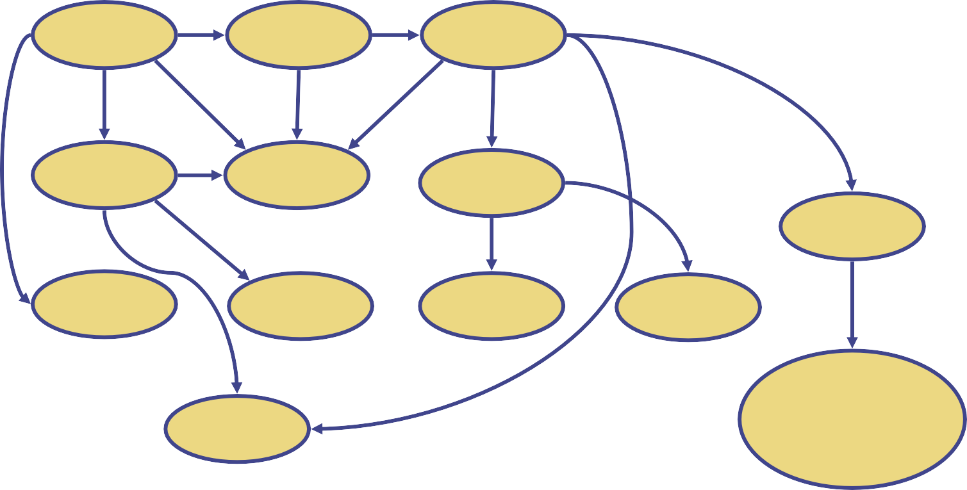
Digraph Application
Scheduling: edge (a,b) means task a must be completed before b can be started
ics21
ics22
ics23
ics51
ics53
ics52
ics161
ics131
ics141
ics121
ics171
ics151
The good life

Slide 6







Directed DFS
We can specialize the traversal
algorithms (DFS and BFS) to
D
digraphs by traversing edges
only along their direction
In the directed DFS algorithm,
E
we have four types of edges
discovery edges
B
back edges
forward edgs
C
cross edges
A directed DFS starting at a
A
vertex s determines the vertices
reachable from s

Slide 7



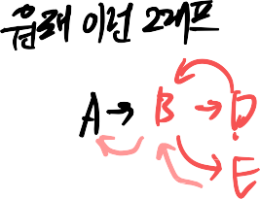
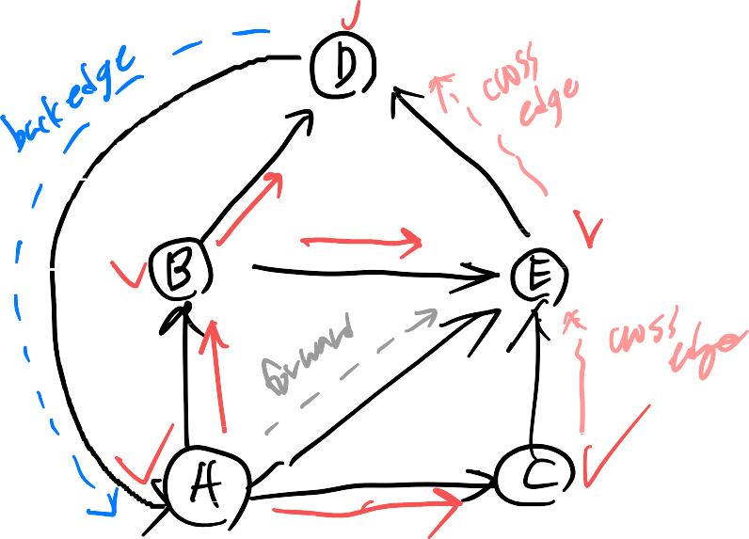

Slide 8
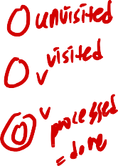
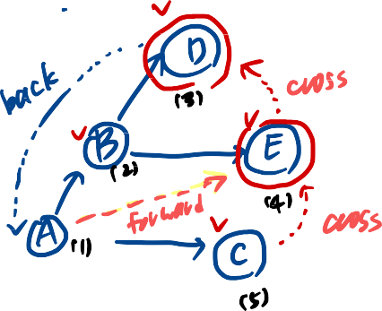
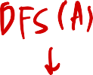
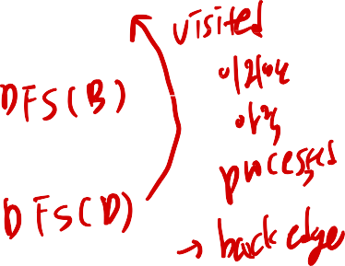
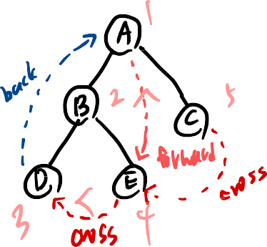


Slide 9
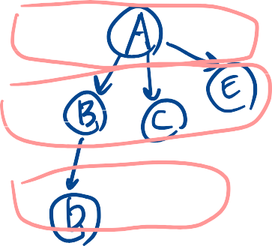


Directed BFS
Unlike directed DFS, directed
BFS algorithm classifies edges
D
as one of the following three
types:
discovery edges
E
back edges
cross edges
B
There are no forward edges in
the directed BFS tree.
C
A
6

Slide 10
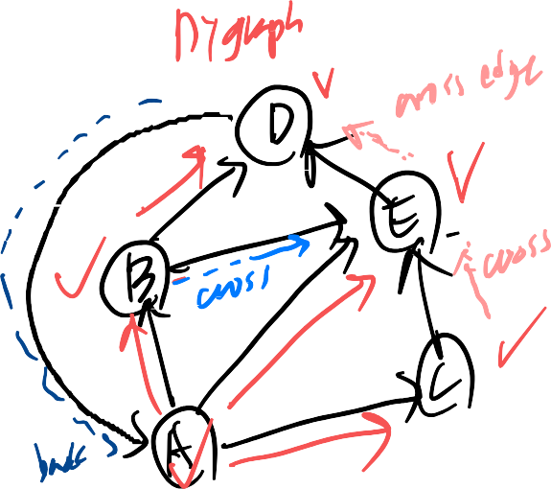


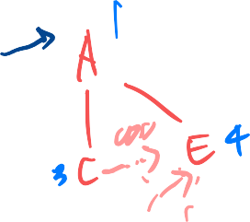
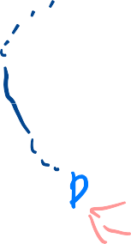

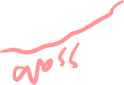

Slide 11
Reachability
DFS (or BFS) tree rooted at v: vertices reachable from v via directed paths
E D
E D
C
A
C
F
E
D
A
B
C
A

Slide 12
Strong Connectivity
Each vertex can reach all other vertices
a
g
c
d
e
b
f

Slide 13

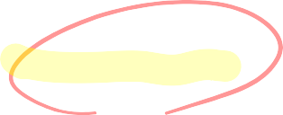



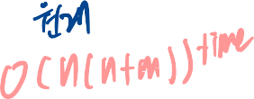



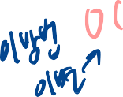


Strong Connectivity Algorithm
Pick a vertex v in G
Perform a DFS from v in G
If there's a w not visited, print “no”
Let G' be G with edges reversed
Perform a DFS from v in G'
If there's a w not visited, print “no”
Else, print “yes”
Running time: O(n+m)
G:
a
c
g
d
e
f
b
a
G':
c
g
d
e
f
b

