Slide 1





DAGs and Topological Ordering
D E
A directed acyclic graph (DAG) is a
digraph that has no directed cycles
A topological ordering of a digraph is a ordering
v₁ , …, v_{n}
of the vertices such that for every
edge (v_{i} , v_{j}), we have i < j
Example: in a task scheduling digraph, a topological ordering a task sequence that satisfies the precedence constraints
B
C
A
DAG G
v₅
E
v₄
D
v₂
B
v₃
Topological ordering of G
10
v₁
C
A
Theorem
A digraph admits a topological ordering if and only if it is a DAG

Slide 2

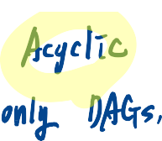







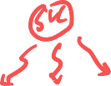
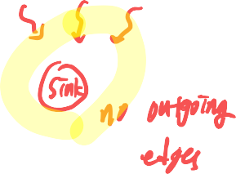
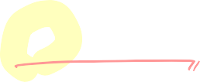


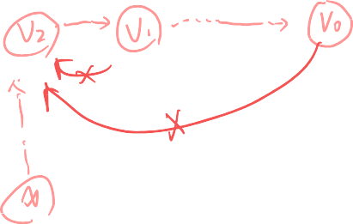

Slide 3


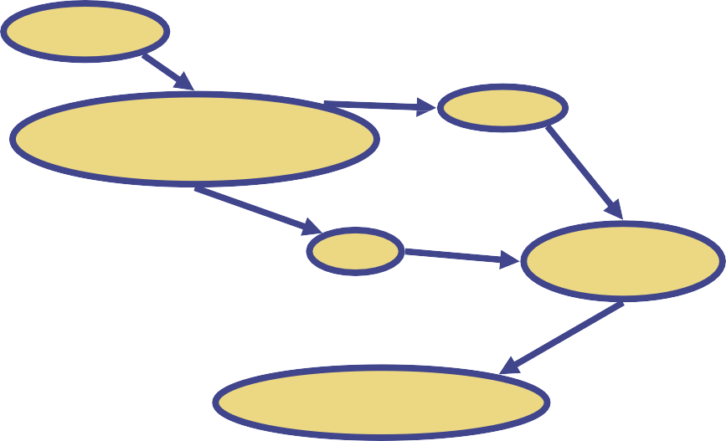





Topological Sorting
Number vertices, so that (u,v) in E implies u < v
wake up ¹
A typical student day
3
eat
2
study computer sci.
4
5
more c.s.
nap
7
play
8
write c.s. program
6
work out
9
bake cookies
10
sleep
11
dream about graphs
11

Slide 4







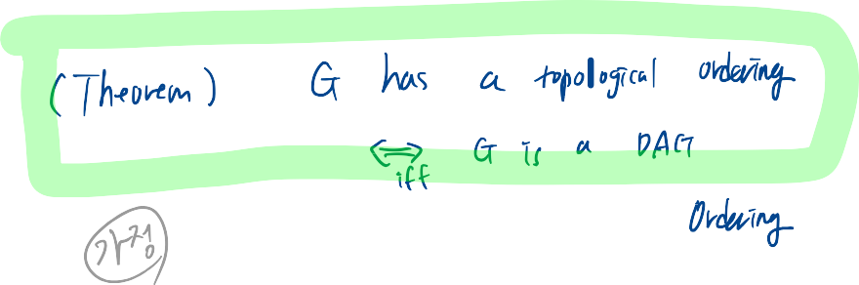
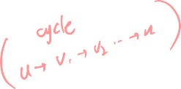





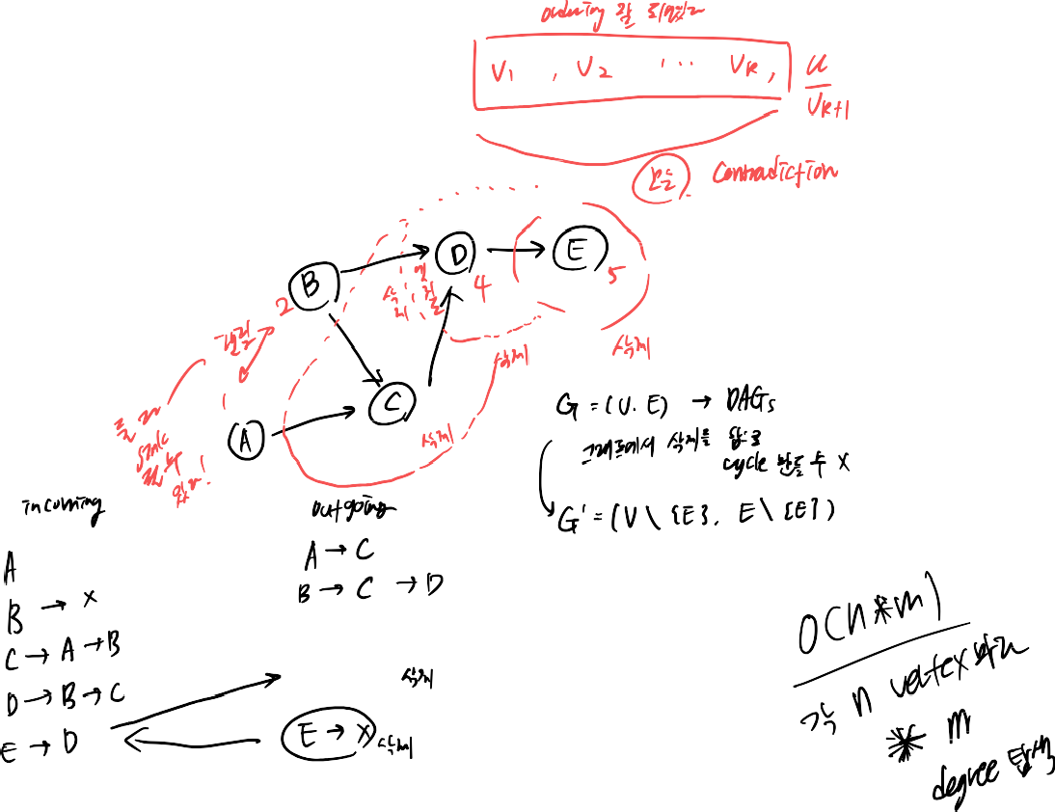






Slide 5





Algorithm for Topological Sorting
Note: This algorithm is different than the one in the book
Algorithm TopologicalSort(G)
H ← G // Temporary copy of G n ← G.numVertices()
while H is not empty do
Let v be a vertex with no outgoing edges
Label v ← n n ← n − 1
Remove v from H
Running time: O(n + m)

Slide 6
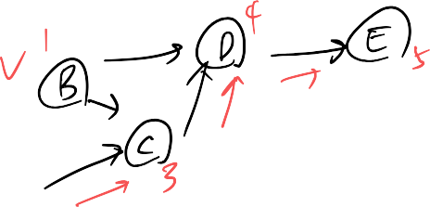





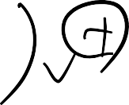
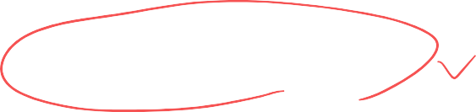
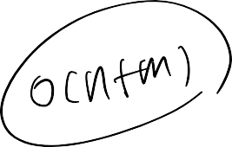
Implementation with DFS
Simulate the algorithm by
using depth-first search
O(n+m) time.
Algorithm topologicalDFS(G)
Input dag G = (V, E)
Output topological ordering of G
n ← |V|
for all u ∈ V
mark u as UNVISITED
for all v ∈ V
if v is marked as UNVISITED topologicalDFS(G, v)
Algorithm topologicalDFS(G, v)
Input graph G and a start vertex v of G
Output labeling of the vertices of G
in the connected component of v
mark v as VISITED
for all w ∈ {neighbors of v}
if w is marked as UNVISITED
topologicalDFS(G, w)
Label v with topological number n n ← n - 1

Slide 7
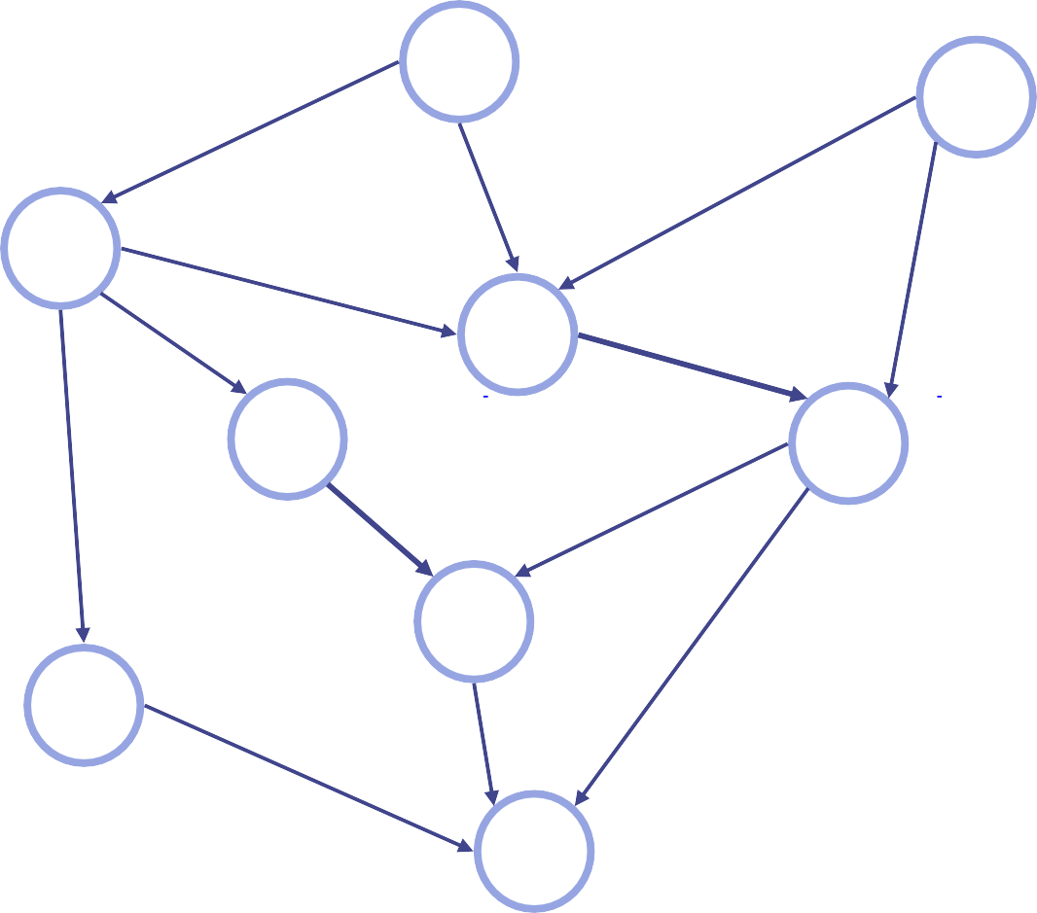
Topological Sorting Example
2
1
3
4
6
5
7
8
9

