Slide 1



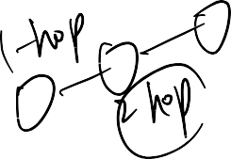
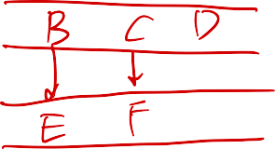





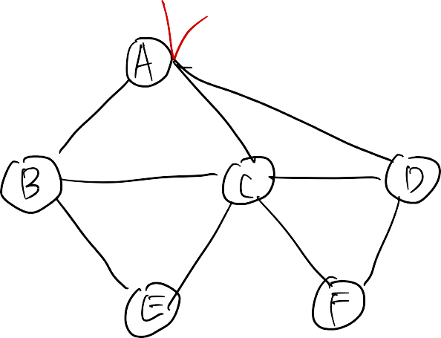




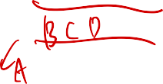



Breadth-First Search
L₀
A
L₁
B
C
D
L₂
E
F
1

Slide 2



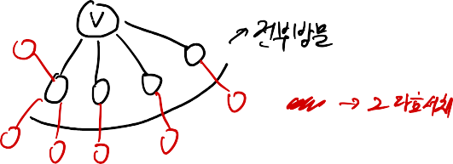







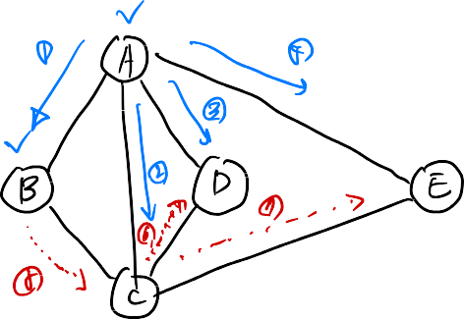
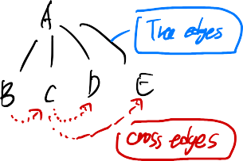





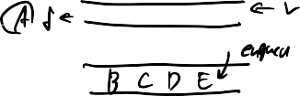






















Slide 3
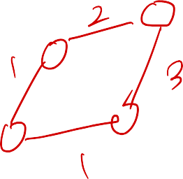





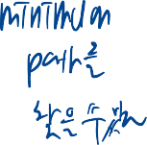
Breadth-First Search
Breadth-first search
BFS on a graph with n vertices and m edges takes O(n + m ) time
BFS can be further extended to solve other graph problems
(BFS) is a general
technique for tr a v ersing
a graph
A BFS traversal of a graph G
Visits all the vertices and edges of G
Find and report a path with the minimum number of edges between two given vertices
Find a simple cycle, if there is one
Determines whether G is
connected
Computes the connected components of G
Computes a spanning
forest of G

Slide 4


















BFS Algorithm
Algorithm BFS(G, s)
L₀ ← new empty sequence
L₀.insertBack(s) mark s as VISITED i ← 0
while L_{i} is not empty
L_{i +1} ← new empty sequence
for all v ∈ L_{i}.elements()
for all w ∈ {neighbors of v}
if w is marked as UNVISITED
mark w as VISITED
L_{i +1}.insertBack(w)
i ← i +1
Algorithm BFS_Traverse(G)
Input graph G = (V, E)
for all u ∈ V
mark u as UNVISITED
for all v ∈ V
if v is marked as UNVISITED BFS(G, v)
The algorithm uses a mechanism for marking vertices as VISITED or UNVISITED

Slide 5

Example
L₀
A A
unvisited vertex visited vertex unexplored edge
A
L₁
B
C
D
discovery edge cross edge
E
F
L₀
L₀
A
A
L₁
L₁
B
C
D
B
C
D
E
F
E
F

Slide 6
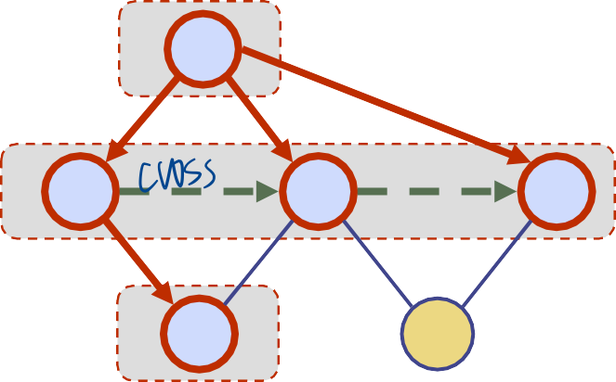
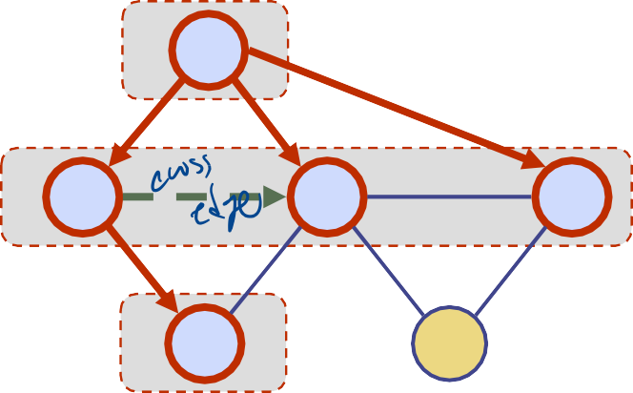
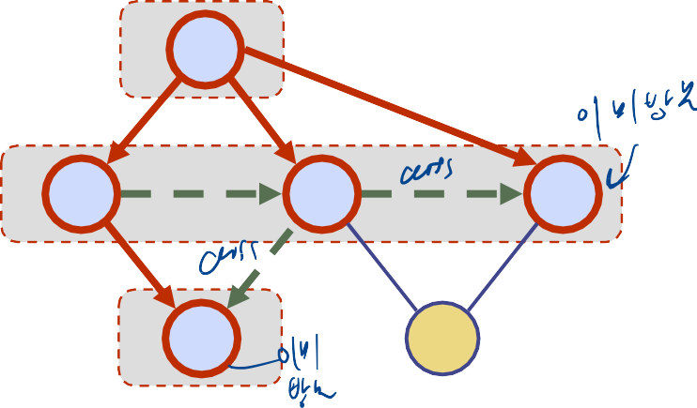
Example (cont.)
L₀
L₀
A
A
L₁
L₁
B
C
D
B
L₂
C
D
E
F
E
F
L₀
L₀
A
A
L₁
L₁
B
L₂
C
D
B
L₂
C
D
E
F
E
F

Slide 7
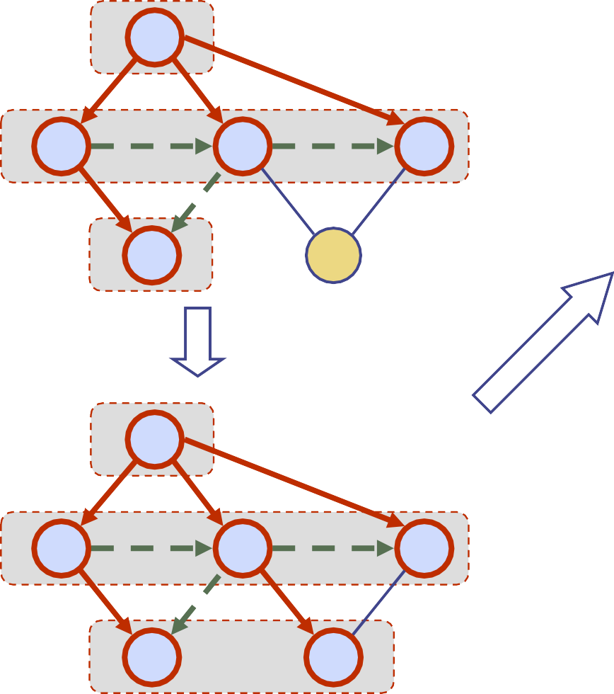
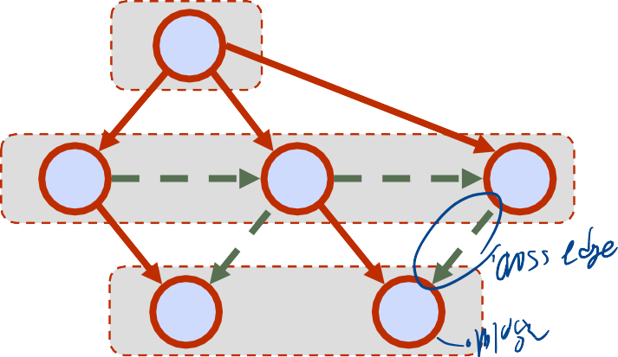
Example (cont.)
L₀
L₀
A
A
L₁
L₁
B
L₂
C
D
B
L₂
C
D
E
F
E
F
L₀
A
L₁
B
L₂
C
D
E
F

Slide 8
Properties
Notation
G_{s}: connected component of s
Property 1
BFS(G, s) visits all the vertices and
A
B
C
D
edges of G_{s}
Property 2
The discovery edges labeled by
E
F
BFS(G, s) form a spanning tree T_{s}
L
of G_{s}
Property 3
For each vertex v in L_{i}
The path of T_{s} from s to v has i
0
A
L₁
B
C
D
edges
Every path from s to v in G_{s} has at least i edges
L₂
E
F

Slide 9
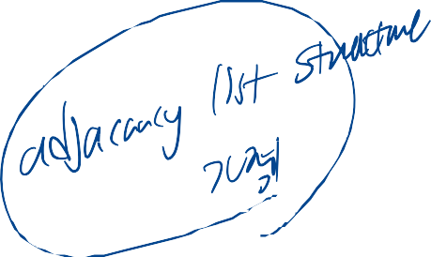

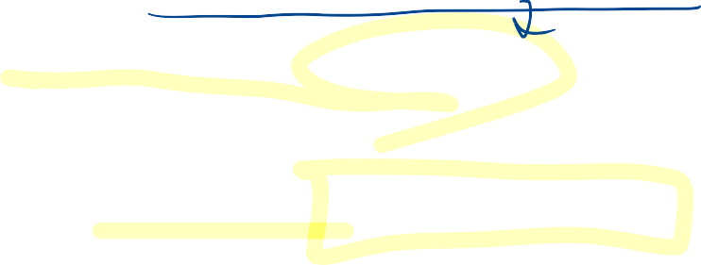
Analysis
Marking a vertex/edge takes O(1) time
Each vertex is marked twice
once as UNEXPLORED
once as VISITED
Each edge is visited twice
Each vertex is inserted once into a sequence L_{i}
Method neighbors is called once for each vertex
BFS runs in O(n + m) time provided the graph is represented by the adjacency list structure
Recall that Σ_{v} deg(v) = 2m

Slide 10
Applications
We can specialize the BFS traversal of a graph G to solve the following problems in O(n + m) time
Compute the connected components of G
Compute a spanning forest of G
Find a simple cycle in G, or report that G is a forest
Given two vertices of G, find a path in G between them with the minimum number of edges, or report that no such path exists

Slide 11
DFS vs. BFS
Applications | DFS | BFS
Spanning forest, connected components, paths, cycles | √ | √
Shortest paths |  | √
L₀
A
A
L₁
B
C
D
B
C
D
L₂
E
F
E
F
DFS
BFS

Slide 12
DFS vs. BFS (cont.)
Cross edge (v,w)
w is in the same level as
Back edge (v,w)
w is an ancestor of v in the tree of discovery edges
v or in the next level
L₀
A
A
L₁
B
C
D
B
C
D
L₂
E
F
E
F
DFS
BFS

Slide 13











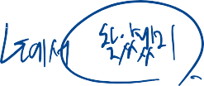

Cross edge property
If (u, v) is a cross edge that is not in the BFS tree, then the level numbers of u and v differ by at most 1.
^{L}i-1
u
(u, v) ?
L_{i}
^{L}i+1
v

