Slide 1



Binary Search Trees
<
6
2
>
9
1
4
=
8

Slide 2

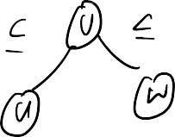





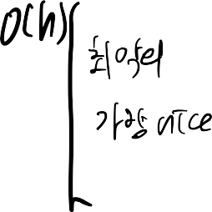
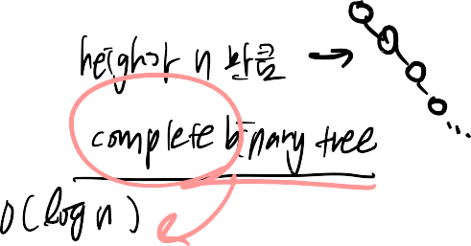





Binary Search Trees
A binary search tree is a
binary tree storing keys
An inorder traversal of a
(or key-value entries) at
binary search trees
its nodes and satisfying
the following property:
visits the keys in
increasing order
Let u, v, and w be three
nodes such that u is in
6
the left subtree of v and
w is in the right subtree
2
9
of v. We have
1
4
8

Slide 3





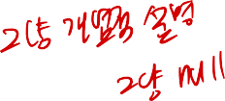



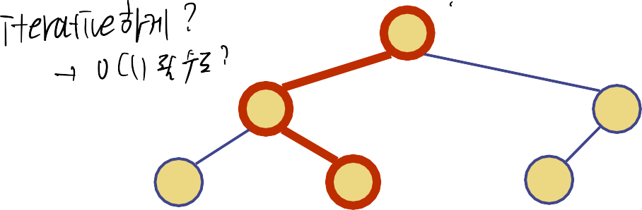
Search (Look Up)
Algorithm Search(k, v)
// assume tree is not empty
return v.parent()
if k < v.key()
return Search(k, v.left())
else if k > v.key()
return Search(k, v.right())
else // k == v.key()
return v
To search for a key k, we trace a downward path starting at the root
The next node visited depends on the comparison of k with the key of the current node
If we reach a leaf, the key is not found
Example: lookup(4):
Call Search(4,root)
if v == null
<
6
2
>
9
1
4
=
8

Slide 4
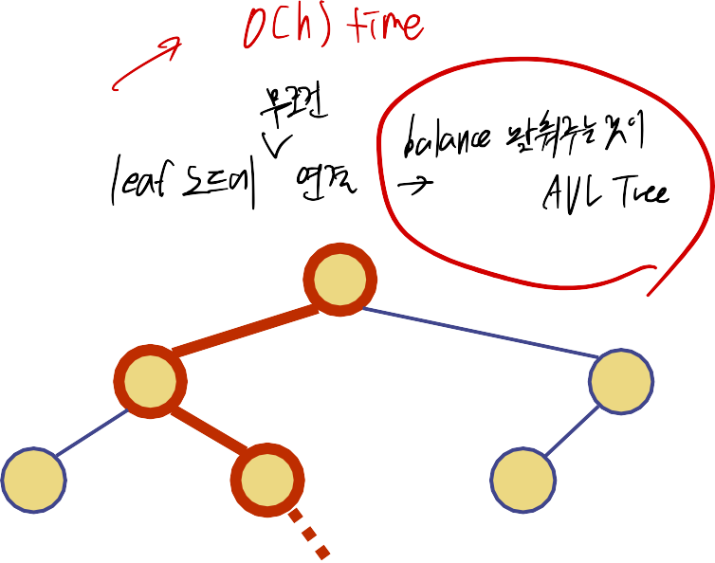
Insertion
<
6
To perform operation put(k,
o), we search for key k
2
>
9
using Search(k, root)
w
1
4
8
Assume k is not already in
the tree, and let w be the
>
leaf reached by the search
6
We create a left or right
child of node w and insert k
2
9
into the node being created.
Example: insert 5
1
4
8
w
5

Slide 5











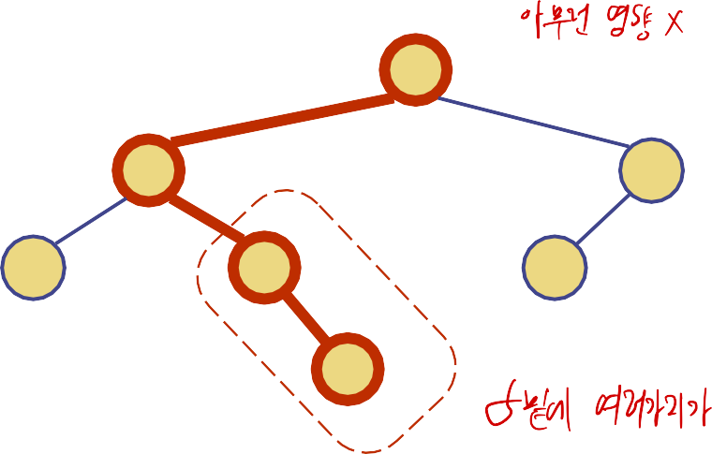





Deletion
To perform operation
<
6
erase(k), we search for key
2
9
k
>
1
4
v
8
Assume key k is in the tree,
and let let v be the node
5
w
storing k
If node v has only a single
child w, remove v and then
6
place w in the plae of v
2
9
Example: remove 4
1
5
8

Slide 6









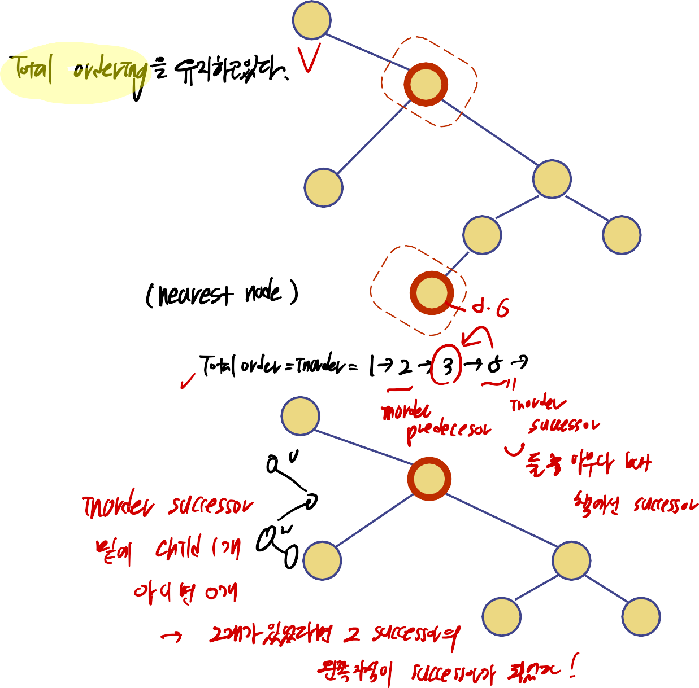





Deletion (cont.)
1
3
v
We consider the case where the key k to be removed is
stored at a node v having two
2
8
children
6
9
Find the node w that follows
w
v in an in-order traversal
5
Copy key(w) into node v
If w is a leaf, remove node w
Else if w is an internal node,
1
erase node w in the same
way
5
Example: remove 3
2
8
6
9

Slide 7











Deletion (cont.)
If w is an internal node, erase node w in the same way as w has always a single child z
Example: remove 3
1
1
3
v
4
2
6
2
6
w
4
8
5
8
₅ z

Slide 8






















Slide 9


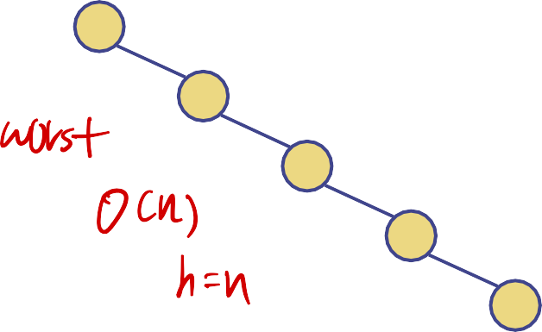




Performance
Consider an ordered map with n items implemented by means of a binary search tree of height h
the space used is O(n)
methods lookup, put and
erase take O(h) time
The height h is O(n) in the worst case and O(log n) in the best case
8

