Slide 1




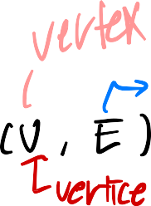








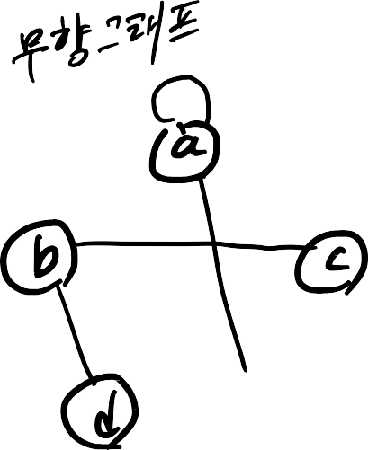










Graphs

Slide 2
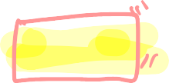


Graphs
A graph is a pair (V, E), where
V is a set of nodes, called vertices
E is a collection of pairs of vertices, called edges
Vertices and edges are positions and store elements
Example:
A vertex represents an airport and stores the three-letter airport code
An edge represents a flight route between two airports and stores the mileage of the route

Slide 3







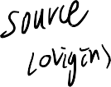










Edge Types
Directed edge
ordered pair of vertices (u,v)
first vertex u is the origin
second vertex v is the destination
e.g., a flight
Undirected edge
unordered pair of vertices (u,v)
e.g., a flight route
Directed graph
all the edges are directed
e.g., route network
Undirected graph
all the edges are undirected
e.g., flight network
flight AA 1206
ORD
PVD
849
miles
ORD
PVD

Slide 4





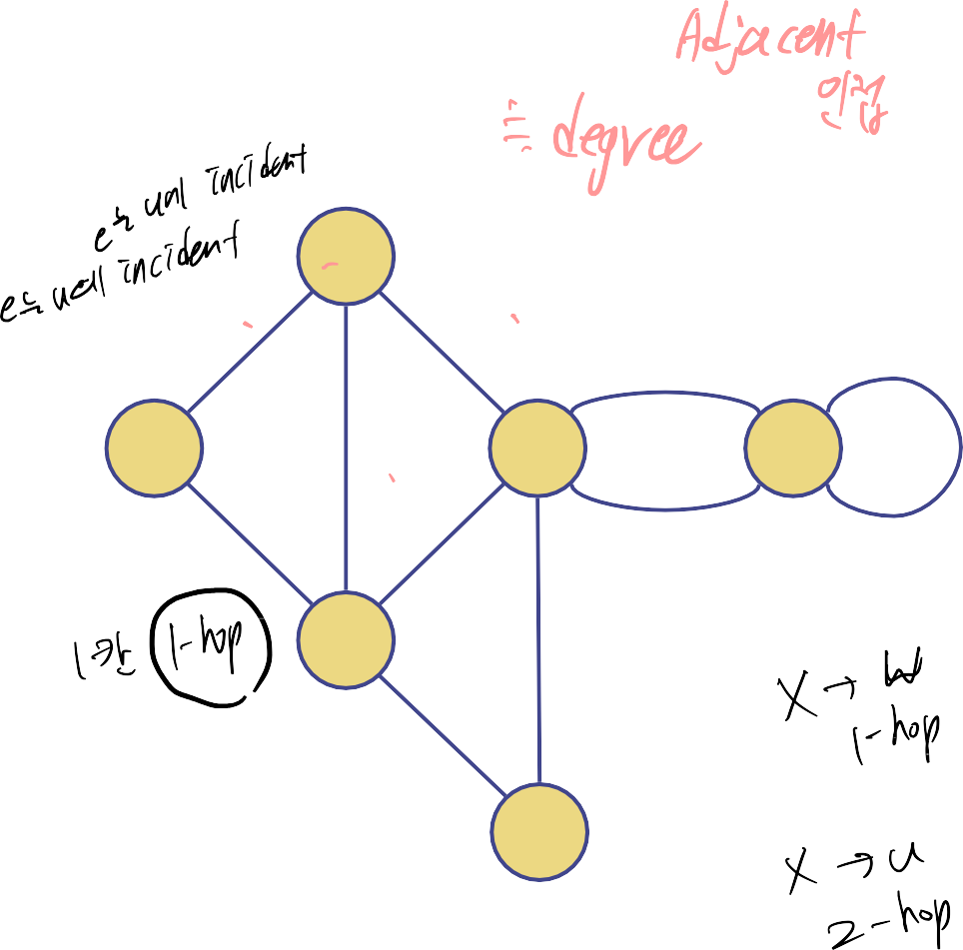



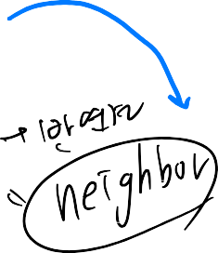



Terminology
End vertices (or endpoints) of
an edge
U and V are the endpoints of the edge a
V
a
b
Edges incident on a vertex
a, d, and b are incident on V
Adjacent vertices
U and V are adjacent
Degree of a vertex
X has degree 5
Parallel edges
h and i are parallel edges
Self-loop
j is a self-loop
h
j
U
d X
Z
c
e
i
W
g
f
Y

Slide 5


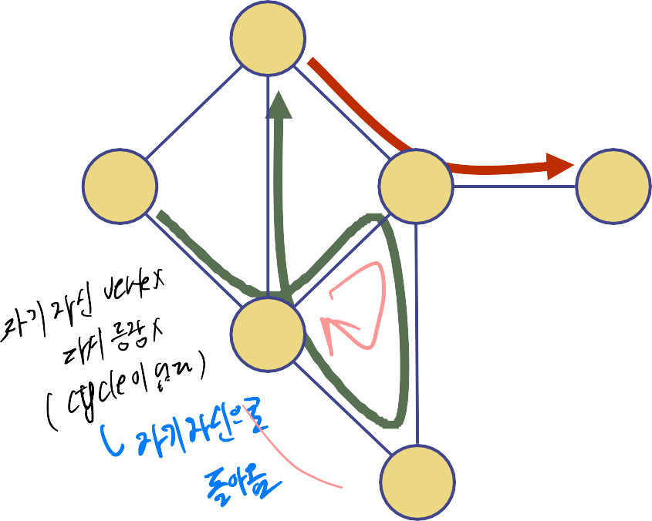


Terminology (cont.)
Path
sequence of alternating vertices and edges
begins with a vertex
ends with a vertex
each edge is preceded and
V
P₁ X
U
Z
followed by its endpoints
Simple path
path such that all its vertices and edges are distinct
Examples
P₁=(V,X,Z) is a simple path
P₂=(U,W,X,Y,W,V) is a path that is not simple
P₂
W
Y

Slide 6
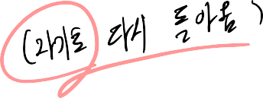


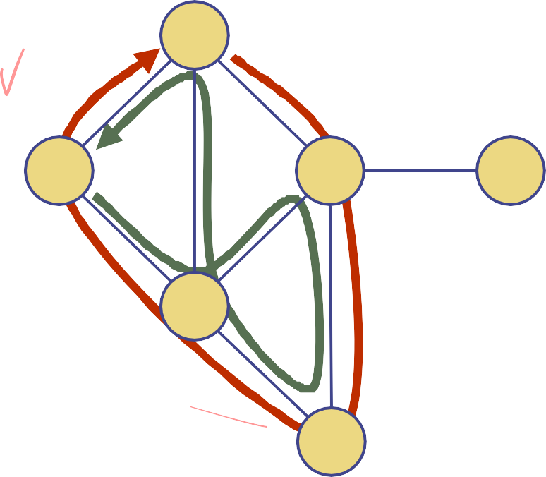



Terminology (cont.)
Cycle
circular sequence of alternating vertices and edges
each edge is preceded and followed by its endpoints
Simple cycle
V
U
X
Z
cycle such that all its vertices and edges are distinct
Examples
C₁=(V,X,Y,W,U,V) is a simple
cycle
C₂=(U,W,X,Y,W,V,U) is a cycle that is not simple
C₂
W
C₁
Y

Slide 7




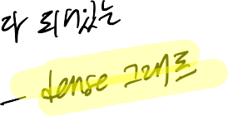

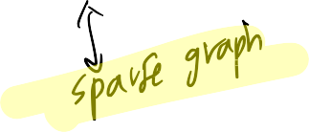
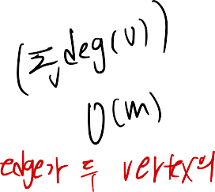
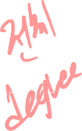





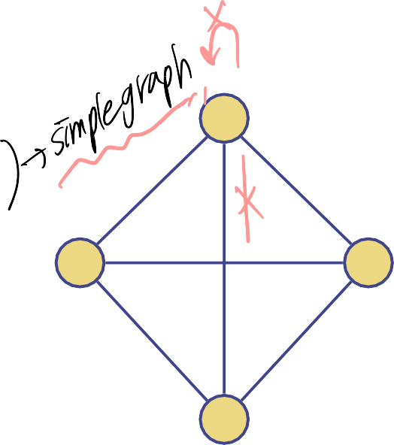
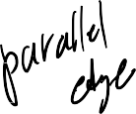

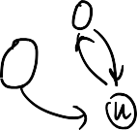
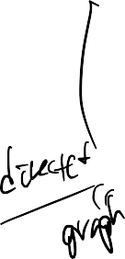
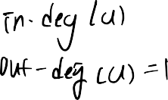
Properties
Property 1
Σ_{v} deg(v) = 2m
Proof: each edge is counted twice
Property 2
In an undirected graph with no self-loops and no multiple edges
m ≤ n (n − 1)/2
Proof: each vertex has
degree at most (n − 1)
What is the bound for a directed graph?
Notation
number of vertices
m number of edges
n
deg(v)
degree of vertex v
Example
n = 4
m = 6
deg(v) = 3

Slide 8





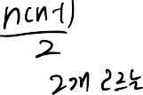


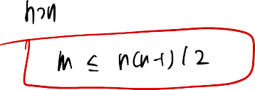
















Slide 9




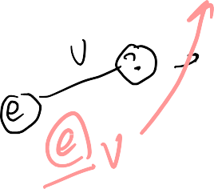


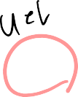

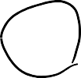
Main Methods of the Graph ADT
Vertices and edges
are positions
store elements
Accessor methods
e.endVertices(): a list of the
two endvertices of e
e.opposite(v): the vertex opposite of v on e
u.isAdjacentTo(v): true iff u and v are adjacent
*v: reference to element associated with vertex v
*e: reference to element associated with edge e
Update methods
insertVertex(o): insert a vertex storing element o
insertEdge(v, w, o): insert an edge (v,w) storing element o
eraseVertex(v): remove vertex v
(and its incident edges)
eraseEdge(e=(v, w)): remove edge e = (v, w)
Iterable collection methods
neighbors(v): list of vertices
adjacent to v
vertices(): list of all vertices in the graph
edges(): list of all edges in the graph
9

Slide 10
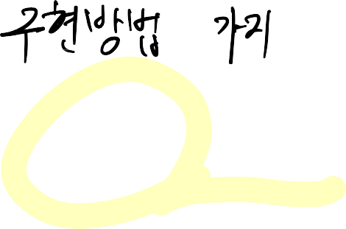





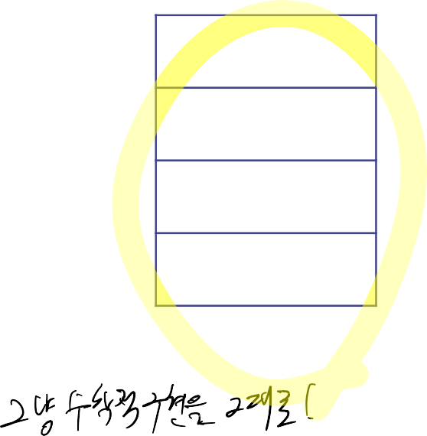

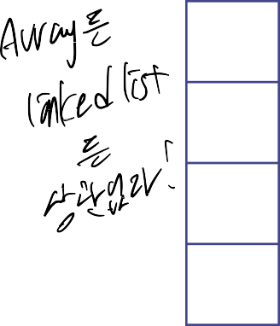


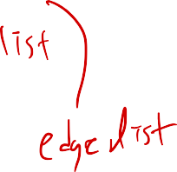

Edge List Structure
u
Vertex sequence
sequence of vertex objects
v
w
z
Edge sequence
sequence of edge objects
u
(u, v)
v
(u, w)
w
(v, w)
z
(w, z)
Vertex List
Edge List
10

Slide 11




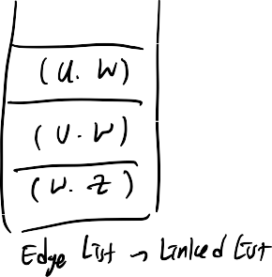










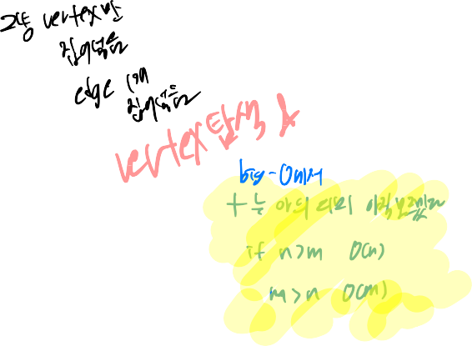








Slide 12
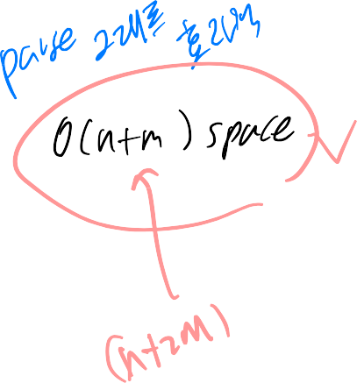
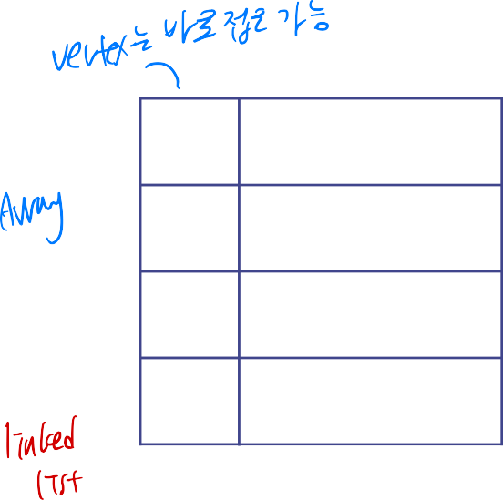


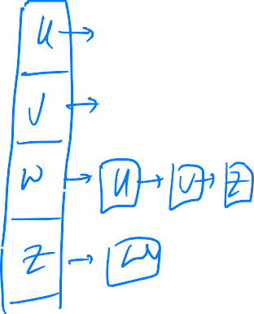




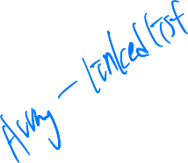



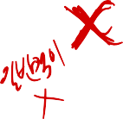


Adjacency List Structure
Adjacency sequence for
u
each vertex
sequence of vertices
adjacent to the vertex
v
w
z
i.e., the list of neighbors of
the vertex
Many variations of how the
u
v, w
association between vertices
and collections is
v
u, w
implemented
(1) hash table on vertices and an
w
u, v, z
array of neighbors for each vertex
z w
Adjacency List
(2) vertices represented by index
numbers and a linked list of
neighbors for each vertex
(3) Object oriented incidence list
structure, where edges are explicit
objects
11

Slide 13
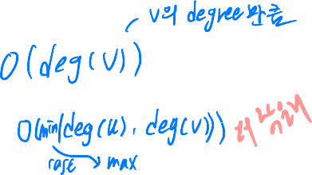

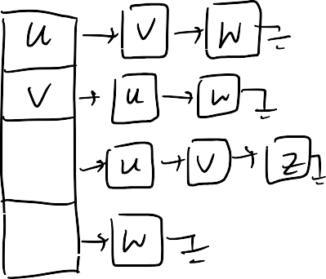






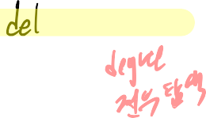
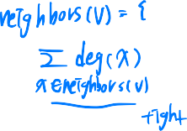
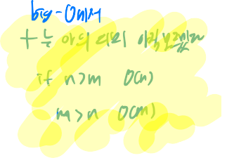






Slide 14
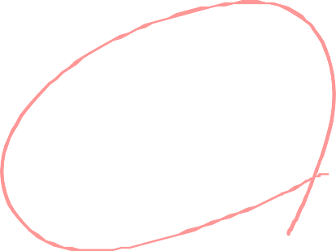


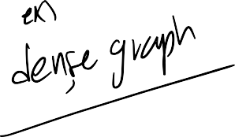
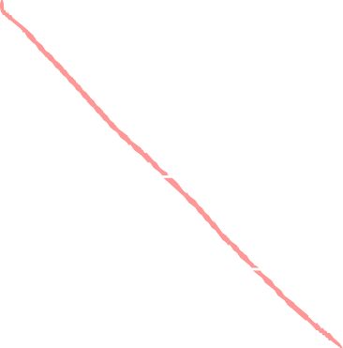

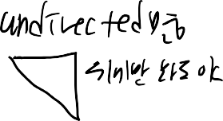

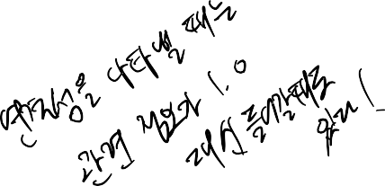
Adjacency Matrix Structure
n by n adjacency array
u
Each element A_{ij} indicates whether pairs of vertices
(i-th vertex and j-th vertex)
are adjacent
v
w
z
If the graph is undirected,
u v w z
the adjacency matrix is
symmetric
u
0 1 1 0
v
1 0 1 0
Diagonal elements are all
zero in a simple graph
w
1 1 0 1
Weighted version
z
0 0 1 0
Adjacency Matrix
Each element A_{ij} represents
the weight carried by an edge
from i-th vertex to j-th vertex
12

Slide 15
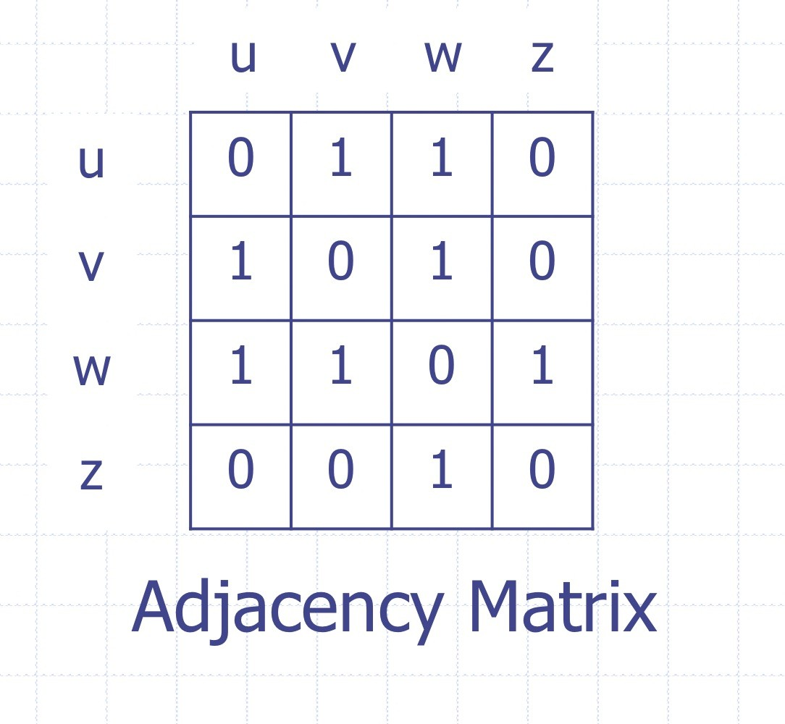
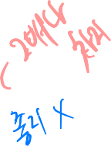
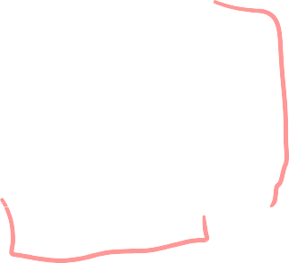
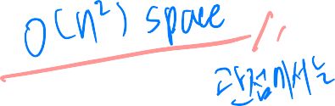

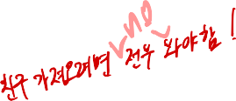


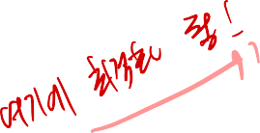

























Slide 16




Performance (different from the textbook)
n vertices, m edges no parallel edges no self-loops | Edge List | Adjacency List | Adjacency Matrix
 | (each list | is assumed to be a linked list)
Space | n + m | n + m | _{n}2
v.neighbors() | m | deg(v) ≤ n | n
u.isAdjacentTo (v) | m | min(deg(u), deg(v)) ≤ n | 1
insertVertex(o) | 1 | 1 | _{n}2
insertEdge(u, v, o) | 1 | 1 | 1
eraseVertex(v) | n + m | Σ deg(u) ≤ m u<neighbors(v) | _{n}2
eraseEdge((u, v)) | m | deg(u) + deg(v) ≤ n | 1
13

Slide 17





























Subgraphs
A subgraph S of a graph
G is a graph such that
The vertices of S are a subset of the vertices of G
The edges of S are a
subset of the edges of G
A spanning subgraph of G is a subgraph that contains all the vertices of G
Subgraph
Spanning subgraph
14

Slide 18


Connectivity
A graph is connected if there is a path between
every pair of
Connected graph
vertices
A connected component of a graph G is a maximal connected subgraph of G
Non connected graph with two
connected components
15

Slide 19







Trees and Forests
A (free) tree is an undirected graph T such that
T is connected
T has no cycles
This definition of tree is different from the one of a rooted tree
A forest is an undirected graph without cycles
The connected components of a forest are trees
Tree
Forest
16

Slide 20






Spanning Trees and Forests
A spanning tree of a connected graph is a spanning subgraph that is a tree
A spanning tree is not unique unless the graph is a tree
Spanning trees have applications to the design of communication networks
A spanning forest of a graph is a spanning subgraph that is a forest
Graph
Spanning tree
17

