Slide 1
Yacc

Slide 2
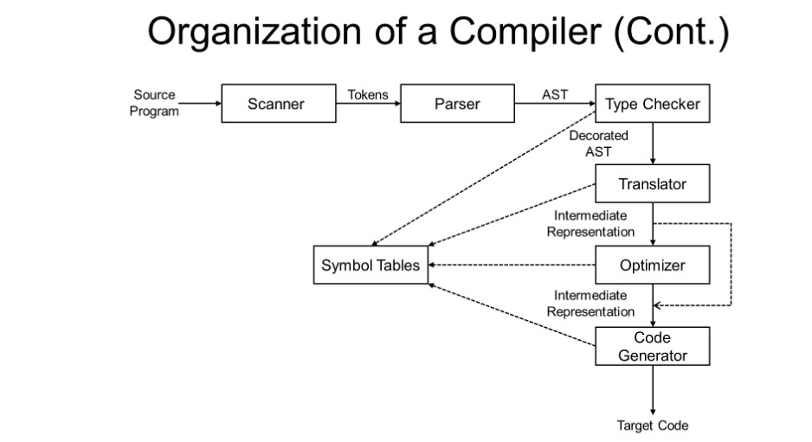
What is Yacc

Slide 3
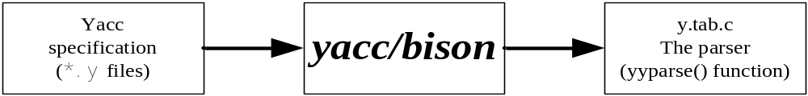
What is Yacc
Yacc: Yet Another Compiler-Compiler
A LALR(1) parser generator
  Read rules from a specification file (*.y file)
  Using *.y to Generate the lexical analyzer in C language
    *.tab.c and *.tab.h file
    Contain a yyparse() function – the parser
    bison is a later implementation of yacc.

Slide 4
Example code
加法分析器 example.l
%{
#include "y.tab.h"
%}
%%
\n { return(0); /* EOF */ }
[ \t]+ { /* do nothing */ }
[0-9]+ { yylval.ival = atoi(yytext);return(INUMBER); }
"+"|"("|")" { return(yytext[0]); }
. { return(yytext[0]); }
%%
注意檔名

Slide 5
Lex part of Cooperation
*.l file need to include the *.h file , which is actually generated by yacc/bison
  #include "y.tab.h“
  #include "string.h"
Lex return token’s values to Yacc
  return(INUMBER);
  return(yytext[0]);
yylval
  This is a variable defined in *.y file
  When token is returned to yacc , yacc can use it to do something
  yylval.ival = atoi(yytext);
  sprintf(yylval.sval, "%s", yytext);
  strncpy(yylval.sval, &yytext[5], strlen(yytext)-3);

Slide 6
Example code
加法分析器 example.y
%{
#include <stdio.h>
#include <string.h>
void yyerror(const char *message);
%}
%union {
int ival;
}
%token <ival> INUMBER
%type <ival> expr
%left '+'
%%
line : expr { printf("%d\n", $1); }
;
expr : expr '+' expr { $$ = $1 + $3; }
| INUMBER
;
%%
void yyerror (const char *message)
{
fprintf (stderr, “%s\n”, message);
}
int main(int argc, char *argv[]) {
yyparse();
return(0);
}
Definition Section
Rules Section
Subroutine Section

Slide 7
The First Impression
The structure of a yacc program – three sections
  Definition section: any initial C/C++ codes or definitions
  Rules section: grammar + action, separated by whitespaces. A production rule consists of grammar and action.
  Subroutine section: any legal C or C++ codes
Sections are separated by “%%” lines
… Definition Section …
%%
… Rules Section …
%%
… Subroutine Section …

Slide 8
Example code
加法分析器 example.y
Definition Section
%{
#include <stdio.h>
#include <string.h>
void yyerror(const char *message);
%}
%union {
int ival;
}
%token<ival> INUMBER
%type<ival> expr
%left '+’
%%
…

Slide 9
The Definition Section
Contains initial C or C++ codes
C/C++ Codes must be enclosed with “%{“ and “%}” lines
We will discuss other useful definitions later
A skeleton for embedding initial codes
%{
initial C or C++ codes
%}
… Other Definitions …
%%
… Rules Section …
%%
… Subroutine Section …

Slide 10
Generic Token Declarations – %token
Basic
  %token token1 [token2 token3 …]
  Ex: %token INTEGER DOUBLE STRING IF ELSE
Token numbers are assigned by yacc automatically
  Higher than any other possible character code (256+)
  Not conflicting with any literal tokens
Alternatively, you can manually assign the numbers
  %token token1 [number1] [token2 [number2] …]
  Ex: %token UP 50 DOWN 60 LEFT 17 RIGHT 25
Note: do not use zero as the token number
  yylex() returns zero on end of file

Slide 11
Non-Integer Symbol Attributes
The %union directive
  %union{
  int ival;
  float fval;
  char sval[10];
  …
  }
yylval has all data type defined in %union, you can assign some data type to yylval
  ex: yylval.ival = atoi(yytext); /*at *.l file*/
Declare data type for terminals and non-terminals
  terminals: %token <ival> INUMBER …
  non-terminals: %type <ival> expr …

Slide 12
Example code
加法分析器 example.y
Rules Section
…
%%
line : expr { printf("%d\n", $1); }
;
expr : expr '+' expr { $$ = $1 + $3; }
| INUMBER
;
%%
…

Slide 13
The Rules Section
The context-free grammar used to generate the parser, the yyparse() function
A production can contain grammar and action
A production must be terminated with a semi-colon (;)
The action is executed on matching a production
‘|’ can merge productions having the same non-terminal at ‘:’ left
An example: expr : expr '+' expr |INUMBER
grammar
action
line : expr { printf("%d\n", $1); }
;
expr : expr '+' expr { $$ = $1 + $3; }
| INUMBER
;

Slide 14
Bottom up Parser
When tokens match all of grammar’s RHS(right hand side),the result of RHS will be reduce to grammar ‘s LHS(left hand side)
  ex: expr: INUMBER
  LHS RHS
Bottom up until reduce the start symbol
  example code start symbol is line

Slide 15
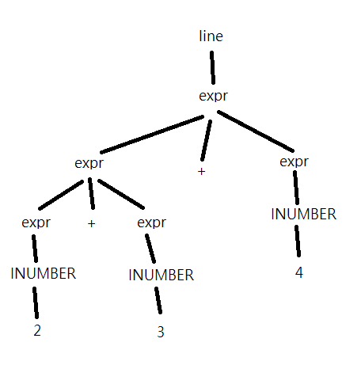
Example code
Process Analysis
Ex:2+3+4 (%left ‘+’)
line : expr { printf("%d\n", $1); }
2+3+4 2+3+4
expr : expr ‘+’ expr { $$ = $1 + $3; }
2+3+4 2+3 4
expr : INUMBER
4
expr : expr ‘+’ expr { $$ = $1 + $3; }
2+3 2 3
expr : INUMBER
2
expr : INUMBER
3

Slide 16
Embedded Rule Action
We would like to do something when only parts of a production is matched
  prod1 : A B { printf(“A B are seen”); } ; //發現a又發現b
  prod1 : A { printf(“A is between B”); } B ; //先a後b
    This action will execute after A is analyzed done
The above production is equivalent to
  prod1 : A B epsilon ;
  epsilon : /*empty*/ { printf(“A B are seen”); } ;
  prod1 : A epsilon B;
  epsilon : /*empty*/ { printf(“A is between B”); } ;

Slide 17
Symbol Attributes
The attribute (value) associated with a symbol – yylval
  In a Lex rule action, you can assign an attribute to a token
  By default, yylval is of type int
  By default, attributes associated with symbols are all type int
  Attributes of symbols can be accessed by $$, $1, $2, $3 …
[0-9]+ { yylval = atoi(yytext); return(NUMBER); }
term : term ‘*’ factor { $$ = $1 * $3; }
| factor { $$ = $1; /* the default action */}
;
factor : NUMBER
;

Slide 18
Synthesized VS Inherited Attribute
There are two types of symbol attribute for a non-terminal
  Synthesized – depends only on itself and its children
  Inherited – depends on its parent, itself, and it’s siblings
We have introduced the synthesized symbol attributes , which can be accessed by $$, $1, $2, …
  ex in ex1.y: expr : expr '+' expr { $$ = $1 + $3; }
How to use attributes from parents?
  Access parent attributes using $0, $-1, …
  However, as we cannot see parents in the production, we have to explicitly assign its data type using $<varname>0, $<varname>-1, …

Slide 19
Example code
加法分析器 example.y
Subroutine Section
…
%%
void yyerror (const char *message)
{
fprintf (stderr, “%s\n”, message);
}
int main(int argc, char *argv[]) {
yyparse();
return(0);
}

Slide 20
The Subroutine Section
yyerror
  deal with error . ex: sytax error
yyparse
  Use the productions of rule section to analyze the syntax
  Communication with yylex

Slide 21
Cooperation of Yacc and Lex
    Using .y file to generate *.tab.c and *.tab.h file
    Using .l file to generate *.yy.c file
    Link .c generated by yacc and lex
bison –d -o “file_name”.tab.c “file_name”.y
gcc -c -g -I.. “file_name”.tab.c
flex –o “file_name”.yy.c “file_name”.l
gcc -c -g -I.. “file_name”.yy.c
gcc -o “file_name” “file_name”.tab.o “file_name”.yy.o

Slide 22
Compile and Run the Example
How to compile?
#compile bison
bison -d -o y.tab.c ex1.y
gcc -c -g -I.. y.tab.c
#compile flex
flex -o lex.yy.c ex1.l
gcc -c -g -I.. lex.yy.c
#compile and link bison and flex
gcc -o ex1 y.tab.o lex.yy.o

Slide 23
Run
$ ./ex1
$ 1+2+3
Output：
$ 6

