Slide 1
Crabtree effect
Model sketch
A dynamic carbon-allocation model for aerobic overflow fermentation
(https://github.com/jinyun1tang/DEB-Agent)
Jinyun Tang (with help of codex)
Notes:
[Sources]
- Model source: references/crabtree-effect-model-sketch.html
- Executable source: references/crabtree-effect-mdeb-model.ipynb
[Presenter note]
Open by framing the deck as a testable model sketch, not a fitted yeast model.

Slide 2
Crabtree effect: ethanol can appear even when oxygen is available
Observed phenotype
High glucose pushes Crabtree-positive yeast toward aerobic fermentation, so ethanol accumulates even before oxygen is exhausted.
Core tradeoff
Respiration is high yield; fermentation is lower yield but can be the shorter, faster pathway under high glycolytic supply.
Batch sequence
Glucose drawdown, ethanol overflow, diauxic transition, ethanol use, stationary phase, then loss of viability.
Modeling task
Represent both the fast overflow decision and the slower regulatory return to respiratory metabolism.
2
Notes:
[Sources]
- Tang et al. 2021, 2021-8 copy.pdf, section 3.5, describes Warburg/Crabtree fermentation despite oxygen availability.
- Model source: crabtree-effect-model-sketch.html, regime descriptions and ethanol-as-second-substrate update.
[Presenter note]
Keep the biology simple: the deck asks what mechanism can make fermentation rational under oxygen availability.

Slide 3
Modeling hypothesis: overflow is a regulated pathway allocation problem
Reserve memory
mDEB reserve density x_C separates external glucose history from immediate catabolic supply.
Pathway economics
Ohm's-law returns compare fermentation and respiration as yield divided by effective resistance.
Softmax splitter
Pathway scores U_F and U_R become allocation weights theta_F and theta_R, with finite regulatory lag.
Second substrate
Ethanol is both product and substrate: glucose represses ethanol uptake until the diauxic phase.
3
Notes:
[Sources]
- Tang and Riley 2025, bg-22-1809-2025.pdf, develops mDEB reserve and structural biomass equations.
- Tang et al. 2021, 2021-8 copy.pdf, motivates Ohm's-law pathway comparisons.
- Model source: crabtree-effect-model-sketch.html, dynamic splitter and ethanol substrate equations.
[Presenter note]
This is the central claim: do not present the splitter as a fitted black box; present it as an allocation hypothesis.

Slide 4
Evaluate the model against batch-culture signatures
Evaluation metrics
The model should be judged by qualitative sequence and quantitative event timing: glucose exhaustion, ethanol peak, oxygen drawdown and recovery, biomass plateau or viability loss, and allocation hysteresis.
Observation target | Metric | Expected batch signature | Interpretation
Glucose | depletion time; uptake rate | Monotone decline during first phase | Constrains uptake and reserve formation
Ethanol | peak; production / use slopes | Accumulation during glucose, decline after diauxic shift | Tests overflow and ethanol-as-substrate dynamics
Dissolved O2 | minimum; recovery time | Demand can depress O2 but should not require an impossible negative pool | Tests respiratory oxygen limitation
Biomass | living V and total V(1+x_C) | Total biomass plateaus; viable structure may decline later | Separates stationary OD from mortality
Allocation | theta_F timing and hysteresis | High-G fermentation; relaxation after G depletion | Tests dynamic splitter timescale
4
Notes:
[Sources]
- Notebook source: crabtree-effect-mdeb-model.ipynb, default metrics and structural-versus-total biomass distinction.
- Model source: crabtree-effect-model-sketch.html, ethanol-as-second-substrate equations.
[Presenter note]
Use this slide as the scorecard before showing equations or plots.

Slide 5
State variables separate reserve, allocation, and biomass
State variables
G: glucose substrate
EtOH: ethanol product and substrate
O2: dissolved oxygen
x_C: internal carbon reserve
V: living structural biomass
theta_F: fermentation allocation
Glucose G
primary substrate
C reserve
x_C and j_E,C
Fermentation
ethanol + ATP
Respiration
ATP + O2 demand
Ethanol
product, then substrate
Living V
growth minus mortality
Glucose drives overflow fermentation; ethanol can later feed respiration when glucose repression weakens.
5
Notes:
[Sources]
- Model source: crabtree-effect-model-sketch.html, state and flux diagram updated with glucose and ethanol substrates.
- Notebook source: crabtree-effect-mdeb-model.ipynb, living structural biomass V and total biomass proxy V(1+x_C).
[Presenter note]
Emphasize that total biomass and living structural biomass are intentionally separate readouts.

Slide 6
Glucose feeds reserve; ethanol feeds oxygen-dependent respiration
Glucose reserve input
j_A,G = j_G,max G/(K_G + G)
dx_C/dt = j_A,G - j_E,C - mu x_C
j_E,C = v_E,C x_C/(K_E,C + x_C)
Ethanol substrate gate
I_G(G) = 1/(1 + (G/K_G,E)^n)
j_A,EtOH = j_EtOH,max EtOH/(K_EtOH+EtOH) * O2/(K_O,EtOH+O2) * I_G
Ethanol uptake is weak while glucose is high.
6
Notes:
[Sources]
- Model source: crabtree-effect-model-sketch.html, external glucose, ethanol, and oxygen equations.
- Tang and Riley 2025, bg-22-1809-2025.pdf, reserve dynamics basis.
[Presenter note]
This slide introduces the diauxic mechanism in the updated HTML: glucose repression is not symmetric competition.

Slide 7
Softmax weights make the pathway switch continuous
Pathway scores
Transition captured by softmax
Pi_F = Y_ATP,F/(1/f_G + r_F)
Pi_R = Y_ATP,R/(1/f_G + r_TCA + r_ETC + 1/f_O2)
U_F = beta Pi_F + beta_a ln(a_G/a_C)
U_R = beta Pi_R
When U_F - U_R crosses zero, allocation shifts smoothly from respiration to fermentation.
Softmax allocation
theta_i* = exp(U_i) / [exp(U_F)+exp(U_R)]
theta_F* = 1 / [1 + exp(-(U_F - U_R))]
dtheta_F/dt = (theta_F* - theta_F)/tau_reg
At equal scores: theta_F* = theta_R* = 0.5
7
Notes:
[Sources]
- Model source: crabtree-effect-model-sketch.html, softmax splitter, explicit sigmoid form, and attention analogy.
- Tang et al. 2021, 2021-8 copy.pdf, Ohm's-law pathway return framing.
[Presenter note]
The attention analogy is mathematical, not biological: scores become normalized allocation weights; the graph shows the smooth transition.

Slide 8
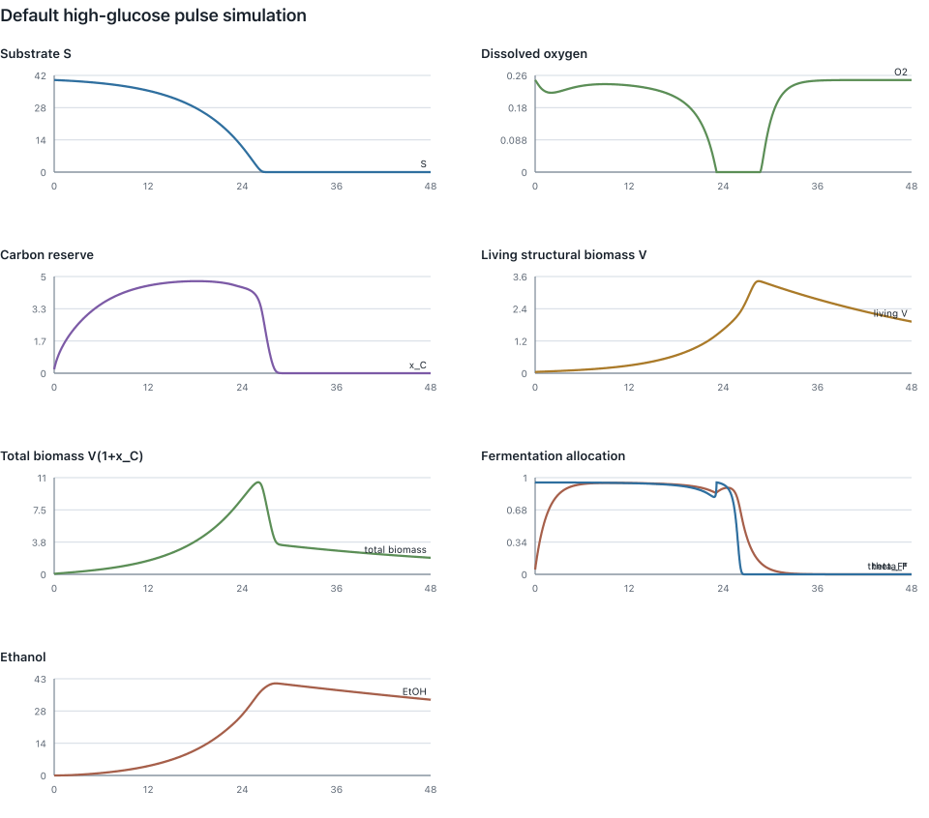
Notebook run captures overflow, not diauxic ethanol use
Overflow appears
theta_F peaks near 0.97 and ethanol peaks near 40.5 in the illustrative high-glucose pulse.
Biomass distinction matters
Total biomass V(1+x_C) peaks at 10.75 while living structural V peaks at 3.45.
Known gap
The notebook trajectory still lacks oxygen-limited ethanol uptake after glucose depletion.
8
Notes:
[Sources]
- Notebook source: crabtree-effect-mdeb-model.ipynb, default run outputs and embedded state plot.
- Model source: crabtree-effect-model-sketch.html, updated ethanol-as-second-substrate equations identify the next implementation step.
[Presenter note]
Be explicit that this plot is a structure test, not a finished batch fit.

Slide 9
A realistic batch fit should reproduce the full diauxic sequence
Glucose phase
Diauxic switch
Stationary / death
Overflow
High G drives theta_F upward; ethanol accumulates while glucose is consumed.
Ethanol use
Glucose repression relaxes; ethanol uptake and respiration require O2.
Biomass readout
Total biomass can plateau while living V declines under maintenance deficit.
9
Notes:
[Sources]
- Model source: crabtree-effect-model-sketch.html, glucose depletion and ethanol substrate regime.
- Notebook source: crabtree-effect-mdeb-model.ipynb, mortality and living-versus-total biomass treatment.
[Presenter note]
This slide turns model gaps into testable next requirements.

Slide 10
Next
Use the sketch as a falsifiable batch model
Implement ethanol uptake
Cap respiratory O2 demand
Fit the batch metrics
Notes:
[Sources]
- Source ledger: outputs/crabtree-model-deck-build/source-notes.txt
- Model source: references/crabtree-effect-model-sketch.html and references/crabtree-effect-mdeb-model.ipynb.
[Presenter note]
Close by making the next work concrete: implement, constrain, then calibrate.

