Slide 1
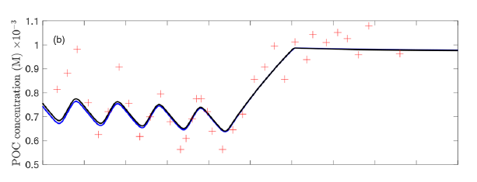

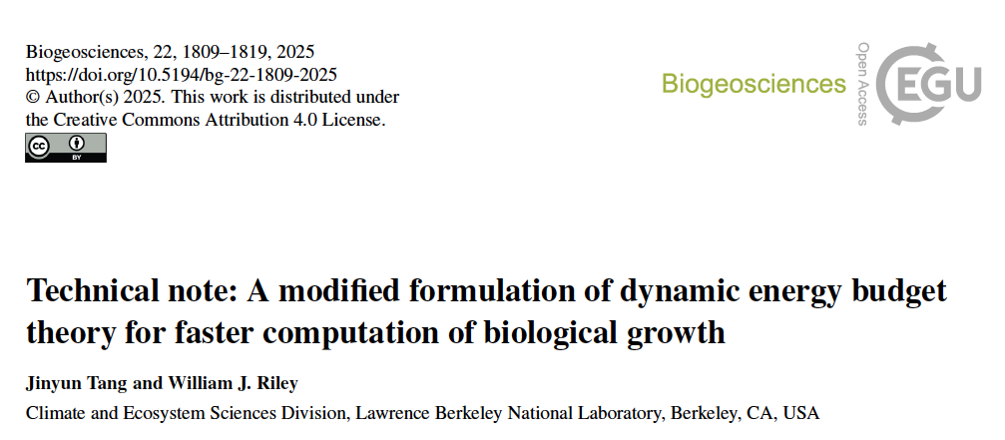
mDEB MICROBIAL MODEL
From bulk rates to stateful cells
01
Physiology engine
Reserve mobilization is explicit, so each cell can grow from its own C/N history.
Individual mDEB makes microbes chemically stateful.
02
Agent events
Division, death, dormancy, lysis, plasticity, and mutation become population dynamics.
03
Microfluidics fit
Lineage-resolved observations give the hidden-state model a real calibration target.
A source-backed concept deck from the two markdown notes in references.
Deck claim: the first build should prove aggregate mDEB equivalence, then use microfluidics to test reserve-memory behavior.
Time reduction > 70%
Sources: agent-based microbial mDEB and microfluidics fitting brainstorm markdown files
01

Slide 2
M O D E L S H I F T
The model replaces memoryless growth particles with stateful cells.
BULK OR MONOD-STYLE
INDIVIDUAL mDEB AGENTS
Response is mostly tied to current external substrate.
Each cell carries reserves, structure, traits, and history.
Useful for aggregate growth curves, but weak on lineage memory, delayed recovery, reserve imbalance, and single-cell divergence.
reserve memory
The same substrate pulse can produce different growth, division, dormancy, or recovery outcomes across cells.
heterogeneous histories
State
substrate pool
V_{, xC, xN}, traits, stress
Event logic
aggregate growth
division, death, dormancy, lysis
Validation
bulk trajectory
single-cell and held-out perturbations
Source basis: 'Why mDEB Fits an ABM' and 'Why Individual Data Matter'
02

Slide 3


P H Y S I O L O G Y L O O P
A direct physiology loop makes many-agent simulation feasible.
The loop gives every agent internal memory without solving an implicit growth equation at every timestep.
Local substrates
Uptake
Reserves
Growth
S_C and S_N sensed at the agent position
jA_i = uptake_i(S_i_local)
xC, xN update with mobilization and dilution
synthesizing unit chooses constrained mu_g
mDEB shortcut that matters in an ABM
Reserve mobilization jE_i = vE_i * x_i does not depend on mu, so growth can be computed directly for many agents.
mu = mu_g - maintenance deficit loss
dx_i/dt = jA_i - jE_i - mu*x_i + remobilized rejected reserve
dV/dt = mu * V
Source basis: physiology loop equations and mDEB advantage from agent brainstorm
03

Slide 4
A G E N T E V E N T S
Agent events turn physiology into population dynamics.
Division
Dormancy
Mutation
V >= V_div
persistent maintenance deficit
trait perturbation at division
structure and reserves split into daughters
Death or lysis
reduced uptake, turnover, and maintenance
Plasticity
adaptation creates strain-level spread
starvation, age, stress, V < V_min
adjust vE, uptake, enzyme allocation
dead biomass enters DOM/POM pools
reserve-use strategy changes before inheritance
Population outputs are not bolted on: total biomass, POC, PON, substrates, reserve distributions, and trait distributions emerge from repeated individual events.
Source basis: agent event list and minimal prototype outputs from agent brainstorm
04

Slide 5
S C A L E P A T H
The environment can scale from chemostat to reactive transport.
01
Well-mixed chemostat
02
Grid ABM
03
Particle or soil aggregate
04
Reactive transport
C and N pools; many agents competing for shared substrates.
Agents occupy cells in a 2D or 3D lattice; substrates diffuse locally.
Agents live on organic matter particles and experience microsites.
Substrate fields follow diffusion, advection, and reaction equations.
G A T E
G A T E
G A T E
G A T E
Prove aggregate equivalence against official chemostat mDEB.
Create reserve-diverse populations after local pulses.
Represent heterogeneous access to organic matter and nutrients.
Let agents act as biological source-sink terms.
A disciplined build path keeps the first prototype falsifiable before adding spatial complexity.
Source basis: environment options, minimal prototype, and next-step sections
05

Slide 6
O B S E R V A T I O N L A Y E R
Microfluidics provides the observables that bulk curves hide.
MEASUREMENT
MODEL INTERPRETATION
FIT SIGNAL
Hidden agent state
Cell length / area
structural biomass V
growth trajectory
V or cell length/area
Fluorescence reporter
reserve density or stress state
C/N stress, enzymes, ribosomes
xC and xN reserve densities
age or generation
Division event
V crosses threshold
interdivision distribution
strain or phenotype
Death or dormancy
reserve deficit
survival and recovery probability
local substrate exposure
Channel position
local nutrient history
spatial gradient response
The observation layer is the contract: hidden reserves must explain what the microscope can actually measure.
Source basis: measurements to fit and observation model from microfluidics brainstorm
06

Slide 7
F I T T I N G W O R K F L O W
Fitting should match trajectories and event statistics together.
01
Segment
03
Simulate
05
Validate
cells and lineages
same nutrient schedule and flow
held-out perturbations
02
Extract
04
Fit
length, area, fluorescence, division, death
continuous traces plus discrete events
This is where microfluidics earns its keep: the fit sees distributions, lineage memory, and recovery dynamics, not just mean growth.
Joint objective
cell-size trajectory
+
division-time distribution
+
fluorescence trajectory
+
lineage correlation
+
population-size trajectory
Source basis: fitting strategy, useful parameters, and joint loss target
07

Slide 8
E X P E R I M E N T D E S I G N
Perturbation experiments separate reserve memory from inherited traits.
Experiment
reserve memory
trait inheritance
local heterogeneity
stress recovery
C pulse then N limitation
strong
weak
weak
weak
N pulse after C starvation
strong
weak
weak
useful
Alternating feast-famine
strong
useful
weak
useful
Constant chamber gradient
useful
weak
strong
weak
Stress exposure then recovery
useful
useful
weak
strong
Mother-machine tracking
useful
strong
weak
useful
train on one schedule
predict another
inspect distributions
reject curve fitting
Source basis: useful experiments and memory-effect rationale from microfluidics brainstorm
08

Slide 9
V A L I D A T I O N T A R G E T
The validation target is prediction under a new nutrient schedule.
Training schedule
Held-out schedule
Pass / fail gate
single-cell trajectories
division-time distribution
fluorescence dynamics
lineage correlations
fit parameters from observed size, division, fluorescence, lineage, and population traces
predict growth, division timing, recovery distributions, and reserve-sensitive lag
population size
A model that only fits the training curve has not captured physiology. The held-out perturbation is the real test.
Source basis: model-data fit target and held-out nutrient perturbation validation
09

Slide 10
B U I L D P L A N
The first build should prove aggregate equivalence before spatial ambition.
01
Prototype
02
Calibrate
03
Stress test
04
Spatialize
B U I L D
B U I L D
B U I L D
B U I L D
well-mixed C/N pools; V, xC, xN, alive
single-cell observation layer and lineage objective
held-out pulse schedules and recovery experiments
grid, aggregate, or transport-coupled environment
G A T E
G A T E
G A T E
G A T E
compare aggregate trajectory to official chemostat mDEB
estimate vE, uptake, K, jM, yV, kappa, thresholds
separate reserve memory from stochastic inheritance
generate reserve-diverse populations in local pulses
Main delivery risk
Adding spatial machinery before the physiology loop has been validated.
Recommended next step
Build the chemostat ABM, then calibrate the observation layer on one microfluidics pulse schedule.
Source basis: minimal prototype, validation target, and next-step sections
10

