Slide 1
De novo assembly of durian
Paper 5
Jinyu Peng

Slide 2
What we want to know from durian?
Durian (Durio zibethinus) is a Southeast Asian tropical plant known for its sulfur and onion-like odor from its fruit. Although durian is an important tropical fruit crop, little genetic research has been done on the species.
The aim of my project is to do a draft whole-genome assembly of the Durian Musang King cultivar. We want to know what genes associate with ripening and oder of Musang King durian.

Slide 3
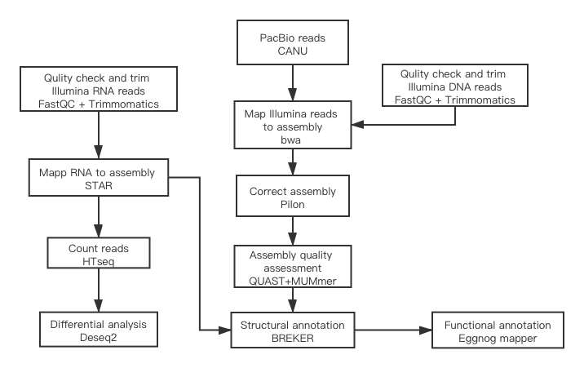
Workflow

Slide 4
Canu
Assemble PacBio and Oxford Nanopore sequences
Canu has three steps: error correction, trimming, and assembly
Load read into read database gkpStore
Count K-mer to calculate overlap between sequences
Calculate the overlap
Load overlap to overlap Database OVLStore
Complete specific analysis target according to READ and OVERLAPS
During reads error correcting, the consistent sequence is selected from overlap to replace the original noise read
During trimming, overlap is used to determine which areas of read are of high quality and which areas are of low quality and need to be trimmed.
In sequence assembly, layout is carried out according to consistent overlap, and contig is finally obtained.
Generate fasta file

Slide 5
Correct the assembly with Illumina reads
bwa
pilon
BWA is a software package that could map low-divergent sequences to a larger reference genome
BWA-backtrack, BWA-SW, BWA-MEM
Generate SAM file
Fasta and BAM as input, generate fasta file
Polish draft assembly
Single base differences
Small indels
Larger indel or block substitution events
Gap filling
Identification of local misassemblies, including optional opening of new gaps
Generate fasta file

Slide 6
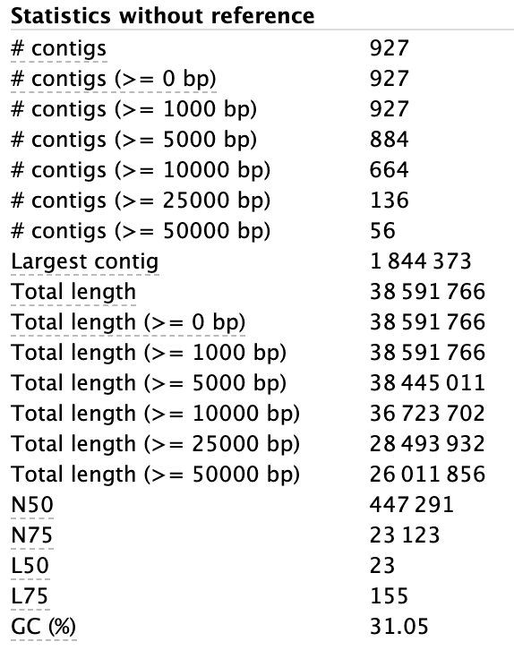
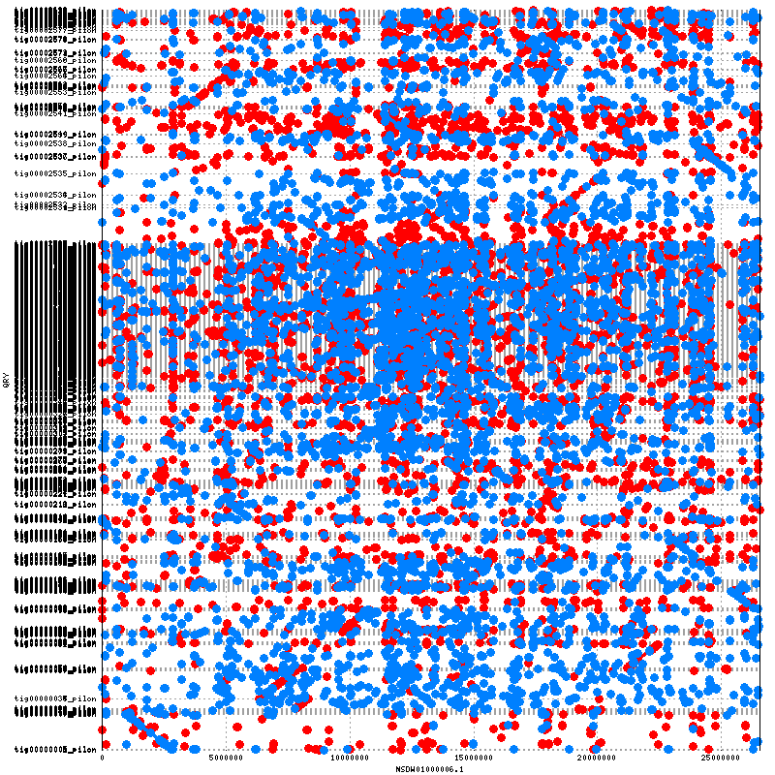
Assembly quality assessment
QUAst
mummerplot

Slide 7
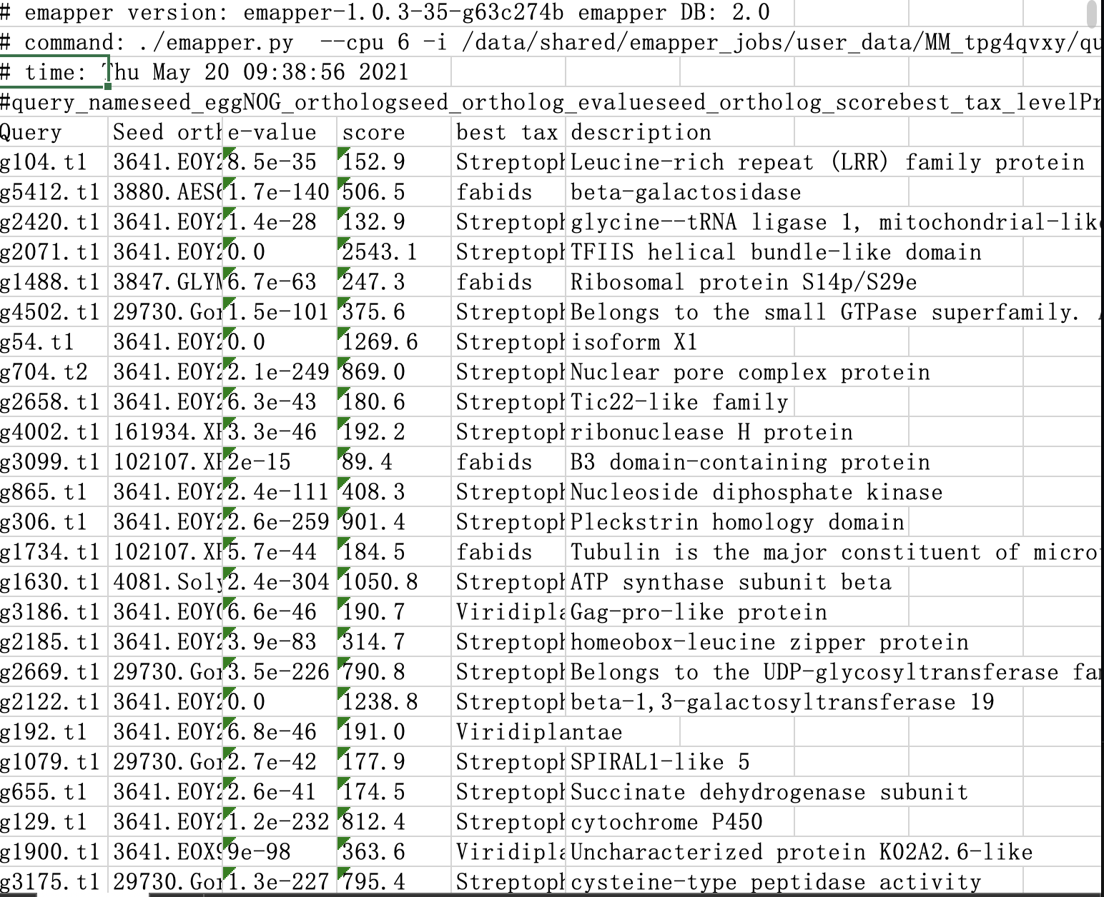
Structural and functional annotation.
BrAker
Eggnong mapper
A combination of GeneMark-ET and AUGUSTUS, that uses genomic and RNA-Seq data to automatically generate full gene structure annotations in novel genome.
Generate gff and gtf file which contain annotation of genes

Slide 8
Differential expression analyses
Map RNA to assembly
Count reads
Differential expression analyses

Slide 9
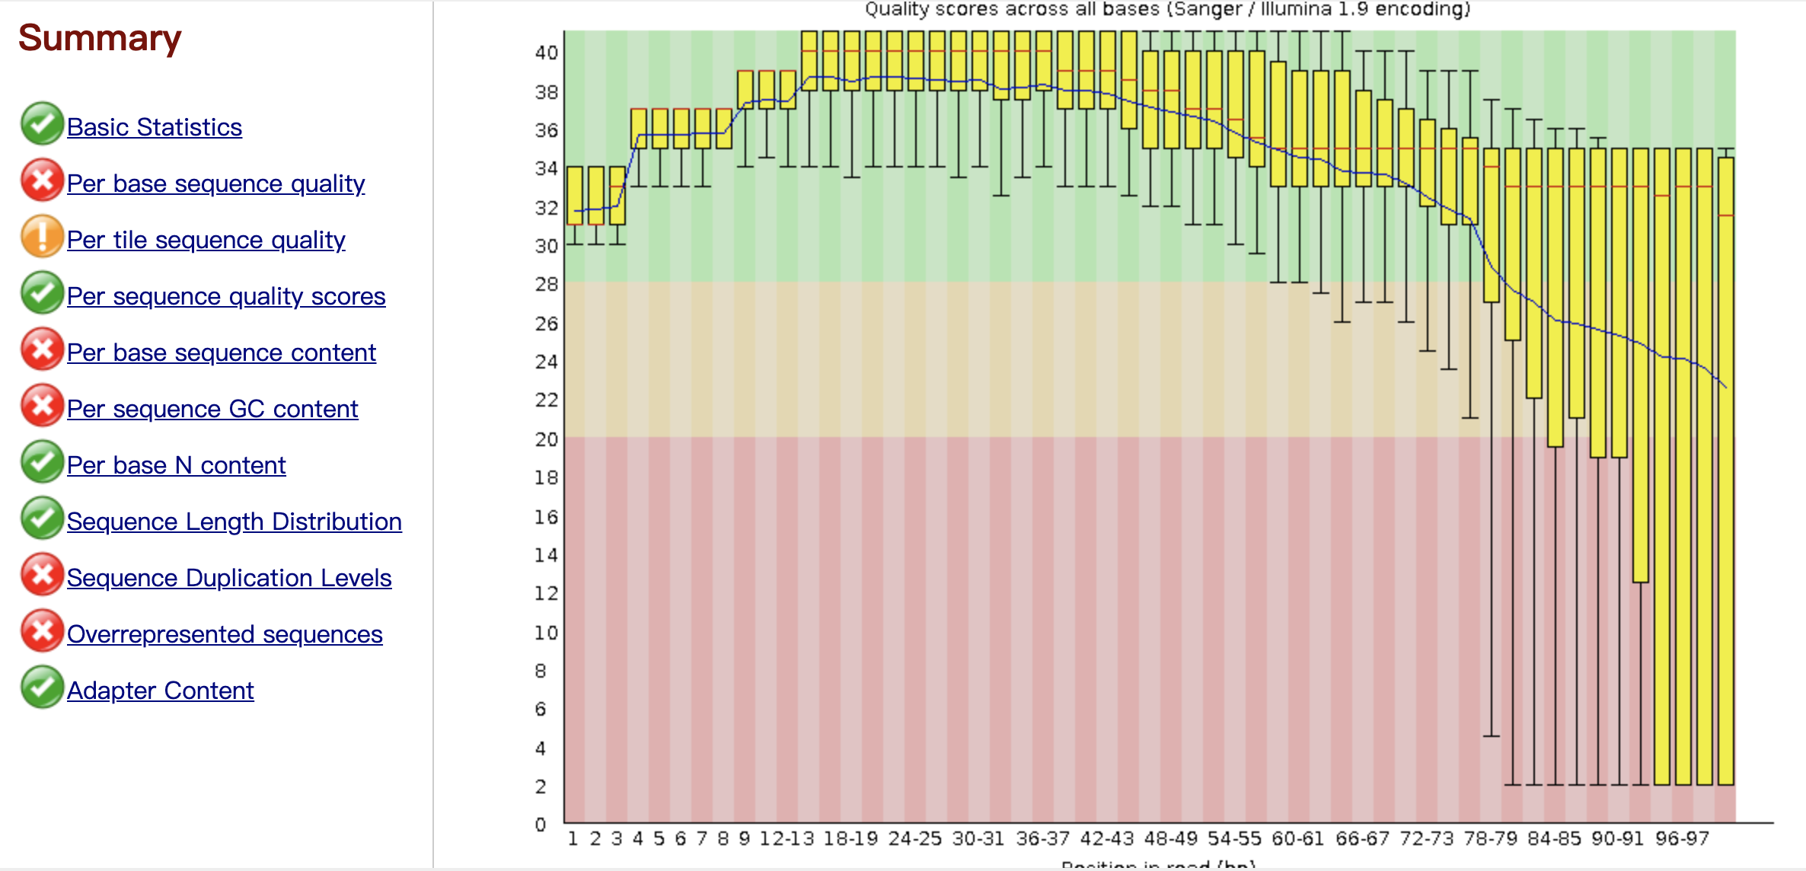
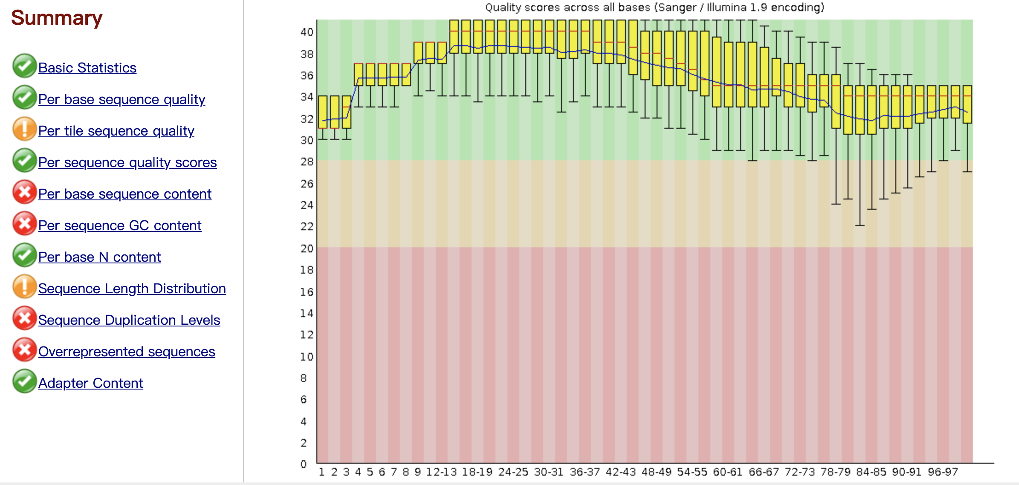
Reads preprocessing
Trimmomatic
ILLUMINACLIP:TruSeq3-PE.fa:2:30:10
Remove adapters
SLIDINGWINDOW:4:15
Scan the read with a 4-base wide sliding window, cutting when the average quality per base drops below 15
LEADING: 3
Remove leading low quality or N bases (below quality 3)
TRAILING:3
Remove trailing low quality or N bases (below quality 3)

Slide 10
Htseq
Python package that provides infrastructure to process data from high-throughput sequencing assays.
RNA BAM file and GTF file as input
Output files contain reads counts

Slide 11
DEseq2
Genes that express different most significantly.
g1217+ F-box kelch-repeat protein
g3158- Clp protease-related protein At4g12060
g1218+ F-box kelch-repeat protein
g1216+ N/A
g378+ translation initiation factor activity
Differential expression analysis among different cultivar in aril
(Monthong VS MusangKing)

Slide 12
DEseq2
Genes that express different most significantly.
g2364 Oleosin 18.5
g1342 thaumatin-like protein
g1217 F-box kelch-repeat protein
g4580 21 kDa protein-like
g1218 F-box kelch-repeat protein
Differential analysis in Musang King
between leaf and aril

Slide 13
DEseq2
Genes that express different most significantly.
g2364 Oleosin 18.5
g1342 thaumatin-like protein
g1217 F-box kelch-repeat protein
g5009 Late embryogenesis abundant protein
g4537 Domain of unknown function (DUF4228)
Differential analysis in Musang King
between root and aril

