Slide 1
The impact of the EUR/AUD currency exchange rate on the travel decisions of Germans visiting Australia
Jin Zhang
Master International Information Systems (IIS)
FAU

Slide 2

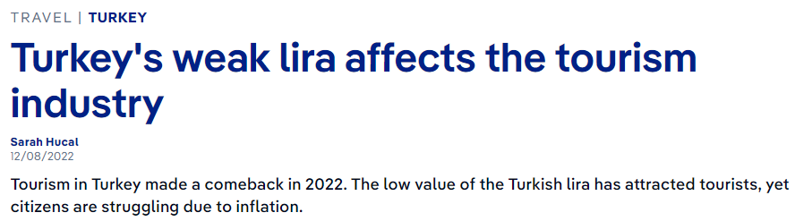


Does exchange rate impact tourism?
Exchange Rate
Tourism
Notes:
https://www.dw.com/en/turkeys-weak-lira-affects-the-tourism-industry/a-63943972

Slide 3
Does exchange rate impact tourism?
Exchange rate Euro (EUR) to Australian dollar (AUD)
Number of German tourists to Australia
Monthly statistics from Jan 2000 to Aug 2023

Slide 4

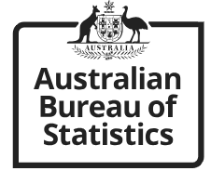
Data Sources
Datasets are obtained from open data sources.
Data source 1: Exchange Rate EUR/AUD
URL: https://data.ecb.europa.eu/data/datasets/EXR/EXR.M.AUD.EUR.SP00.A
Data source 2: Visitor arrivals and resident returns in Australia
URL: https://explore.data.abs.gov.au/vis?tm=visitor%20arrivals&pg=0&df%5Bds%5D=ABS_ABS_TOPICS&df%5Bid%5D=OAD_COUNTRY&df%5Bag%5D=ABS&df%5Bvs%5D=1.0.0&pd=2000-01%2C2023-08&dq=...M&ly%5Bcl%5D=TIME_PERIOD&ly%5Brw%5D=COUNTRY_RESID&ly%5Brs%5D=CAT_TRAVELLER

Slide 5
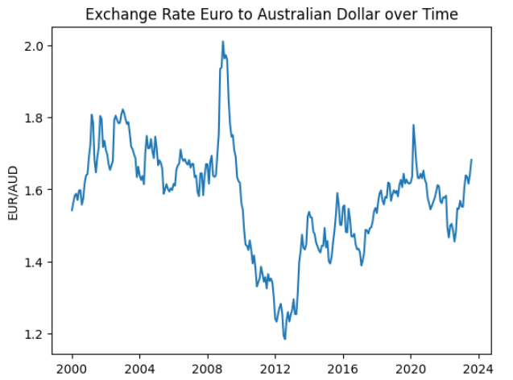
Exchange rate EUR/AUD
Monthly data from Jan 2000 to Aug 2023 from ECB

Slide 6
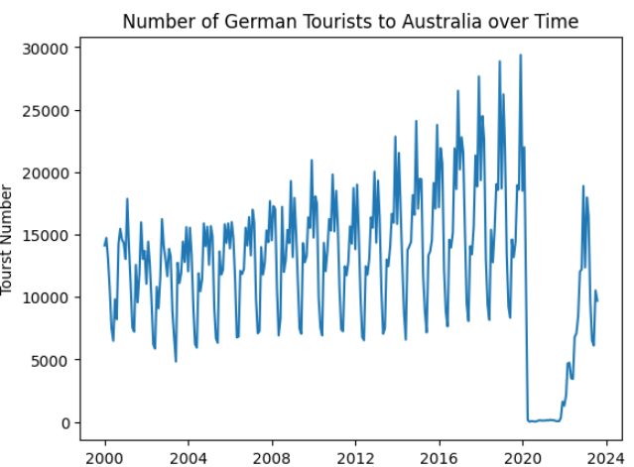
Tourist numbers

Slide 7
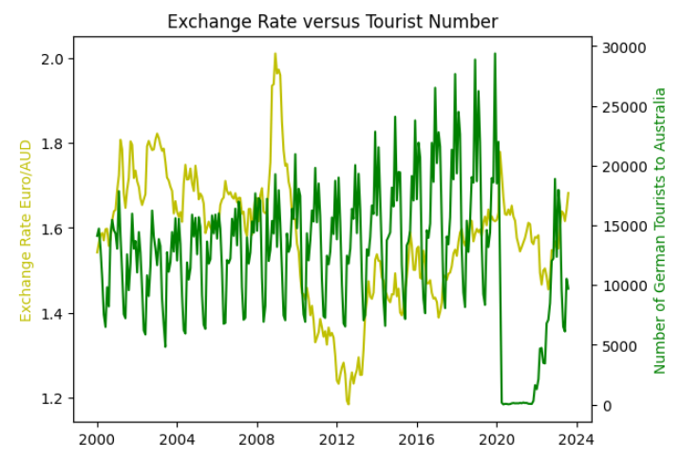
Comparison: exchange rate vs tourist number

Slide 8
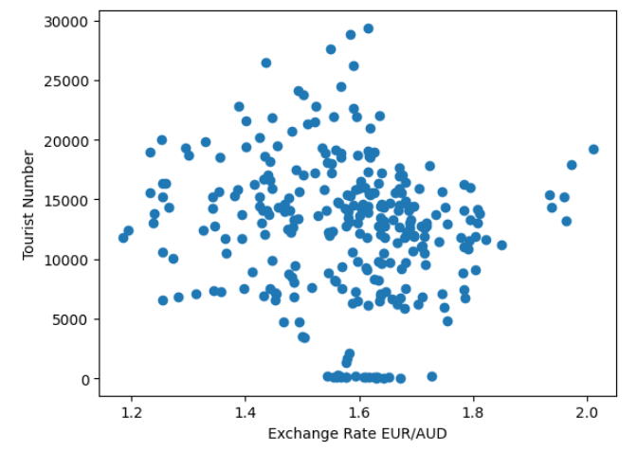
Correlation: exchange rate vs tourist number
Correlation Coefficient: -0.11

Slide 9
Observation and limitation
The EUR/AUD exchange rate:
no clear pattern over the specified over 20-year timeframe.
Numbers of German tourists to Australia:
a clear and steady growth pattern
seasonal peaks.
No clear correlation between the EUR/AUD exchange rate and the number of German tourists visiting Australia within the observed time frame.
Limitation: only the exchange rate was analyzed.

Slide 10
Thank you!

