Slide 1

Audio data
Speech recognition
deeplearning.ai

Slide 2
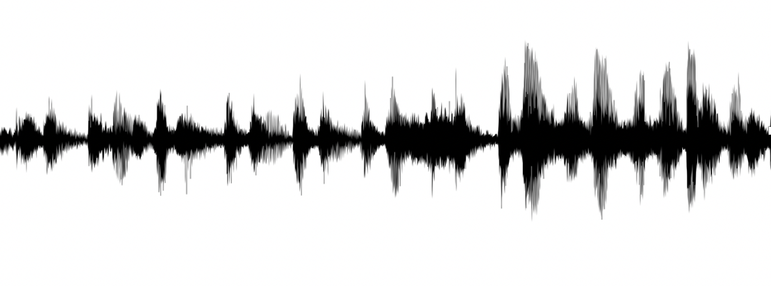

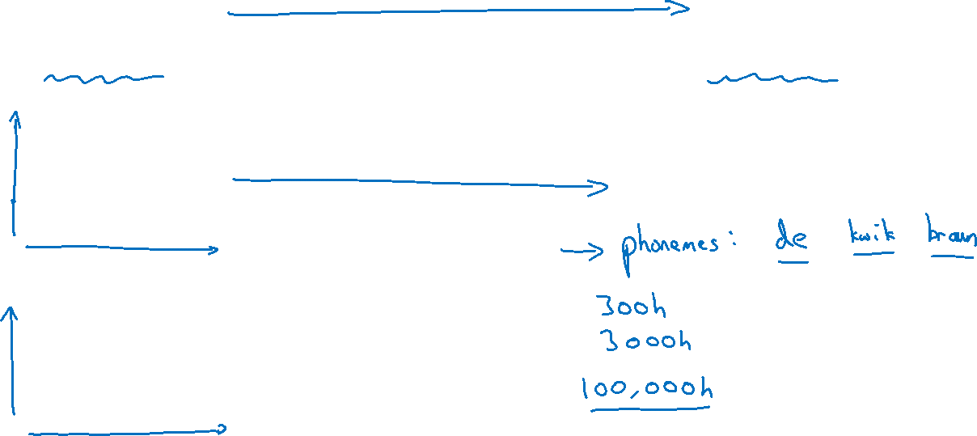

Speech recognition problem
$$x^{ }$$
$$y$$
audio clip
transcript
“the quick brown fox”

Slide 3











Attention model for speech recognition
“T”
“h”
$$s^{<2>}$$
$$⋯$$
$$s^{<1>}$$
$$+$$
$$a^{<0>}$$
$$⋯$$
$$x^{<1>}$$
$$⋯$$
$$x^{<999>}$$
$$x^{<2>}$$
$$x^{<1000>}$$

Slide 4

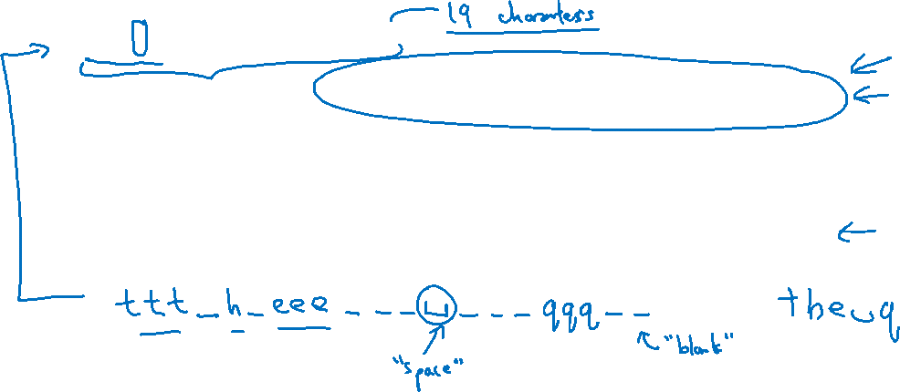
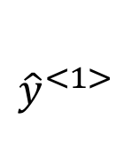




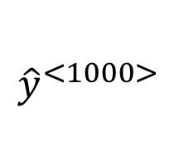
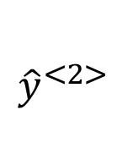
CTC cost for speech recognition
(Connectionist temporal classification)
“the quick brown fox”
$${\hat{y}}^{<1> }$$
$${\hat{y}}^{<2> }$$
$${\hat{y}}^{<1000> }$$
$$a^{<0>}$$
$$⋯$$
$$x^{<1>}$$
$$x^{<2>}$$
$$x^{<1000>}$$
Basic rule: collapse repeated characters not separated by “blank”
[Graves et al., 2006. Connectionist Temporal Classification: Labeling unsegmented sequence data with recurrent neural networks]

