Slide 1
10-708 Probabilistic Graphical Model Project Presentation
Learning
SNP-Gene Network
Using Mixed Graphical Model
Hyun Ah Song¹ and Ji Oh Yoo²
¹ Machine Learning Department
² Computer Science Department

Slide 2
Contents
Introduction
Problem formulation
Related works
Method
Proposed method
Experiment
Synthetic data
Human Liver Cohort (HLC) data
Conclusion
Reference

Slide 3
Introduction -
Problem formulation
SNP-gene network

Slide 4
Introduction -
Related works
Lasso, MTLasso, SCGGM
MG (Jason’s)?

Slide 5
Method
Proposed method – ‘MG’?

Slide 6
Experiment -
Synthetic data
How we generated synthetic data…

Slide 7
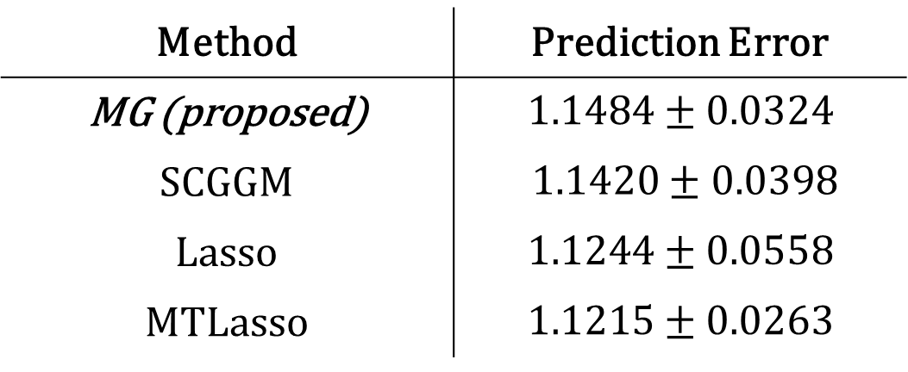
Experiment -
Synthetic data
Method | Prediction Error
MG (proposed) | $$1.1484±0.0324$$
SCGGM | $1.1420±0.0398$
Lasso | $$1.1244±0.0558$$
MTLasso | $$1.1215±0.0263$$

Slide 8
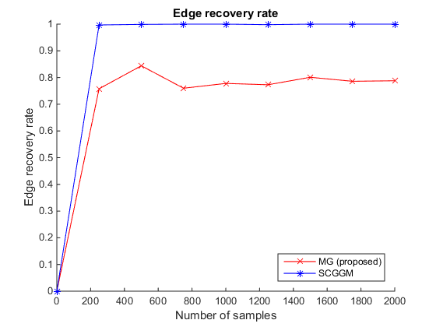
Experiment -
Synthetic data

Slide 9
Experiment -
Human Liver Cohort (HLC) data
Explain about HLC data

Slide 10
Experiment -
Human Liver Cohort (HLC) data
Method | Prediction Error
MG (proposed)
SCGGM
Lasso
MTLasso

Slide 11
Experiment -
Human Liver Cohort (HLC) data
Anal on the result – theta, beta, sparsity, etc…

Slide 12
Conclusion
Remind of our problem domain
Summarize our contribution again (if any…)
Summarize exp result
Summarize anal on exp res

Slide 13
Reference

Slide 14
THANKS!!

