Slide 1
A Brief Introduction to Prompting Methods
Yuntian (Jack) Shen
Research Intern at CMU HCII
Joined GEM 💎 Team in March 2024

Slide 2
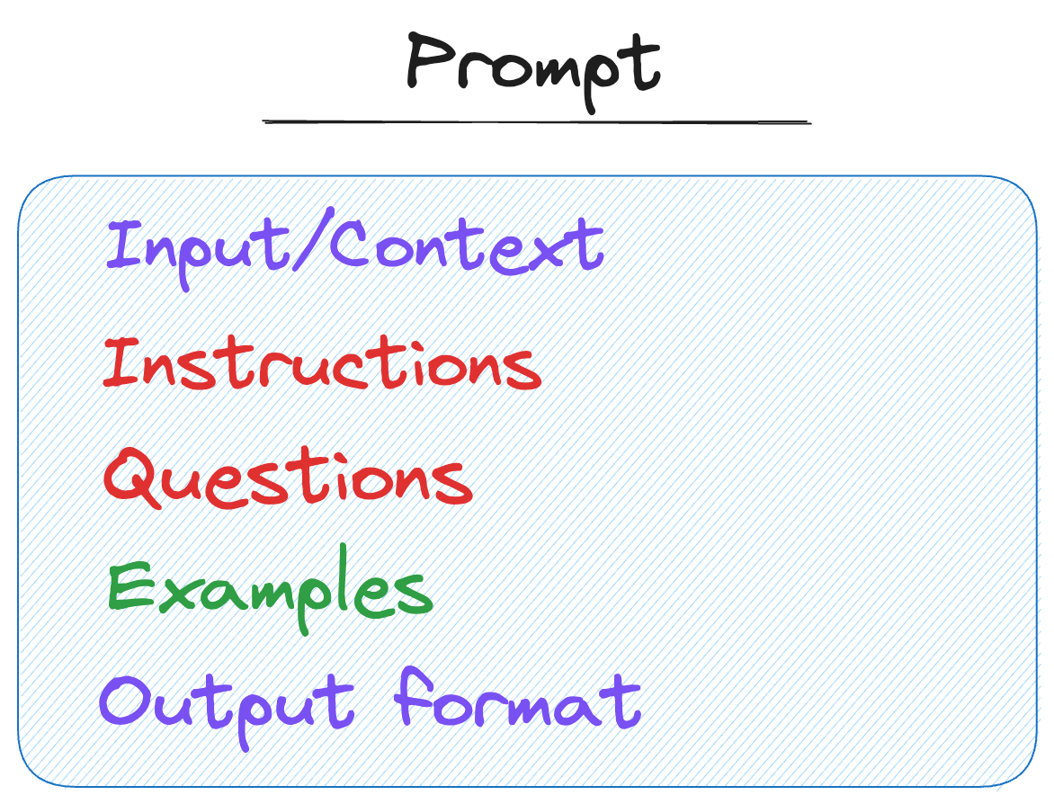
Elements of a Prompt
Instructions:
> Translate from English to German: How are you?
Questions:
> What is the meaning of life?
Input data / Context:
> Here is a transcript of a podcast about Generative AI: {transcript}. What do they say about LLMs?
Output format:
> Provide a short answer and explain your reasoning.
Figure from https://colab.research.google.com/drive/1lHd9b8C4ccAGpkK06dzcFB0asjXWGZi0?usp=sharing#scrollTo=Oz5naLl7JpLV

Slide 3
Use Cases of Prompts
Summarization:
> Summarize the following text:
> Text: …
Text classification:
> Classify the following text into one of the classes - sports, finance, education.
> Text: ...
Translation:
> Translate from English to French: What’s your name?
Text Generation / Text completion:
> AI is _________
Question / Answering:
> Based on the following podcast transcript, what is the host's opinion about AI?
> Transcript: ...
Image generation:
> Generate an image of a cute puppy.
Citation: https://colab.research.google.com/drive/1lHd9b8C4ccAGpkK06dzcFB0asjXWGZi0?usp=sharing#scrollTo=Oz5naLl7JpLV

Slide 4
Why Prompt Engineering?
Suppose you have a few examples and a large language model (LLM).
How do you adapt the LLM to fit to your task specifically?
 | Supervised Fine-Tuning | In-Context Learning
Definition | Further train a pre-trained model on a specific task using labeled data (by updating all model parameters using backpropagation). | Make the model perform a specialized task by feeding examples to the LLM as a prompt, without updating the model’s parameters.
Pros | Better performance and accuracy Still works when you have lots of examples | No training, no updates to model weights Useful when labeled data is scarce
Cons | Requires significant computational resources and time Requires substantial amount of labeled data for effective training Many good models are not publicly available! (GPT-4/4o, Sora, DALL·E 2/3, etc.) Even available, too large to download and use (Grok: 314B, Mistral: 7B, LLaMA-2: 7B, 13B, 70B) | Model performance can be constrained by input length Might not achieve same level of performance as fine-tuned models for complex or specialized tasks
Citation: https://www.cs.cmu.edu/~mgormley/courses/10423//slides/lecture10-icl-ink.pdf
Notes:
Backpropagation requires ~3x the memory and computation time as the forward computation (i.e., too time-consuming and expensive!)
7B requires 14GB of GPU RAM.
GPT-3 has 175 billion parameters.
GPT-4 is estimated to have 1.76 trillion parameters.
Grok: 314B
Mistral: 7B
LLaMA-2 is open-source but 7B, 13B, 70B
No backpropagation required and only one
pass through the training data
Does not require model weights, only API
access

Slide 5
In-Context Learning
Zero-Shot Learning:
No previous information or guidelines given in the prompt.
“Straight away write prompt with no reference.”
One-Shot Learning:
One piece of information or guideline given in the prompt.
“Using this Example 1 as reference, then [prompt].”
Few-Shot Learning:
Several pieces of information or guidelines given in the prompt.
“Using these Examples 1, 2, 3 as references, then [prompt].”
Citation: https://www.youtube.com/watch?v=J3bfv711aGk

Slide 6
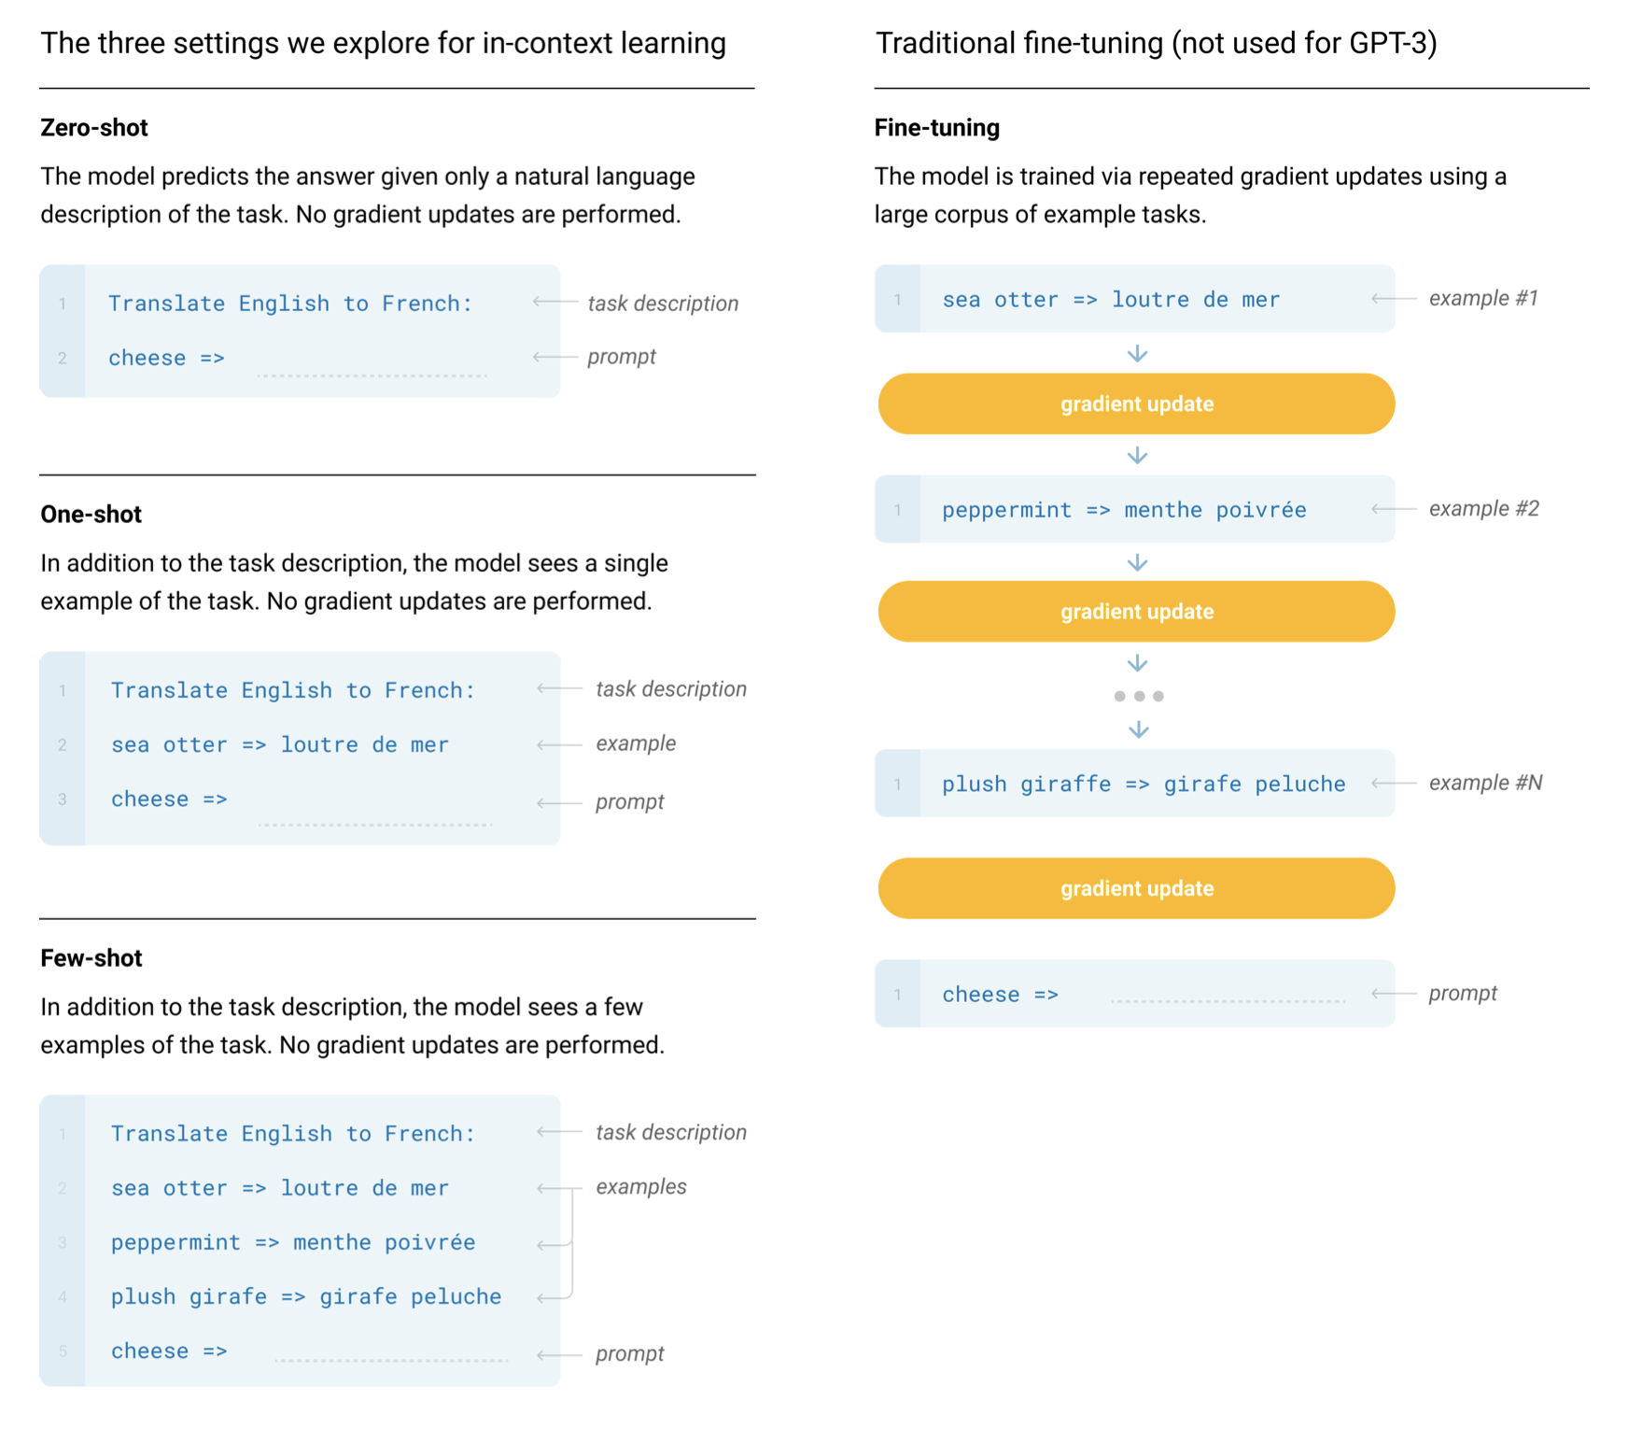
In-Context Learning (Example)
Figure from https://arxiv.org/pdf/2005.14165

Slide 7
More Prompting Methods
Retrieval-Augmented Generation (RAG) [22 May 2020, Facebook + UCL + NYU]
Chain-of-Thought Prompting (CoT) [28 Jan 2022, Google Brain]
ReAct (Reason + Act) [6 Oct 2022, Google Brain + Princeton]
Directional Stimulus Prompting (DSP) [22 Feb 2023, Microsoft + UCSB]

Slide 8
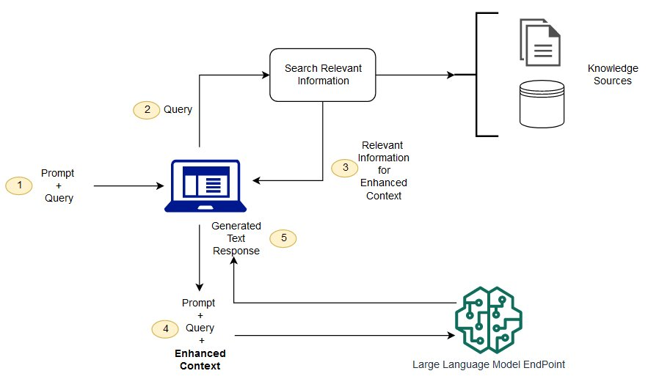
Retrieval-Augmented Generation (RAG)
“Retrieve relevant contextual information from a data source and pass that information to a large language model alongside the user’s prompt.”
Link to RAG 101 by Jiarui Rao
Example Prompt:
Use RAG to answer the following question. First, retrieve relevant information from the knowledge base, then generate a detailed response based on the retrieved information.
Question: What are the main differences between quantum computing and classical computing, and what are the potential advantages of quantum computing over classical computing?
[Retrieve relevant information]
[Generate response based on retrieved information]
Answer:
Figure from AWS

Slide 9
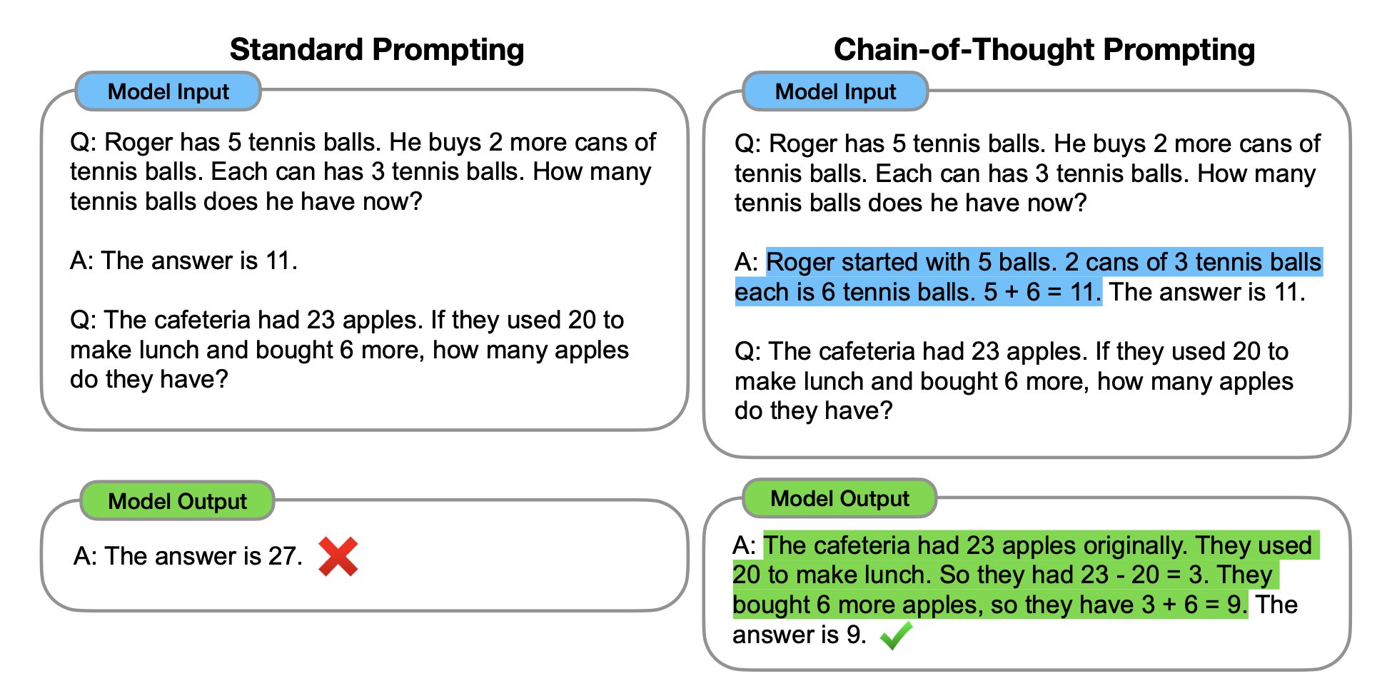
Chain-of-Thought Prompting (CoT)
A prompting strategy where the model is guided through a step-by-step reasoning process.
Structure the input prompt in a way that mimics human reasoning.
Figure from https://arxiv.org/pdf/2201.11903

Slide 10
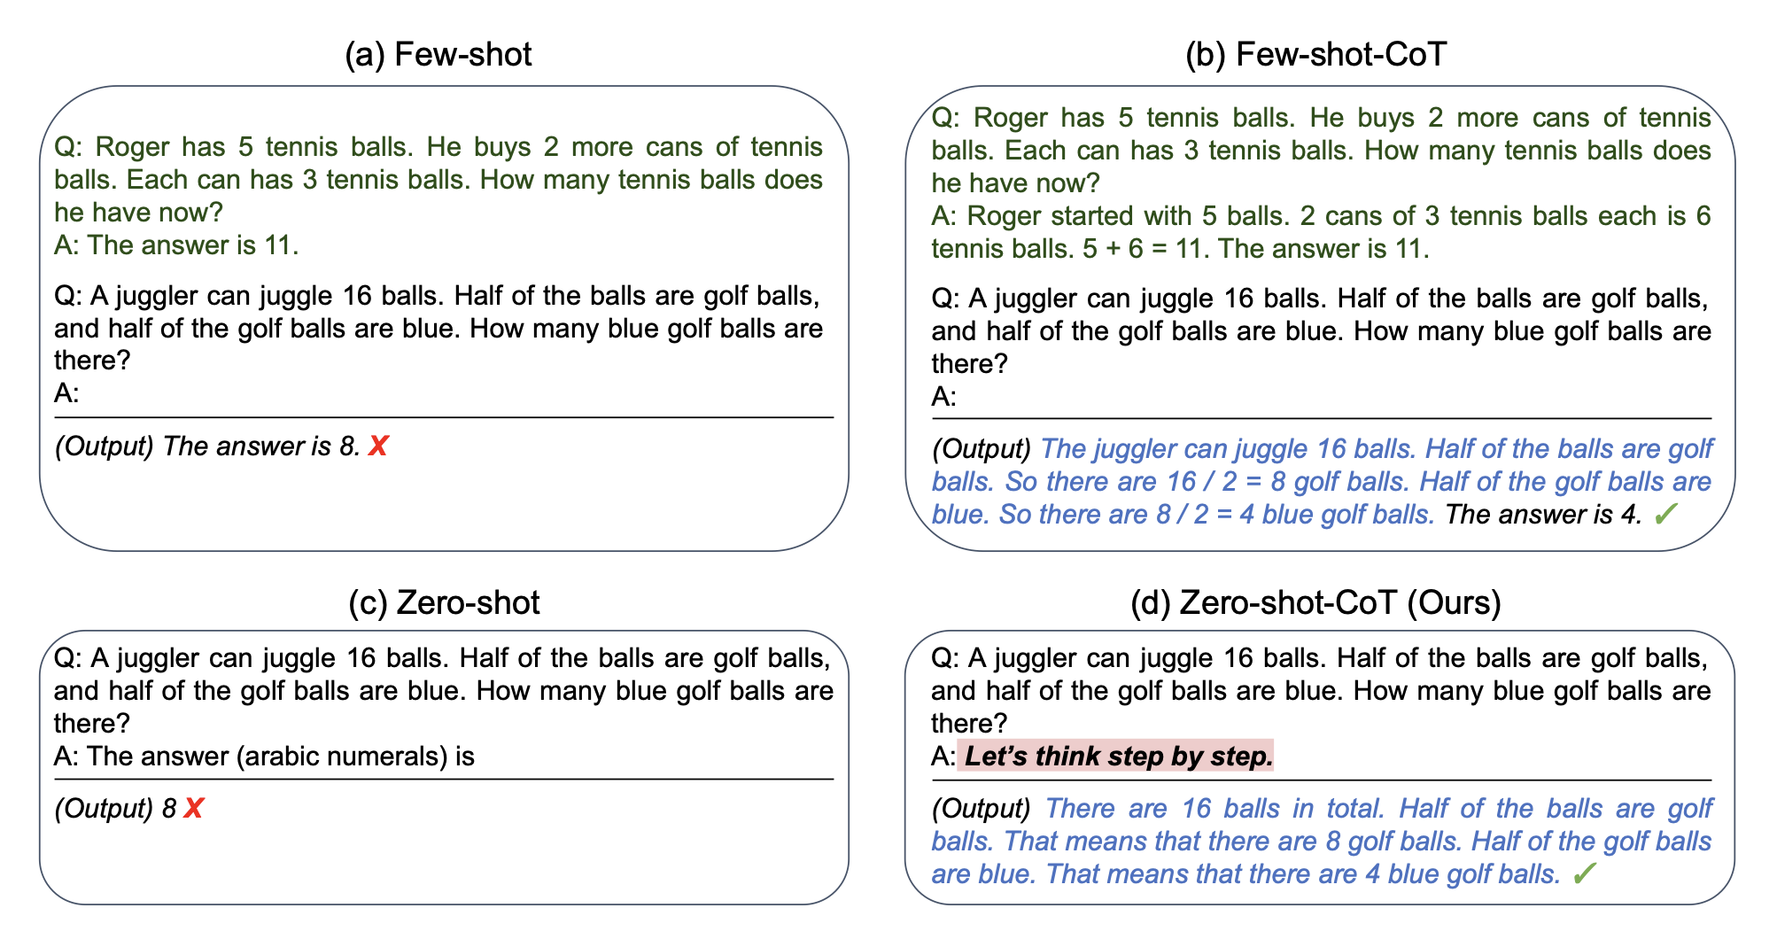
Chain-of-Thought Prompting (CoT)
The model does better even when simply prompted with “Let’s think step by step.”
Figure from https://arxiv.org/pdf/2205.11916

Slide 11
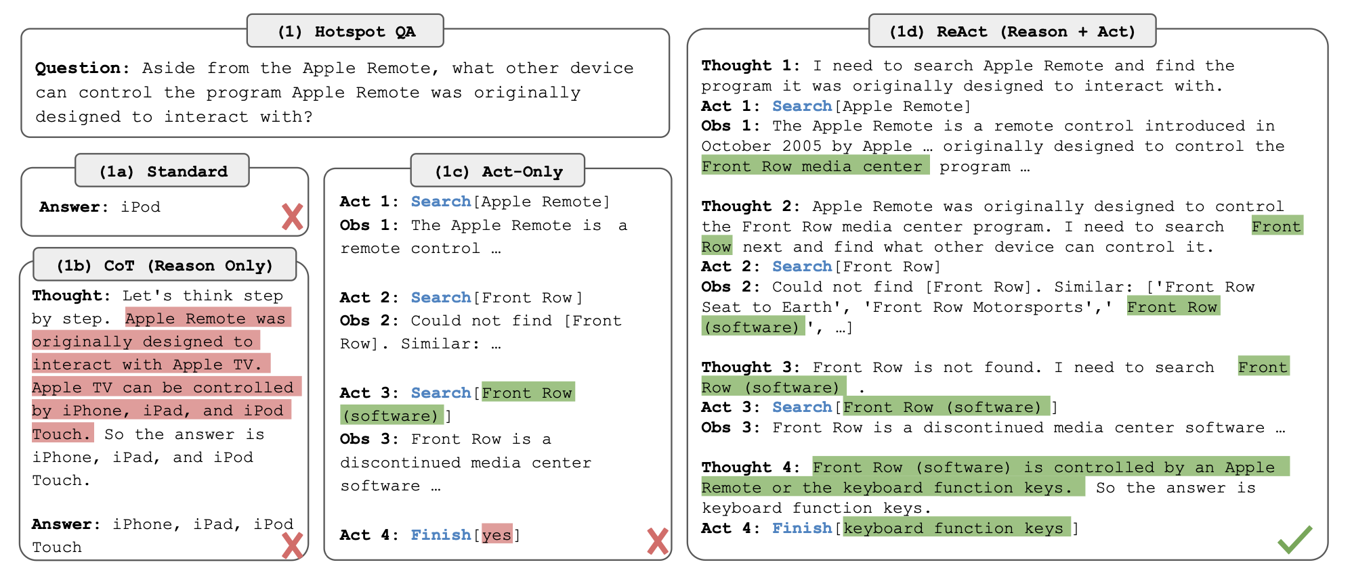
ReAct (Reason + Act)
Combines LLM’s ability to reason (by providing thoughts) and to act (by letting the LLM search from external sources).
Figure from https://arxiv.org/pdf/2210.03629

Slide 12
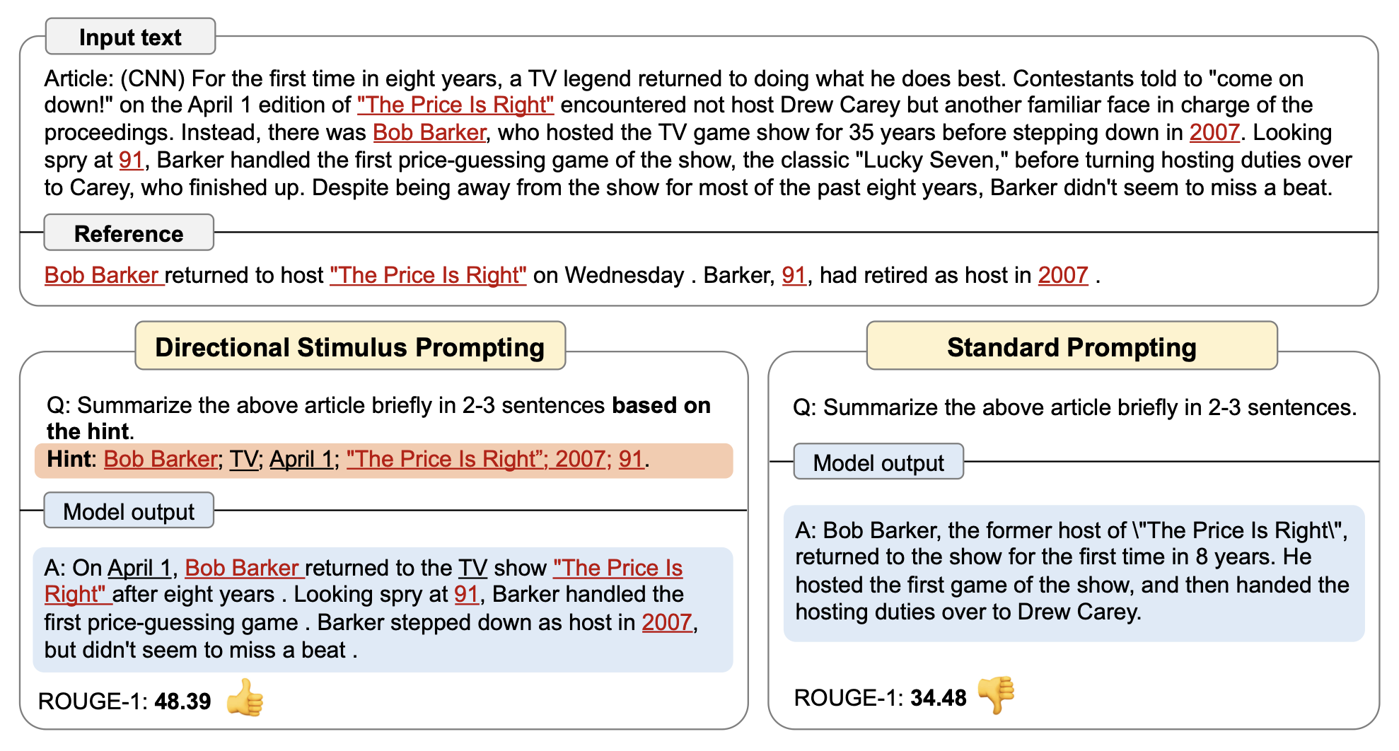
Directional Stimulus Prompting (DSP)
Use a small LM to generate hints and clues for the input prompt, and further provide these hints to the LLM to guide it in generating desired outcomes.
Figure from https://arxiv.org/pdf/2302.11520

Slide 13
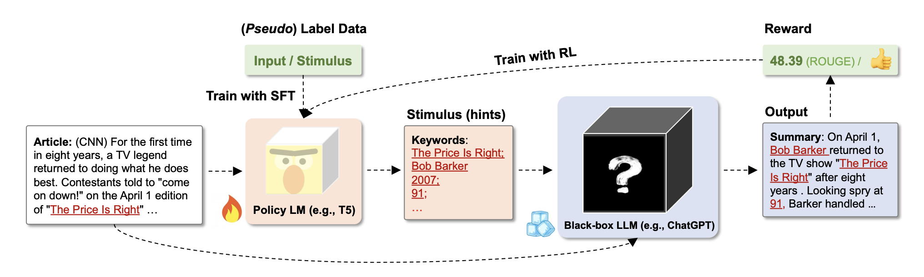
DSP Framework
The small policy LM can be learned with supervised fine-tuning and reinforcement learning.
Figure from https://arxiv.org/pdf/2302.11520

Slide 14
A powerful LLM vs. A great prompt?
Both are important.
A better model grants more tolerance for a bad prompt.
Advancing LLM architecture is generally managed by research teams from large companies.
A small startup or an individual researcher might leverage a decent model with excellent prompting techniques to achieve satisfactory results without the need for extensive computational power.

Slide 15
Research Paper Recommendations
A Survey on In-context Learning
Original Paper of RAG:
Retrieval-Augmented Generation for Knowledge-Intensive NLP Tasks
Original Paper of Chain-of-Thought Prompting:
Chain-of-Thought Prompting Elicits Reasoning in Large Language Models
Original Paper of ReAct:
ReAct: Synergizing Reasoning and Acting in Language Models
Original Paper of Directional Stimulus Prompting:
Guiding Large Language Models via Directional Stimulus Prompting
Large Language Models are Zero-Shot Reasoners

Slide 16
Additional Learning Resources
Prompting:
Video: 4 Methods of Prompt Engineering
Video: What is Prompt Tuning?
Video: Prompt Engineering 101 - Crash Course & Tips (Google Colab Link)
Generative AI:
Video: Generative AI in a Nutshell - how to survive and thrive in the age of AI
Talk: Andrew Ng: Opportunities in AI - 2023
The Batch | DeepLearning.AI | AI News & Insights by Andrew Ng
Coursera Course: Generative AI for Everyone by Andrew Ng
CMU Generative AI (10-423/623) Course Website

Slide 17
Thanks!

Slide 18
Q & A
Contact: yuntian2@andrew.cmu.edu

