Slide 1
RAG and its application in chemistry

Slide 2
Motivation of RAG: the problems with LLM
Large language model (LLM) are large,autoregressive model that is powerful in generate human-like text through next token prediction.
Howevers, since technically next token prediction does not directly penalize LLM for generate factually mistaken information, even a well-trained LLM makes factual mistakes, especially when generating topics that are not frequently presented in its training corpus. This phenomenon is termed ‘hallucination’
Moreover, an LLM have only a limited training corpus. For example, it may not have knowledge after a certain date, it may does not have access to proprietary data…

Slide 3
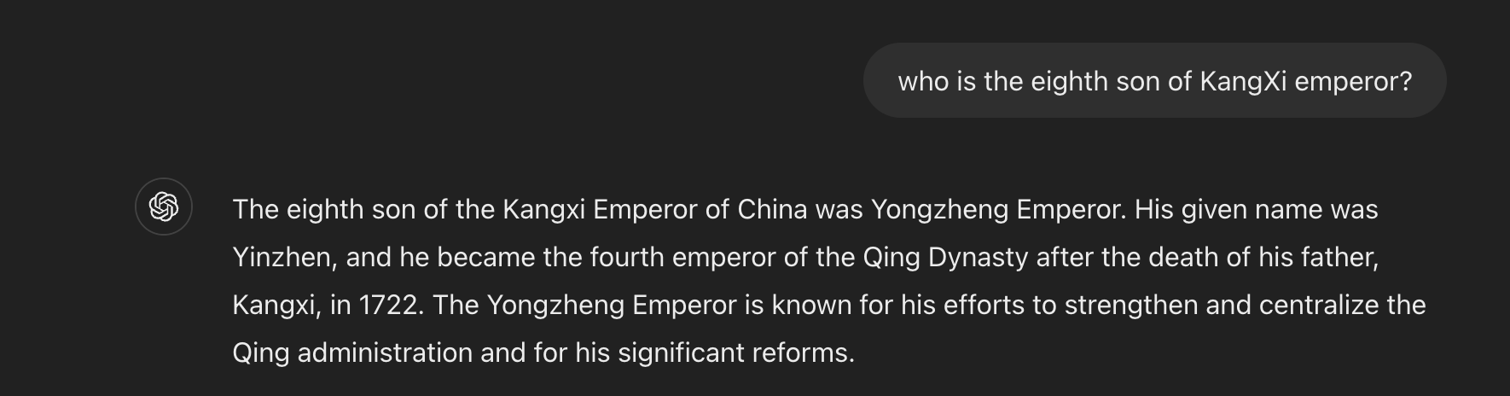
SoME example of hallucination
It should be Yinsi (or Yunsi)

Slide 4
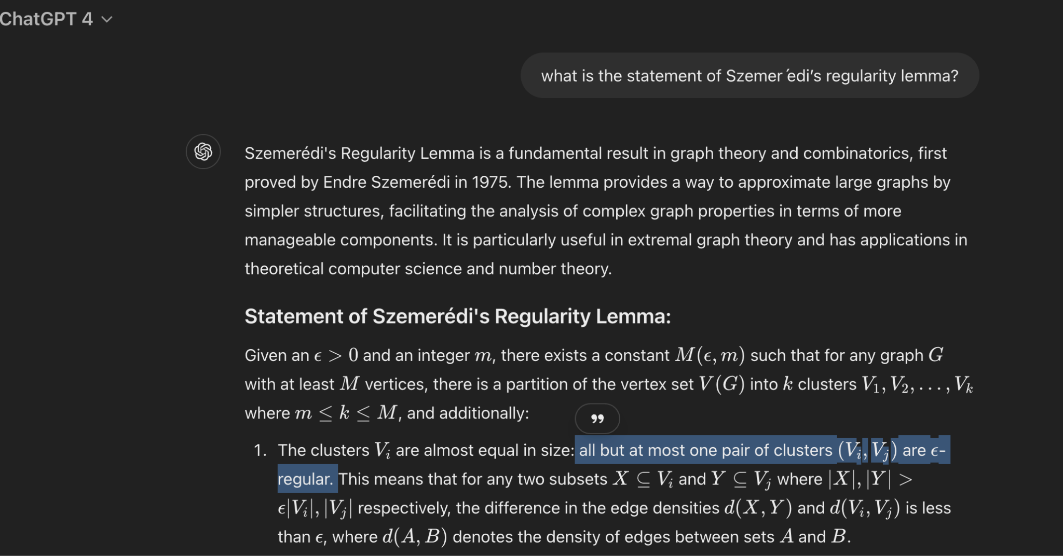
SoME example of hallucination, a larger model
Should be
At most epsilon * k^2

Slide 5
RAG
Retrieval Augmented generation is introduced to reduce LLM hallucinations and allows LLM to have an extended knowledge base.
Basic formulation: We have a set of documents that serves as our knowledge base, KB := [d_1, … d_n], each of which a chunk of text. When given a query q, we retrieve k most relevant documents from KB that is most relevant to the query q, with k << n, and we feed the following as input to LLM:
Answer query {q} based on the following evidences {k documents we retrieve}

Slide 6
RAG example: KangXi emperor’s eighth son
Query: who is KangXi’s eighth son?
KB: https://en.wikipedia.org/wiki/Kangxi_Emperor (wiki page of KangXi)
Retrieved Document: 3 text segments is selected from the KB, they are presented in the Next slide
Final prompt: ‘Answer the questions: who is KangXi’s eighth son? Based on the following documents’ + all the retrieved documents

Slide 7
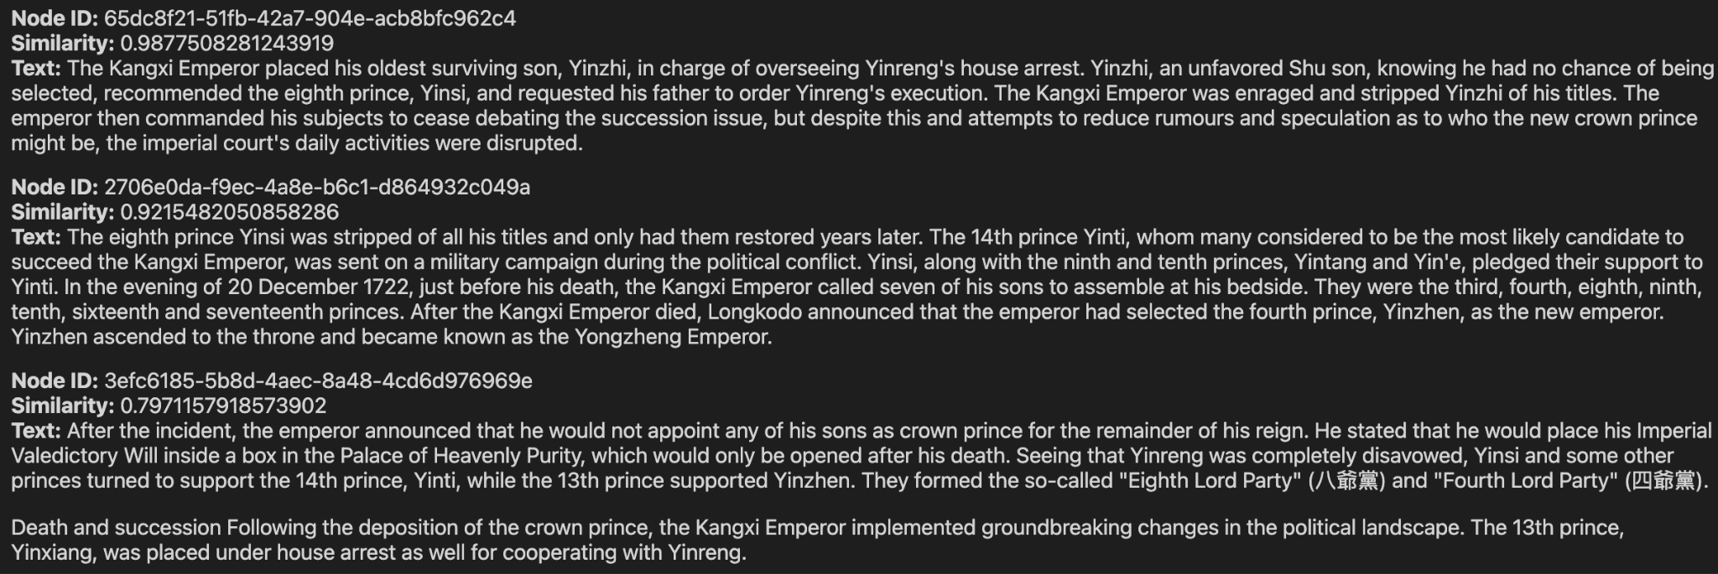

Slide 8
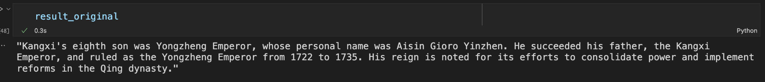
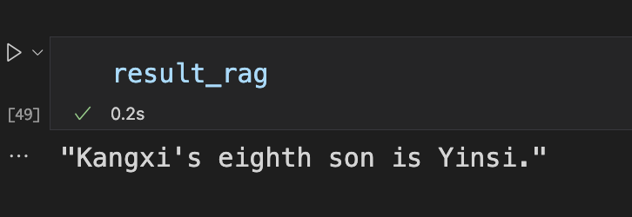
RAG example result: KangXi emperor’s third son
Gpt-4o-mini answer w/o RAG
Gpt-4o-mini answer w/ RAG

Slide 9
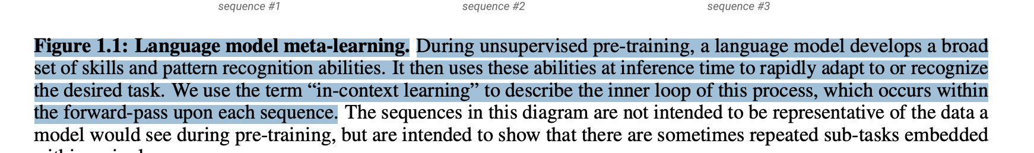
Reason why RAG works
LLMs have the ability to learn the knowledge/pattern from the prompt, and apply them at inference time.
From gpt-3 paper

Slide 10
How is retrieval done?
Task: we have a query q and a set of text segment KB, we want to retrieve k documents from KB that is most relevant to q.
There are two major ways of retrieving document from KB:
Sparse retrieval
Dense retrieval
But, our strategy is always as followed:
For each document d in KB, calculate similarity(q,d), select the ds with the highest similarity.

Slide 11
Sparse retrieval
Traditional NLP approach, used by search engines.
The baseline is TF-IDF
The algorithm has two major components, for each word w in each document d, we calculate:
TF-IDF(w,d) = TF(w,d) * IDF(w,d)
= (# of w in d/# of total word in d) * ln(# of documents in KB / # of document that contains w)
The first term gives how common word w is in document d, and the second term gives how rare the term w is in our entire KB

Slide 12
Sparse retrieval (con)
So for example， by compute the TF-IDF score for each word w for document
‘Jacob greenfield is a person’
We can have a vector [0.4,0.5,0.2,0.1,0,0,0,0,0….]. Where each index represents a word w, and each indexed value represents TF-IDF(w,document).
Therefore, after we compute the TF-IDF for our query q and all documents in KB, we will have a sparse vector representation of them,giving a sparse matrix

Slide 13
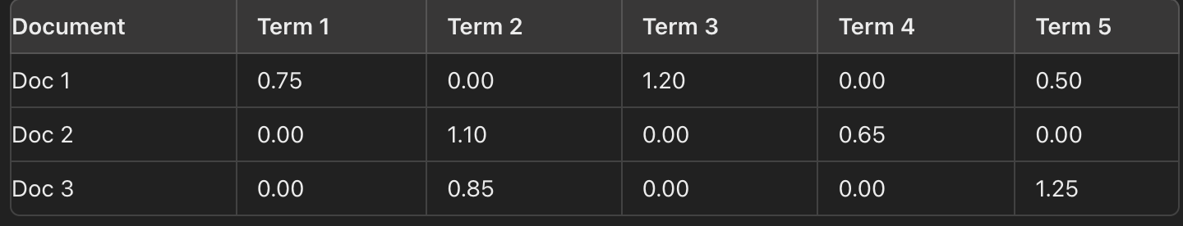
Example

Slide 14
Spase retrieval(con)
Then we compute the cosine similarity to find out the k vectors that bear the highest cosine similarity with the vector of query q, and then we pull the corresponding text for those vector.

Slide 15
Sparse retrieval (con)
Now the prevailing algorithm is BM-25(best match 25), which is an improvement on the TF-IDF algorithm. It have a better coefficient compared to TF. However it still uses the heuristic IDF.
So as we see: the reason why sparse retrieval is called sparse is that it gives our KB a sparse matrix representation (|KB| x # of possible words in BM-25 and TF-IDF).
Then, the reason why dense retrieval is called dense is that…
It gives our KB a dense matrix representation.

Slide 16
Dense retrieval
Motivation: we do not want to simply use the IDF heuristic, we want to match query to document that are semantically similar.
How: We still follow the “calculating similarity” strategy, and use neural network to approximate a function similarity(q,d), which takes in a query q and a document d, and outputs the similarity.

Slide 17
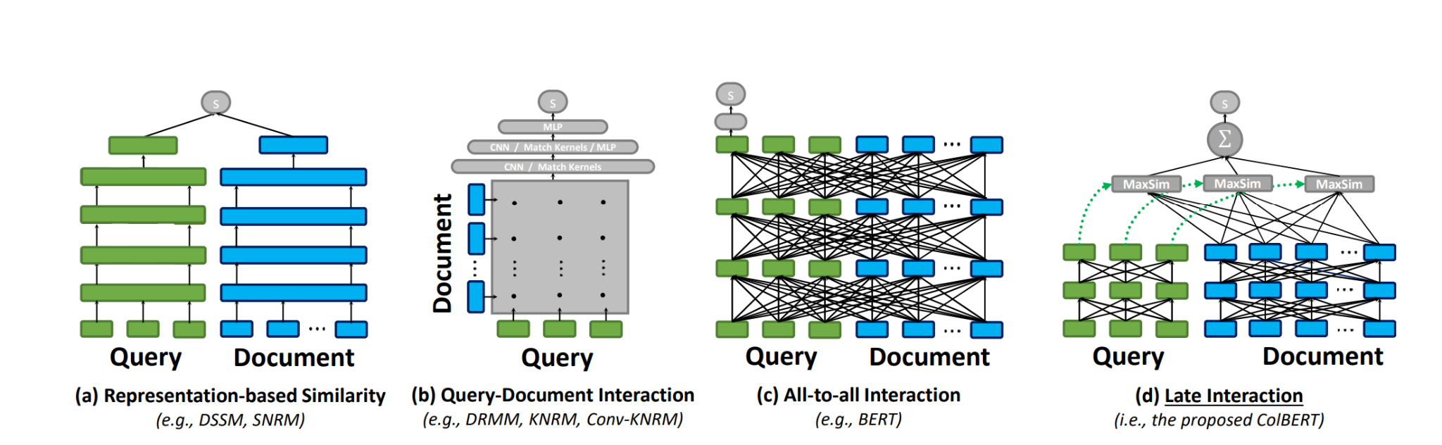
Dense retrieval
From

Slide 18
Dense retrieval staging
In the neural network of type (a)
And type (d). Parameters that receives input from the documents does not interacts with the parameters that receive input from the query.
So, we can do the computation for document d in similarity(q,d) without the presence of query q – the computation for query and for document is largely splitted.
This means that for a fixed KB we can do some computation for each document in KB to give it a certain tensor embedding. Then, we can use those embeddings to calculate similarity(q,d) for any q, saving a lot of computation.

Slide 19
Dense retrieval(con)
SOTA in dense retrieval is changing, and they have varying architecture. However, they are mostly following the paradigm of splitting the computation for query and for document.

Slide 20
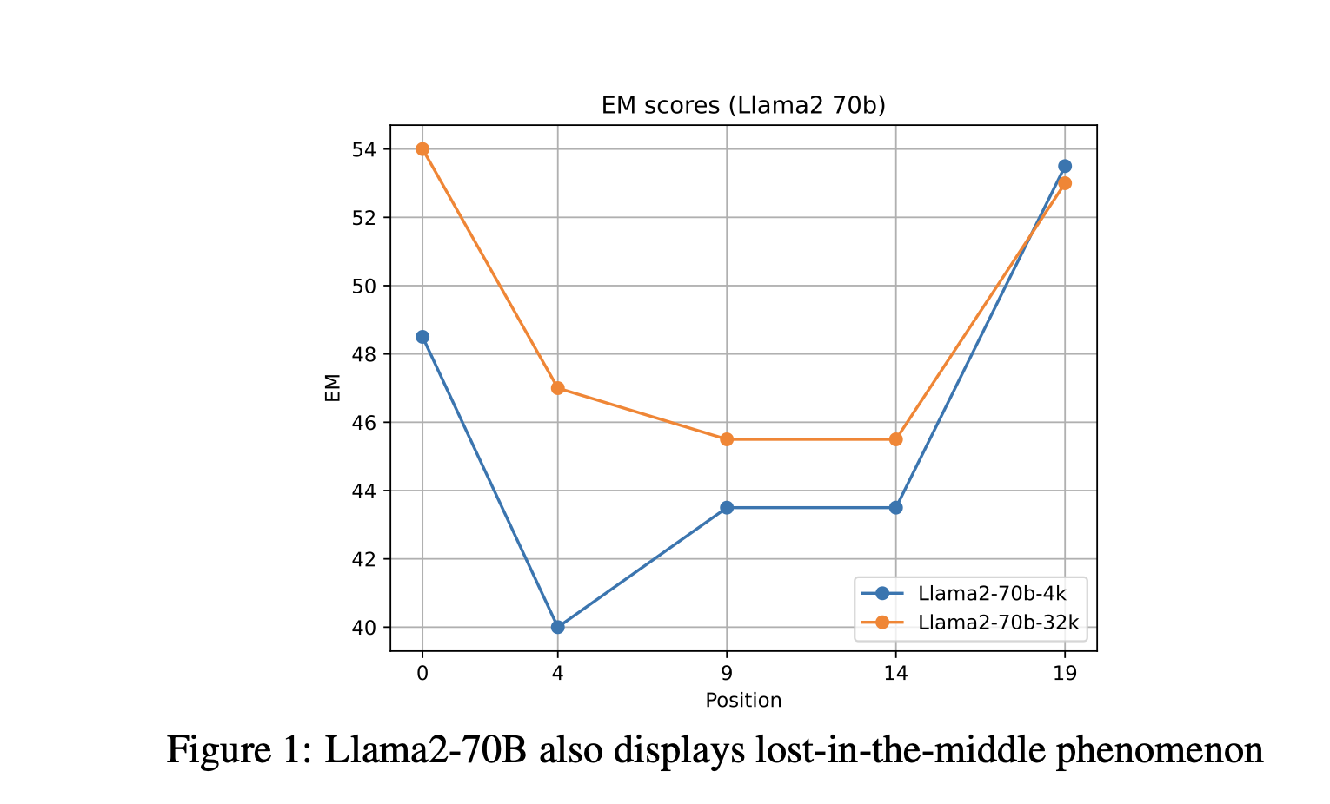
Brief note on long-context LLM
Many argued that in the age of long-context LLM we can just stuff the entire KB in the context window, however, this is a little problematic:
The task is to find certain part of an
Hour-long academic meeting. Researcher dump
The entire meeting record into a long-context LLM,
But information loss occurs, especially when it is in the middle of
The conference recording

Slide 21
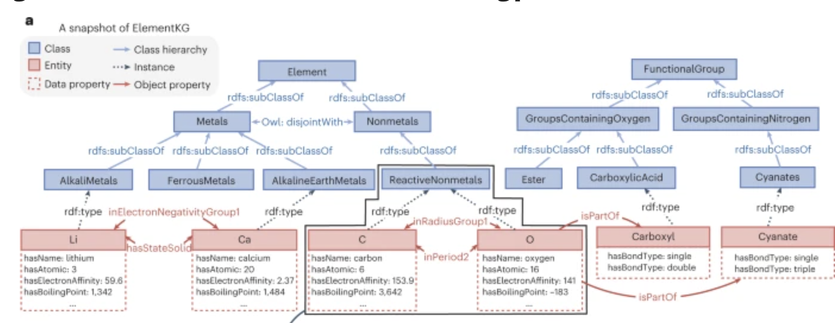
RAG in chemistry: KB is no longer chunks of text
In chemistry, our KBs are no longer chunks of texts. They comes in variety different form, for example, knowledge graph and table.

Slide 22
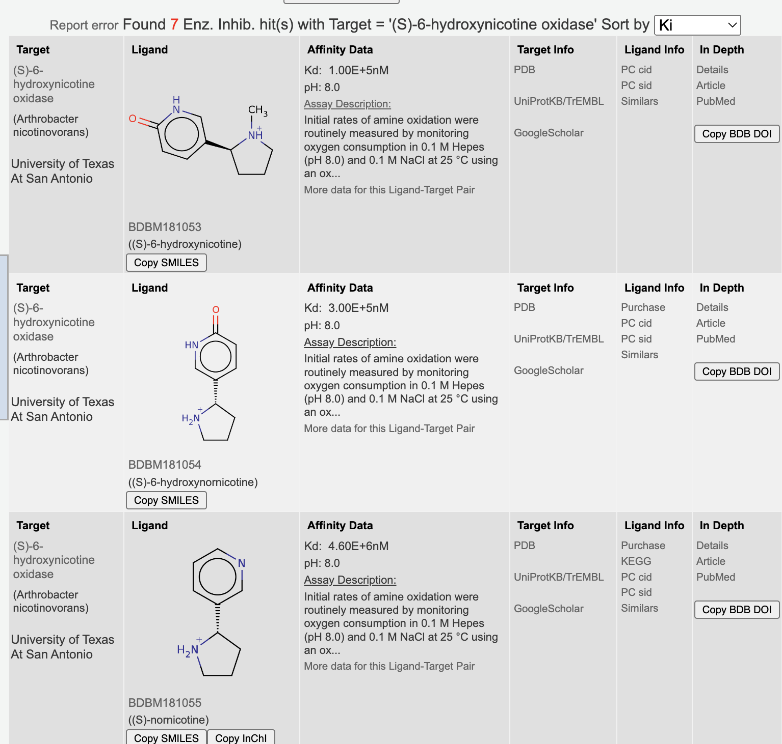
Example table

Slide 23
solution
Current solutions are usually transforming those structured text into unstructured text chunk so that they can become viable format for LLM to use.
While not much development is seen for transforming table data, there are many interesting result for knowledge graph.

Slide 24
Approach overview
Traditional graph theory: community (dense subgraph) detection + community summarization
Retrieval-based approach: retrieve vertex of graph through retrieval technique, and get its text and the text from its neighbors .
GNN-based approach: GNN layer + LM layer to develop knowledge graph informed LLM.

Slide 25
Thanks!

