Slide 1
RAG 101: Understand Retrieval Augmented Generation (RAG) In 20 minutes
Jiarui Rao (Jeri)
Research Intern at CMU HCII, Joined GEM Team in March 2024
Notes:
Main title: 40 pt. Arial
Presenter Name: 16 pt. Arial
Presenters Title: 16 pt. Arial Italic

Slide 2

What is RAG
RAG (Retrieval Augmented Generation) , is a natural language processing (NLP) technique that combines generative and retrieval-based artificial intelligence (AI) model) is the process of retrieving relevant contextual information from a data source and passing that information to a large language model alongside the user’s prompt.
This information is used to improve the model’s output (generated text or images) by augmenting the model’s base knowledge.
Source: Nvidia
Notes:
The roots of the technique go back at least to the early 1970s. That’s when researchers in information retrieval prototyped what they called question-answering systems, apps that use natural language processing (NLP) to access text, initially in narrow topics such as baseball.
The concepts behind this kind of text mining have remained fairly constant over the years. But the machine learning engines driving them have grown significantly, increasing their usefulness and popularity.
In the mid-1990s, the Ask Jeeves service, now Ask.com, popularized question answering with its mascot of a well-dressed valet. IBM’s Watson became a TV celebrity in 2011 when it handily beat two human champions on the Jeopardy! game show.

Slide 3

History Of RAG
Ask.com
Source: NVIDIA

Slide 4
Why RAG
Known challenges of LLMs include:
Presenting false information when it does not have the answer.
Presenting out-of-date or generic information when the user expects a specific, current response.
Creating a response from non-authoritative sources.
Creating inaccurate responses due to terminology confusion
Advantages of RAG include:
Cost-effective implementation
Current information
Enhanced user trust
More developer control

Slide 5
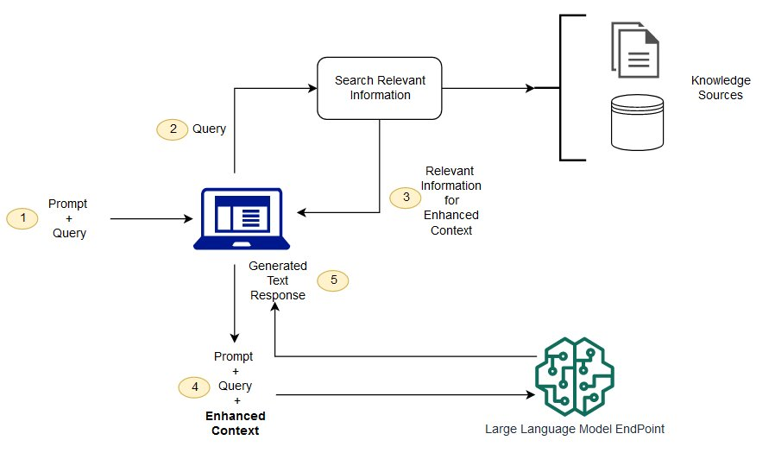
How RAG Works
Retrieve Relevant Information
Create External Data
Augment the LLM Prompt by adding relevant retrieval data
Source: AWS

Slide 6
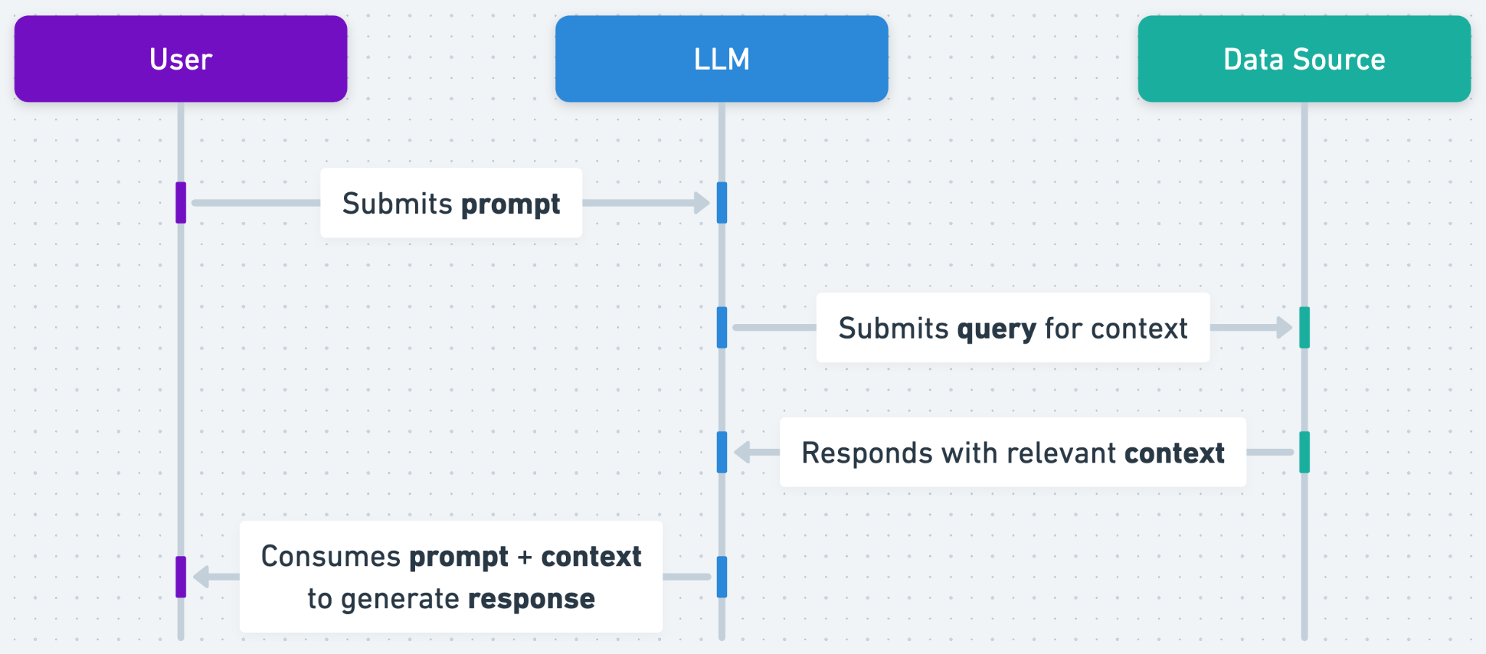
RAG Basic WorkFlow in LLM Apps
Source: OpenAI

Slide 7
RAG & Semantic Search
Retrieval-Augmented Generation (RAG)
Combines information retrieval with text generation.
Useful for integrating vast external knowledge into LLM applications.
Struggles with retrieving context at scale, reducing output quality.
Semantic Search
Enhances RAG by accurately scanning large databases.
Retrieves precise answers from documents, not just search results.
Simplifies data preparation by handling word embeddings and document chunking.
Generates relevant passages ordered by relevance to improve RAG quality.
Notes:
RAG is valuable for use-cases where the model needs knowledge which is not included in the information the model has learned from. For example, let’s say you are building a GPT to help your support team answer customer inquiries. GPT-4 is able to reason about customer problems using its base knowledge, but it cannot know the latest facts about your specific product or service. You can get much better results by giving a GPT access to your ticketing system, so that it can retrieve past tickets pertaining to similar issues and use that context to generate more relevant answers. When you use the knowledge retrieval feature in a GPT, RAG is being performed for you automatically.

Slide 8
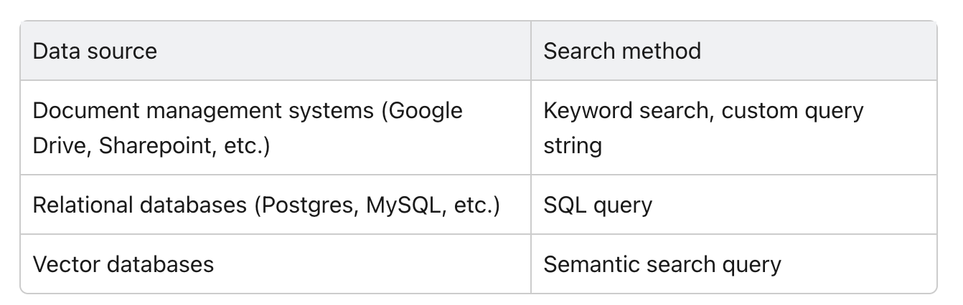
What is Semantic Search?
Semantic search uses a vector database, which stores text chunks (derived from some documents) and their vectors (mathematical representations of the text). When you query a vector database, the search input (in vector form) is compared to all of the stored vectors, and the most similar text chunks are returned.
Similarity Search: https://medium.com/@kbdhunga/a-beginners-guide-to-similarity-search-vector-indexing-part-one-9cf5e9171976
Source: OpenAI

Slide 9
Example of semantic search
You are building a customer support chatbot. If you want to populate a vector database with articles from a knowledge base, you might:
Break each of the articles up into chunks
Use the OpenAI Embedding API to process those chunks and return embeddings (i.e. mathematical representations of the nature of the chunk in vector space)
For example: [ -0.006929283495992422,-0.005336422007530928, … -4.547132266452536e-05, -0.024047505110502243]
Store the chunks and their embeddings in the database

Slide 10
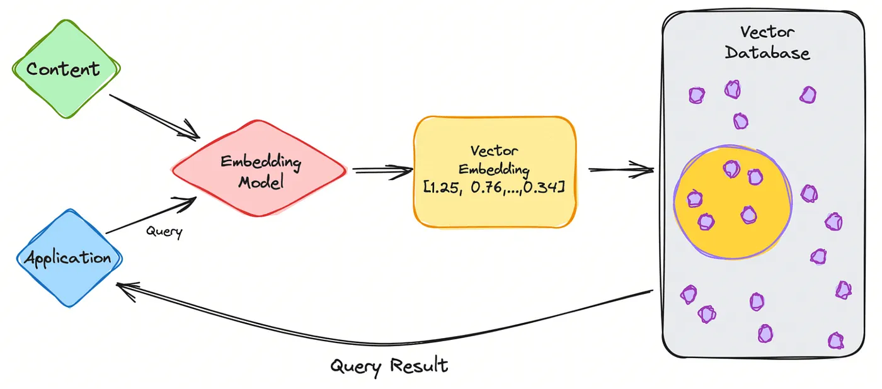
Example of semantic search
When a user asks the chatbot a question, a semantic search is performed:
User submits a query like “How can I use the OpenAI API?”
Use the OpenAI Embedding API to produce a vector representation of the query string
Submit that vector to the search endpoint associated with your vector db
Get back one or more text chunks which are similar to my query
Source: Medium

Slide 11
RAG Common Use Cases
Chatbots and AI Technical Support: Answer customer queries using organizational knowledge bases.
Language Translation: Improve translations with domain-specific context.
Medical Research: Provide up-to-date medical information.
Educational Tools: Enhance learning with detailed, context-based answers.
Legal Research and Document Review: Streamline legal document analysis and review.

Slide 12
Common Tools for Building RAG Applications
Building Tools
ElasticSearch: Powerful search engine for fast and scalable retrieval.
FAISS: Facebook AI Similarity Search, efficient similarity search for large datasets.
Haystack: Framework for developing RAG systems, supports various retrievers and generators.
Milvus: Vector database optimized for similarity search and large-scale AI applications.
Dev Tools
Hugging Face Transformers: Library for pre-trained models and fine-tuning capabilities.
LangChain: Framework for developing applications that utilize language models.
OpenAI API: Access to advanced LLMs for generating and retrieving information.
Streamlit: Simplifies building and sharing data applications.

Slide 13
RAG in Education
Personalized Tutoring: Delivers customized lessons and feedback based on individual student needs.
Research Assistance: Helps students and educators quickly find relevant research materials.
Automated Grading: Assists in evaluating open-ended responses with contextual accuracy
Interactive Learning: Creates engaging and interactive educational content dynamically.
Virtual Study Assistants: Offers real-time assistance and answers to students' questions
Course Recommendation: Provide course recommendations based on individual Interest
Demo: https://huggingface.co/spaces/dinosaur-organization/coursera-recommendation

Slide 14
RAG’s Impact on LLM
Enhanced Accuracy
Contextual Retrieval: Better response accuracy.
Reduced Hallucinations: Fewer errors.
Scalability
Efficient Data Use: Handles vast info.
Dynamic Updates: Stays current.
Customization
Domain-Specific Knowledge: Tailored responses.
Adaptive Learning: Continuous improvement.
Cost-Effectiveness
Resource Optimization: Less fine-tuning.
Efficient Processing: Lower computational costs.
Transparency
Traceable Outputs: Clear sources.
Explainable Responses: Understandable answers.

Slide 15
Learning Resources
RAG in 5 Lines of Code:
https://huggingface.co/facebook/rag-token-nq
Generative QA with RAGenerator:
https://colab.research.google.com/github/deepset-ai/haystack-tutorials/blob/main/tutorials/07_RAG_Generator.ipynb
LLAMA3 - RAG:
https://medium.com/@tharindumadhusanka99/llama3-rag-on-google-colab-73c43aa53281
Advanced RAG:
https://huggingface.co/learn/cookbook/en/advanced_rag
Hugging Face Open-Source CookBook for RAG:
https://huggingface.co/learn/cookbook/en/rag_zephyr_langchain

Slide 16
Research Paper Recommendations
The origin paper of RAG:
Retrieval-Augmented Generation for Knowledge-Intensive NLP Tasks
RAG for Tutoring Assessment:
[2402.14594] Improving Assessment of Tutoring Practices using Retrieval-Augmented Generation
RAG for Middle School Math Question-Answering:
[2310.03184] Retrieval-augmented Generation to Improve Math Question-Answering: Trade-offs Between Groundedness and Human Preference
Evaluate Retrieval Quality in RAG:
Evaluating Retrieval Quality in Retrieval-Augmented Generation

Slide 17
Q & A
Thanks for Watching!

