Slide 1
A Brief Introduction to Scaffolding
Jahnvi Shah
Electrical and Computer engineering
June 26, 2024

Slide 2

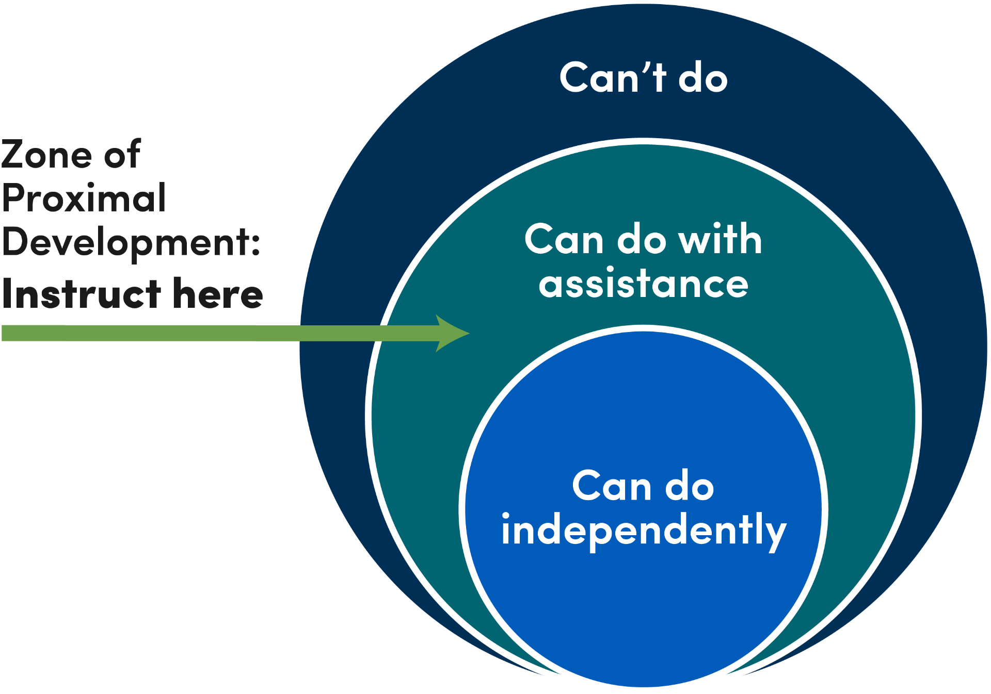
Introduction to Scaffolding (background)
Scaffolding is an instructional technique that involves providing support to students as they learn new concepts and skills.
It draws on the Vygotsky’s socio-cultural theory
Learning occurs on two levels:
First through social interaction with others.
Then within the individual.
Introduces the concept of the Zone of Proximal Development (ZPD)
ZPD highlights potential for cognitive growth
Scaffolding operates in this zone
Language as a crucial tool
Learning situated within meaningful, real-life activities

Slide 3
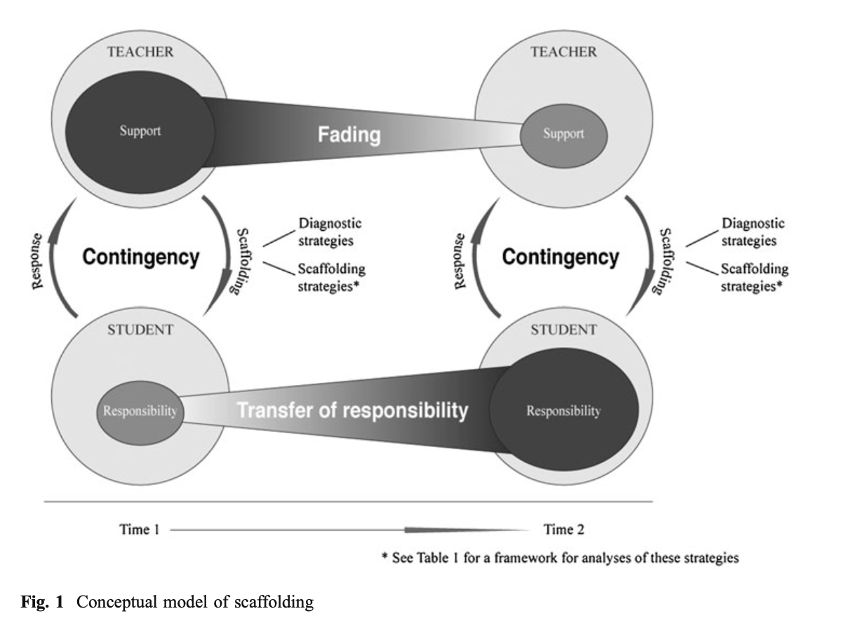
Key characteristics of Scaffolding
1. Contingency
Support tailored to student’s performance level
Continuous assessment and adaptation
Promotes optimal learning
2. Fading
Gradual withdrawal of support
Develops student independence
Reduces reliance on external help
3. Transfer of Responsibility
Shift control from teacher to student
Develops independent problem-solving
Encourages self-regulation skills
Increases student confidence FROM : Scaffolding in Teacher–Student Interaction: A Decade of Research
Notes:
In the zero-shot scenario (1), llama2 provided an incorrect answer, but in (2) with a few examples,
llama2 gave the correct answer. To conclude, llama2 initially struggled to solve a complex math
problem in a zero-shot scenario but succeeded in giving the correct answer after being guided with a
few examples in a few-shot learning context.

Slide 4

Scaffolding Strategies
Modeling: Demonstrating tasks or skills
Bridging: Connecting new information to prior knowledge
Contextualizing: Using aids to make learning relevant
Schema Building: Linking new information to existing structures
Re-presenting Text: Transforming information formats
Developing Metacognition: Encouraging self-reflection
Notes:
In the zero-shot scenario (1), llama2 provided an incorrect answer, but in (2) with a few examples,
llama2 gave the correct answer. To conclude, llama2 initially struggled to solve a complex math
problem in a zero-shot scenario but succeeded in giving the correct answer after being guided with a
few examples in a few-shot learning context.

Slide 5
Descriptive Studies: Using Scaffolding
Descriptive studies on scaffolding provide rich narratives and classifications of various scaffolding strategies used in different educational contexts. They aim to explore and detail the ”how” and what” of scaffolding practices.
Mertzman (2008): Literacy scaffolding
Maloch (2002): Literature discussions
These studies highlight the diverse applications of scaffolding and its impact on student engagement and learning outcomes across different subjects and age groups.

Slide 6
Effective Studies: Overview
Several effectiveness studies have investigated the impact of scaffolding on student learning outcomes. Effectiveness studies aim to answer the "how well" question, providing evidence on the outcomes and benefits of scaffolding practices through measurable results.
Cognitive Activities - Pratt and Savoy-Levine (1998)
Metacognitive Activities - Mercer et al. (2004)
Broad utility - Peer Scaffolding and Self Scaffolding
Notes:
The fundamental reason is that certain data augmentation methods in images, such as rotating the image by a few degrees or converting its color to grayscale, do not change the inherent meaning of the image while enhancing the data. However, the semantics of text can be easily altered.

Slide 7
Advantages and Disadvantages
Advantages:
Active learner engagement
Enhanced motivation and reduced frustration
Improved learning outcomes and autonomy
Disadvantages:
Time-consuming for teachers
Requires high teacher expertise
Challenges in large classrooms
Notes:
We take pre-trained word embeddings such as Word2Vec, GloVe, FastText, Sent2Vec, and use the nearest neighbor words in the embedding space as the replacement for some word in the sentence.

Slide 8
Challenges in Measurements
Operationalization: Different studies used various definitions and operationalizations of scaffolding, making comparisons difficult.
Measurement Instruments: There is a lack of reliable and valid measurement instruments that capture all three key characteristics of scaffolding (contingency, fading, transfer of responsibility).
Units of Analysis: The unit of analysis varied across studies, from teacher utterances to whole interactions, complicating the synthesis of findings.
Context Specificity: Scaffolding is highly context-dependent, requiring detailed specification of the context in which it occurs.

Slide 9
Future Directions in Scaffolding research
Address measurement challenges
Explore diverse educational settings
Develop reliable measurement instruments
Focus on key characteristics: contingency, fading, responsibility
Notes:
Take some sentence (e.g. in English) and translate to another Language e.g. French
Translate the French sentence back into an English sentence
Check if the new sentence is different from our original sentence. If it is, then we use this new sentence as an augmented version of the original text.

Slide 10
Can AI perform scaffolding
Personalized Learning: Tailored assistance
Instant Feedback: Immediate corrections
Resource Access: Wide range of materials
Practice and Reinforcement: Extra practice, games, simulations
Current Limitations: Lacks human interaction understanding
Struggles with unique needs
Limited emotional support
Future Potential: Advancements may bridge gaps

Slide 11
Conclusion
Effective scaffolding improves educational outcomes.
For college students, understanding scaffolding:
Enhances academic experience.
Makes learning manageable.
Provides valuable future skills.
Notes:
we add spelling errors to some random word in the sentence. These spelling errors can be added programmatically or using a mapping of common spelling errors such as this list for English.
This method tries to simulate common errors that happen when typing on a QWERTY layout keyboard due to keys that are very near to each other. The errors are injected based on keyboard distance.
These methods add robustness to the model.

Slide 12
Thank You!

Slide 13
Q & A

