Slide 1
Introduction to Front End Development with React and Next.js
Megan Gu

Slide 2
Front End Development
Works with user interface
Client Side
Basic languages for front-end development:
HTML - basic structure of the website
CSS - style
JavaScript - interaction and dynamic content
Notes:
https://www.w3schools.com/whatis/whatis_frontenddev.asp
https://www.computerscience.org/bootcamps/resources/frontend-vs-backend/#:~:text=All%20websites%20require%20front%2Dend,system%2C%20data%2C%20and%20logic.

Slide 3
What are React and Next.js?
React is a JavaScript library used for building user interfaces.
Next.js is a web development framework based on React.
Framework vs Library
A framework contains code written to perform common tasks to build applications for a particular platform
A library is a collection of pre-written code that can be used to perform common tasks and is designed to be reusable and modular
Key differences:
With a framework, the framework controls the overall flow of the application, while with a library, the developer retains control over the flow
Notes:
https://www.shiksha.com/online-courses/articles/framework-vs-library/
https://legacy.reactjs.org/tutorial/tutorial.html#what-is-react
https://www.geeksforgeeks.org/nextjs/

Slide 4
React
Features of React:
JavaScript Syntax Extension
Virtual DOM
One-way Data Binding
Performance
Extension
Conditional Statements in JSX
Components
Notes:
https://www.geeksforgeeks.org/react-tutorial/

Slide 5
JavaScript Syntax Extension (JSX)
Syntax extension of JavaScript
Allows for HTML to be written in JavaScript
JavaScript Expressions can be embedded in JSX code using curly braces
Allows for conditional statements with HTML elements
General Rules for JSX:
Return a single Root Element
Close all tags
Use camelCase
JSX with Typescript
Includes type safety
Notes:
https://www.geeksforgeeks.org/reactjs-jsx-introduction/

Slide 6
Virtual DOM
The Document Object Model (DOM) represents the objects that make up the structure and content of a document on a website.
DOM allows the Javascript code to interpret and interact with the HTML document.
The virtual DOM is a copy of the real DOM. With a virtual DOM, whenever there is a change, instead of updating the entire real DOM, the virtual DOM is updated and compared to the real DOM, so only the changed parts of the real DOM are updated.
Results in improved performance.
Notes:
https://www.geeksforgeeks.org/react-tutorial/
https://www.geeksforgeeks.org/what-are-the-features-of-reactjs/#1-jsxjavascript-syntax-extension
https://www.geeksforgeeks.org/dom-document-object-model/
https://developer.mozilla.org/en-US/docs/Web/API/Document_Object_Model/Introduction

Slide 7
One-way Data Binding
Data is transferred from parent components to child components.
Child components can’t directly return data to parent components but can modify states based on provided inputs.
Results in better control throughout the application.
Notes:
https://www.javatpoint.com/react-features

Slide 8
Components
Independent and reusable code
Both structure and behavior
Can be combined into a parent component and used in other components
Types of Components:
Functional Components
Similar to JavaScript functions
Accept properties and return a React element
Class Components:
Has inheritance and can access data of other components
Must include “extends React.Component”
Notes:
https://www.geeksforgeeks.org/reactjs-components/
https://www.geeksforgeeks.org/reactjs-class-components/

Slide 9
Next.js
Features of Next.js:
Built-in Routing and SSR
Faster Development
SEO Optimization
Notes:
https://www.geeksforgeeks.org/nextjs/

Slide 10
App Routing
Supports shared layouts, nested routing, loading states, error handling, etc.
app directory
File System based router
Folder are used to define routes
Routes are paths of nested folders
page.tsx file creates the user interface of a route
Special files to create UI with specific behavior
Includes: layout, page, loading, error
Dynamic API Routes
(There is also page routing, but app routing is recommended)
Notes:
https://nextjs.org/docs/app/building-your-application/routing

Slide 11
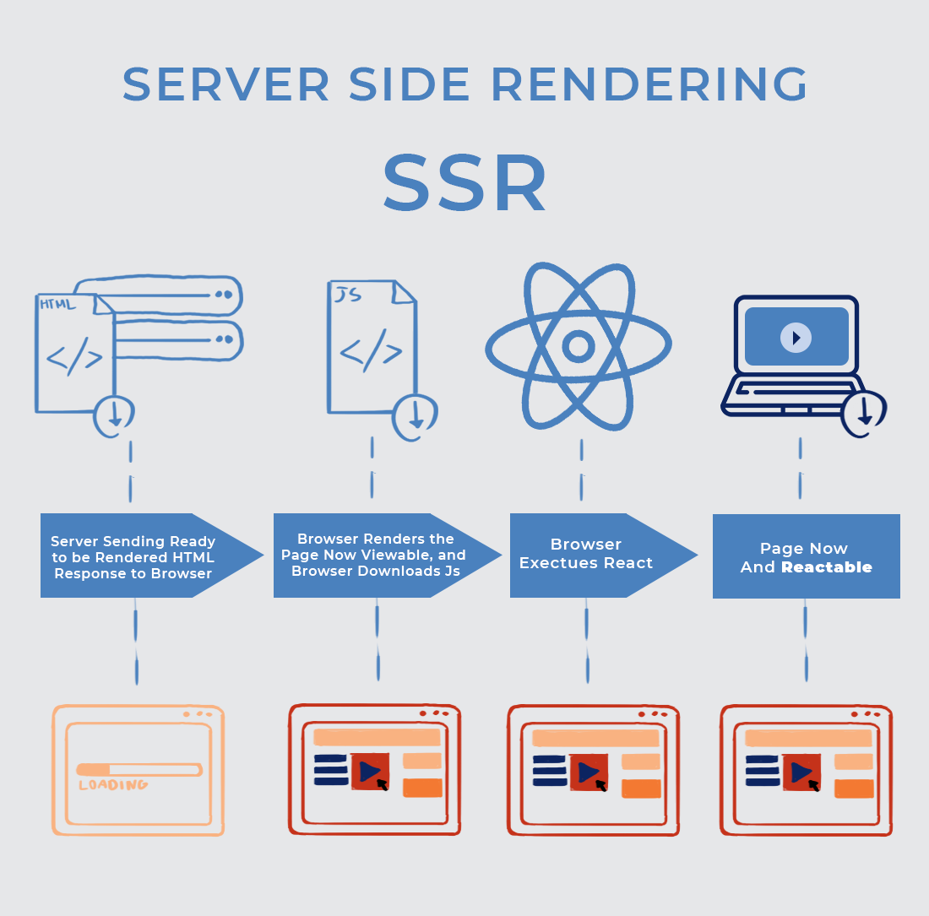
Server Side Rendering (SSR)
Pre-rendering
Web page is rendered on the server rather than the browser and the fully render page is sent to the client
HTML is generated on each request
Dynamic Content
Improves performance
Image from Krusche Company
Notes:
https://solutionshub.epam.com/blog/post/what-is-server-side-rendering
https://kruschecompany.com/ssr-or-csr-for-progressive-web-app/

Slide 12
Search Engine Optimization (SEO)
Higher ranking position in search engine results
Optimization
Technical - crawling and web performance
Creation - target specific keyword
Popularity - boost site presence
Next.js improves rendering performance and loading times
Notes:
https://nextjs.org/learn-pages-router/seo/introduction-to-seo

Slide 13
API Routes
Create serverless functions within the application
Add backend functionality without needing a separate server
Can access and store data in a database without a separate backend server
Create an API endpoint inside a Next.js application
Notes:
https://www.geeksforgeeks.org/nextjs/
https://refine.dev/blog/next-js-api-routes/#introduction

Slide 14
Thank You for Listening
Any Questions?

Slide 15
Sources:
General:
https://www.w3schools.com/whatis/whatis_frontenddev.asp
https://www.computerscience.org/bootcamps/resources/frontend-vs-backend/
https://www.shiksha.com/online-courses/articles/framework-vs-library/
https://developer.mozilla.org/en-US/docs/Web/API/Document_Object_Model/Introduction
React:
https://legacy.reactjs.org/tutorial/tutorial.html#what-is-react
https://www.geeksforgeeks.org/react-tutorial/
https://www.geeksforgeeks.org/reactjs-jsx-introduction/
https://www.geeksforgeeks.org/what-are-the-features-of-reactjs/#1-jsxjavascript-syntax-extension
https://www.geeksforgeeks.org/dom-document-object-model/
https://www.geeksforgeeks.org/reactjs-components/
https://www.geeksforgeeks.org/reactjs-class-components/
Next.js:
https://www.geeksforgeeks.org/nextjs/
https://nextjs.org/docs/app/building-your-application/routing
https://solutionshub.epam.com/blog/post/what-is-server-side-rendering
https://kruschecompany.com/ssr-or-csr-for-progressive-web-app/
https://nextjs.org/learn-pages-router/seo/introduction-to-seo
https://refine.dev/blog/next-js-api-routes/#introduction

