Slide 1
A Brief Introduction to Text Data Augmentation
Glenn Xu
Language Technologies Institute
Jun 18, 2024

Slide 2
INTRO: Few data problem in language models
Typically, in-context learning (zero-shot, one-shot, few-shot) works very well (no weight updations required).
LLMs are trained on a large amount of text, one-shot and few-shot learning helps locate relevant context to boost the performance.

Slide 3
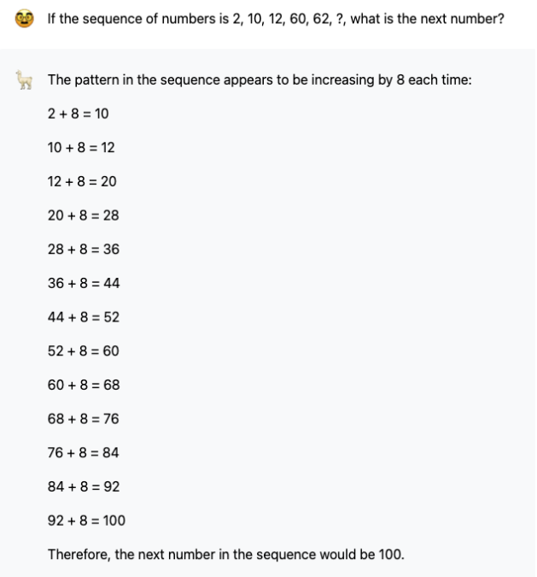
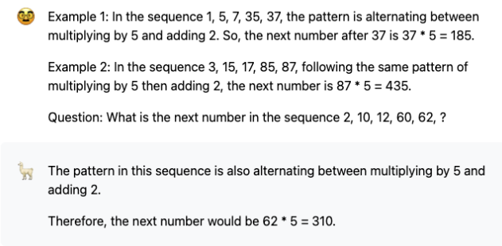
INTRO: Few data problem in language models
Llama2 (https://www.llama2.ai/) is Meta’s open source large language model. Not as poweful as ChatGPT, we can use it to show the performance under zero- and few-shot learning scenarios.
Notes:
In the zero-shot scenario (1), llama2 provided an incorrect answer, but in (2) with a few examples,
llama2 gave the correct answer. To conclude, llama2 initially struggled to solve a complex math
problem in a zero-shot scenario but succeeded in giving the correct answer after being guided with a
few examples in a few-shot learning context.

Slide 4
INTRO: Few data problem in language models
However, there may need to be more than just a few-shot learning.
If the task is too specific, the model has little prior knowledge, say law case analysis, tutoring response, etc.
The model may need to be finetuned on domain-specific data to get better performance.
But typically, we do not have that many domain-specific data.
Notes:
In the zero-shot scenario (1), llama2 provided an incorrect answer, but in (2) with a few examples,
llama2 gave the correct answer. To conclude, llama2 initially struggled to solve a complex math
problem in a zero-shot scenario but succeeded in giving the correct answer after being guided with a
few examples in a few-shot learning context.

Slide 5
Possible Solutions
Data Augmentation (today’s topic)
Transfer Learning
Active Learning
……

Slide 6
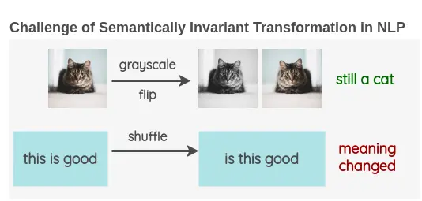
Data Augmentation
Different from CV, data augmentations in NLP seems harder.
Notes:
The fundamental reason is that certain data augmentation methods in images, such as rotating the image by a few degrees or converting its color to grayscale, do not change the inherent meaning of the image while enhancing the data. However, the semantics of text can be easily altered.

Slide 7
Data Augmentation
Traditional Data Augmentation Methods
Word Replacement
Back Translation
Random Noise Injection
……
Data Augmentation using LLMs
Structural
Unstructual

Slide 8
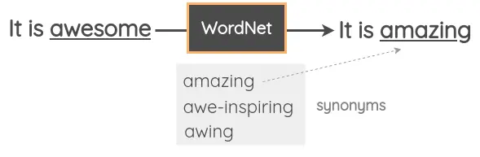
Word Replacement
1.1 Thesaurus-based substitution
A Visual Survey of Data Augmentation in NLP
https://amitness.com/posts/data-augmentation-for-nlp

Slide 9
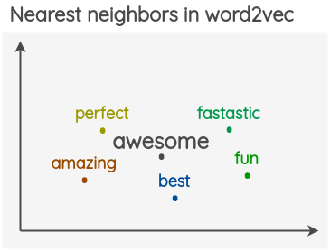
Word Replacement
1.2 Word-Embeddings Substitution
A Visual Survey of Data Augmentation in NLP
https://amitness.com/posts/data-augmentation-for-nlp
Notes:
We take pre-trained word embeddings such as Word2Vec, GloVe, FastText, Sent2Vec, and use the nearest neighbor words in the embedding space as the replacement for some word in the sentence.

Slide 10
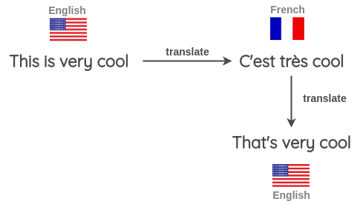
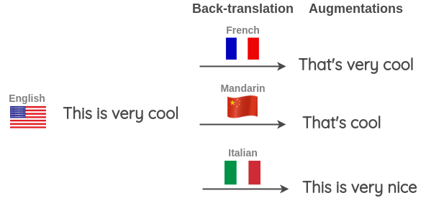
Back Translation
A Visual Survey of Data Augmentation in NLP
https://amitness.com/posts/data-augmentation-for-nlp
Notes:
Take some sentence (e.g. in English) and translate to another Language e.g. French
Translate the French sentence back into an English sentence
Check if the new sentence is different from our original sentence. If it is, then we use this new sentence as an augmented version of the original text.

Slide 11

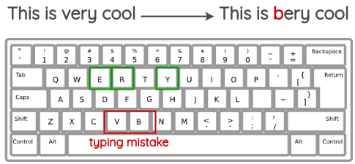
Random Noise Injection
2.1 Spelling Error Injection
2.2 QWERTY Keyboard Error Injection
A Visual Survey of Data Augmentation in NLP
https://amitness.com/posts/data-augmentation-for-nlp
Notes:
we add spelling errors to some random word in the sentence. These spelling errors can be added programmatically or using a mapping of common spelling errors such as this list for English.
This method tries to simulate common errors that happen when typing on a QWERTY layout keyboard due to keys that are very near to each other. The errors are injected based on keyboard distance.
These methods add robustness to the model.

Slide 12
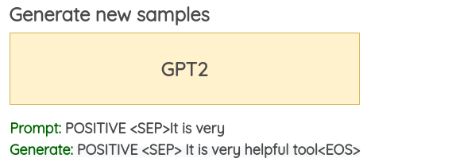
Data Augmentation using LLMs - Unstructural
Generate new samples using other more powerful LLMs like ChatGPT-4o, but rely heavily on prompting.
A Visual Survey of Data Augmentation in NLP
https://amitness.com/posts/data-augmentation-for-nlp

Slide 13
Data Augmentation using LLMs - Structural
In some tasks like NER (named entity recognition), unstructural augmentation may result in bad samples.
Prompt: I need you to generate more data for …, one example is: <PERSON>The Fifteenth Doctor<\PERSON> and <PERSON>Ruby<\PERSON> are taking a trip in <PLACE>the Remembered TARDIS<\PLACE> to reflect on their recent adventures.
Agent: Sure, here is another example for an NER (Named Entity Recognition) task:
<PERSON >Elizabeth Bennet</PERSON> and Mr. Darcy</PERSON> strolled through the gardens of <PLACE>Pemberley</PLACE> in the late afternoon.
Notes:
The examples are too homogeneous and do not provide the model with enough diverse and effective information.

Slide 14
Data Augmentation using LLMs - Structural
We may tackle this using structural augmentation.
<PERSON>The Fifteenth Doctor<\PERSON> and <PERSON>Ruby<\PERSON> are taking a trip in <PLACE>the Remembered TARDIS<\PLACE> to reflect on their recent adventures.
*************************** divided into entity groups ***************************
PERSON: [The Fifteenth Doctor, Ruby]
PLACE: [the Remembered TARDIS]
NON-ENTITY: [and, are taking a trip in, to reflect on their recent adventures.]
***************************** augment each group *****************************
PERSON: {The Fifteenth Doctor: [doctor, the Doctor, the Doc], Ruby: [the lady, his partner]}
PLACE: {the Remembered TARDIS: [the time machine, TARDIS]}
NON-ENTITY: {and: [as well as], are taking a trip in: [are traveling in], to reflect on their recent adventures.: [to think about their last travels.]}
***************************** random combination *****************************
<PERSON>The Doctor<\PERSON> and <PERSON>his partner<\PERSON> are traveling in <PLACE>TARDIS<\PLACE> to think about their last travels.
Notes:
Can ensure the structure and labels are correct.
May result in Incoherent semantics & homogeneous examples.

Slide 15
Thanks!

Slide 16
Q & A

