Slide 1
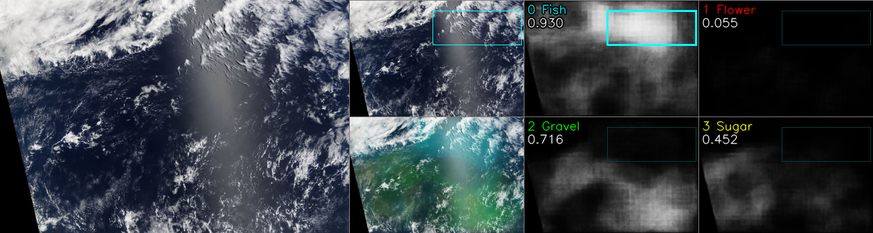
software version : on_cloud_one_02a
- implement resnet34-fpn
- single fold with 3x TTA (null, flip_lf, flip_ud)= lb 0.656, ensemble of 3x fold = 0.6586
- what is implemented:
1. prediction results visualisation

Slide 2
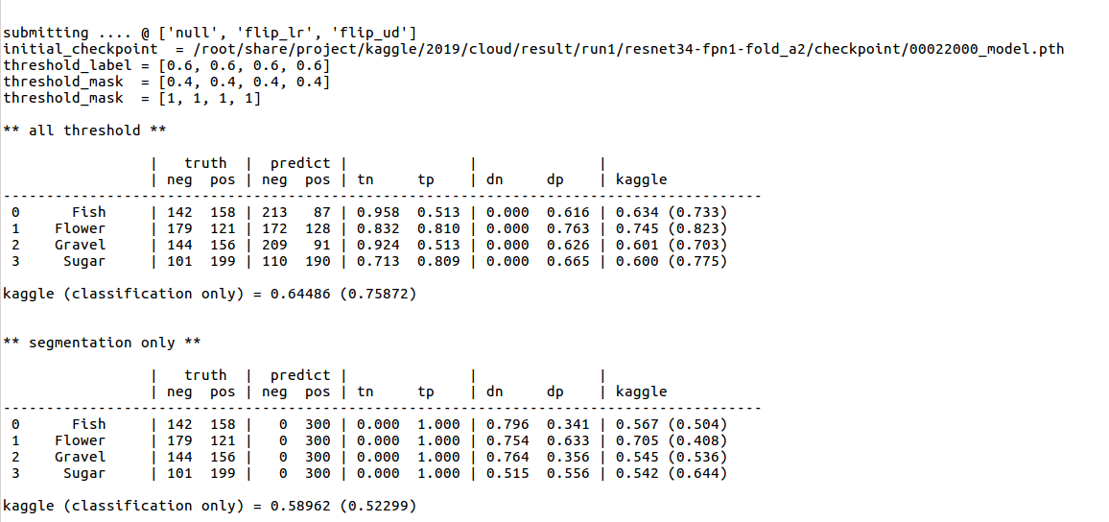
2. prediction of kaggle LB score

