Slide 1
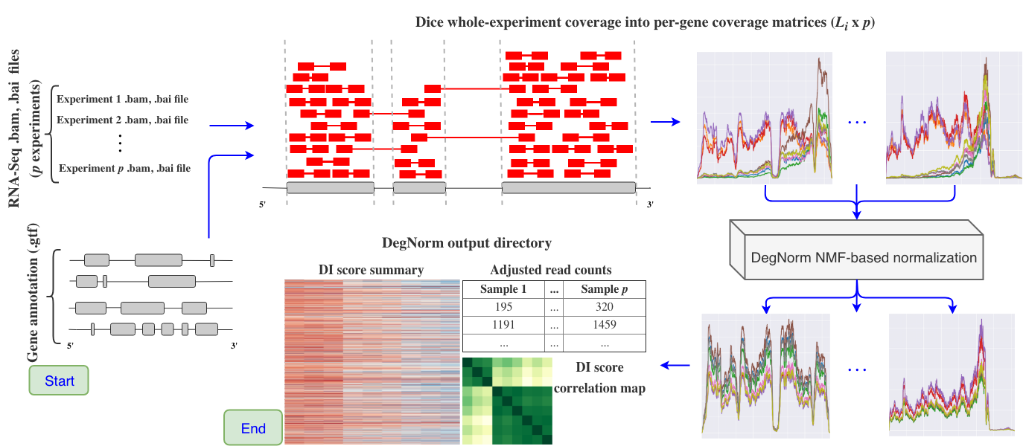
RNA-degradation bias normalization

