Slide 1








Slide 2



Data science is the study of data to extract knowledge and insights from the data and apply knowledge and actionable insights. In this tutorial, we will work on IPL Data Analysis and Visualization Project using Python where we will explore interesting insights from the data of IPL matches like most run by a player, most wicket taken by a player, and much more from IPL season 2008-2020.

Slide 3
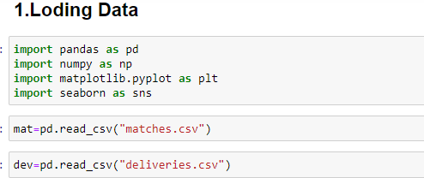
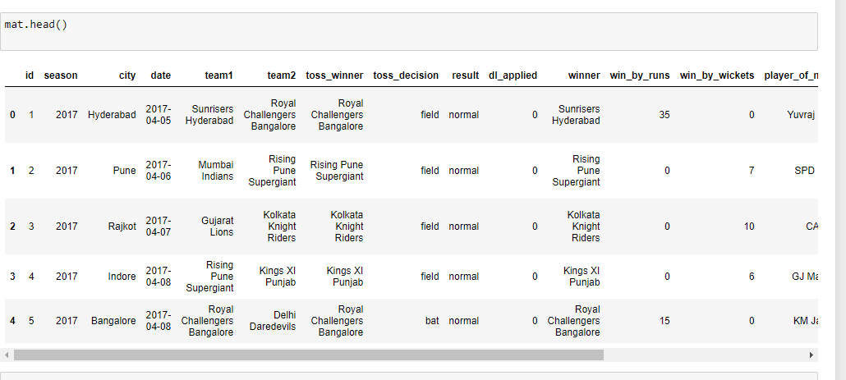
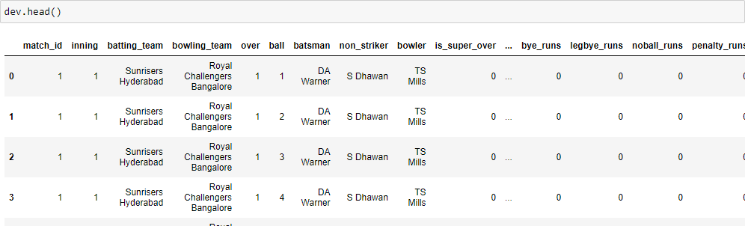

Slide 4


Slide 5
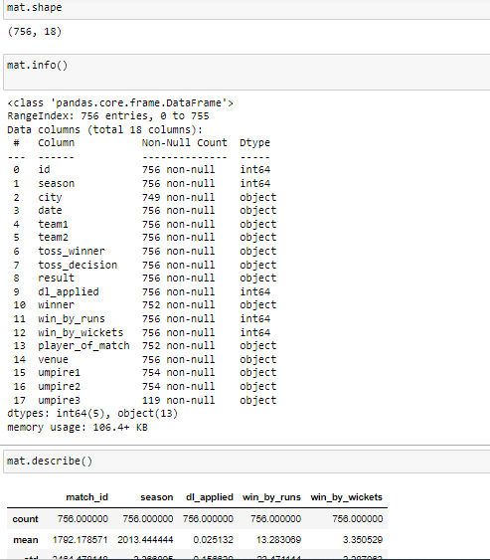


Slide 6


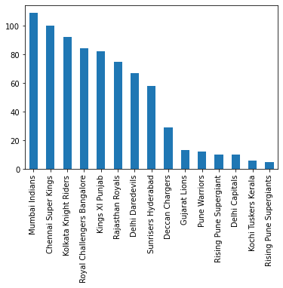

Total match played by all team
2. maximum time won the player of the match

Slide 7
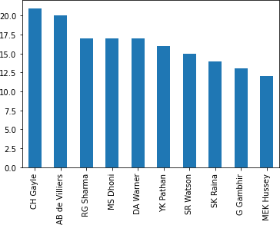
3.toss win by perticuler team

Slide 8
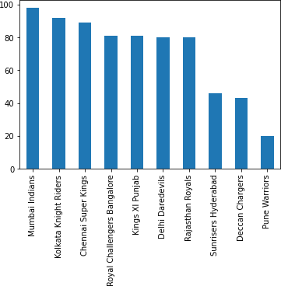
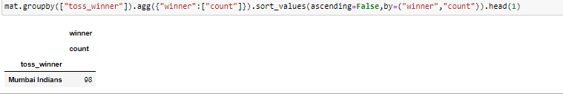

Team that won most matches by batting first

Slide 9

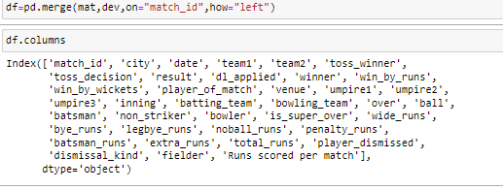



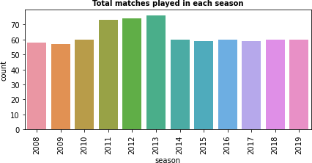

Merging the two Datasets into a new datasets and read it

Slide 10
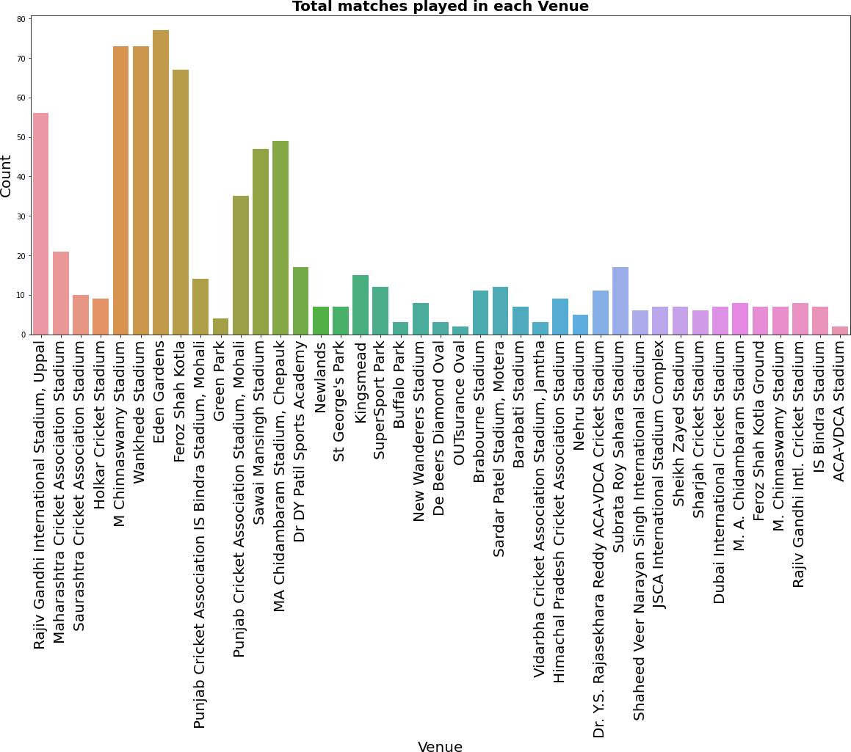

Slide 11



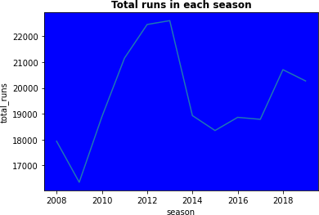

Slide 12





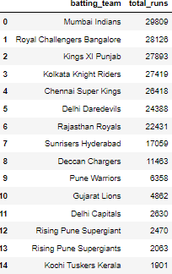

Slide 13

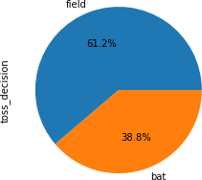




Slide 14
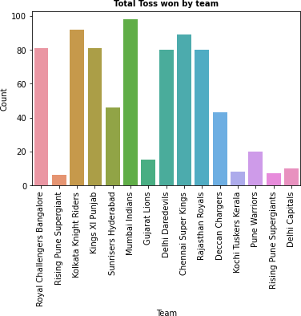

Slide 15
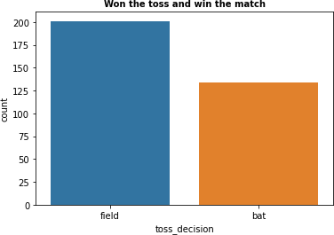

Slide 16


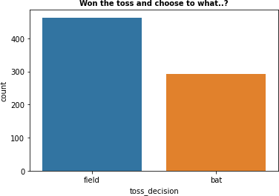

Slide 17


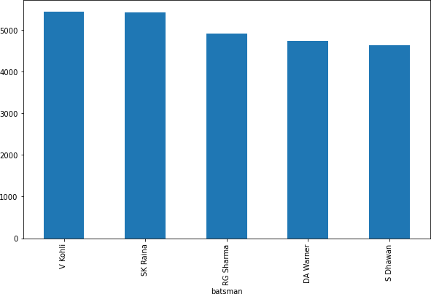

Slide 18




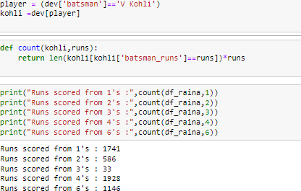

Slide 19


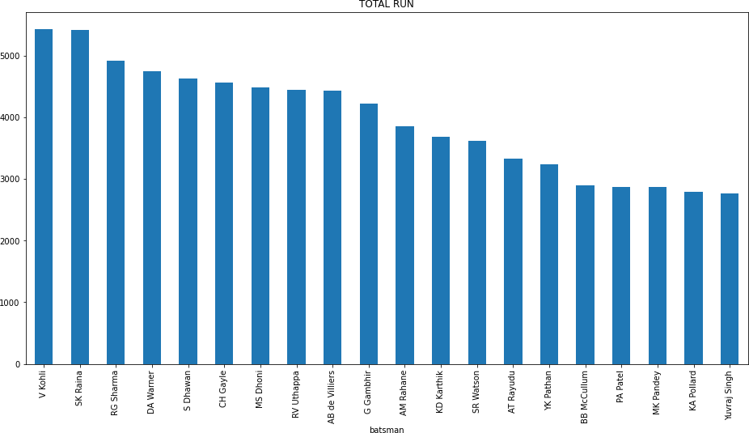

Slide 20


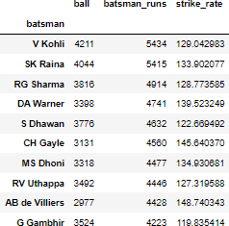

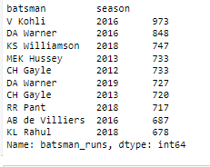

Slide 21


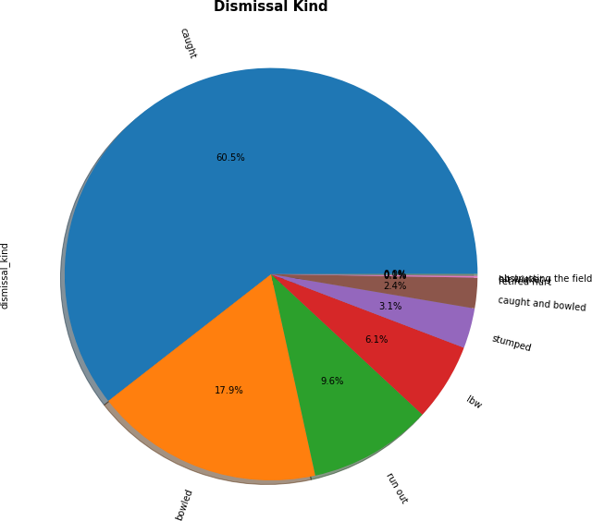

Slide 22
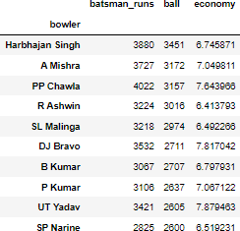
Economy with maximum bolling

Slide 23





Slide 24



Hope you liked our project on IPL Data analysis and Visualization using Python. We just listed some basics to medium-advanced analysis over here, to give you an idea of how to use the data set. You can come up with your own data analysis of IPL data with Python libraries and projects.

