Slide 1


MICROSOFT AGENTS LEAGUE · REASONING AGENTS (MICROSOFT FOUNDRY)
BenefitNavigator
MALAYSIA 🇲🇾
Tell it your situation in plain language — it finds the government benefits you’re
entitled to, every figure traceable to a gazetted .gov.my source, or it refuses to guess.
Multi-step reasoning
5 agents on Azure AI Foundry
Deterministic trust core · cite-or-refuse
Live on Azure: benefitnav-api.ashyocean-f47e8ddf.swedencentral.azurecontainerapps.io

Slide 2
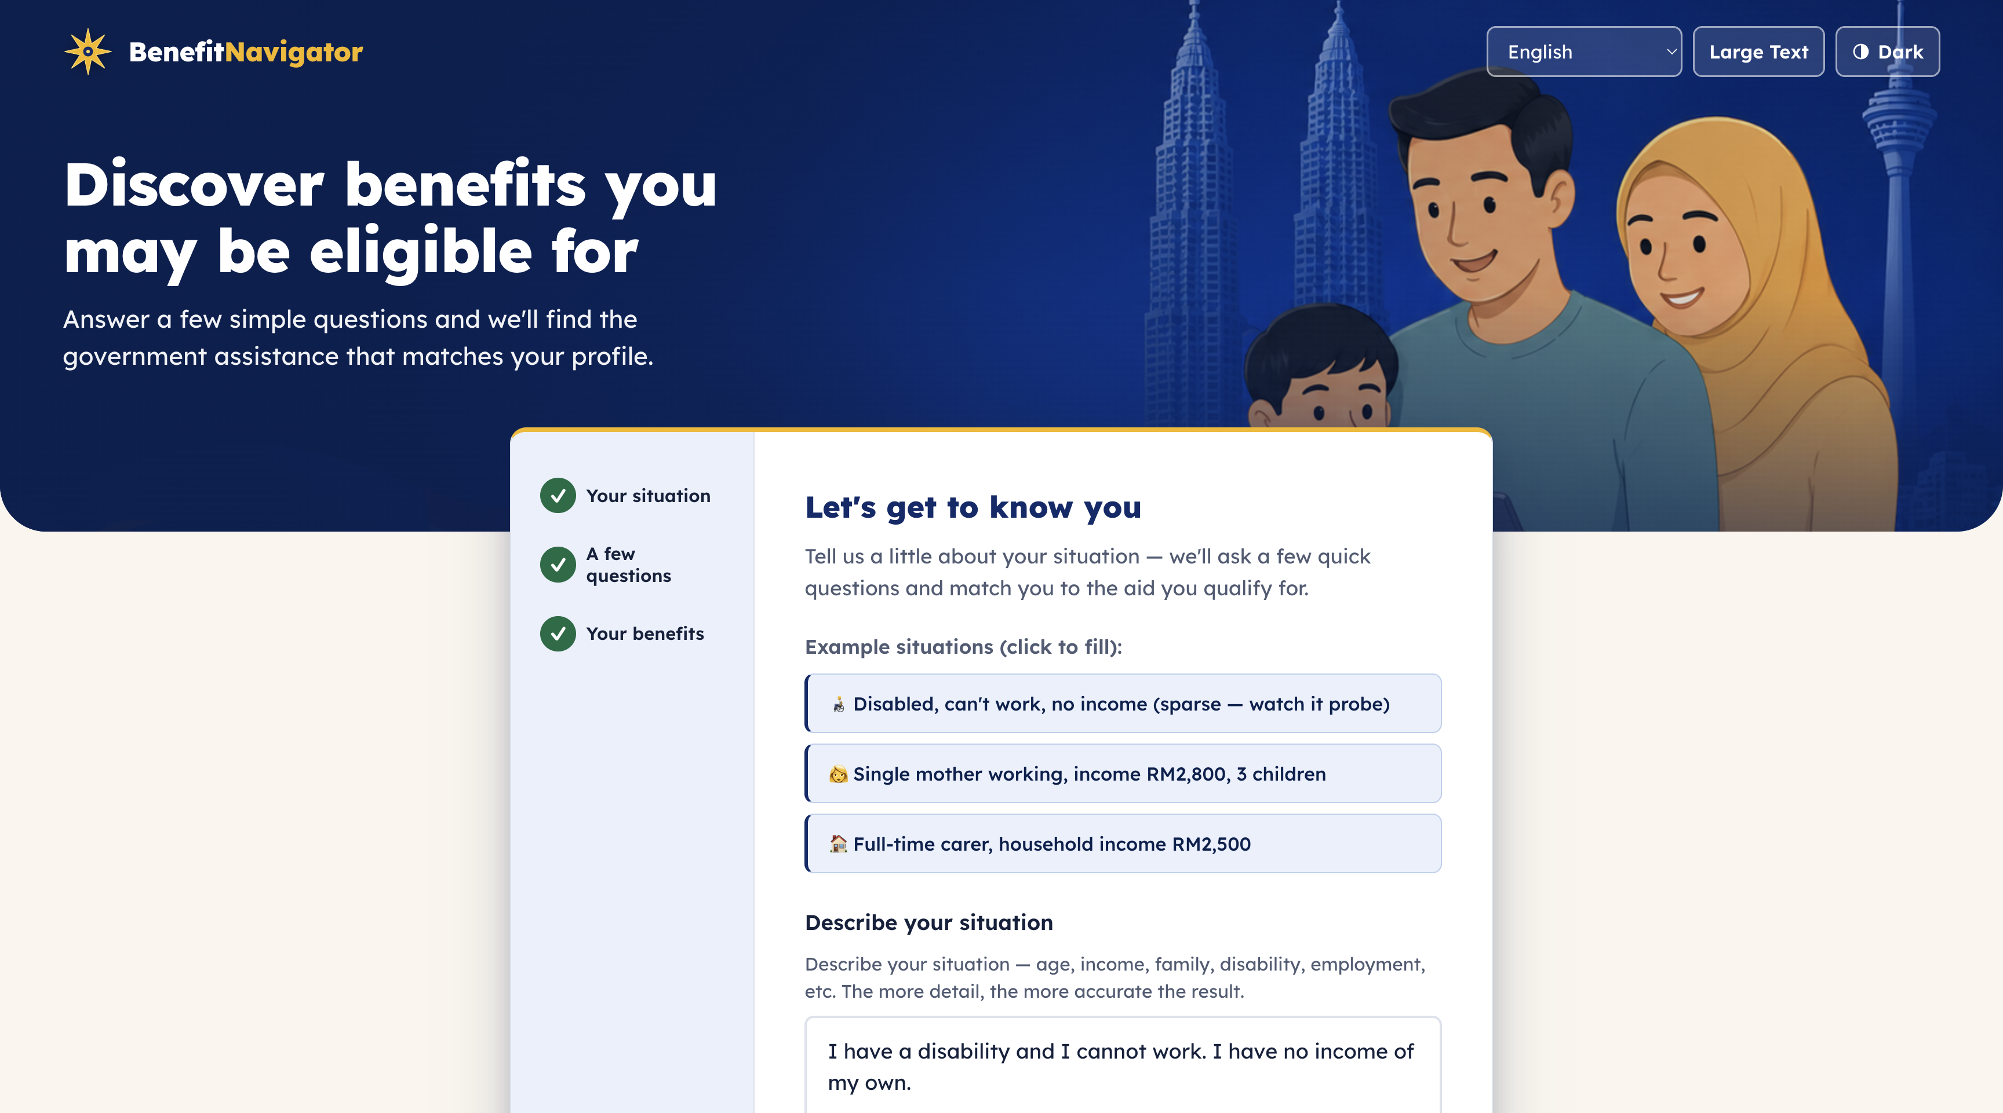
THE PROBLEM
Millions qualify. Few ever claim.
Malaysia's safety net is real — but the rules are scattered across JKM, PERKESO and LHDN, written in dense officialese. “Am I eligible?” has no single answer, so eligible citizens simply never apply.
6
gazetted .gov.my documents a citizen would have to read and cross-reference
3
agencies (JKM · PERKESO · LHDN) with different income rules & categories
The live app — Malay-first, accessible (ARIA, large-text, 4 languages).
0
tolerance for a hallucinated entitlement — wrong aid advice is worse than none
BenefitNavigator Malaysia · Microsoft Agents League · Reasoning Agents
02

Slide 3




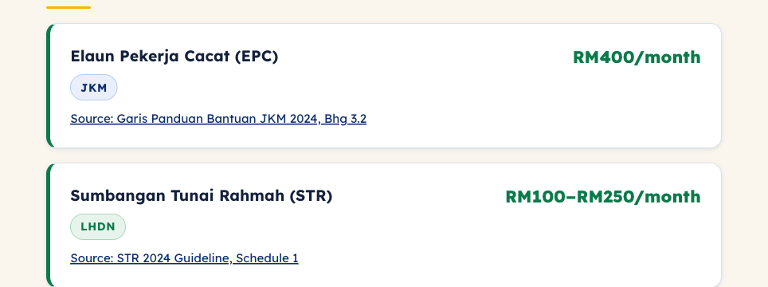
WHAT IT RETURNS
Three answers — and every figure is cited.
You already qualify
You almost qualify
Appeal, ready to send
Benefits you're entitled to now, each with its ringgit amount and a .gov.my citation.
Near-miss programmes plus the single action that would unlock each one.
A drafted surat rayuan grounded in your stated facts and the programme's cited criteria.
Straight from the live app:
Verified against official sources ✓ 0% unverified — the amount is a sum of computed, cited verdicts, not an LLM guess.
BenefitNavigator Malaysia · Microsoft Agents League · Reasoning Agents
03

Slide 4

ARCHITECTURE
FastAPI conducts · agents execute · core owns the truth
⚙ Conductor — FastAPI · Container App
🧠 Azure AI Foundry
Citizen
orchestrate.run_chat — per-turn driver
route · execute
Agent Service · 5× gpt-4o
Accessible web UI
Malay-first · 4 langs
Orchestrator (router)
DUAL SAFETY GATE (non-bypassable)
Interview
1 · amount guard 2 · Content Safety groundedness → fail = refuse to a human
Communicator
Escalation
Retrieval (live)
🔒 Deterministic trust core — no LLM
MCP · HMAC token
compute.summarise — checker · status · elicit (Kleene 3-valued)
🛠 MCP trust-core server
thresholds.json — cited, gazetted rules (a benefit = a data edit, not code)
Container App · 5 tools: grill_next · grade · retrieve (live) · assess · optimize (latent)
tools → compute
📚 Knowledge — Foundry IQ
Azure AI Search (Basic) · hybrid BM25 + vector + semantic rerank
text-embedding-3-large · Blob: 6 gazetted .gov.my docs
BenefitNavigator Malaysia · Microsoft Agents League · Reasoning Agents
04

Slide 5






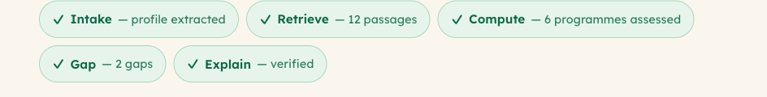
REASONING & MULTI-STEP THINKING
One turn = a seven-step reasoning pipeline
The design decision: the LLM never decides eligibility and never does arithmetic. It only extracts facts and narrates verdicts — the deterministic core does the rest.
1
2
3
4
5
6
7
Shield
Intake
Route
Interview
Compute
Retrieve
Dual gate
injection screen
extract stated facts
ask / assess / escalate
3-valued · next best Q
verdicts + amounts
cited .gov.my passages
verify or refuse
Why the interview is deterministic
Shown to the citizen — “How we checked”
Kleene three-valued logic. An incomplete profile evaluates to unknown — never a wrong guess. next_field() then picks the one unanswered fact that would unlock the highest-value programme. The LLM only phrases that question; it never chooses it.
Each step is surfaced in the UI — the reasoning trail is the product, not a black box.
BenefitNavigator Malaysia · Microsoft Agents League · Reasoning Agents
05

Slide 6
MICROSOFT FOUNDRY
A genuine multi-agent system on Azure AI Foundry
Orchestrator
Interview
Communicator
Escalation
Retrieval
Router — picks ask / assess / escalate. Tool-less; produces no facts.
Asks the next question warmly; the engine chooses which.
Explains verdicts in plain Malay; drafts appeals.
Hands off to a human, never a dead end.
Formulates a Malay query, calls retrieve — on the critical path.
— (router)
grill_next
grade
—
retrieve
🛠 Trust-core MCP server
📚 Foundry IQ — agentic retrieval
Agents reach the deterministic core ONLY through Model Context Protocol tools — verdicts and questions are signed across an HMAC state token the agent can relay but never alter.
An Azure AI Search knowledge base over 6 gazetted .gov.my documents — hybrid BM25 + vector + semantic rerank returns extractive, cited passages that ground every narrative.
† Same-project Foundry→Foundry A2A is an open platform bug, so the conductor performs the delegation hop — the Orchestrator still owns the routing decision. Genuine multi-agent; only the network hop moved.

Slide 7
RELIABILITY & SAFETY
Two things LLMs are bad at — fenced off by design
🧠 What the LLM does
🔒 What the core does (no LLM)
Extract facts the citizen stated Phrase the next question Narrate the verdict in plain Malay Hand off to a human
Decide eligibility Compute every RM amount Pick the next question Cite the .gov.my source Refuse the unverifiable
Every narrative passes a non-bypassable dual gate before any citizen sees it:
1 · Amount guard (hard)
2 · Content Safety (soft)
Fail = refuse
Every RMxxx in the text must trace to a verdict, the stated income, or a gazetted threshold. A fabricated “RM9000” trips it precisely.
Azure AI Content Safety scores groundedness against the verdicts + cited passages — catches ungrounded claims that have no fake number.
Either check fails ⇒ the turn refuses and routes to Talian Kasih 15999. A missing agent fails hard (action=error) — never a local guess.
BenefitNavigator Malaysia · Microsoft Agents League · Reasoning Agents
07

Slide 8


THE AZURE STACK
Fully cloud-hosted — no laptop in the loop
Azure AI Foundry — Agent Service
Azure Container Apps ×2
5× gpt-4o agents: route · interview · narrate · escalate · retrieve
benefitnav-api (conductor + gate + UI) · benefitnav-mcp (trust tools)
Azure AI Search (Basic) + Foundry IQ
Azure OpenAI — gpt-4o + embeddings
hybrid + semantic rerank, extractive citations over the corpus
agent inference + intake; text-embedding-3-large (3072-d)
Azure AI Content Safety
Azure AI Translator + Blob Storage
Prompt Shields (injection) + Groundedness (the gate's soft guard)
BM ↔ EN · 中文 · தமிழ் · 6 source-of-truth .gov.my documents
Secrets: none in the repo. The conductor uses a Container-App managed identity (Azure AI Developer); keys & the shared HMAC token are injected as Container-App secrets, fetched at runtime via the az CLI locally.

Slide 9
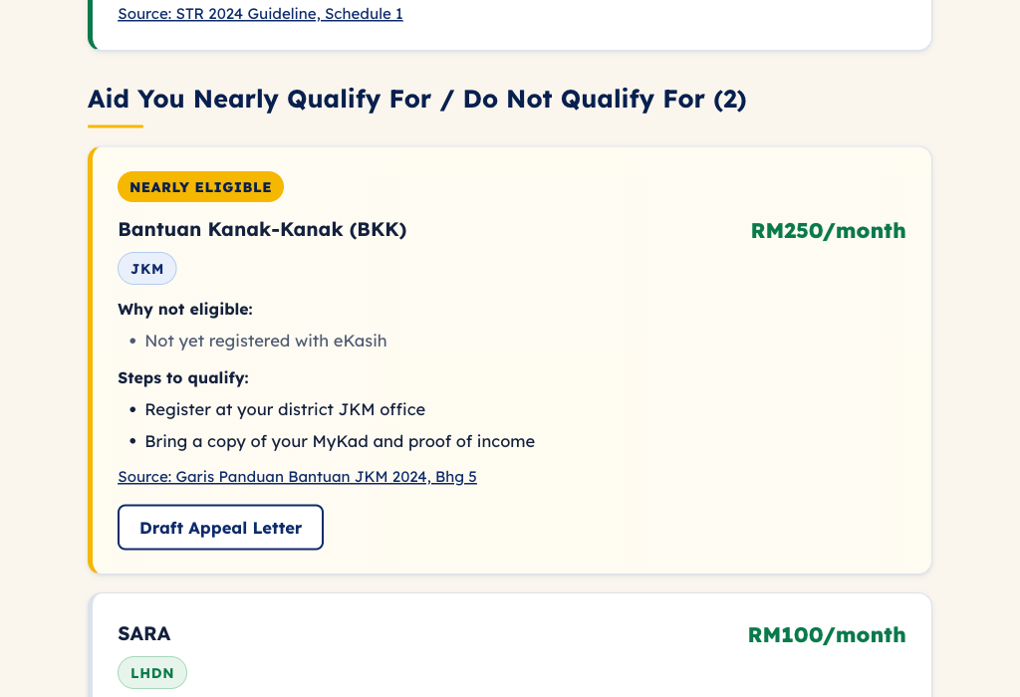
LIVE DEMO
Let's see it work.
1
Type a situation in plain Bahasa Melayu — single mother, OKU child, low income
2
Watch the adaptive interview ask one decision-relevant question at a time
3
See the verdict cards — amounts + .gov.my citations + the one unlocking action
4
Toggle EN / 中文 / Tamil instantly · generate the appeal letter
Near-miss → the one unlocking action → a drafted appeal letter.
▶ benefitnav-api.ashyocean-f47e8ddf.swedencentral.azurecontainerapps.io (synthetic data only — never a real MyKad)

Slide 10
BenefitNavigator
Right benefit · right citizen · every figure cited — or it refuses to guess.
Reasoning
Foundry
Reliability
Accuracy
UX
7-step pipeline · Kleene 3-valued interview
5 agents · MCP trust core · Foundry IQ
dual gate · fail-hard · cite-or-refuse
deterministic verdicts from cited rules
Malay-first · accessible · 4 languages
Live on Azure: benefitnav-api.ashyocean-f47e8ddf.swedencentral.azurecontainerapps.io
Built for the Microsoft Agents League · Reasoning Agents (Microsoft Foundry) · Terima kasih 🇲🇾

