Slide 1
GTT-Parking System
Ticket distribution - Ticket checking
Parking maintenance - Money collection
Paolo Caleffi
Filippo Castrogiovanni
Andrea Cuiuli
Alessio Valenti
Notes:
1

Slide 2
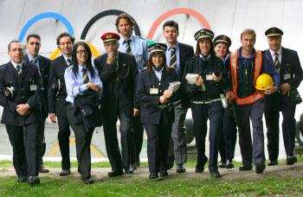
Presentation: GTT local transport company
SIZE:
Employs 5,500 personnel
Transports 200 millions of passengers per year
GOAL: it manages…
The local public transport service (tram, bus, metro)
Parking spots
PROFIT: 500mln € turnover (2010)
Notes:
2

Slide 3
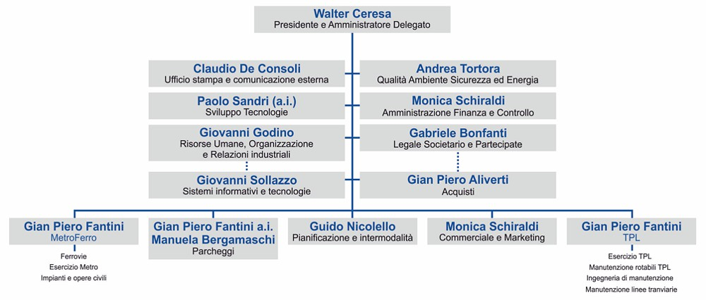
Organizational structure: Functional & Service
Departments are organized by separating each of functional areas and managing them independently of the others.
Functional Managers
Each service group falls within the reporting structure of an executive and that person oversees everything related to that particular service.
Service Managers
Notes:
3

Slide 4
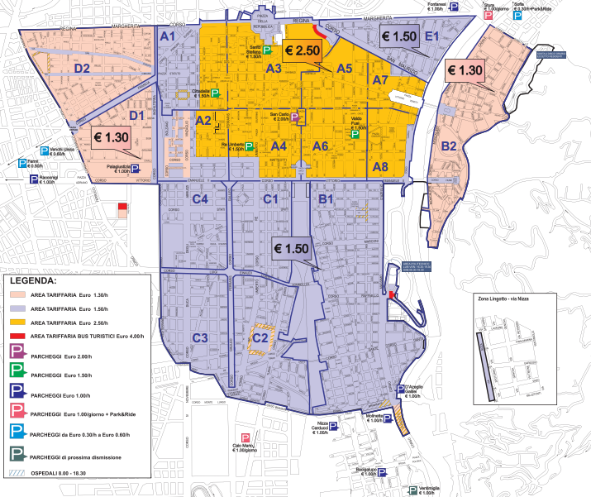
Blue Zone Parking Area
Parking is allowed inside the blue lines against payment only
The price depends on the parking zone and calendar time
Blue zones include the city centre and a wide surrounding area.
Notes:
4

Slide 5
AS - IS
Notes:
5

Slide 6
FUNCTIONAL VIEW
Notes:
6

Slide 7
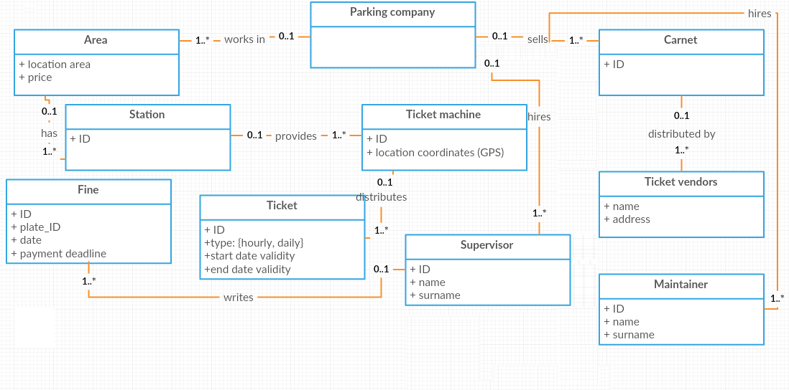
Class diagram
Notes:
7

Slide 8
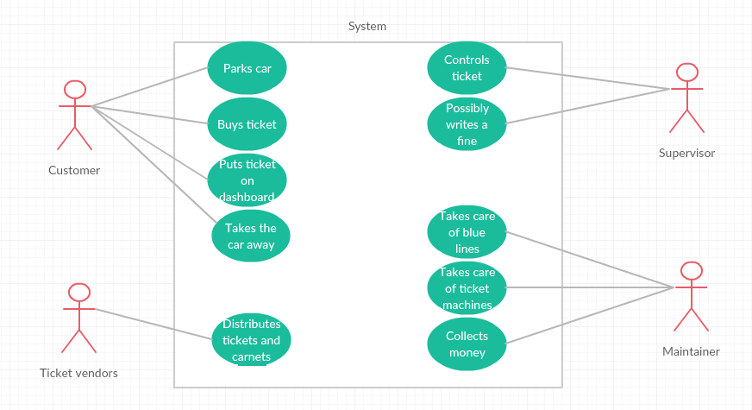
Use Case diagram
* for sake of simplicity, the maintainer includes also the role of money collector (actually they are two different roles in the company)
Notes:
8

Slide 9
Main processes
Ticket distribution
Ticket checking
Parking maintenance and money collection
Notes:
9

Slide 10
KPIs
Notes:
10

Slide 11
KPIs
KPI Category (General, cost ..) | KPI Name | KPI Description | Unit of measure
General | N_TK | Number of ticket issued per year
 | N_TU | Number of ticket machines
 | N_TV | Number of ticket vendors
 | N_NO_TK | Number of car parked per year without ticket
Efficiency | C_TK | Cost of issuing a ticket (paper or carnet, ticket machine, personnel, distribution to vendors) | Euro
 | C_C | Cost of controlling tickets (personnel) | Euro
 | C_NO_TK | Loss of revenue due to N_NO_TK (higher is N_NO_TK higher is the loss) | Euro
 |  |  | Euro
 | C_M_M | Cost of maintenance of ticket machines (paper, ink, malfunction, broken)
 | C_R_M | Cost of retrieving money from ticket machines (personnel) | Euro
Service | L_TK | Lead time to buy a ticket and put it in the car (ticket machines or vendor) | T
Quality | E_TK | Errors in tickets issued
 | P_C_NO_TK | Precision of C_NO_TK

Slide 12
KPIs description
The process “Ticket distribution” involves lot of phases and it’s really expensive for the company.
The ticket can be bought at a turret or at a ticket vendor (bar, shops, etc): turrets are non-human resources and vendors are human resources.
The output volume is the number of tickets produced by turrets plus the tickets sold by vendors.
There are costs spread between distribution, checking and maintenance.
Because of defect in turrets there is the possibility of having invalid or failed tickets so we need to calculate the conformity and the reliability of the turrets.
In particular we said that a tickets is invalid if it has a wrong start/end date/time or a wrong parking zone or it’s unreadable, instead is failed when it’s not emitted due of some malfunctioning of the turret (no paper, money not accepted, etc).

Slide 13
Customer point of view
From the point of view of the customer the process consist in finding a turret or a vendor near the spot in which he parked the car, buy the ticket (or a carnet) and put it on the car visible for the inspector to check it.
Otherwise if he previously bought a carnet he just need to put it visible in the car.
Notes:
13

Slide 14
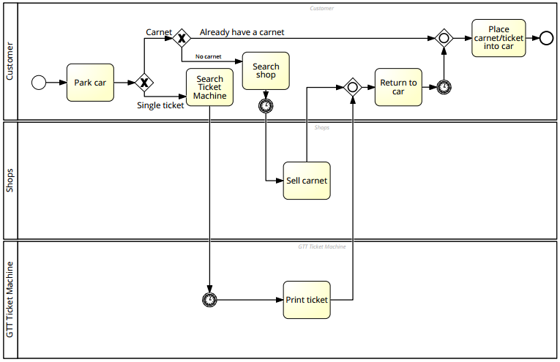
Ticket distribution
Notes:
14

Slide 15
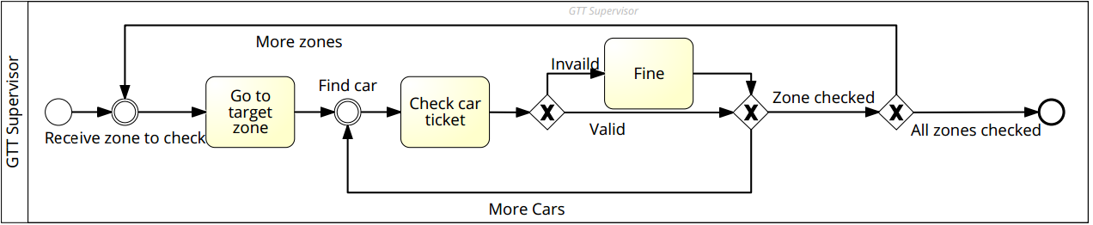
Ticket checking
Notes:
15

Slide 16
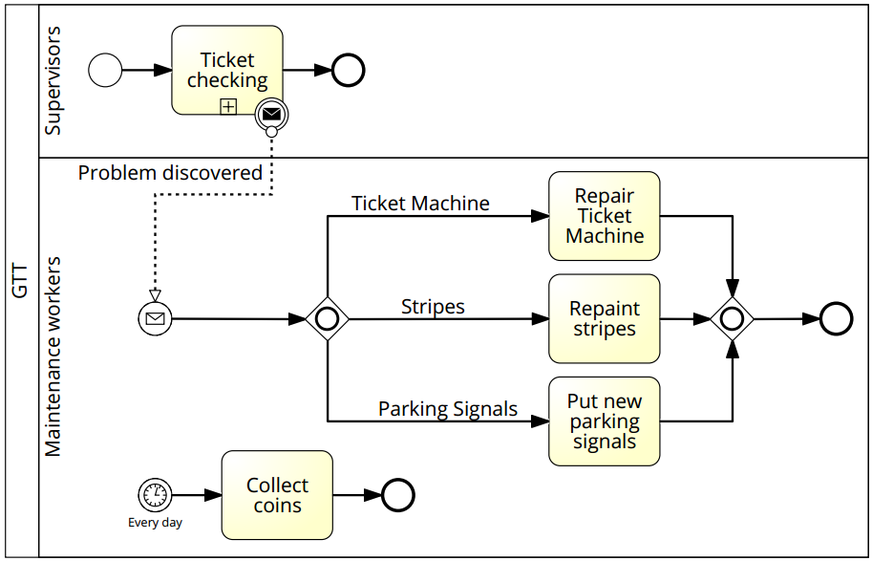
Parking maintenance and money collection
Notes:
16

Slide 17
TO BE
The paper ticket will be substituted by electronic ticket managed via smartphone.
An app will be developed in two flavours: for customers and for supervisors.
Ticket vendors and carnets will be eliminated, some sort of pass can be deployed instead.
Knowing the number of park spots in an area and the number of electronic tickets, can be used to implement a “search free spot” feature.
For customers: the app creates an account for the user, either via classic login or with social network.
Each account is associated with a credit card on which ticket cost is accredited: in this way we grant per minute ticket accounting and an easy payment method.
Ticket retrieving is managed in this way: the user parks a car, scans the QR code on the parking signals, which identify the pricing zone, inserts the license plate of the parked car (or selects it from a pre-inserted car description) and starts the time count.
Once returned, he stops the time count and the system calculates the due price, accrediting it on the user credit card.
For supervisors: supervisors' account are inserted by the GTT company and have access to a second version of the app.
Ticket checking is managed in this way: the supervisor inserts the car license plate in the app which returns latest tickets associated with that car: if there is no active ticket, a fine is issued on the user account.
If the car has never been inserted into the system, a physical fine is deployed on the car.
Notes:
17

Slide 18
TRANSITION
Discounts should be deployed in order to persuade customers to download the app and register.
The old and new systems will initially coexists, gradually abandoning the first one (do not replace broken ticket machines, less money to collect, less ink and paper, etc.) while most of the customers start to use the electronic tickets instead of the physical one. Tickets vendors will continue to sell paper tickets until they finish all of them, then there will be no more ticket vendors.

Slide 19
VIEWS
Notes:
19

Slide 20
IT VIEW
Server
Database
Client
Smartphone app for customers
Smartphone app for supervisors
Notes:
20

Slide 21
FUNCTIONAL VIEW
Notes:
21

Slide 22
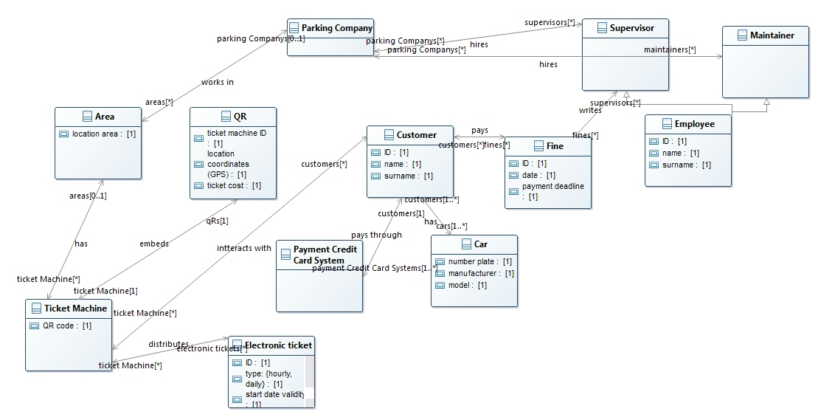
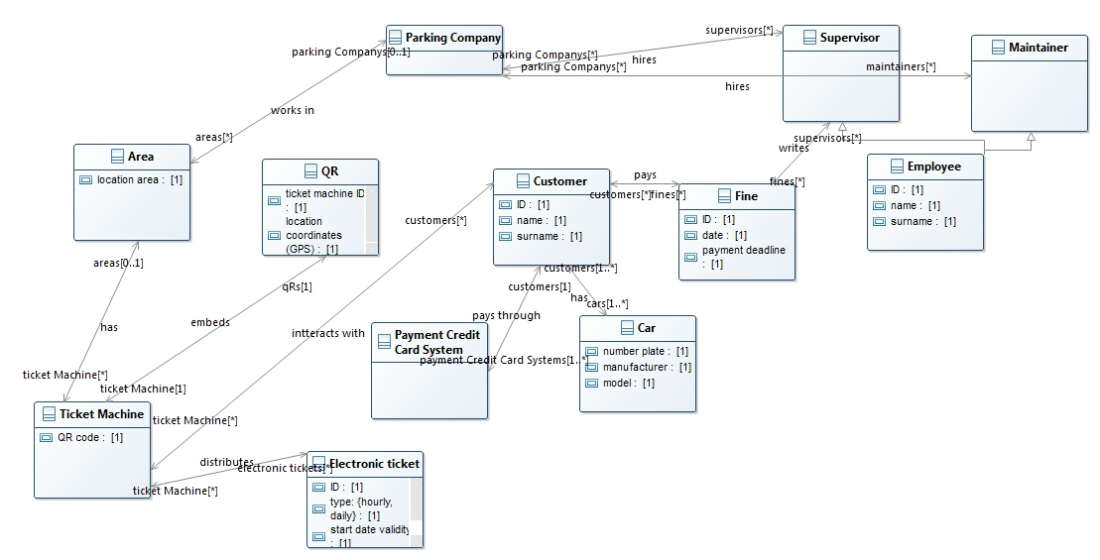
Class diagram
Notes:
22

Slide 23
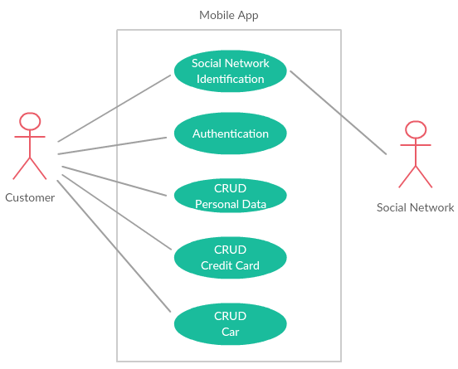
Use Case diagram
Notes:
23

Slide 24
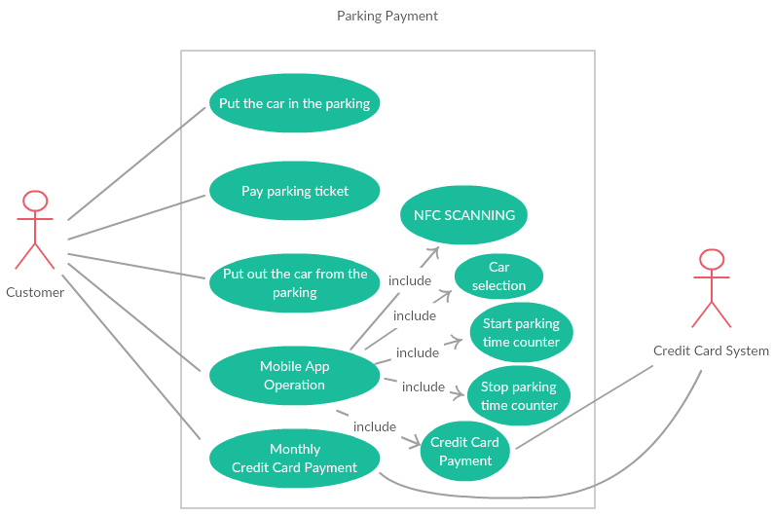
Use Case diagram
Notes:
24

Slide 25
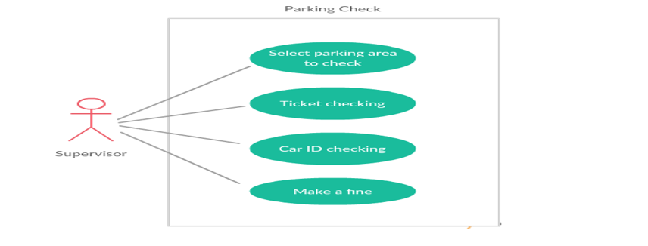
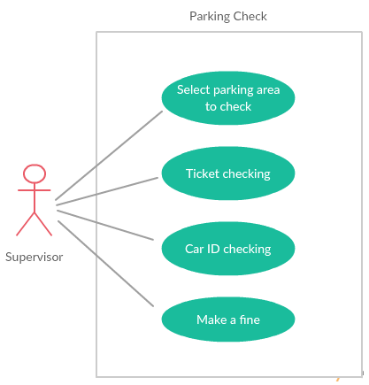
Use Case diagram
Notes:
25

Slide 26
KPIs
KPI Name | AS IS | TO BE
N_TK |  | May Increase with the help of the app to find free spots
N_TU |  | No more Tickets Machines
N_TV |  | No more ticket vendors because everything will be electronic
N_NO_TK | Hard to measure. | May decrease due to the app helping controllers, but uncertain.
C_TK |  | Highly Decrease (no more ticket to print, less personnel and no vendors)
C_C |  | Slightly decrease (less personnel)
C_NO_TK | Hard to measure. | Decrease if N_NO_TK decrease.
C_M_M |  | No more maintenance cost for the ticket machines
C_R_M |  | No more cost for retrieving money from ticket machines
L_TK |  | Decrease (with the use of electronic payment)
E_TK |  | Errors in tickets should disappear
P_C_NO_TK |  | Probably unchanged. However the app should help supervisor controlling tickets.
Notes:
27

Slide 27
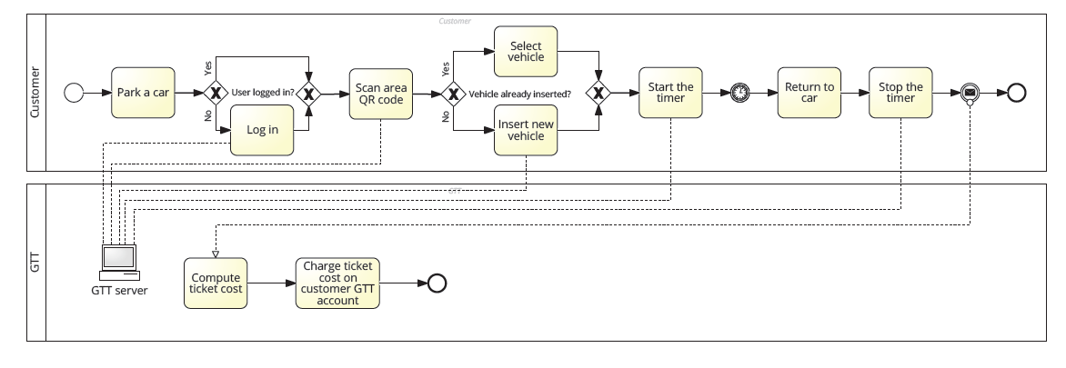
Ticket distribution
Notes:
28

Slide 28
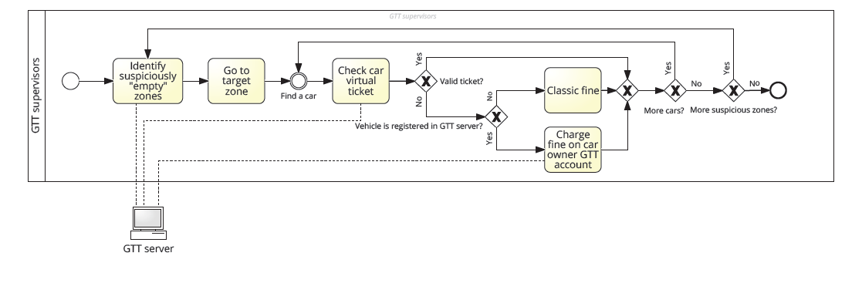
Ticket checking
Notes:
29

Slide 29
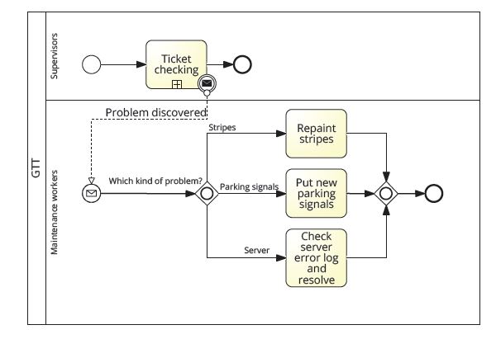
Parking maintenance
Notes:
30

Slide 30
EFFECTS
The most important effect regards:
the decrement of raw materials (ink, paper, etc)
the decrement of the number of the employees (both supervisors and maintainers) of the company, because their work hours are reduced (the job of collecting money will be deleted after the transition)
We can conclude that the TO BE situation is better with respect to the AS IS: some costs will decrease (the cost of the investment may re-gained quite quickly), and the overall service (and in particular the customer satisfaction) will improve due to the new IT system.
In addition, GTT will have more, and more specific, data about their customers which can help while analyzing future goals at strategic level.
Notes:
31

Slide 31
Thanks for your attention
Notes:
32

