Slide 1

LEXASSIST
DSC 550: MASTER’s Project
Automating Legal Intelligence: Design and Implementation of a Multi-Agent LLM System for Legal Clause Analysis and Risk Detection
Presented by: Shruthi Ravi (02196018)
Presented TO: INSTRUCTOR: Prof. ASHOKKUMAR R PATEL

Slide 2
PROBLEM STATEMENT
Why did I decide to choose this topic? What are the real legal scenarios that we come across day-to-day?
Legal documents such as contracts, policies, and amendments are often long, complex, and difficult to interpret in real time, especially under time pressure.
Existing legal resources are not designed for instant querying, structured understanding, or risk evaluation in simple, human-readable terms.
There is a need for an intelligent system that allows users to instantly search, understand, and assess legal clauses using real-world legal datasets(in this case, Legal-Clause Dataset from Kaggle), enabling faster and more informed decision-making without requiring immediate legal assistance.
CEO / High Authority
Had to produce a summary regarding policies for the immediate query asked by the Company sponsor
International student /
Clueless User
Just curious about Government Rules and Policies / in an extreme critical situation

Slide 3
OBJECTIVES
Develop an intelligent legal assistant (LexAssist) to automate the analysis of large-scale legal clause datasets
Enable accurate clause classification across 395 legal categories using semantic similarity and LLM reasoning
Implement efficient semantic retrieval to identify relevant legal clauses from 150,000+ entries
Design a risk analysis module to detect critical legal risks such as liability, indemnification, and unfair terms
Generate structured, plain-English summaries for improved readability and decision-making
Build a modular multi-agent architecture to handle complex legal workflows in a scalable and flexible manner

Slide 4
TECH STACK
FRONTEND
Streamlit (interactive UI)
BACKEND
FastAPI + Uvicorn (REST API & server)
AI AGENTS
Anthropic (LLM for reasoning & analysis)
DATA & RETRIEVAL
DEPLOYMENT & TOOLS
ChromaDB (vector database)
Python (core language)
HTML/CSS + Plotly (design & visualizations)
LangChain & LangGraph (agent workflows)
Multi-Agent System (Supervisor, Retriever, Classifier, Risk, Summariser)
Sentence Transformers (all-MiniLM-L6-v2)
Pytest + Logging (testing & debugging)

Slide 5
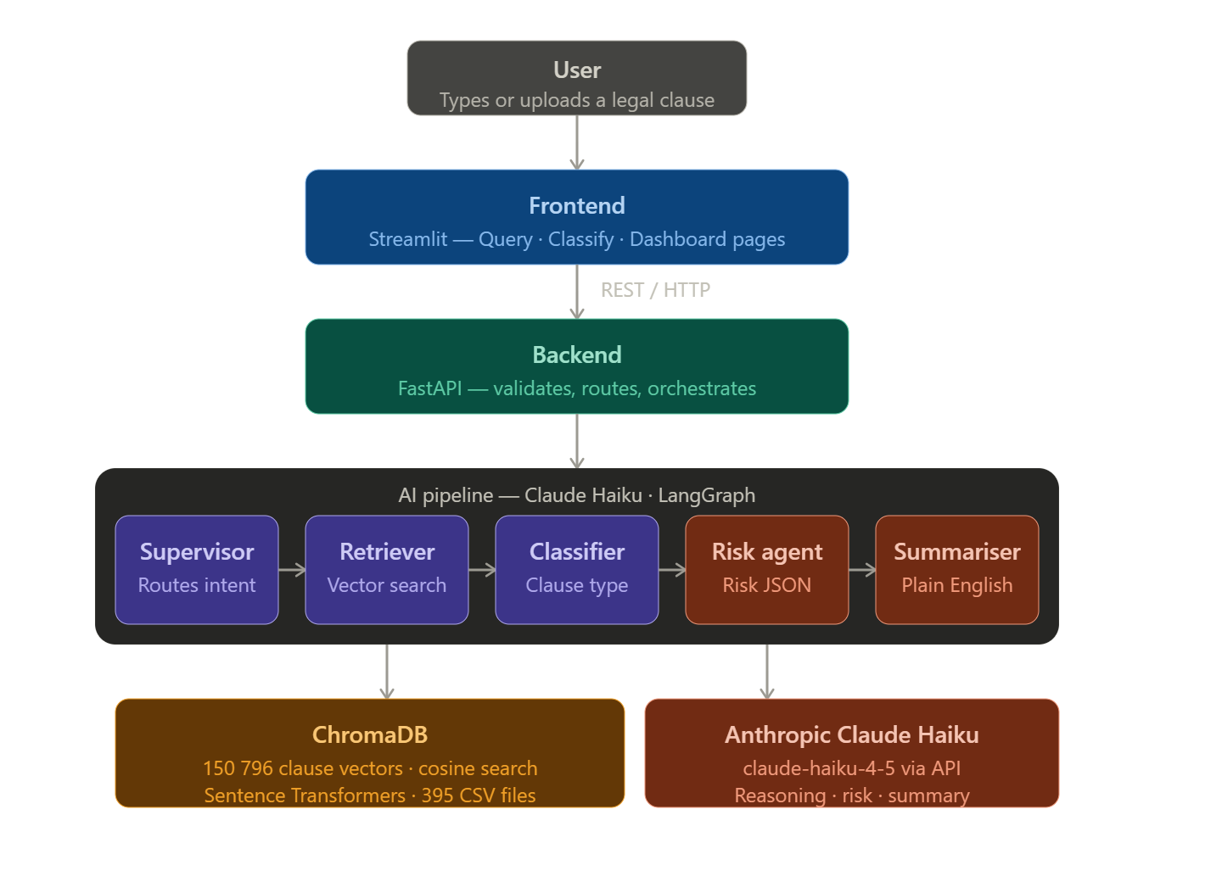
SYSTEM ARCHITECTURE (sIMPLIFIED Ver.)

Slide 6
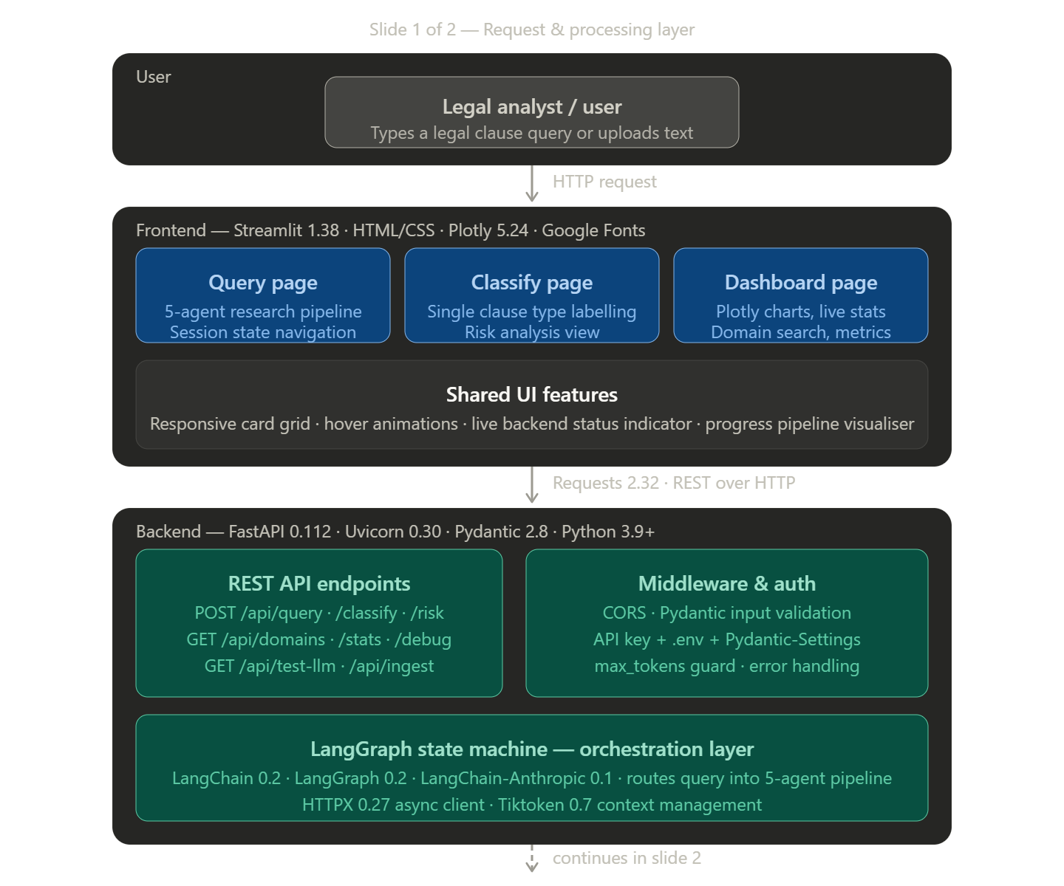
SYSTEM ARCHITECTURE
Step 1. User Input User enters a query or legal clause in the Streamlit app.
Step 2. Page Handling Streamlit routes the request based on action:
Research (full pipeline)
Classify (label only)
Risk Assessment (Analysis)
Dashboard (overview) + Document (Legal Clause Dataset)
Step 3. API Request Streamlit sends an HTTP POST request to FastAPI (/api/query, /api/classify).
Step 4. Validation FastAPI validates the request using Pydantic schemas.
Step 5. Middleware Checks CORS, API key authentication, and error handling are applied.
Step 6. Orchestration Start Request is passed to LangGraph, which initializes state and triggers the Supervisor agent.

Slide 7
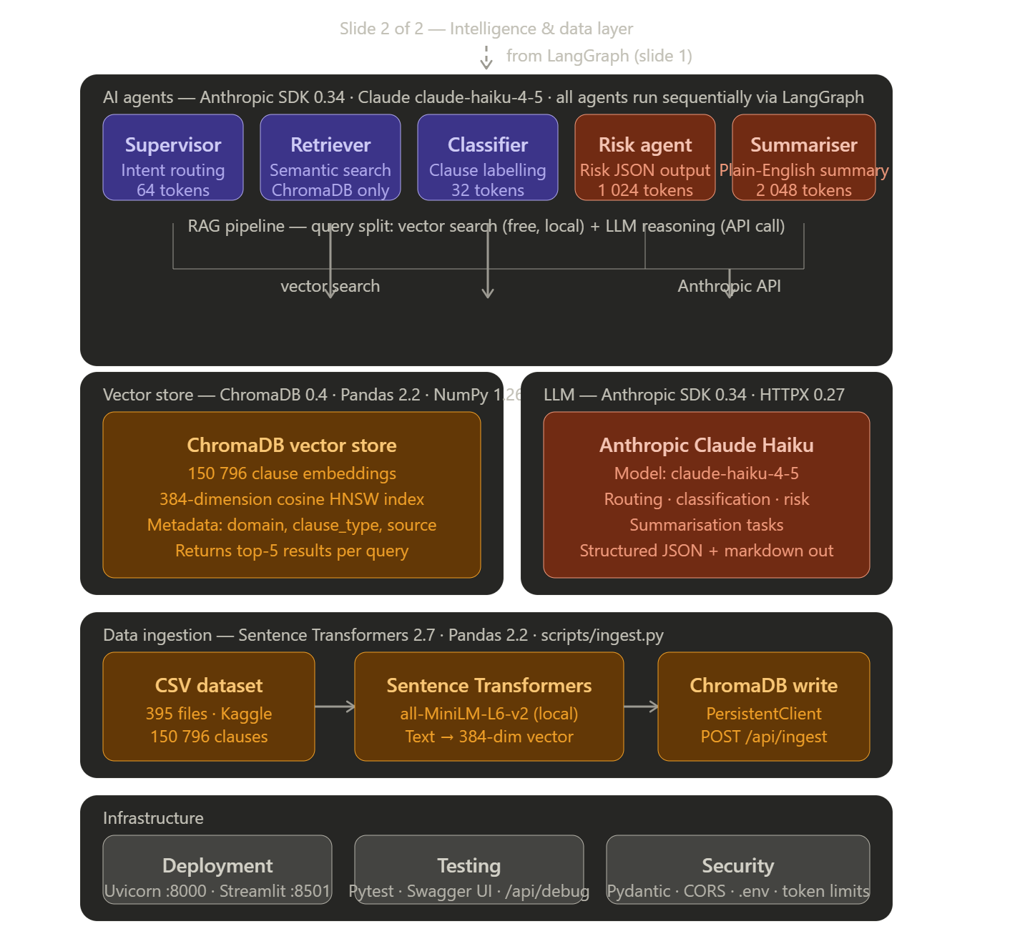
SYSTEM ARCHITECTURE
Step 7. Supervisor Agent Routing LangGraph routes the validated query to the Supervisor agent, which identifies the user’s intent and determines the sequence of agents to invoke.
Step 8. Retriever Agent Search The Retriever agent performs semantic search in ChromaDB and retrieves the most relevant legal clauses and supporting context.
Step 9. Classifier Agent Processing The Classifier agent labels the clause into appropriate legal categories such as liability, termination, or confidentiality.
Step 10. Risk Agent Analysis The Risk agent analyzes the retrieved clauses and classified results to generate structured risk insights.
Step 11. Summarizer Agent Response Generation The Summarizer agent converts the legal analysis into a plain-English explanation for the user.
Step 12. Final Response Delivery LangGraph returns the final output through FastAPI to Streamlit, where the results are displayed to the user.

Slide 8
AGENTS
Supervisor Agent
Receives every user query first. Analyses the intent and decides which agent path to activate — full pipeline, retrieval only, classification only, or risk only. Ensures no wasted compute.
Retriever Agent
Searches 150,796 embedded legal clauses in ChromaDB using cosine similarity. Returns the top 5 most relevant clauses with their domain, clause type, and similarity score. Requires no LLM call — pure vector search.
Classifier Agent
Identifies the exact type of any legal clause from 395 possible categories. Uses ChromaDB semantic match as the primary method. Falls back to Claude with the full dynamic category list if confidence is below the threshold. Classifies based on user type.
Risk Agent
Summariser
Scans clause language for 10 specific risk indicators, including unlimited liability, unilateral modification rights, vague terms, and unfair termination triggers. Returns a structured JSON report.
Takes all outputs from the previous 4 agents and generates a structured plain-English summary. Breaks complex legal findings into Overview, Key Points, Risk Assessment, and Recommended Actions — readable by non-lawyers.

Slide 9
UI: MAIN MODULES IMPLEMENTATION
Module 1: Legal Research
Users can enter any legal query or prompt, not just a clause.
The system identifies the type of query and maps it to the relevant clause category.
Module 2. Clause Classifier
Users can submit a clause or legal query to classify what type of clause it belongs to.
The system labels the clause category automatically.
Module 3. Risk Analysis
Users can analyze the risk level associated with a clause or legal situation.
The system evaluates risk from Low to Critical.
Providing: one-sentence explanation or solution, Key points related to the query, Risk assessment, Recommendations based on the analysis, Clause type identification and Similar related clauses for additional context
The interface also supports different user personas
For each user type, the system provides, Suggested questions they can ask, Recommended clause examples and Use-case specific legal queries
Example: A student facing rental agreement issues can receive an analysis showing whether their situation is low, medium, high, or critical risk, along with guidance.

Slide 10
EXPECTED OUTCOMES & FUTURE ENHANCEMENTS
Expected Outcomes
Future Enhancements
Faster and smarter legal research support
Improved clause classification and risk analysis
Better decision support for different users
Scalable multi-agent legal assistance platform
Role-based login portals for legal professionals, authorities, and consumers
Add more legal datasets to improve LLM and agent performance
Perform deeper data analysis for continuous model evolution
Expand with specialized agents and document-level legal assistance

Slide 11
CONCLUSION & rEFEReNCES
Conclusion
This work presents the development of a multi-agent AI legal assistant designed to support legal research, clause classification, and risk analysis. By integrating LLM, LangChain and LangGraph-based agent workflows, vector databases, and advanced LLM reasoning, the system enables more structured and context-aware legal decision-making. The approach demonstrates how combining multiple AI paradigms can enhance the accessibility, scalability, and efficiency of legal analysis, ultimately helping professionals navigate complex legal documents and reducing manual effort.
References & Related Works:
LegalGraphRAG: Multi-Agent Graph Retrieval-Augmented Generation for Reliable Legal Reasoning. (Focuses on integrating graph-based retrieval with multi-agent systems to improve reliability in legal reasoning tasks.)
PAKTON: A Multi-Agent Framework for Question Answering in Long Legal Agreements. (Proposes a multi-agent RAG framework specifically tailored for analyzing and answering questions from lengthy legal contracts.)
LawLuo: A Multi-Agent Collaborative Framework for Legal Consultation. (Introduces a collaborative agent system leveraging case-based retrieval for enhanced legal consultation.)
ChatLaw: Multi-Agent Collaborative Legal Assistant. (Presents a legal assistant that combines multi-agent workflows with knowledge graphs for improved legal support and interaction.)

