Slide 1
AI Medical Assistant Smart Web-based Healthcare Application DSC 550: Master’s Project Presented by: Raghav Krishnamurthy (02912244) Shruthi Ravi (02196018) Presented to: Instructor: Prof. Ashokkumar Patel Associate Teaching Professor

Slide 2
INTRODUCTION
AI Medical Assistant is an intelligent healthcare web application
It leverages AI to assist doctors, patients, and healthcare staff
Facilitates patient interaction, health data management, and symptom guidance
Combines modern web technologies with machine learning
Aims to improve accessibility, accuracy, and efficiency in medical services

Slide 3
PROBLEM STATEMENT & MOTIVATION
Traditional medical consultation faces issues of accessibility and scalability
High patient-to-doctor ratios lead to delayed diagnoses, as seen in private health services that require booking appointments
Patients often lack immediate access to reliable medical advice in case of a sudden emergency
AI is only trained for automating basic medication and symptom analysis
Motivated to develop a system that bridges patients and medical experts efficiently

Slide 4
OBJECTIVES
Develop a conversational AI to provide medical guidance
Enable patients to input symptoms and receive real-time insights
Integrate secure access to health records and prescriptions
Support both patients and medical professionals through digital tools
Ensure ethical AI use and compliance with healthcare standards

Slide 5
TECH STACK
Frontend: React, TypeScript, Tailwind CSS, HTML5, CSS3, Vite
Backend: Node.js, Express.js, TypeScript, Axios, REST APIs
Database: PostgreSQL, SQL Queries
AI Integration: OpenAI GPT Models, NLP Engine, Contextual Chat Processing
Authentication: PostgreSQL (Supabase) Auth, JWT Tokens, Session Management
Data Analytics: Custom SQL Queries, PostgreSQL (Supabase) Analytics
Deployment / DevOps: Vercel, Netlify, GitHub, CI/CD
Security: Data Encryption, HIPAA Compliance, Access Control, Secure API Endpoints, Regular Security Audits, Anonymization of Patient Data
Testing & Debugging: Unit Testing for NLP Models, Integration Testing for API Endpoints, Debugging Tools for Chatbot Conversations, Performance Testing for Scalability, User Acceptance Testing (UAT) for Clinical Validation

Slide 6
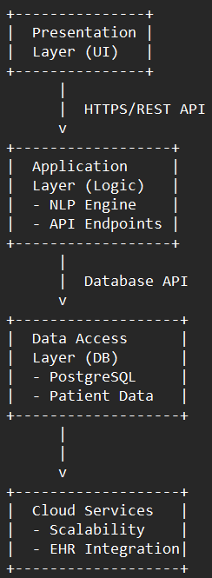
SYSTEM ARCHITECTURE
Three-tier architecture: UI, Application Logic, and Database
Chat interface connected to NLP-based medical engine
Secure API endpoints for patient data exchange
Authentication through PostgreSQL (Supabase) Auth with encryption
Scalable design for cloud deployment and integration with EHR systems

Slide 7
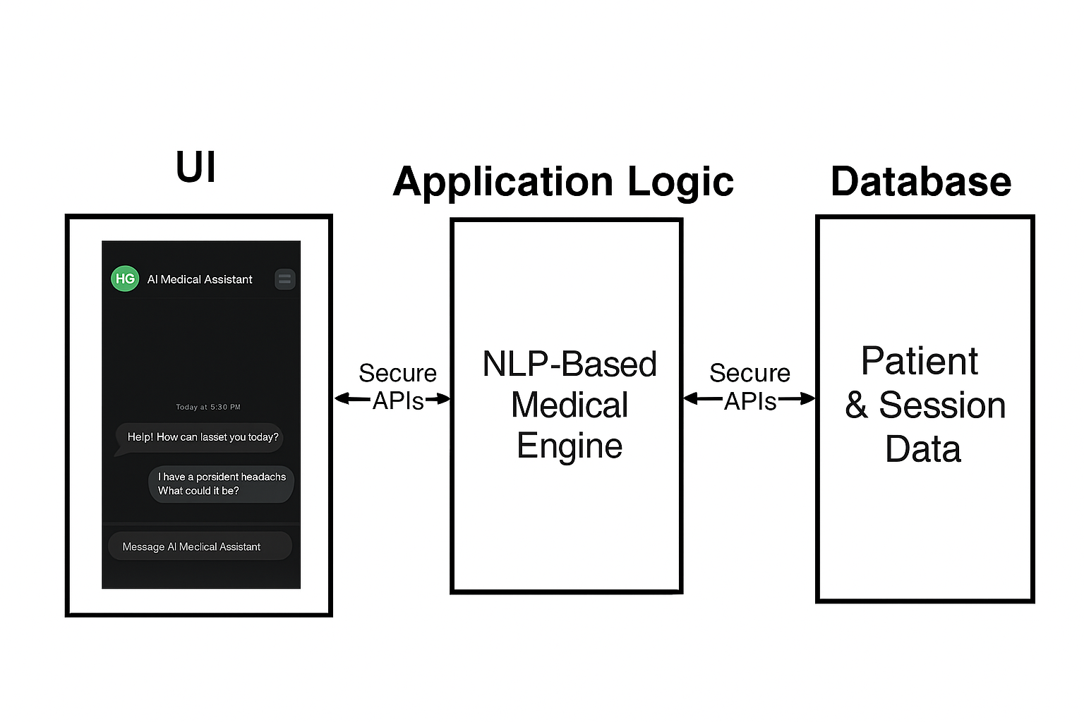
SIMPLIFIED ARCHITECTURAL DIAGRAM

Slide 8
IMPLEMENTATION MODULES
User Module: Patient Registration, Chat Interface, Reports, Appointment Scheduling, Medication Reminders, Profile Management, Notification System
Doctor Module: Review Patient Chat Logs, Provide Feedback, Prescription Management, Patient Monitoring, Secure Messaging, Medical History Access, Consultation Scheduling
AI Module: Natural Language Processing (NLP), Symptom Analysis, Chatbot, Predictive Analytics, Knowledge Graph, Sentiment Analysis, Intent Identification
Data Module: Data Storage, Data Analytics, Query Handling, Data Security, Integration, Data Backup, Data Visualization

Slide 9
DATA HANDLING & SECURITY
JWT tokens used for authentication and session control
Data validation on both frontend and backend layers
Regular audits for data access and security logging.
Secure HTTPS communication between clients and servers
All medical data is stored with encryption and privacy compliance

Slide 10
EXPECTED OUTCOMES & FUTURE ENHANCEMENTS
Provide quick, AI-driven medical assistance 24/7
Reduce doctor workload, AI will be trained to predict and diagnose simple health issues.
Enhance patient satisfaction and accessibility
Integration with wearable health devices and predictive analytics
Expand AI knowledge base with continuous learning models

Slide 11
CONCLUSION & REFERENCES (APA)
Batista, A. S. (2025). The Transforming Clinical Practice: The Role of AI-Powered Medical Assistants in Enhancing Healthcare Efficiency and Decision-Making. Journal of Next-Generation Research 5.0.
Tenajas, R., & Miraut, D. (2025). A New Kind of Assistant in our Inboxes: Can AI Join the Family Medicine Team?.
Bryndin, E. (2025). Intelligent Digital Clinic of Interacting Multimodal AI Assistants. Research in Medical & Engineering Sciences, 11(4), 1237-1241.
Alessandro, L., Crema, S., Castiglione, J. I., Dossi, D., Eberbach, F., Kohler, A., ... & Farez, M. F. (2025). Validation of an artificial intelligence-powered virtual assistant for emergency triage in neurology. Neurologist.
Bacha, A., & Shah, H. H. (2025). AI-Powered Virtual Health Assistants: Transforming Patient Care and Engagement. Global Insights in Artificial Intelligence and Computing, 1(1), 15-30.

