Slide 1
Tabular Deep Learning: A Leakage-Free, Threshold-Tuned Income Classifier
An End-to-End Deep Learning Workflow: Beyond Accuracy: F1-Optimised Deep Learning on Imbalanced Data
Namrata Raghavan · Shruthi Ravi
Final Project · TensorFlow / Keras

Slide 2
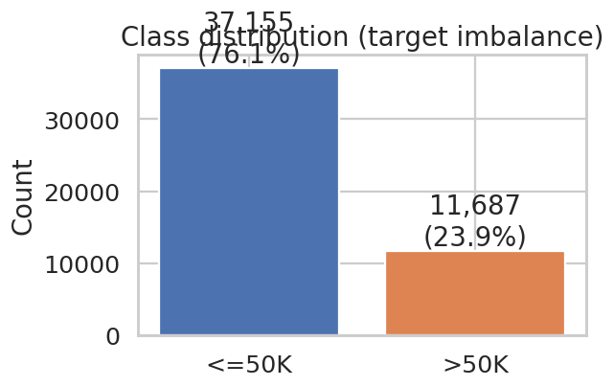
The Problem
Can we predict whether an adult earns more than $50K from 14 census attributes?
What makes this realistic
• 48,841 records, mixed numerical & categorical
• Real missing values encoded as '?'
• ~24% positive class — moderate imbalance
• Documented fairness concerns to discuss
Why care?
• Tabular DL with leakage-free pipeline, calibration, threshold tuning — same shape as a real production ML problem.
1994 US Census · Becker & Kohavi · UCI ML Repository

Slide 3
Dataset at a Glance
UCI Adult Census Income — quick numbers
48,841
Records
14
Input features
~24%
Positive rate
~6%
Missing values
Numerical features
age · fnlwgt · education-num · capital-gain · capital-loss · hours-per-week
Categorical features
workclass · education · marital-status · occupation · relationship · race · sex · native-country
Target
income → binary >50K vs <=50K
Stable feature schema · numerical / categorical split frozen before modelling

Slide 4
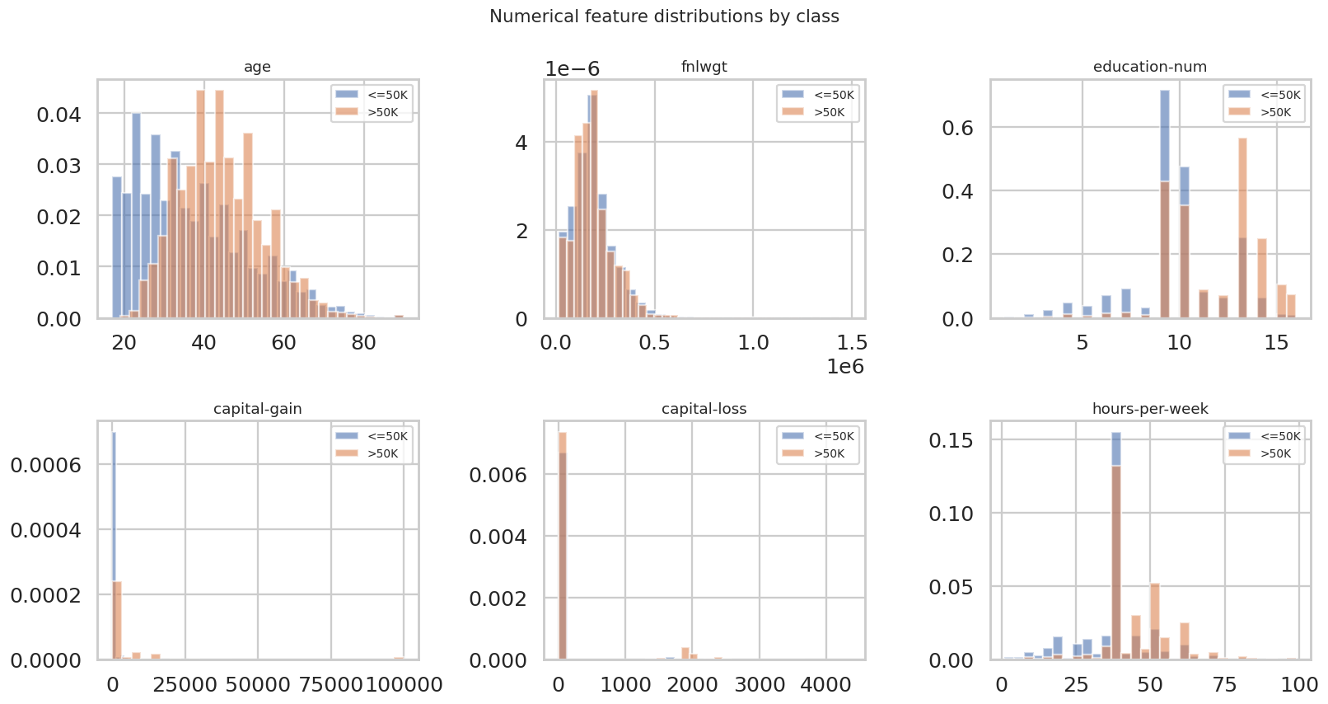
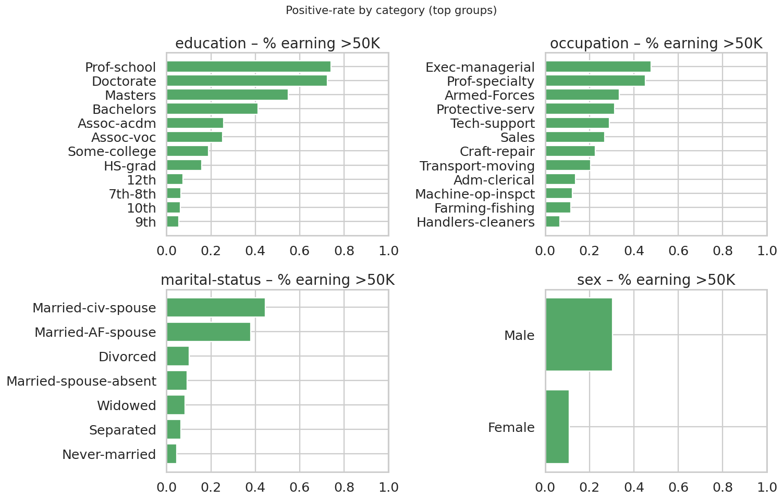
EDA Highlights
Older, more educated, longer hours, and capital-gains earners skew >50K
Strong signal: education-num · capital-gain · marital-status

Slide 5
End-to-end Methodology
One pipeline, fit only on training data
Load & binarise
EDA
Stratified split
Preprocess (fit on train)
Baselines + DNN
Threshold tuning
Evaluate on a single held-out test set with 6 metrics → choose model on F1
Ground rules
• Split BEFORE preprocessing — no leakage.
• Same ColumnTransformer used for training and inference.
• Decision threshold tuned on validation, frozen before testing.
• Random seed fixed (numpy, python random, tensorflow).
Reproducibility built in from step one

Slide 6
Preprocessing — One Pipeline, Two Branches
Fit only on the training fold, reused unchanged at inference
Numerical branch
Categorical branch
• SimpleImputer(strategy='median')
• StandardScaler()
• → robust to outliers (capital-gain has heavy tail)
• → zero-centred, unit-variance for the DNN
• SimpleImputer(strategy='most_frequent')
• OneHotEncoder(handle_unknown='ignore')
• → unseen categories at inference encoded as zeros
• → no production crash, easy drift signal
preprocess.fit_transform(X_train) → .transform(X_val) → .transform(X_test)
ColumnTransformer is fit once and reused everywhere — zero leakage by construction

Slide 7
Deep Neural Network
Five layers · ~880 KB on disk · trains in ~15 seconds
Input (110)
post-preprocessing
Hyperparameters
• Loss: binary cross-entropy
• Optimizer: Adam (1e-3)
• Batch size: 256
• L2 reg on layer 1: 1e-5
• EarlyStopping (val_auc, p=8)
• ReduceLROnPlateau (val_loss)
Dense 256 + BN + Dropout 0.40
wide first layer
Dense 128 + BN + Dropout 0.30
compress
Dense 64 + Dropout 0.20
final hidden
Dense 1 (sigmoid)
binary probability
Dropout + BatchNorm chosen to control over-fitting on a 31K-row train fold

Slide 8
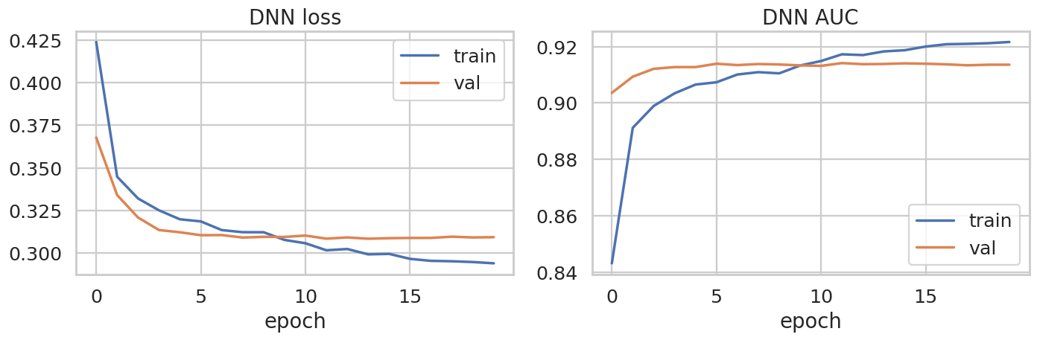
Training Behaviour
Converges in ~20 epochs with no over-fit gap
EarlyStopping(restore_best_weights=True) avoids the 'best epoch ≠ last epoch' trap

Slide 9
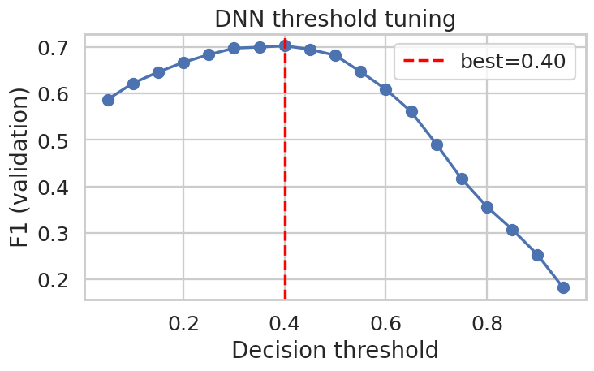
Threshold Tuning
0.5 is rarely optimal under class imbalance — sweep on validation, freeze, then test
Why this matters
• Raises DNN F1 by ~3 points
• Same model, different operating point
• Tuned on validation, never on test
• Threshold persisted alongside model in inference_config.json
Best threshold = 0.40
Single highest-leverage tweak in the project

Slide 10
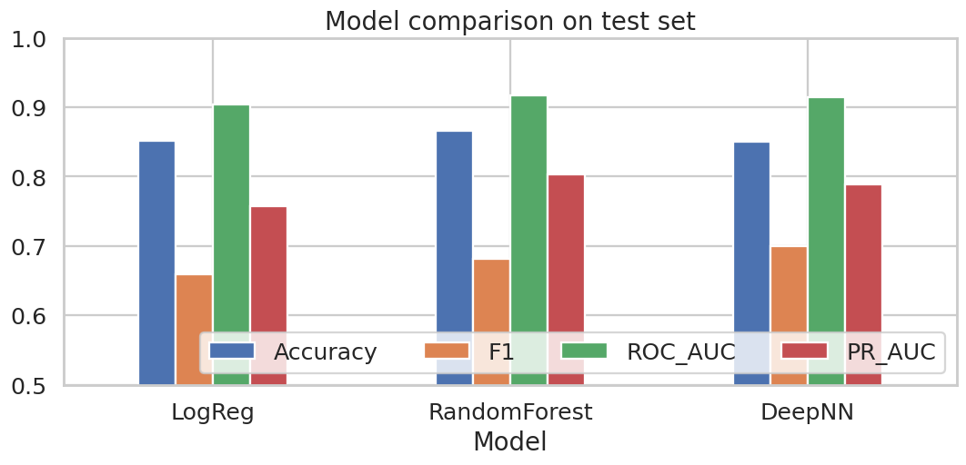
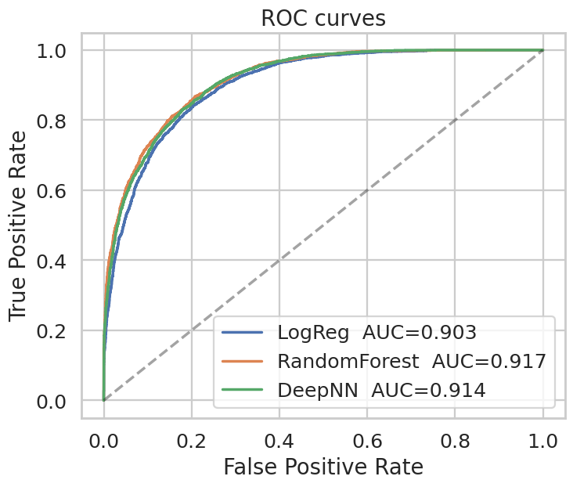
Results — Test Set
DNN wins on F1, matches Random Forest on AUC, beats Logistic Regression everywhere
0.700
DNN F1
0.914
DNN ROC-AUC
0.789
DNN PR-AUC
0.850
DNN Accuracy
Numbers on the held-out 20% test split (n = 9,769) · same metrics for all models

Slide 11
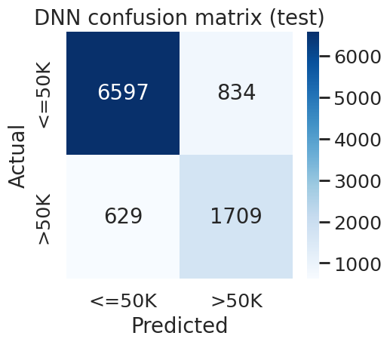
Final Model — DNN (chosen)
Confusion matrix on the held-out test fold
Why this model
• Best F1 across all candidates after threshold tuning
• ROC-AUC within 0.003 of Random Forest
• Probabilistic output enables calibration & risk-scoring
• Can be incrementally fine-tuned on new data
• 880 KB on disk · loads in <1 s
Saved bundle: adult_dnn.keras + preprocess_pipeline.joblib + inference_config.json

Slide 12
Limitations & Next Steps
Honest scope statement and the roadmap if this were going to production
Limitations
Next steps
• 1994 Census — not the modern labour market
• Sensitive features (race, sex, country) used as predictors
• No fairness audit yet — a real deployment requires one
• Probabilities not calibrated (Platt / isotonic scaling pending)
• Add Platt / isotonic calibration
• Per-group fairness audit (sex, race)
• Wrap predict() in FastAPI with auth + rate-limit
• Drift monitor (PSI on features, unknown-category counter)
• Compare with XGBoost as an ensemble member
All artefacts in models/ are version-controlled together — one bundle = one model release

Slide 13
Thank you
Questions?
Code · notebook.ipynb Methodology · Methodology.docx Model · models/

