Slide 1
Basic Task in NLP
Machine Translation
Information Extraction
Opinion Mining
Text Classification
Sentiment Analysis
Mal Email Classification
Text Summarization
Knowledge Representation
Knowledge Graph Construction/ Alignment / Inference
Information Retrieval
Search Engine
Chatbot/ Q&A Engine

Slide 2
Basic Task in NLP
Machine Translation
Information Extraction
Opinion Mining
Text Classification
Sentiment Analysis
Mal Email Classification
Text Summarization
Knowledge Representation
Knowledge Graph Construction/ Alignment / Inference
Information Retrieval
Search Engine
Chatbot/ Q&A Engine

Slide 3
Text Classification
Doc 1
Step 1: PreProcess
Step 2: Feature Extraction
TF-IDF
Topic Model
Embedding Method
Step 3: Classification
Traditional Classifiers: Naïve Bayes, NN
Multi-classes, multi-labels Classification
Transfer Learning Method
1. Mal-Email Detection
- Label: 1 mal email; 0 otherwise
2. Sentiment Analysis
- Label: 1 POS; 0 NEG
3. General Classification
- News Classification
4. Multi-classes, multi-labels
- StackOverflow
Doc 2
…
Doc n
Input
Text Classification Engine
Output

Slide 4
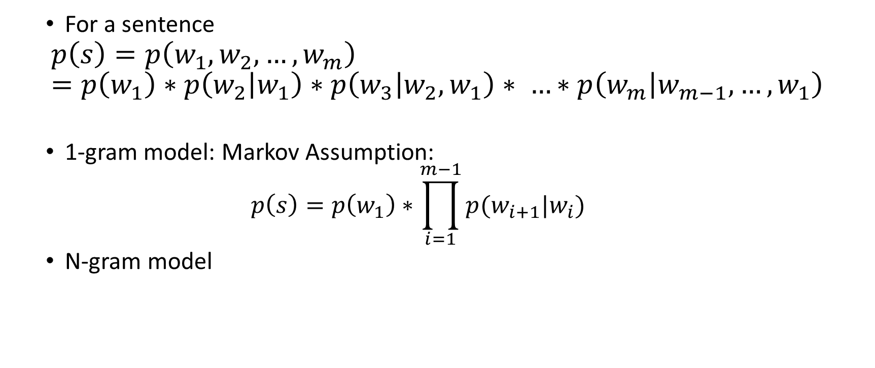
Basic Knowledge: Language Model (Sequential Modeling)
For a sentence
$$p\left(s\right)=p\left(w_{1}, w_{2}, …,w_{m}\right)=p\left(w_{1}\right)∗p\left(w_{2} | w_{1}\right)∗p\left(w_{3} | w_{2},w_{1}\right)∗ …∗p\left(w_{m} | w_{m−1},…,w_{1}\right)$$
1-gram model: Markov Assumption:
$$p\left(s\right)=p\left(w_{1}\right)∗\prod_{i=1}^{m−1}{p(w_{i+1}|w_{i})}$$
N-gram model

Slide 5
Basic Knowledge
Before doing your NLP jobs, you can do following things:
Tokenize
Especially coping with Chinese
N-gram (usually 2-gram is enough)
Statistic-based or Dictionary-based
Especially for English or dealing with domain specific language.
Stemming/ Lemmatization
POS tagging
Stopword Filtering
Tool: nltk, TextBlob, spaCy (python), standfordNLP (JAVA), jieba, LTP(Chinese, Python)

Slide 6
Document Representation - Supervised
Chi-squared
[X-E(X)]/E(X)
Mutual Information
IV
Etc.

Slide 7
Document Representation - Unsupervised
-
BOW, TF-IDF
Importance modeling
Random Project
Topic Modeling
Co-occurrence modeling + Importance modeling
Word2Vec Modeling
Sequential Modeling + Co-occurrence modeling + Importance modeling
Gensim (python)
Abstract
+

Slide 8
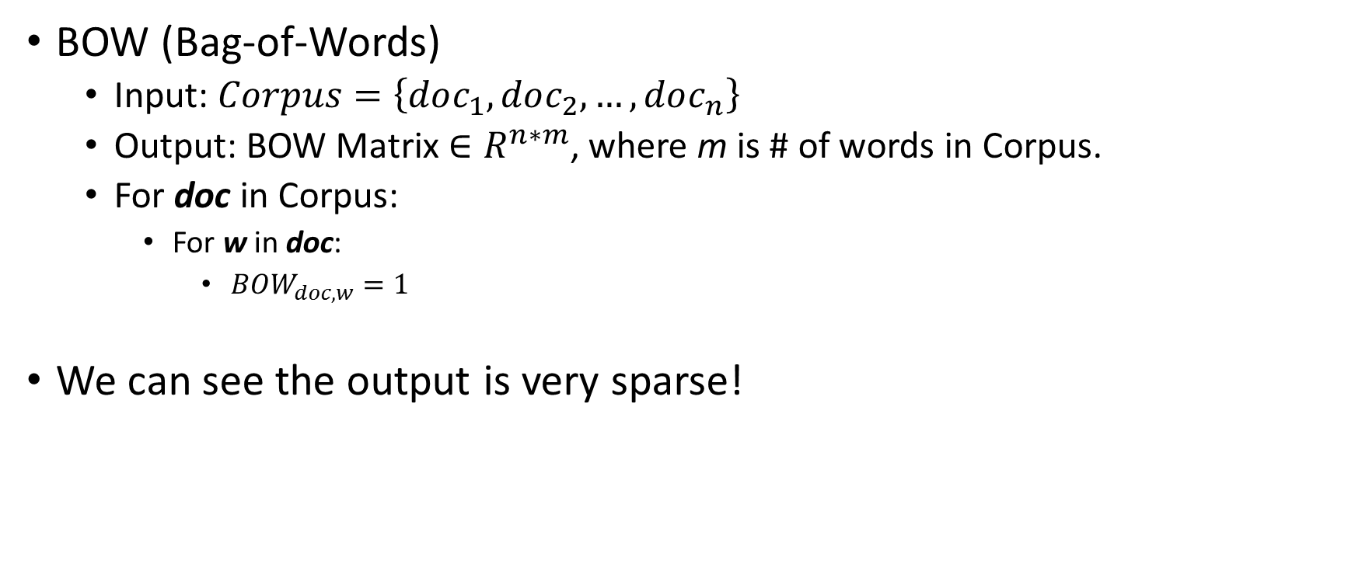
Document Representation
BOW (Bag-of-Words)
Input: $Corpus=\left\{doc_{1},doc_{2}, …, doc_{n}\right\}$
Output: BOW Matrix $∈R^{n∗m}$, where m is # of words in Corpus.
For doc in Corpus:
For w in doc:
$BOW_{doc,w}=1$
We can see the output is very sparse!

Slide 9
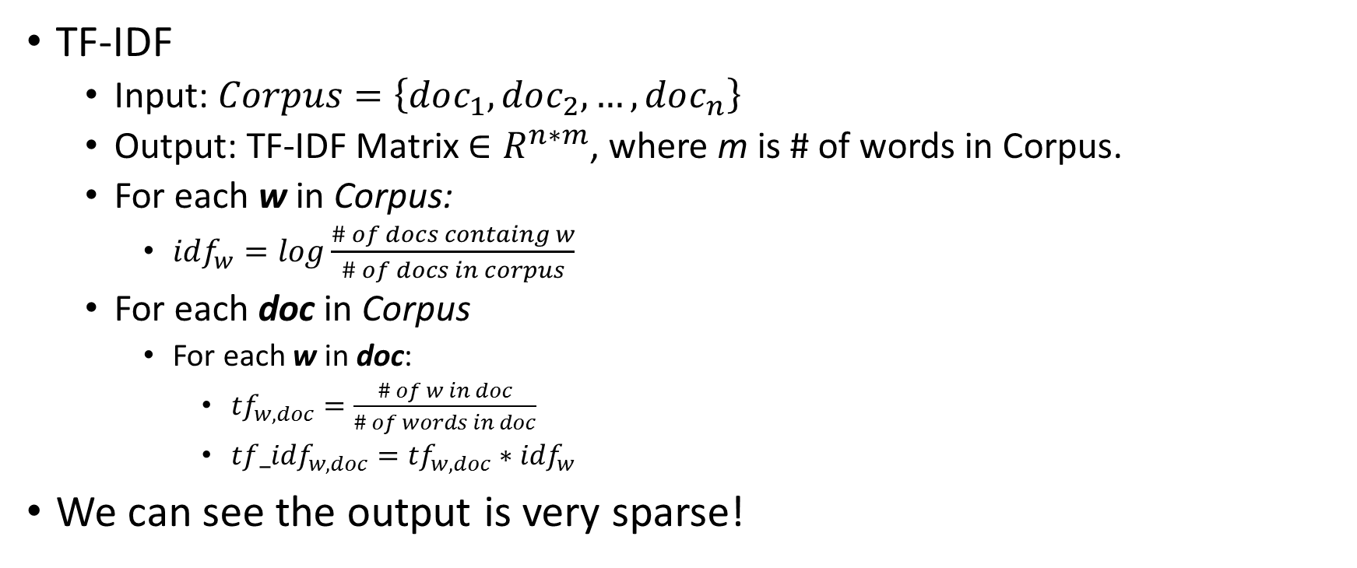
Document Representation
TF-IDF
Input: $Corpus=\left\{doc_{1},doc_{2}, …, doc_{n}\right\}$
Output: TF-IDF Matrix $∈R^{n∗m}$, where m is # of words in Corpus.
For each w in Corpus:
$idf_{w}=log\frac{\# of docs containg w}{\# of docs in corpus}$
For each doc in Corpus
For each w in doc:
$tf_{w, doc}=\frac{\# of w in doc}{\# of words in doc}$
$t{f_idf}_{w, doc}=tf_{w, doc}∗idf_{w}$
We can see the output is very sparse!

Slide 10
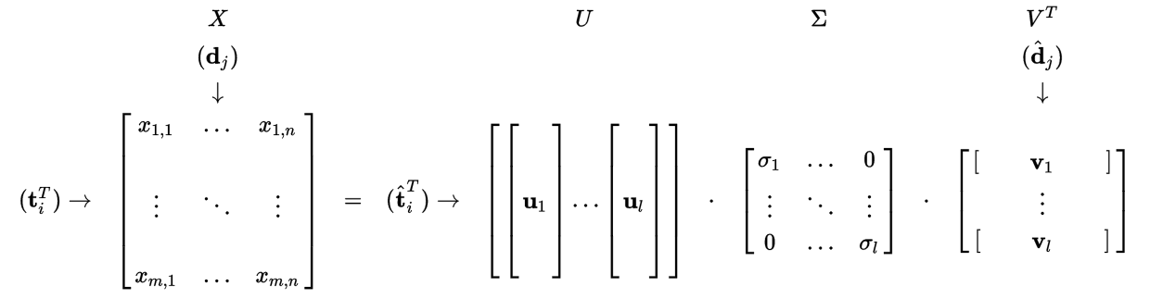
Document Representation
Topic Modeling:
LSI (Latent Semantic Indexing): Run SVD to BOW or TF-IDF Matrix
m*n
m*l
Word-topic
l*l
Topic Importance
l*n
Topic-Doc

Slide 11
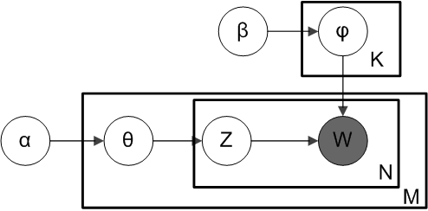
Document Representation
Topic Modeling:
LDA (Latent Dirichlet Allocation):
Input: BOW Matrix
Output: Topic-Word Distribution, Doc-Topic Distribution

Slide 12
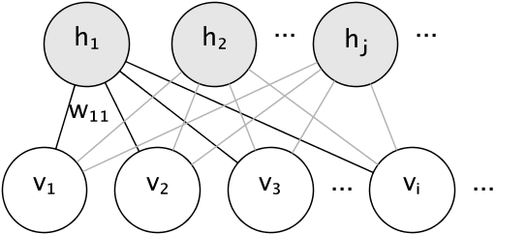

Document Representation
Topic Modeling:
Restricted Bolzman Machine (RBM)
Input: BOW Matrix
Persistent Contrastive Divergence

Slide 13
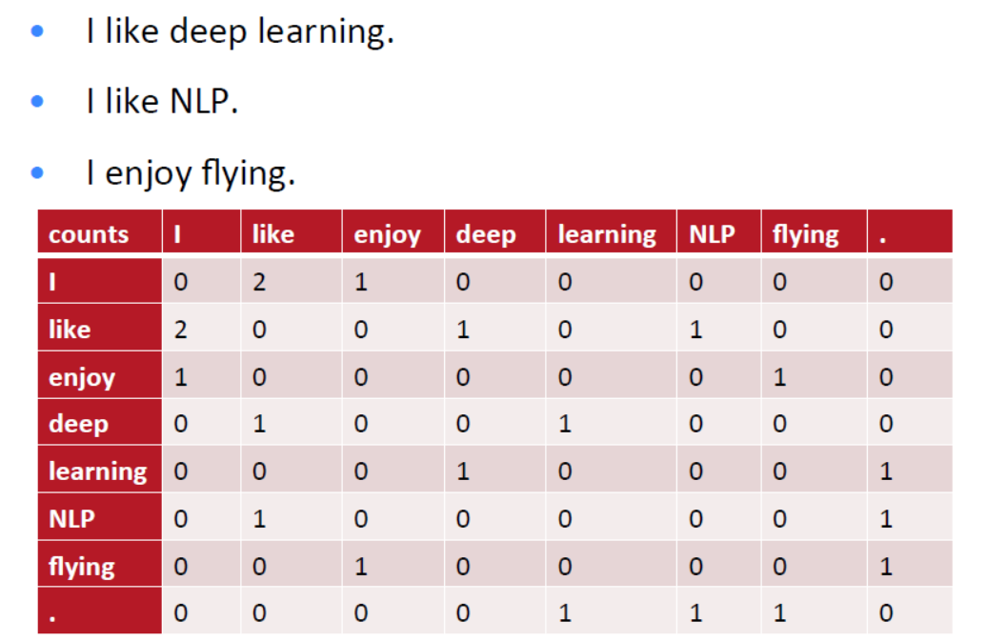
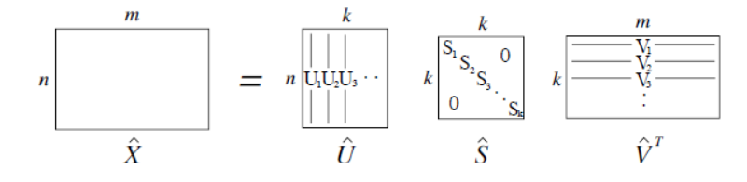
Word2Vec I – Co-occurrence Matrix Decomposition
Word2Vec:
unsupervised learning, co-occurrence modeling, mapping a word to a k-dimension vector.
SVD
Rows of U are the word vector.

Slide 14
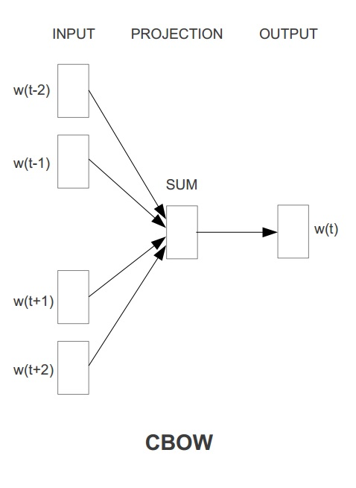
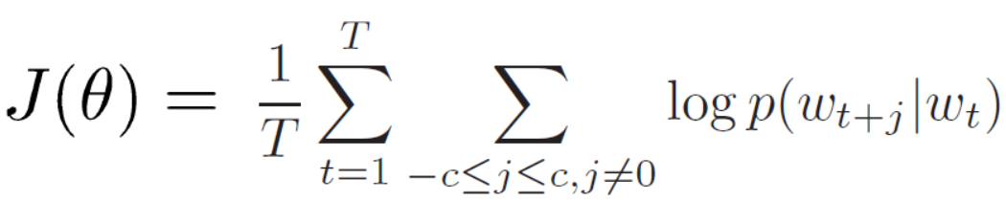
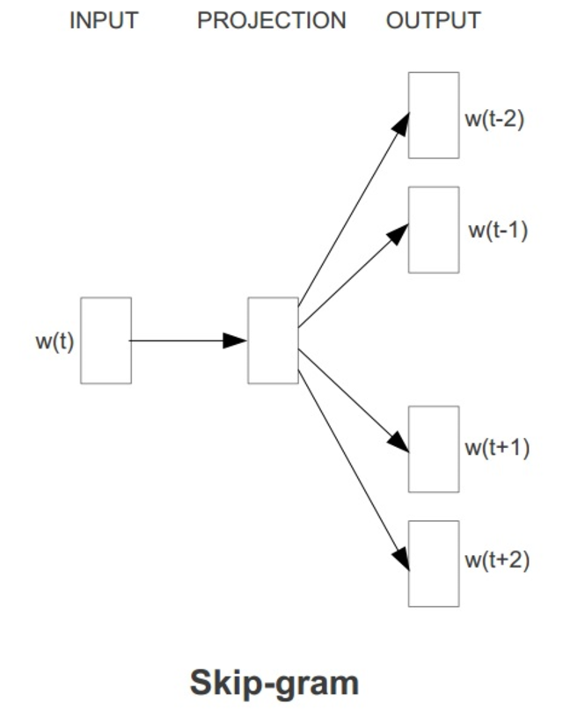
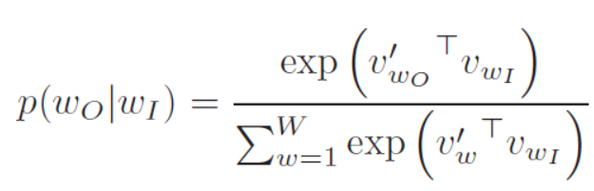

Word2Vec II – CBOW, Skip-gram
Word2Vec:
Predict Surrounding words in a window of length c of every word.
$$w=[w_{o}, w_{I}]$$

Slide 15
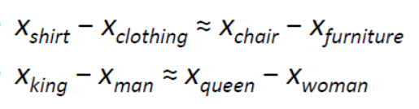
Word2Vec III - Advantages
Capture Relations:
Can be initial values of other jobs, especially embedding work in many NN-based tasks.
Notes:
Evaluation: relation query

Slide 16
Word2Vec I – Embedding Method
Word2Vec:
unsupervised learning, co-occurrence modeling, mapping a word to a n-dimension vector.

Slide 17
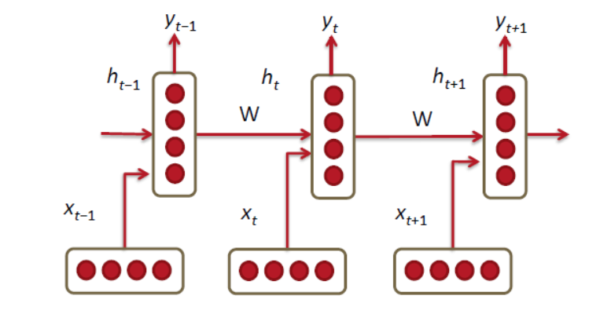
Word2Vec II – Sequential Modeling
Use unsupervised word vec as input.
Apply RNN to model doc sequentially (very suitable to model short text).
…
Encoder
Last State
Decoder

Slide 18
Document Classification
Sentiment Analysis
Input: Document Represented
Output: Label
Method:
TF-IDF, BOW: Naïve Bayes
LDA: NN, SVM, LR, etc.
Embedding: NN

