Slide 1
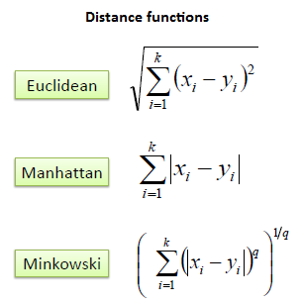
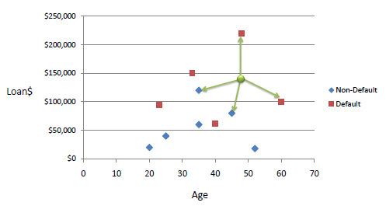
https://www.saedsayad.com/flash/KNN_flash.html

