Slide 1
Welcome to Memory experiment
Best experiment ever!

Slide 2
First, you will see some words
Try to memorise them
Each word is shown for 2 second
You do not need to touch anything
flower
tree
sky

Slide 3
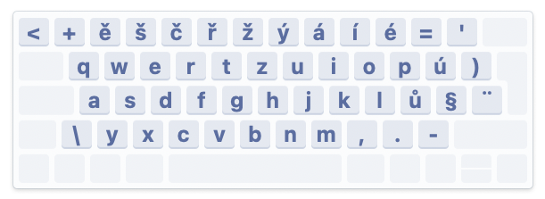
Next, you will be asked about some words
Decide whether you have seen them in the first part or not
Use your keyboard
Press Y if you have seen the word (the word is old)
Press N if not (the word is new)
Keep one finger on Y, another on N
Try to respond as fast as possible
star
flower
green

Slide 4

Learning phase

Slide 5
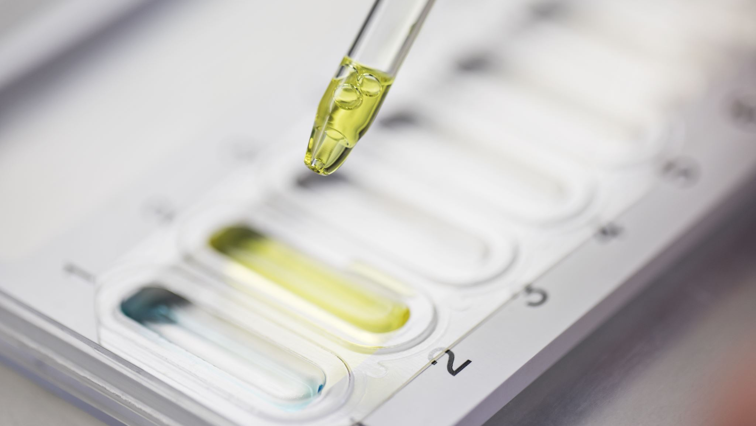
Testing phase

Slide 6

Thank you!
Press anything to save your data

