Slide 1

Szedata v. 2
  Jiri Slaby
  slaby@liberouter.org

Slide 2
Introduction
Fast transfers without copying data
Szedata is that, so why szedata2?
  New platform (NetCOPE)
   new concept, new design
  Incompatible
    no PPC
    different data format
  Similar approach in concept
    mmap, subscribe, lock, unlock

Slide 3
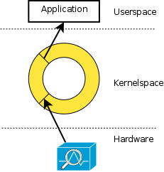
Design
2*N ring buffers
  RX, TX
  N areas (interfaces)
  App sees only 2 spaces
Pointers (per ring buffer):
  Tail and head in HW
  App RX: tail, head
  App TX: only locked size
    Only one writer at a time

Slide 4
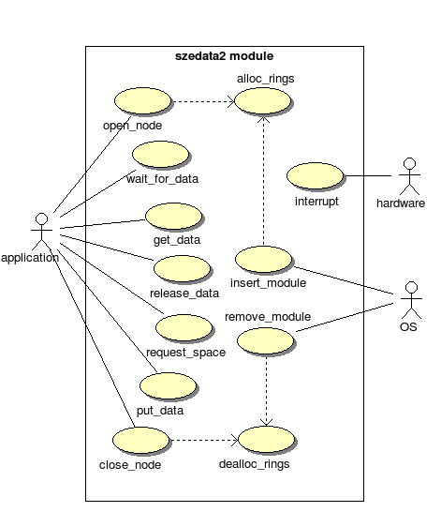
Interface
Open
Mmap
  status_page
  spaces
Subscribe
Start
Wait
Lock
Unlock
Close

Slide 5
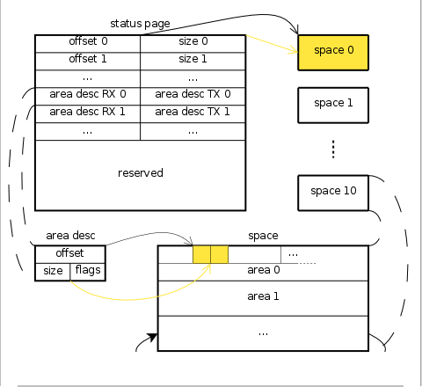
Interface cont.
A

Slide 6
Status
Working non-HW dependant layer
  Tested only on simulator – a module which tries to behave as the card, no known bugs :)
  Libsze2 (see later)
  Szetest2 – a testing application
Design driver in few weeks
  Fill in ring buffer descriptors
  Setup DMA transfers
  Start/stop HW
  The rest is on the layer (counting pointers...)

Slide 7
Libsze2
Unlike szedata, szedata2 provides its library
Encapsulate init/deinit and processing
  No more mmaps, ioctls – abstraction
  Easy to upgrade/change – dynamic library
Code (SVN): software/trunk/libs/libsze2
Docco: http://andre.liberouter.org/~slaby/libsze2_api/

Slide 8
Libsze2 cont.
Functions
struct szedata2 *szedata2_open(const char *node);
int szedata2_subscribe(struct szedata2 *sze2, __u32 *rx, __u32 *tx, __u32 rx_poll, __u32 tx_poll);
int szedata2_start(struct szedata2 *sze2);
int szedata2_poll(struct szedata2 *sze2, short *events, int timeout);
struct szedata2_lock *rx_lock_data(struct szedata2 *sze2, __u32 areas);
int rx_unlock_data(struct szedata2 *sze2, const struct szedata2_lock *lock);
struct szedata2_lock *tx_lock_data(struct szedata2 *sze2, __u32 size, __u8 area);
int tx_unlock_data(struct szedata2 *sze2, const struct szedata2_lock *lock, __u32 size);
void szedata2_close(struct szedata2 *sze2);

Slide 9
End
Thanks for your attention.
Questions?

