Slide 1
kGraft
Live patching of the Linux kernel
Jiří Kosina, Petr Mládek, Vojtěch Pavlík, Jiri Slaby

Slide 2
Why live patching?
Common tiers of change management:
  1. Incident response – (we're down, actively exploited …)
  2. Emergency change – (we could go down, are vulnerable …)
  3. Scheduled change – (time is not critical, we keep safe)
Live patching fits in with 1 and 2
Rebooting a 1000 servers is not a quick way to fix a pressing issue and also carries the risk of them not coming up for other reasons
Live patching allows quick response and leaving an actual update to a scheduled downtime window

Slide 3
What is kGraft?
A research project
A live patching technology
Developed by SUSE Labs
Specifically for the Linux kernel
Based on modern Linux technologies
  INT3/IPI-NMI self-modifying code
  Lazy update mechanism
  fentry-based NOP space allocation
  standard kernel module loading/linking mechanisms

Slide 4
Advantages of kGraft
Doesn't require stopping the kernel, ever
  not even for short time periods, like competing technologies
Allows code review on kGraft patch sources
  kGraft patch can be built from C source directly, without the need for object code manipulation
  Object-code based automated patch generation is provided as an alternative
kGraft is lean
  Small amount of code thanks to leveraging other Linux technologies, no complex instruction decoders or such

Slide 5
How does kGraft work?
A kGraft patch is a .ko kernel module in a KMP RPM
The .ko is inserted into the kernel using 'insmod' at RPM install or update time
kGraft replaces whole functions in the kernel
  even while those functions may be executed
An updated kGraft RPM/module can replace an existing patch

Slide 6
Limitations
kGraft is designed for fixing critical bugs
  and thus primarily for simple changes
Changes in kernel data structure layout require special care
  and depending on the size of the change, the change may not be possible to do without rebooting at all – same as with other live patching tech
kGraft depends on a stable build environment
  and thus best suited for Linux distributions, their customers or anyone who builds their own kernels, rather than 3rd party support companies

Slide 7
kGraft function in detail: fentry
To patch a function, kGraft needs some space at the start of a function
This is provided by GCC profiling
Kgraft/ftrace uses the compiler profiling options ("fentry") to obtain this space
fentry increment instructions are patched out at boot and replaced with 5-byte nops

Slide 8
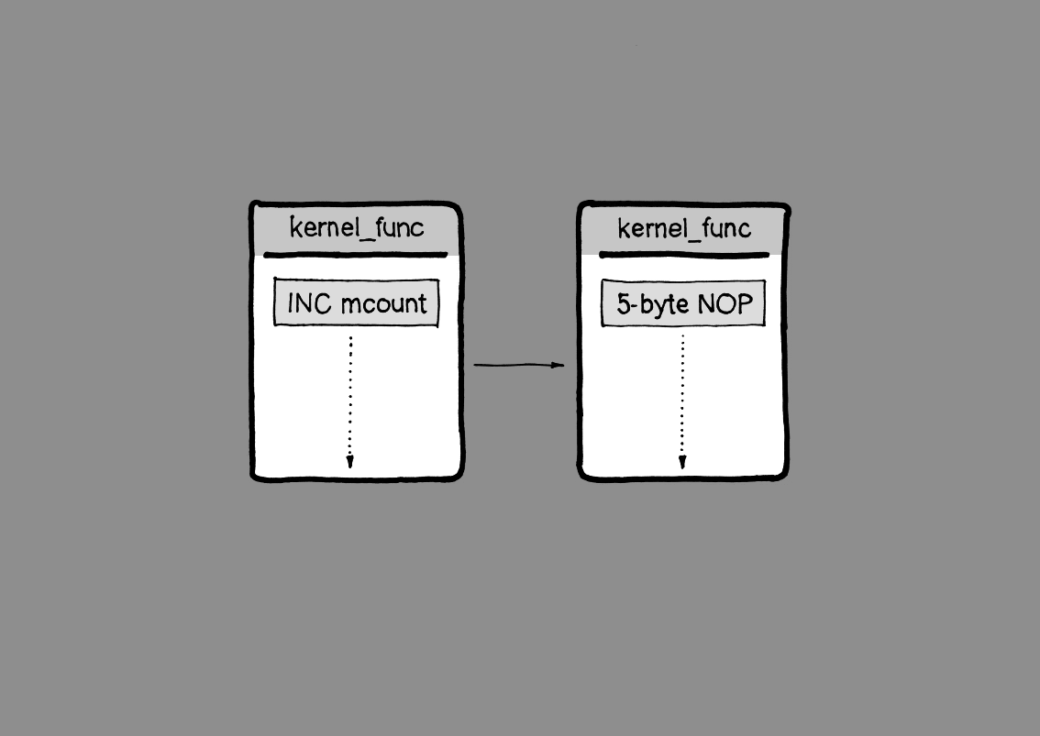
kGraft function in detail: fentry

Slide 9
kGraft function in detail: ftrace
kGraft uses the ftrace infrastructure to perform patching
INT3 handler is installed with a JMP to the destination address
first byte of NOP is replaced by INT3, taking care of incomplete instruction
remaining bytes are replaced by address
first byte is replaced by JMP
NMI IPIs are used throughout to flush instruction decoders on other CPUs

Slide 10
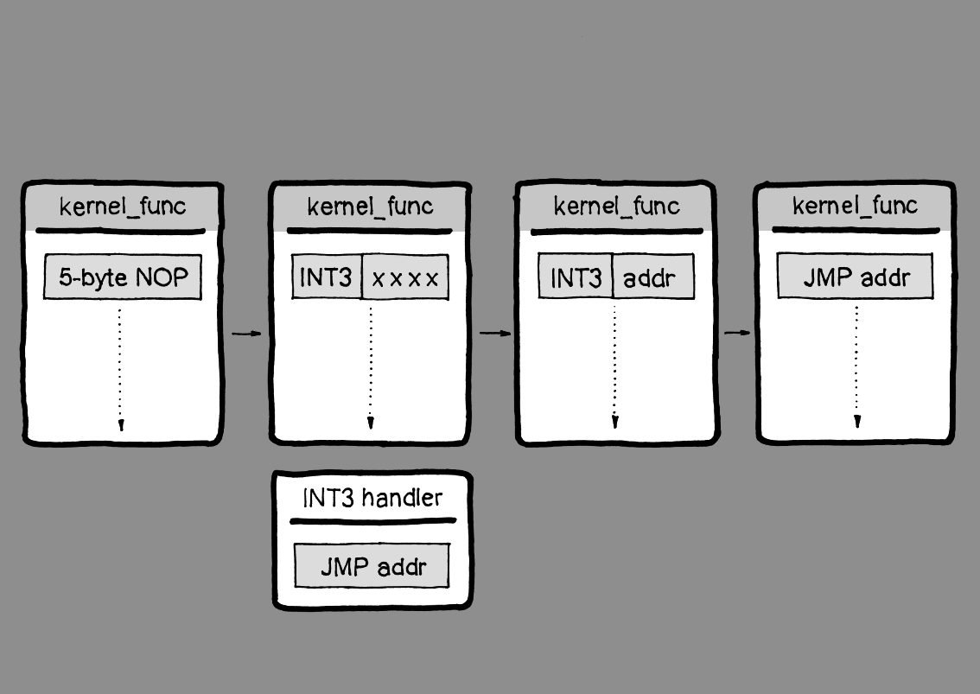
kGraft function in detail: ftrace

Slide 11
kGraft function in detail: new function
Patching during runtime, no stop_kernel();
Callers are never patched
Rather, callee's NOP is replaced by a JMP to the new function
So a JMP remains forever
But this takes care of function pointers, including in structures
And doesn't require saving any old data in case we want to un-patch

Slide 12
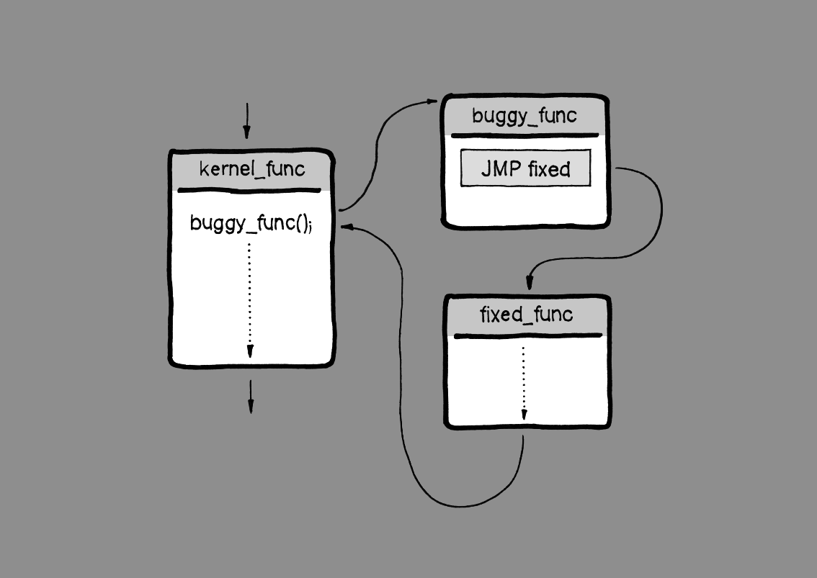
kGraft function in detail: new function

Slide 13
kGraft in detail: RCU-like replacement
So what happens when a replaced function changes semantics and subsequent calls rely on each other?
Or when it is called recursively?
We need to provide a consistent 'world-view' to each execution thread
  user processes
  interrupts
  kernel processes
This is done through a "reality check" trampoline and a per-thread flag set on each kernel entry/exit

Slide 14
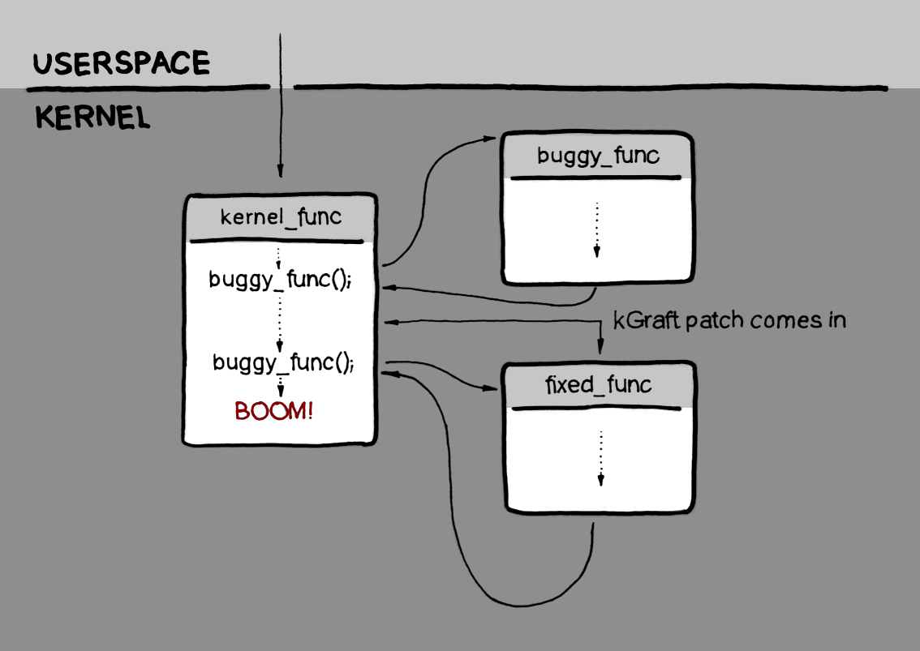
kGraft in detail: RCU-like replacement

Slide 15
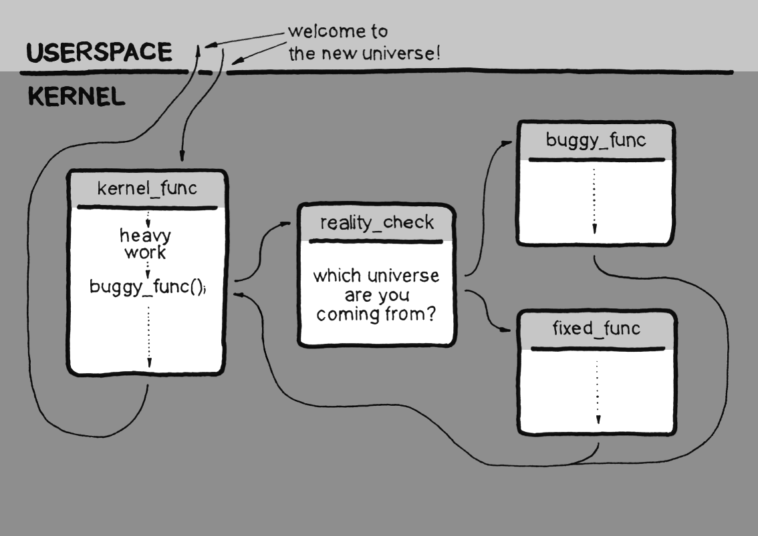
kGraft in detail: RCU-like replacement

Slide 16
kGraft in detail: lazy replacement
All processes must wake up or execute a syscall
Sometimes this requires a signal to be sent (like for getties)
Once all processes have the "new universe" flag set, patching is complete and trampolines can be removed
  /proc/<pid>/kgr_in_progress
  /proc/kgr_in_progress

Slide 17
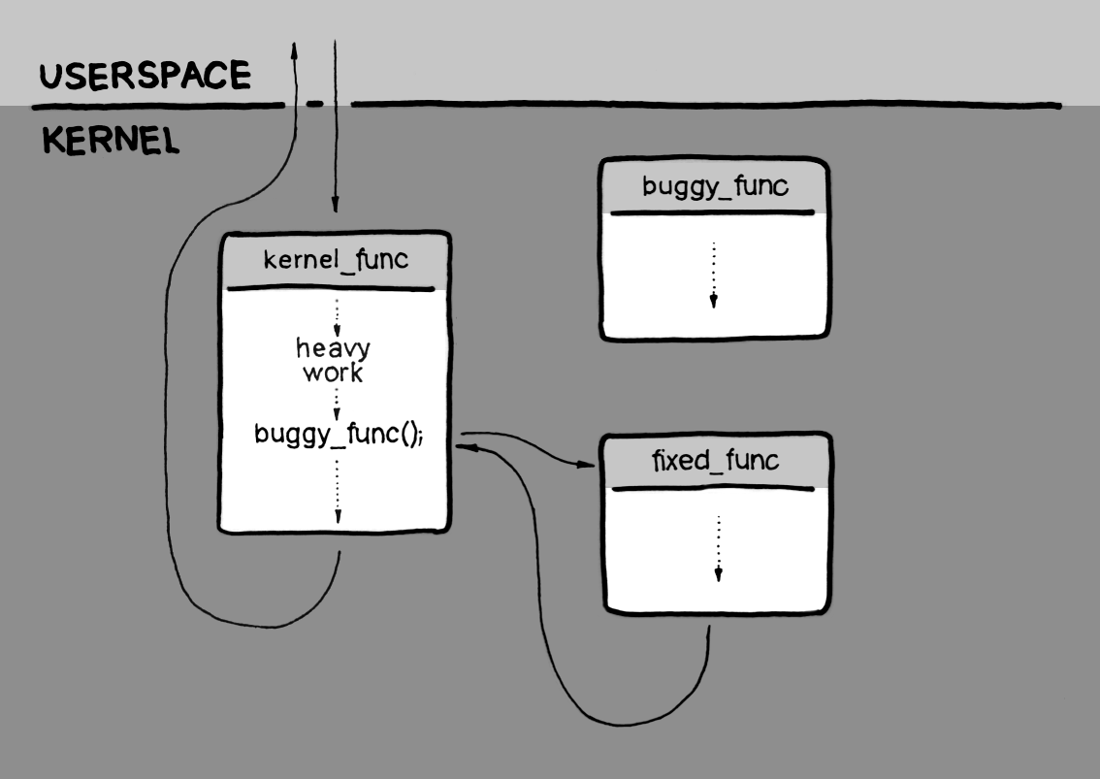
kGraft in detail: RCU-like replacement

Slide 18
Get it
Upstreaming
  kGraft was submitted to Linus' tree, review underway
  SUSE will work together with the community to create a common standard kernel live patching solution
    There are other groups working on competing technologies (kPatch, kSplice, criu-based aproach)
Publishing
  part of SLE12 kernel tree
  kGraft code has become available in a GIT repository upstream
    git://git.kernel.org/~jslaby/kgraft.git

Slide 19
Live Demo

Slide 20
Live Demo – Packaging
kgraft - common scripts
kgraft-patch-<flavor> - fixed kernel code
"patching engine" is integral part of kernel

Slide 21
Live Demo – Patch “cannot” be unloaded
once package is installed, module is inserted into kernel and added to initrd
persists even across reboots
to uninstall remove the package and refresh initrd

Slide 22
Live Demo – the actual Demo
IBS: home:jirislaby:sle12-exploit
http://download.suse.de/ibs/home:/jirislaby:/sle12-exploit/standard/
  Kernel with a security vulnerability
  Exploit program
  kGraft patch

