Slide 1
Static Code Checking
The State-of-the-Art
Jiri Slaby [Yiri Sla-be]
Suse Labs
jslaby@suse.cz

Slide 2
Presentation Outline
Introduction to static analysis (checking)
Principles of static analysis
Current state
Presentation of tools

Slide 3

What is Static Analysis?
Analysis of a code
  In whatever language (even machine code)
Without execution on a processor
  Program state simulation
Foo(Int a) {
If (some_cornercase_config)
a = a / 0;
...
}

Slide 4
Kinds of Static Analysis
In this presentation
  Simple analyses
  Abstract interpretation
  Symbolic execution
Not in this presentation
  Model checking
  … some more

Slide 5
Pros
In comparison to (dynamic) testing
Checks all paths
  Higher coverage
Does not need specific hardware
  E.g. when checking drivers

Slide 6
Cons
In comparison to (dynamic) testing
Produces false positives
  Imprecision in the state simulation
May be slow
  Complex algorithms
  Complex code
    E.g. find y such that MD5(y) == 1 holds
The problem is generally undecidable
  Not every program can be reasoned about
  We can try our best for the rest :)

Slide 7
History and Basics

Slide 8
1970s
Three papers laying down the foundation
  Kildall – A Unified Approach to Global Program Optimization
  Cousot&Cousot – Abstract interpretation: a unified lattice model for static analysis of programs by construction or approximation of fixpoints
  King – Symbolic execution and program testing
No big advances till 2000s

Slide 9

Flow Analysis
(Kildall)
Analyze functions in respect to code flow
Code | must-be |  | may-be
 | a | b | a | b
Foo() { Int a, b = 0; Choose { : a = 0; : a = 1; } If (b) Print(b / a); } | { } { } { 0 } { 1 } { } { } { } | { 0 } { 0 } { 0 } { 0 } { 0 } { 0 } { 0 } | { } { } { 0 } { 1 } { 0, 1 } { 0, 1 } { 0, 1 } | { 0 } { 0 } { 0 } { 0 } { 0 } { 0 } { 0 }
Potential division by zero
Dead code

Slide 10
Flow Analysis
Uses
Used for decades
Optimizing compilers
Static analysis
  FindBugs (Java)
  Sparse, Smatch (C)
  Lint, Splint (C)
  Clang analyzer (C, C++)
  …

Slide 11
Flow Analysis
Caveat
a = 0;
While (something) {
a++;
}
may-be(a) = { 0, 1, 2, … }
|may-be(a)| = ∞

Slide 12
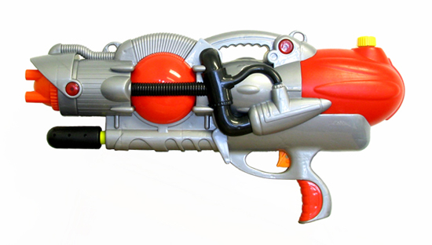
Abstract Interpretation
(Cousot&Cousot)
Handle states of programs abstractly
  Forget irrelevant information
  Arbitrary levels of abstraction
Original Code | Abstraction
Int | AInt
0 | ZERO
…, -2, -1, 1, 2, … | NONZERO
Int a = 5 + 0; | AInt a = NONZERO + ZERO;

Slide 13
Abstract Interpretation
Example
Original Code | First Abstraction | Second Abstraction
Foo() { Int a; Choose { : a = 5; : a = -1; : a = 0; } If (a == 0) Error(); ElsIf (a == -2) Error(); } | Foo() { AInt a; Choose { : a = POS; : a = NEG; : a = ZERO; } If (a == ZERO) Error(); ElsIf (a == NEG) Error(); } | Foo() { AAInt a; Choose { : a = POS0; : a = NEG; : a = POS0; } If (a == POS0) Error(); ElsIf (a == NEG) Error(); }

Slide 14
Abstract Interpretation
Formalism
Cousot&Cousot formalized AI
  Is the abstraction correct?
  Is an abstraction A more abstract than B?
  Will the computation halt?

Slide 15
Abstract Interpretation
Uses
Commercial bugfinders
  Codesonar (C, C++, Java, …)
  Coverity (C, C++, Java, …)
  Klockwork (C, C++, Java, …)
Some research tools
  Stanse (C)
  Uno (C)

Slide 16
Abstract Interpretation
Caveat
Code | may-be(a)
AInt a = ZERO; If (X) a = NONZERO; AInt b = Compute(); If (X) Print(b / a); | { ZERO } { ZERO } { NONZERO } { ZERO, NONZERO } { ZERO, NONZERO } { ZERO, NONZERO }
Division by zero?
NO!

Slide 17
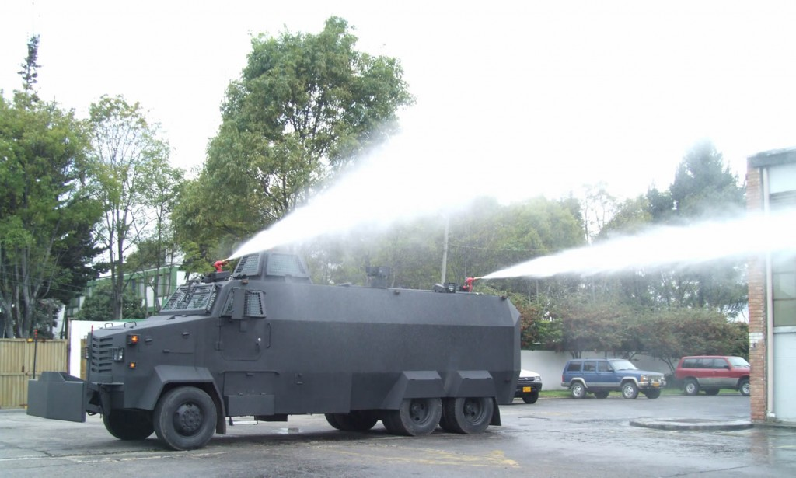
Symbolic Execution
(King)
Handle program states symbolically
  Remember relations between variables
  Use (SAT) solver
  Often works with binary language
Code | Symbolic state
AInt a = ZERO; If (X) a = NONZERO; AInt b = Compute(); If (X) Print(b / a); | a=ZERO a=ZERO (!X && a=ZERO) || (X && a=NONZERO) (!X && a=ZERO) || (X && a=NONZERO) (!X && a=ZERO) || (X && a=NONZERO) (!X && a=ZERO) || (X && a=NONZERO)

Slide 18
Symbolic Execution
Uses
(Unit) test generation
  Klee (LLVM)
Finding bugs
  With minimum false positives
  Pex (.NET)
  Sage (x86, ARM)

Slide 19
Symbolic Execution
Caveats
Loops
Limited symbolic space
  Symbolic disk when checking filesystems?

Slide 20
1970s Summary
Three approaches formalized
  Duck
  Squirting gun
  Water cannon

Slide 21
1970s-1990s
Many simple checking tools
  Lint, Splint, …
  Most their checks are now in optimizing compilers
Optimizing compilers
  Flow analysis, Abstract interpretation
Really, no big deal
  In checking

Slide 22
2000s
Computers are finally powerful enough
  Boom of checking tools
Resurrected AI idea
  At Stanford – Metal
Resurrected SE idea
  At Microsoft Research – DART
Start of
  Improving techniques
  Combining techniques

Slide 23
Current State

Slide 24
Current State
Flow analysis
Abstract interpretation
Symbolic execution
Combination of techniques

Slide 25
Combination of Techniques
Abstract Interpretation + Symbolic Execution
  Fast analysis, low false positives
Concrete (dynamic) + Symbolic Execution
  Ask concrete run if SE in trouble
  Solves: MD5(y) == 1, x*x*x == 100
Model Checking + Symbolic Execution
  Helps MC with state explosion

Slide 26
Mix of Algorithms
How to explore the execution tree
  DFS, BFS, generational search, random, …
Increase precision
  Alias analysis, handle floating point, assembler, …
Increase checking speed
  Better solvers, parallelization
Reduce memory consumption
  Bit-state hashing

Slide 27
Our Research
I am still a PhD researcher
Speeding up Symbolic Execution
  Loops!
Int a;
String s = Read();
For (Int b : 1 .. 30)
If (s.at(b) == 'A')
a++;
If (a > 10 && a < 15)
Error();

Slide 28
Loop Counters
Express loop counts in the state relation
  Tell the solver we need to go through the for-if 10 to 15 times
Int a;
String s = Read();
For (Int b : 1 .. 30)
If (s.at(b) == 'A')
a++;
If (a > 10 && a < 15)
Error();

Slide 29
Speeding Up
Check only relevant code
  The hard part: what is relevant?
Fun() {
Lock();
Work();
Unlock();
}

Slide 30
Summary

Slide 31
Summary
Three analyses
Combination
  Of techniques
  Of algorithms
Future work
  Speedup
  Further combination
All pictures taken from the Internet

Slide 32
Any questions?

