Slide 1
Priority Inversion in Real-Time Operating Systems Advances in Secure Scheduling for Real-Time Environments
Joseph Rissman
CS575 Operating Systems
April 29th, 2025
Video Presentation: https://youtu.be/JGlVL1sQQoE

Slide 2
Understanding Real Time Systems and Priority Inversion
Real time systems require tasks to complete by strict deadlines for correct operation.
Common scheduling methods like RMS and DDS use task priorities to manage execution.
Priority inversion is a problem where a high priority task is delayed by a lower priority task.
Often occurs when tasks compete for shared resources managed using synchronization tools like semaphores or locks.
These tools can cause blocking where a high priority task must wait for a lower priority task to release a resource.

Slide 3
The Risks and Impacts of Unbounded Priority Inversion
Unbounded priority inversion occurs when blocking duration is unpredictable.
A high priority task can be blocked by intermediate priority tasks that do not share resource resources, which extends the high priority task's waiting time unexpectedly.
This uncontrolled blocking seriously harms system performance and predictability.
High priority tasks might miss critical deadlines even if the system is not busy.

Slide 4
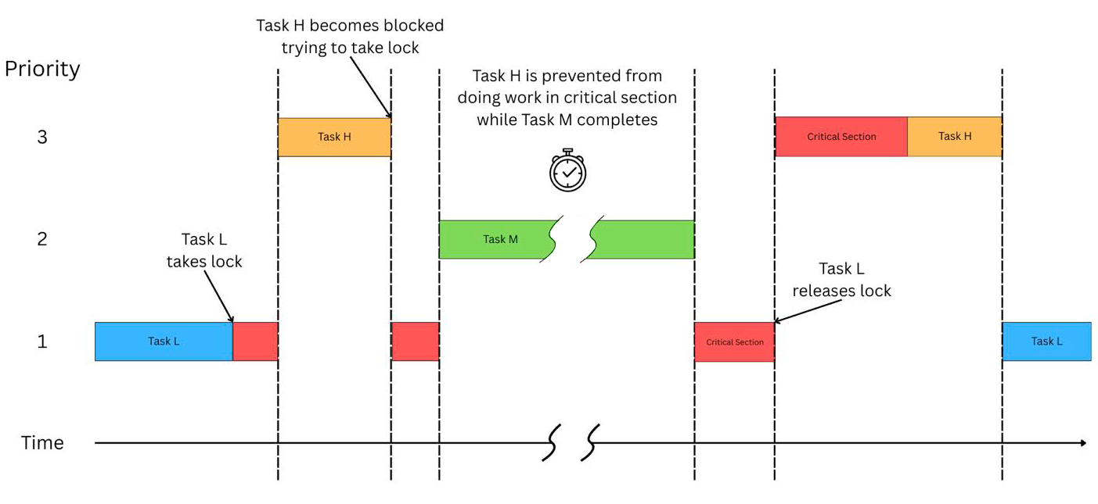
Unbounded Priority Inversion

Slide 5
Foundational Techniques to Address Priority Inversion in Real-time Systems
Basic protocols aim to minimize and bound priority inversion blocking times.
The Priority Inheritance Protocol or PIP is one common approach.
With PIP, a lower priority task holding a needed resource temporarily inherits the higher priority of the task it is blocking.
This inheritance prevents medium priority tasks from delaying the release of the resource.
Other related methods like the Priority Ceiling Protocol also help manage resource contention but are not explored further here.

Slide 6
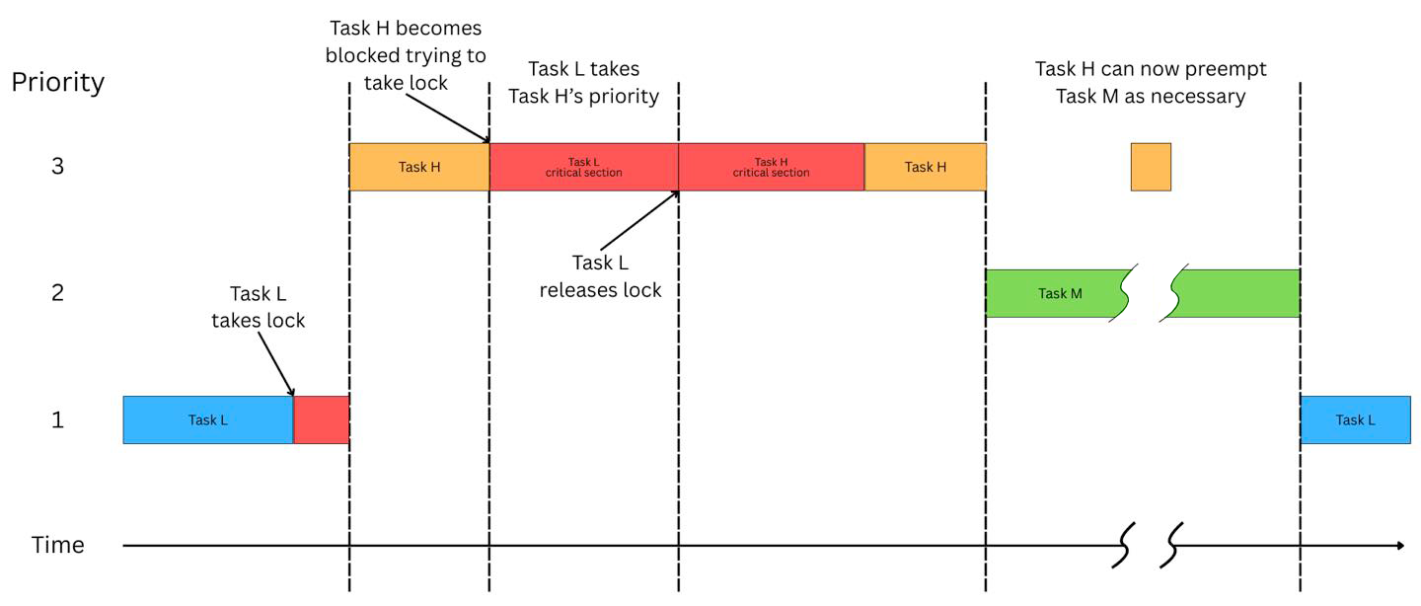
Priority Inheritance Protocol (PIP)

Slide 7
Timing Channels and Side Channel Attack Vulnerabilities
Predictable scheduling in real time systems creates security risks.
Attackers exploit timing patterns to infer sensitive system information or disrupt tasks.
Timing side channels allow attackers to learn about task schedules by observing execution intervals or preemptions.
Priority inversion events and resource contention contribute to the timing variations that these attacks exploit.
Covert timing channels represent another way hidden information can be communicated between system components.

Slide 8
Mitigation via Randomization for Covert Channels Using TimeDice
TimeDice targets covert timing channels between system partitions.
It introduces randomness into the partition scheduling process.
At runtime it dynamically and randomly inverts the priorities of partitions.
This randomization includes checks to ensure real time deadlines are still met.
The goal is to disrupt timing patterns making covert channels less effective.

Slide 9
Mitigation via Enhanced Randomization for Side Channels Using REORDER++
REORDER++ combats side channel attacks through enhanced schedule randomization.
It uses controlled random priority inversions to disrupt predictable task execution patterns.
A key feature is its online test using runtime data to safely maximize randomization opportunities.
This improves security against timing inference attacks without harming system schedulability.

Slide 10
Mitigation by Preventing Leakage via Shared Resources Using FT-PIP
FT-PIP focuses on preventing information leakage through shared resources.
The protocol combines Priority Inheritance Protocol PIP with a Flush Task (FT) mechanism.
Flush tasks are used conditionally to sanitize resource states like caches.
This prevents data remnants from being exploited with side channel attacks while managing priority inversion.

Slide 11
Comparing Security Approaches Randomization and Resource Sanitization
The discussed protocols represent two main security strategies – randomization and resource sanitization.
Randomization used by TimeDice and REORDER++ fights timing attacks by making schedules unpredictable, while maintaining schedulability and ensuring real-time deadlines are met.
Resource sanitization used by FT-PIP prevents data leakage directly via shared components like caches.
These methods address different vulnerability types using priority inversion, ultimately improving overall system security.

Slide 12
Balancing Security with Real Time Guarantees
Recent protocols offer distinct strategies for enhancing real time system security.
Methods like TimeDice REORDER++ and FT-PIP target specific threats including timing channels and resource data leakage.
These advanced scheduling techniques represent ongoing efforts to create more robust and resilient systems.
A key challenge remains successfully balancing strict timing requirements with effective defenses against sophisticated attacks.

