Slide 1
RFscorer
Recency-Frequency based
Product Recommendation Scoring — a Python package
pip install rfscorer
GitHub: github.com/jiro-iwanaga/rfscorer PyPI: pypi.org/project/rfscorer
rfscorer (v0.5.3): MIT License / This deck (v0.1.2): CC BY 4.0
© 2026 Erdos Inc.

Slide 2
Contents
● RF-scoring for product recommendation
● Issues in recommendation systems
● Recommendation system architecture using RF-scoring
● Target users
● Installation & usage
● Input & output data
● Features
● Citation
● Summary
● Appendix: math model, API, tutorials, author
© 2026 Erdos Inc. | CC BY 4.0
1

Slide 3
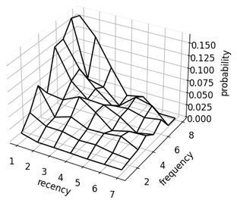
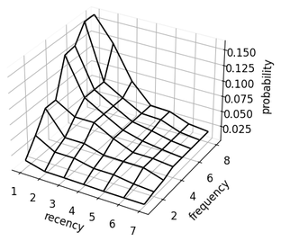
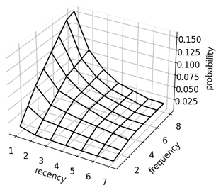
RF-scoring for product recommendation
rfscorer is a Python package that estimates a recommendation score (product-choice probability) for items a user has previously interacted with, based on recency and frequency.
● Recency: more recently viewed items tend to attract more interest
● Frequency: more frequently viewed items tend to attract more interest
By estimating product-choice probabilities that satisfy recency–frequency monotonicity via mathematical optimization,
it gives an intuitive recommendation order over previously interacted items.
Empirical
Monotonicity
Monotonicity-Convex-Concave
📄 Based on the paper:
Jiro Iwanaga, Naoki Nishimura, Noriyoshi Sukegawa, and Yuichi Takano, “Estimating product-choice probabilities from recency and frequency of page views,” Knowledge-Based Systems, Vol. 99, 2016, pp. 157–167.
© 2026 Erdos Inc. | CC BY 4.0
2

Slide 4
Issues in recommendation systems
A recommendation system can be framed as deciding, from past behavior history, which items to prioritize for future recommendation.
With rfscorer, even when recency and frequency trade off, it accounts for their interaction while satisfying recency–frequency monotonicity, yielding natural product recommendations.
Past behavior history
Choosing items to recommend (Jul 7)
Item | Jul 5 | Jul 6
A |  | 1 view
B |  | 2 views
C | 1 view
D | 2 views
● [By frequency] A viewed once vs B viewed twice ▶ B, viewed more often
● [By recency] A viewed 1 day ago vs C viewed 2 days ago ▶ A, viewed more recently
● [Trade-off] A: once, 1 day ago vs D: twice, 2 days ago ▶ hard to judge by intuition
© 2026 Erdos Inc. | CC BY 4.0
3

Slide 5
Recommendation system architecture using RF-scoring
The product-choice probabilities from rfscorer work not only as a standalone recommendation ranking, but also as input to downstream models (a rating matrix for collaborative filtering, or features for ML models).
These features capture the recency–frequency interaction, enabling stronger models.
User
Behavior history
rfscorer
Product-choice prob. (ranking)
Recommend items
seen before
Rating matrix
Collaborative filtering
NMF, etc.
Recommend items
not seen before
User DB
Item DB
Etc.
ML features
ML model
📄 Based on the paper:
Jiro Iwanaga, Naoki Nishimura, Noriyoshi Sukegawa, and Yuichi Takano, “Improving collaborative filtering recommendations by estimating user preferences from clickstream data,” Electronic Commerce Research and Applications, Volume 37, Article 100877, 2019.
© 2026 Erdos Inc. | CC BY 4.0
4

Slide 6
Target users
Practitioners
Researchers
● Data scientists & ML engineers
● Marketers & analysts
● Recommender owners on e-commerce / content platforms
● Recommender systems & information retrieval
● Marketing science & consumer behavior
● Operations research & mathematical optimization
● Cognitive psychology (memory, mere-exposure effect)
© 2026 Erdos Inc. | CC BY 4.0
5

Slide 7
Installation & usage
pip install
$ pip install rfscorer
Usage (compute scores in 3 steps: fit → optimize → transform)
from rfscorer import RecencyFrequencyScorer, split_by_date
# Split behavior history (cols:user,item,datetime) at a target date into 7-day obs/1-day ground truth
df_obs, df_gt = split_by_date(df, "2026-07-07", 7, 1)
scorer = RecencyFrequencyScorer()
scorer.fit(df_obs, df_gt) # fit the model
scorer.optimize(kind="mono") # optimize under RF monotonicity
# score the test data
df_scores = scorer.transform(df_test_obs, "2026-07-07", kind="mono")
© 2026 Erdos Inc. | CC BY 4.0
6

Slide 8
Input & output data
Input: behavior history with 3 columns
user | item | datetime
u011 | i144 | 2026-07-05
u042 | i091 | 2026-07-06
u044 | i077 | 2026-07-07
u044 | i072 | 2026-07-07
Output: a table adding a score and rank to each user × item
user | item | recency | frequency | probability | order
u011 | i144 | 3 | 4 | 0.0767 | 1
u042 | i091 | 2 | 3 | 0.0789 | 1
u044 | i077 | 1 | 2 | 0.0621 | 1
u044 | i072 | 1 | 1 | 0.0248 | 2
Recommend items to each user in descending probability
© 2026 Erdos Inc. | CC BY 4.0
7

Slide 9
Features
● 01 [scikit-learn style] a simple fit() / transform() API
● 02 [minimal data] just three columns: user / item / datetime
● 03 [explainable] RF monotonicity via optimization explains each recommendation
● 04 [stable probabilities] estimated directly from recency & frequency
● 05 [downstream use] as input to collaborative filtering / ML
● 06 [diagnostics & visualization] statistics & plots for practice and research
© 2026 Erdos Inc. | CC BY 4.0
8

Slide 10
FEATURE
scikit-learn style
01
/ 06
Provides the familiar fit() / optimize() / transform() interface, fitting naturally into existing ML workflows
HIGHLIGHTS
● Complete in three steps: fit() → optimize() → transform()
● Save and reuse models with save() / load()
sklearn-style API
scorer = RecencyFrequencyScorer()
scorer.fit(df_obs, df_gt)
scorer.optimize(kind="mono")
df_scores = scorer.transform(df_test_obs, "2026-07-07", kind="mono")
scorer.save("rfscorer.pkl")
scorer_loaded = RecencyFrequencyScorer.load("rfscorer.pkl")
© 2026 Erdos Inc. | CC BY 4.0
9

Slide 11
FEATURE
Minimal data
02
/ 06
All you need is a behavior history with three columns: user, item, datetime no special preprocessing or extra features required
HIGHLIGHTS
● Most services already log user, item, datetime behavior history
● No additional feature engineering
minimal data
user | item | datetime
u011 | i144 | 2026-07-07
u042 | i091 | 2026-07-06
u044 | i077 | 2026-07-07
u044 | i072 | 2026-07-07
© 2026 Erdos Inc. | CC BY 4.0
10

Slide 12
FEATURE
Explainable
03
/ 06
Estimates scores satisfying RF monotonicity via optimization not a black box — every recommendation is explainable
HIGHLIGHTS
● “Items viewed more recently or more often are more likely to be chosen” matches intuition - Recency: recently viewed items tend to attract more interest
- Frequency: frequently viewed items tend to attract more interest
● Each score is explained purely by recency and frequency
explainable
© 2026 Erdos Inc. | CC BY 4.0
11

Slide 13
FEATURE
Stable probability estimation
04
/ 06
Estimates product-choice probabilities directly from recency & frequency, avoiding the instability of rescaling ML outputs into probabilities
HIGHLIGHTS
● No fragile probability rescaling, so the values are easy to use —
ready for expected-value calculations such as expected revenue
● fit_rolling() pools multiple reference dates to stabilize empirical probabilities
stable probability
© 2026 Erdos Inc. | CC BY 4.0
12

Slide 14
FEATURE
Downstream use
05
/ 06
Beyond standalone use, the scores work as a rating matrix for collaborative filtering or as features for ML models
HIGHLIGHTS ● Build models on useful features that capture the recency–frequency interaction
downstream use
User
Behavior history
rfscorer
Product-choice prob. (ranking)
Recommend items
seen before
Rating matrix
Collaborative filtering
NMF, etc.
Recommend items
not seen before
User DB
Item DB
Etc.
ML features
ML model
© 2026 Erdos Inc. | CC BY 4.0
13

Slide 15
FEATURE
Rich diagnostics & visualization
06
/ 06
Rich statistics (e.g., correlations) and visualizations easy to explain in practice and to report in research
HIGHLIGHTS
diagnostics
& visualization
● Output statistics such as correlation coefficients ● Grasp recency × frequency × probability intuitively as a 3D surface
Empirical
Monotonicity
Monotonicity-Convex-Concave
© 2026 Erdos Inc. | CC BY 4.0
14

Slide 16
Citation
If you use rfscorer in academic work, cite it in your text as follows.
We used rfscorer (Iwanaga et al., 2016), a Python library for Recency-Frequency-based recommendation scoring.¹
¹ https://github.com/jiro-iwanaga/rfscorer
References
● Iwanaga, Nishimura, Sukegawa, Takano (2016) “Estimating product-choice probabilities from recency and frequency of page views,” Knowledge-Based Systems, Vol.99, pp.157–167.
● Iwanaga, Nishimura, Sukegawa, Takano (2019) “Improving collaborative filtering recommendations by estimating user preferences from clickstream data,” Electronic Commerce Research and Applications, Vol.37, 100877.
© 2026 Erdos Inc. | CC BY 4.0
15

Slide 17
Summary
✓ A Python package that estimates product-choice probabilities from recency and frequency
✓ Mathematical optimization satisfies RF monotonicity for an interpretable, natural order
✓ Works with just user / item / datetime, in a scikit-learn-like API
✓ Use it standalone or as input to collaborative filtering / ML
✓ Rich diagnostics & visualization support explanation and reporting
pip install rfscorer
GitHub: github.com/jiro-iwanaga/rfscorer PyPI: pypi.org/project/rfscorer MIT License
This deck: CC BY 4.0 / © 2026 Erdos Inc.

Slide 18
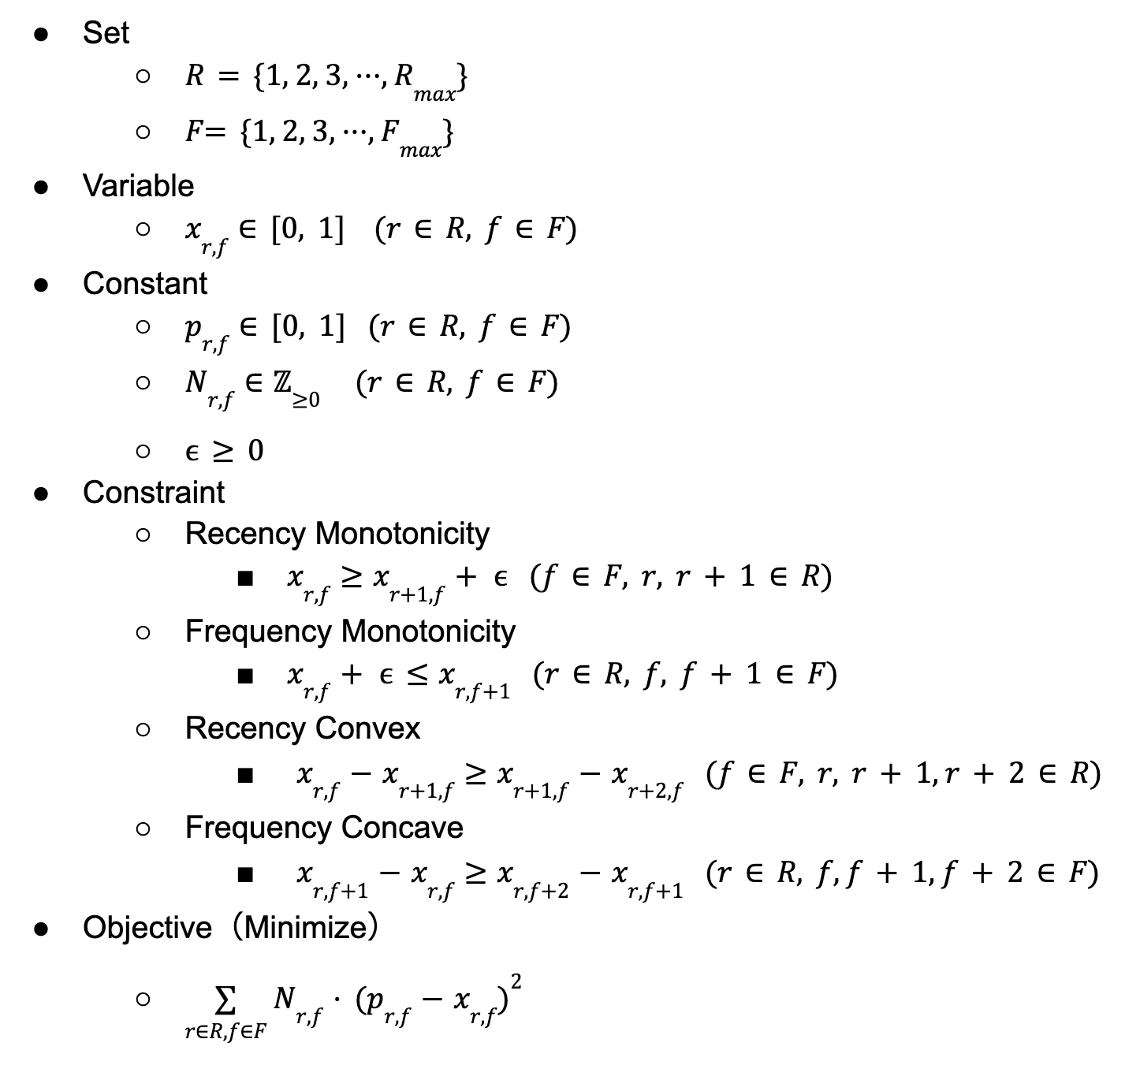
Mathematical optimization model
Optimization models
● mono: Monotonicity ● mrc : Monotonicity & Recency Convex ● mfc : Monotonicity & Frequency Concave ● mcc: Monotonicity & Convex & Concave
Optimization packages
● Modeling: CVXPY ● Solver: Clarabel
© 2026 Erdos Inc. | CC BY 4.0
16

Slide 19
APPENDIX
API
API | Description
split_by_date(df, date, obs, gt) | Split behavior history into observation / ground-truth by time
RecencyFrequencyScorer() | Create a scorer
.fit(df_obs, df_gt) | Aggregate empirical probabilities by recency × frequency
.fit_rolling(...) | Rolling aggregation over reference dates to stabilize empirical probabilities
.optimize(kind="mono") | Estimate scores satisfying monotonicity etc. via optimization
.transform(df_obs, date, kind) | Compute scores (probability / order)
.predict(r, f, kind) | Return the probability for a given (recency, frequency)
.evaluate(df_rec, df_gt) | Evaluate recommendation accuracy
.plot_probability_surface(kind) | Visualize the probability surface in 3D
.save(path) / .load(path) | Save / load the model
© 2026 Erdos Inc. | CC BY 4.0
17

Slide 20
APPENDIX
Tutorials
▍ Beginner
● tutorial_beginner_en.ipynb The fastest way to grasp fit → optimize → transform: load data, fit() empirical probabilities, optimize() under RF constraints, visualize the surface, and transform() to scores.
▍ Practical
● tutorial_practical_en.ipynb A production-style workflow: split data chronologically, build all 9 models (empirical + optimized), compare accuracy with evaluate(), and save/load the trained model.
▍ Advanced
● tutorial_advanced_fit_rolling_en.ipynb Uses fit_rolling() to pool multiple reference dates and stabilize empirical probabilities.
● tutorial_advanced_int_time_col_en.ipynb Handling time-series data without calendar dates (integer time column).
● tutorial_advanced_day_freq_en.ipynb Caps frequency by counting distinct days an item was viewed instead of total views.
© 2026 Erdos Inc. | CC BY 4.0
18

Slide 21

APPENDIX
Author
▍ IWANAGA Jiro
● CEO, Erdos Inc.
● Specially Appointed Professor, The University of Electro-Communications
▍ Expertise
● Mathematical optimization, recommender systems, machine learning, NLP
▍ Selected papers
● Iwanaga et al. (2016), Knowledge-Based Systems Estimating product-choice probabilities from recency and frequency of page views
● Iwanaga et al. (2019), Electronic Commerce Research and Applications Improving collaborative filtering recommendations by estimating user preferences from clickstream data
▍ Book
● Iwanaga, Ishihara, Nishimura, Tanaka (2021), Ohmsha, Pythonではじめる数理最適化（in Japanease）
▍ Contact
● GitHub: https://github.com/jiro-iwanaga
● Mail: iwanaga@erdos-the-book.com
© 2026 Erdos Inc. | CC BY 4.0
19

