Slide 1

How to Spot a Troll Using Natural Language Processing
James M. Irving, Ph.D.
06/12/19

Slide 2

Background on Russian Trolls & Internet Research Agency
In February 2018, Robert Mueller filed indictments against Russian nationals for engaging in illegal political activities as part of his Russia investigation.
The Internet Research Agency is a defendant, accused of being a Russian “Troll Factory” connected to 2,848 twitter handles.
FiveThirtyEight extracted 3 million tweets from these twitter handles.
Reuters / Evgenia Novozhenina

Slide 3
Goals & Value for Your Organization
Our goal is to build a machine learning model that uses Natural Language Processing alone to identity Russian Troll tweets versus authentic users.
Imagine an algorithm for your platform that can detect if user’s social media messages may be foreign agents.
Get ahead of manipulation of your platform for malicious purposes.
Avoid bad press and drops in public trust/perception.

Slide 4
Content Analyzed
We wanted to focus our initial analyses on the language alone.
To do so, we limited our analyses to only original-content tweets written in English, which totaled 1.4 millions tweets.
Using the Twitter API, we extracted 40,000 tweets, matching the top 40 most common @’s (mentions) and compared them to an equal-sized random sample from the 1.4 million tweets.

Slide 5
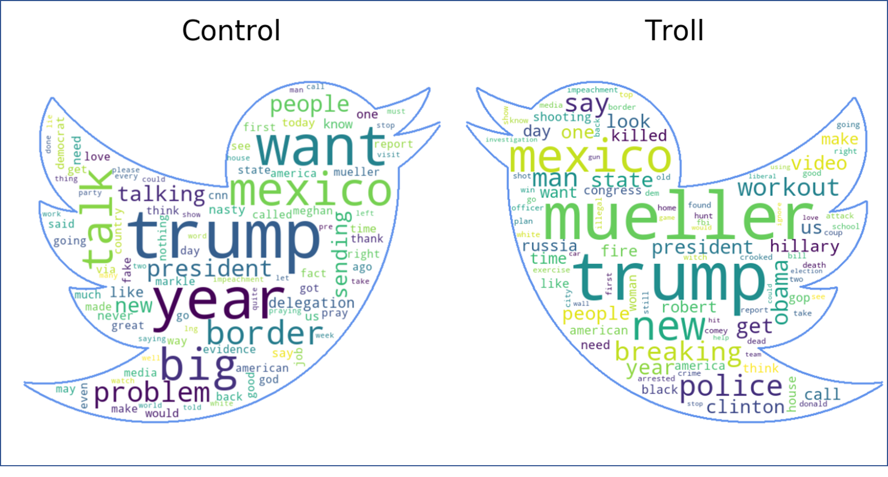
Most Frequently Used Words

Slide 6
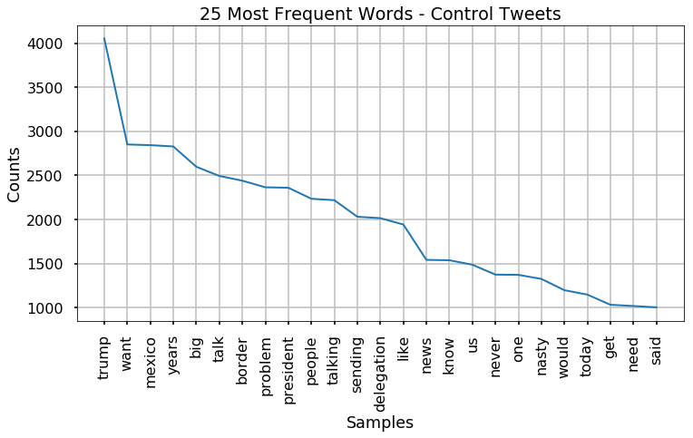
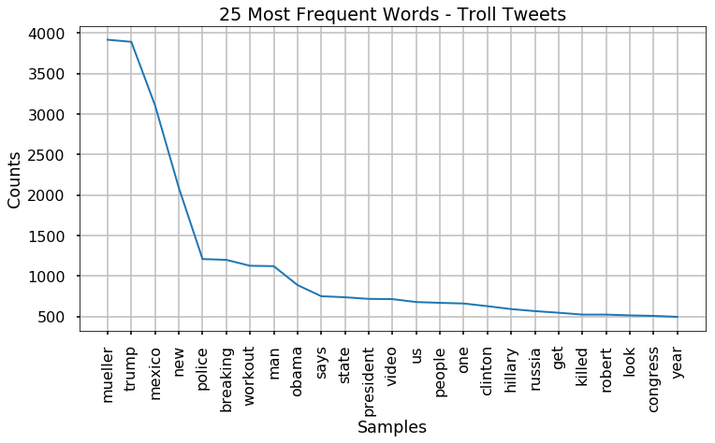
Most Frequently Used Words

Slide 7
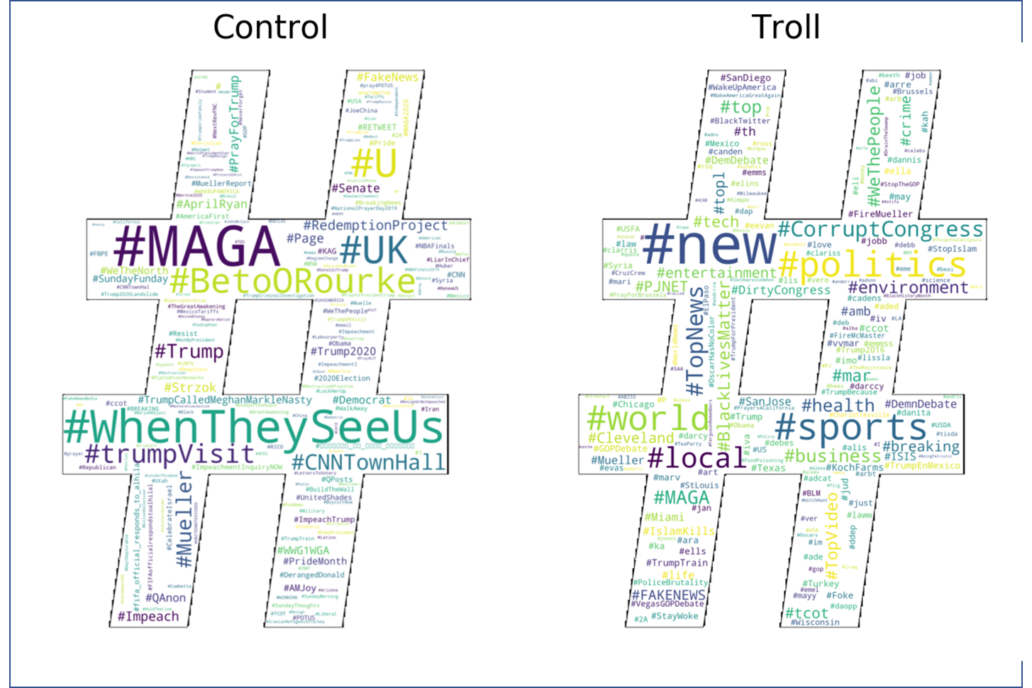
Most Common Hashtags

Slide 8
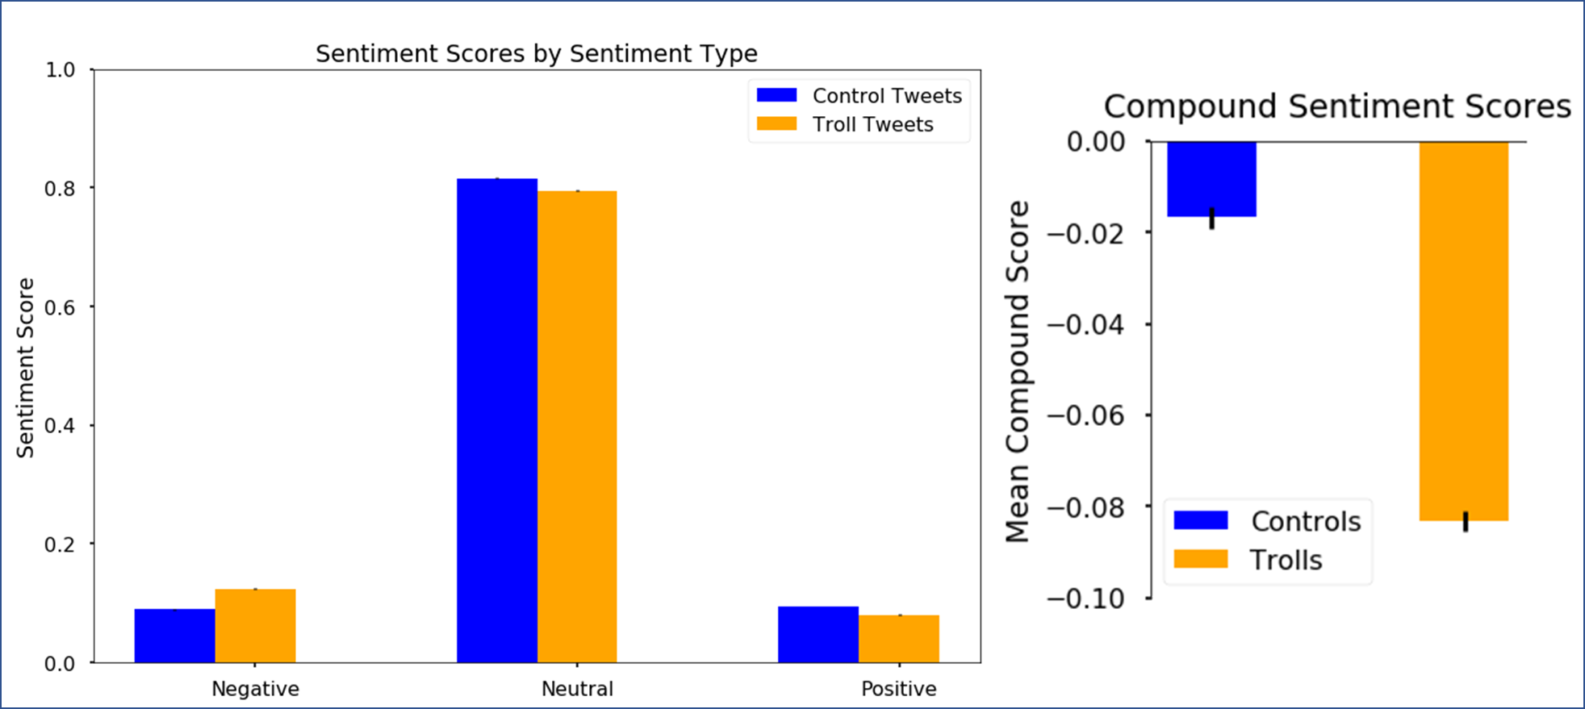
Sentiment Analysis

Slide 9
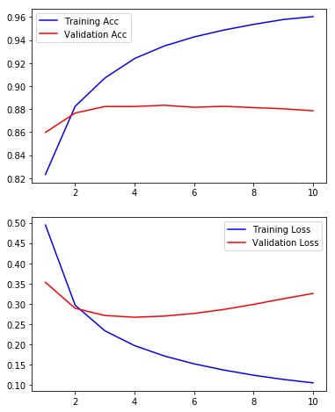
Our Model
Using multiple machine-learning models, including artificial neural networks, we can predict Russian troll tweets:
With 88-93% accuracy in 78 ms using logistic regression.
With 89-99% accuracy in 31 sec using artificial neural networks.

Slide 10
Future Directions
By granting our organization Enterprise-level Twitter API access, we can provide even better predictive capabilities equipped with batch historical tweets.
We can build models upon our Natural Language Processing models to use our initial predictions combined with additional descriptive statistics.
We can produce more sophisticated neural networks to provide better long-term analyses.

Slide 11
Thank you!
Flatiron School – Data Science Bootcamp
Brandon Lewis – Instructor
Jeff Herman – Advisor
FiveThirtyEight – supplying troll tweet dataset
Dr. Darren Linvill and Dr. Patrick Warren from Clemson University:
Initial harvesting and analyses on Russian troll tweets

Slide 12
