Slide 1

How to Spot a Troll Using Natural Language Processing
James M. Irving, Ph.D.
06/12/19

Slide 2
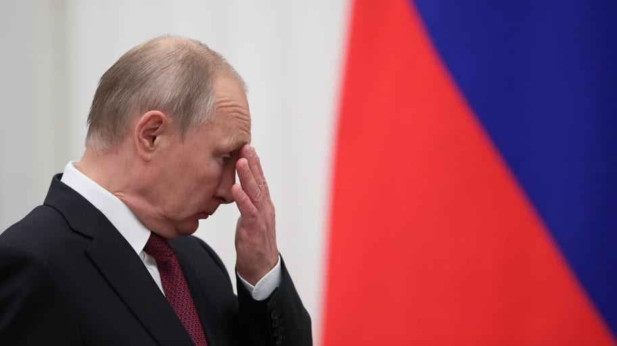
Background on Russian Trolls & Internet Research Agency
In February 2018, Robert Mueller filed indictments against Russian nationals for engaging in illegal political activities as part of his Russia investigation.
The Internet Research Agency is a defendant, accused of being a Russian “Troll Factory” connected to 2,848 twitter handles.
FiveThirtyEight extracted 3 million tweets from these twitter handles.
Reuters / Evgenia Novozhenina

Slide 3
Goals & Methods
Our goal is to build a machine learning model that uses Natural Language Processing alone to identity Russian Troll tweets versus authentic users.

Slide 4
Content Analyzed
We wanted to focus our analyses on the language content alone.
To do so, we limited our analyses to only original-content tweets written in English, which totaled 1.4 millions tweets.
Using the Twitter API, we extracted 40,000 tweets, matching the top 40 most common @’s (mentions) and compared them to an equal-sized random sample from the 1.4 million tweets.

Slide 5
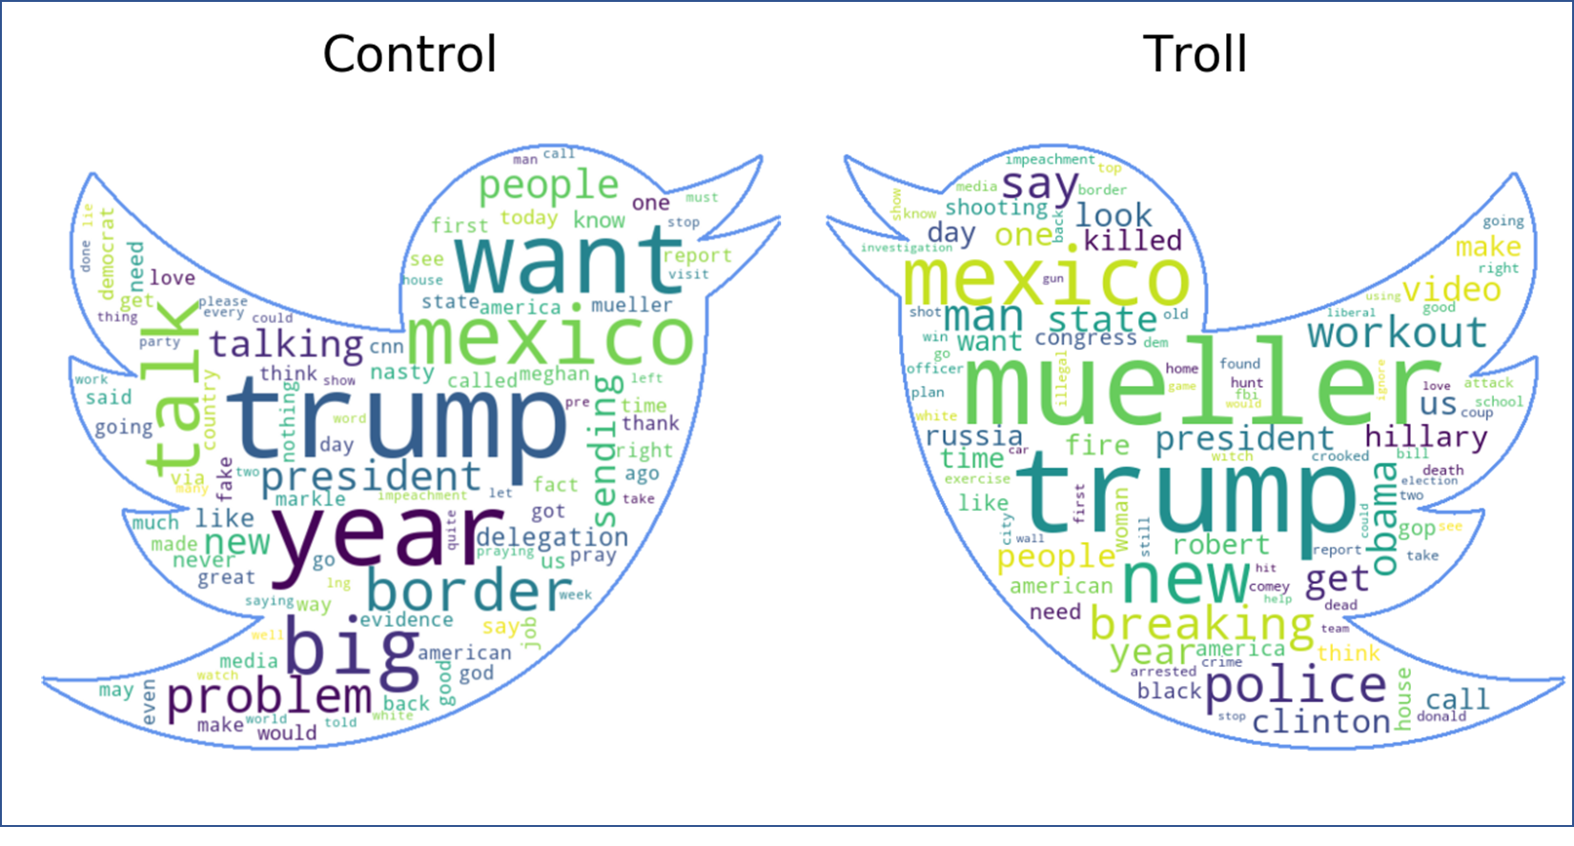
Most Frequently Used Words

Slide 6
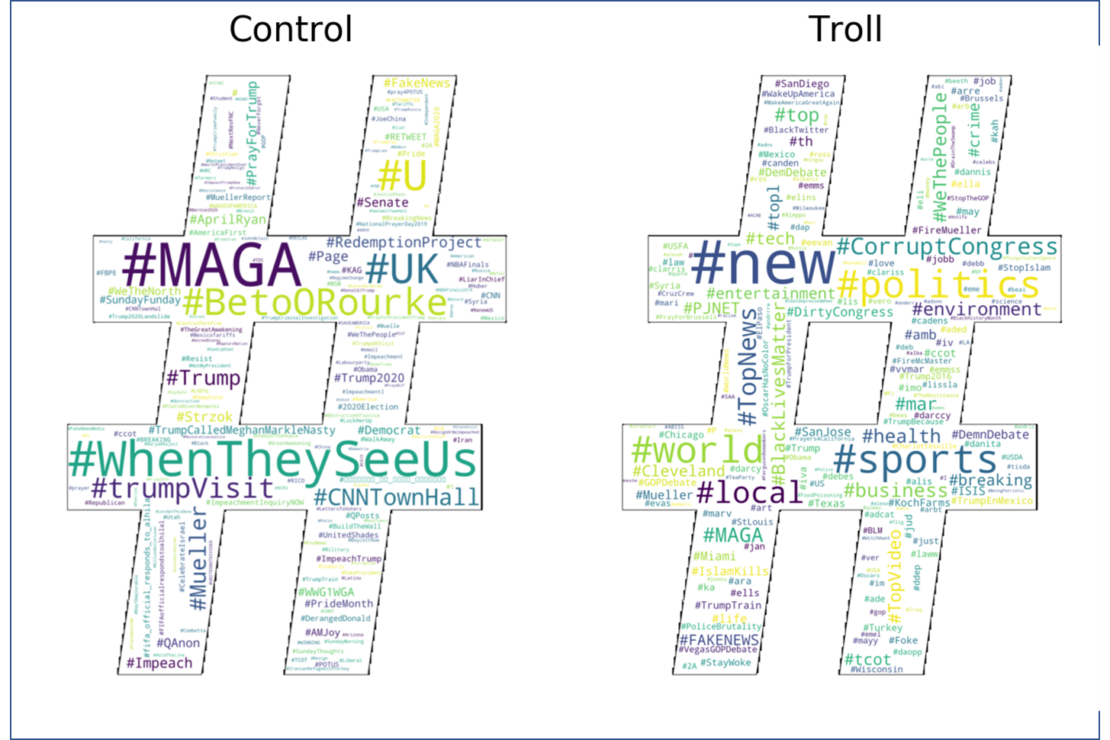
Most Common Hashtags

Slide 7
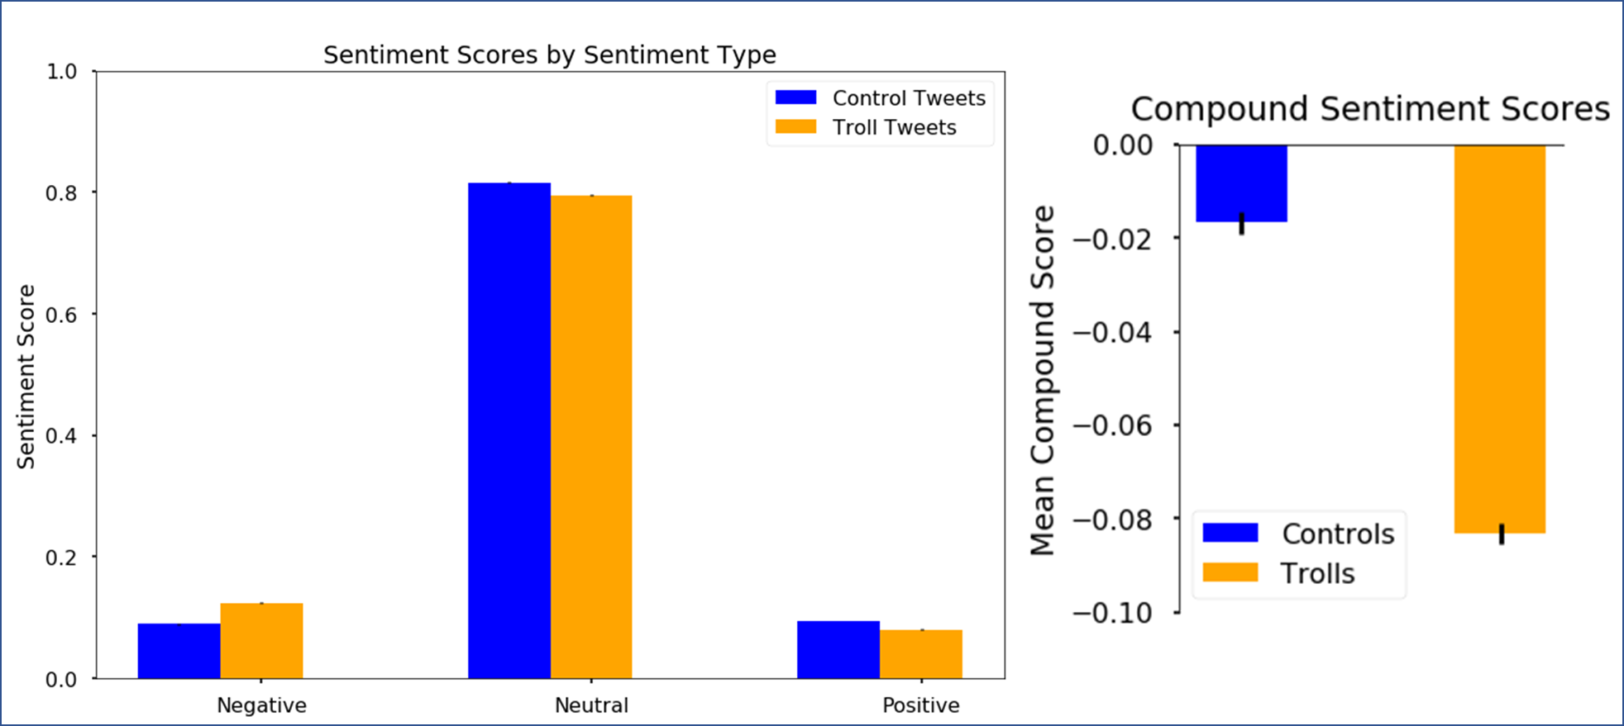
Sentiment Analysis

Slide 9
