Slide 2
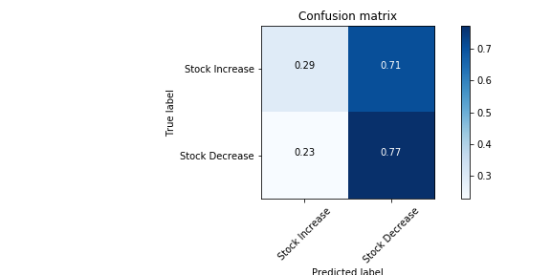
Simple Stock Price +/- Prediction from Trump’s Tweets

Slide 3
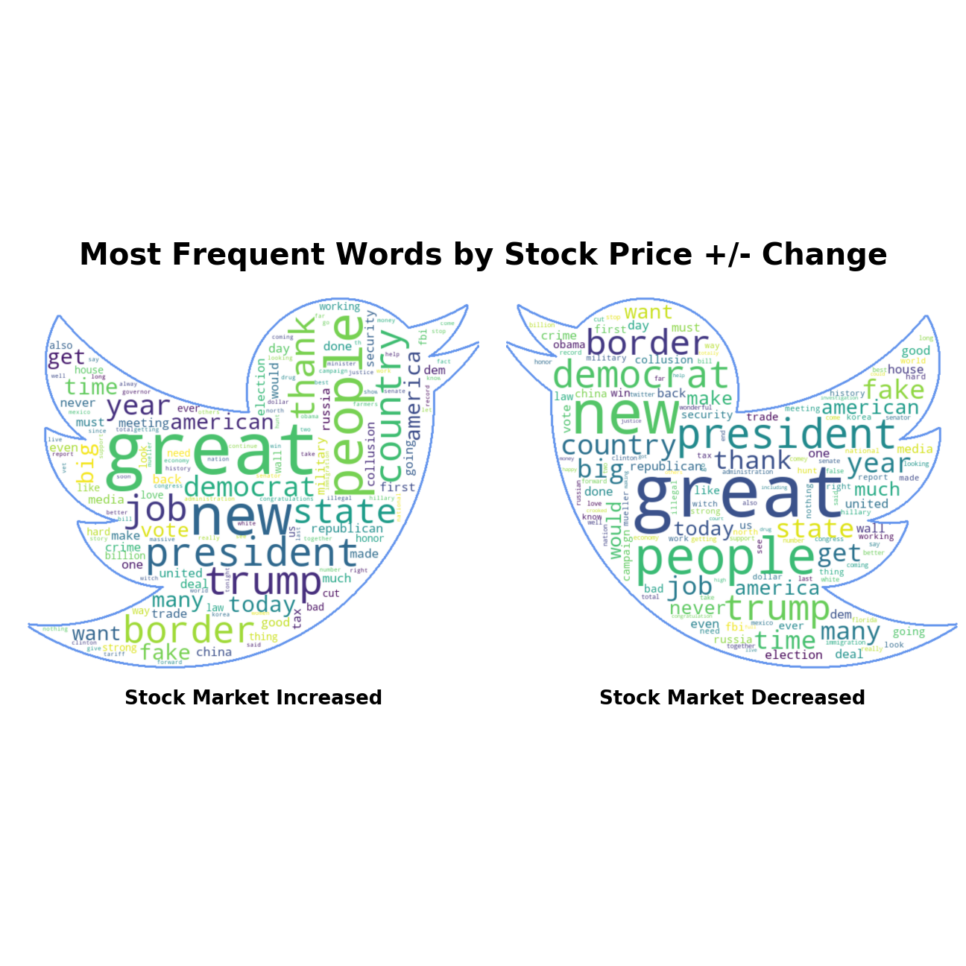
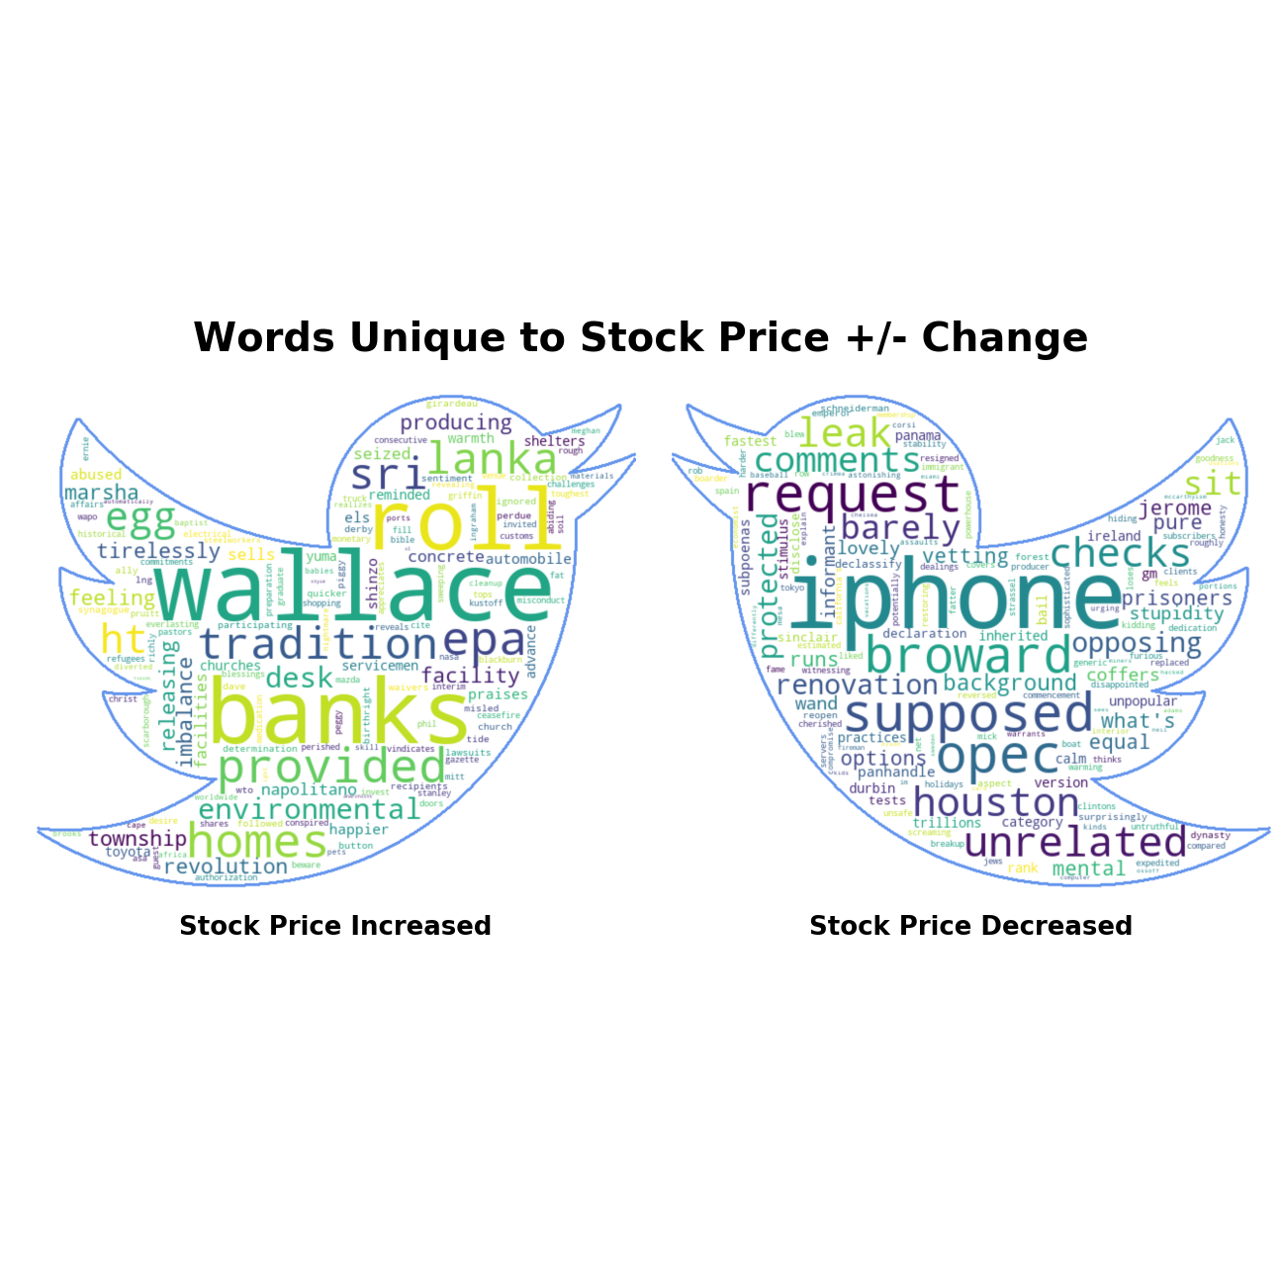
Which words cause what change in S&P500??

